Slide 1

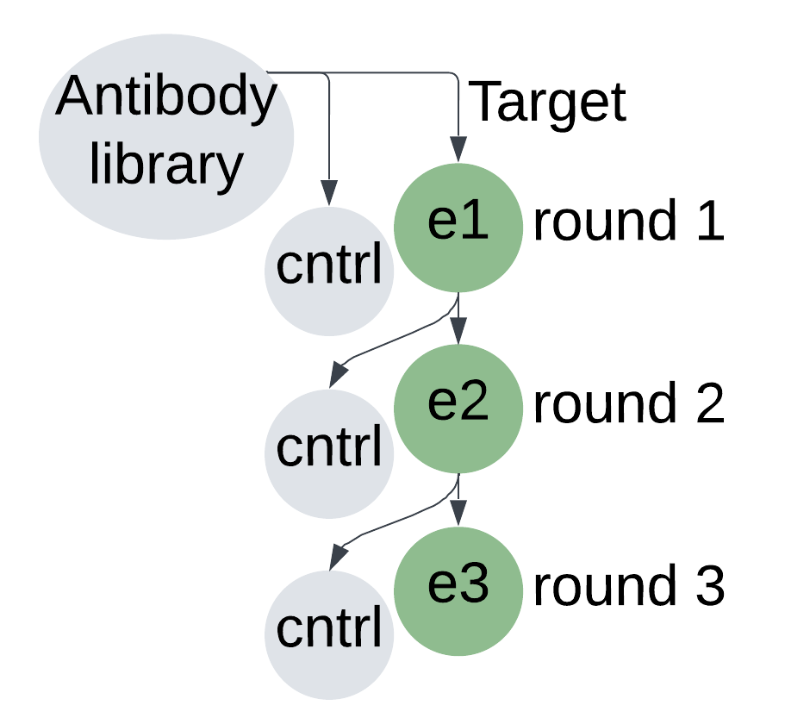
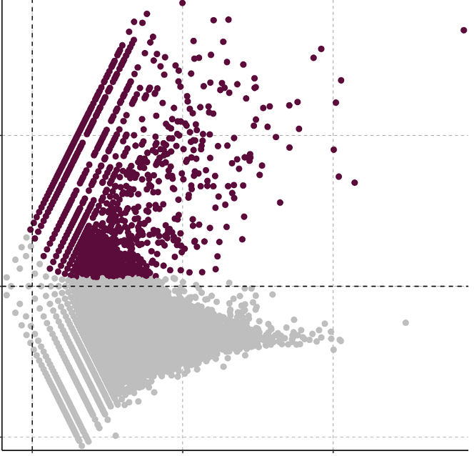
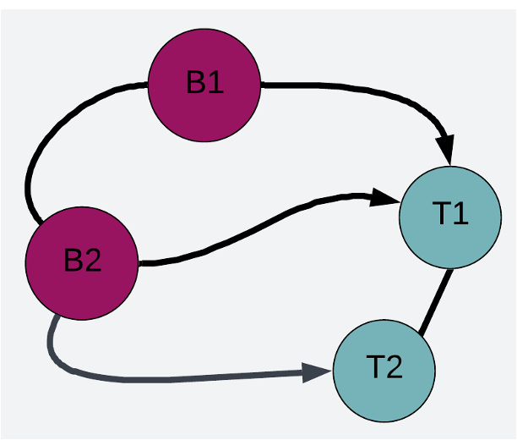
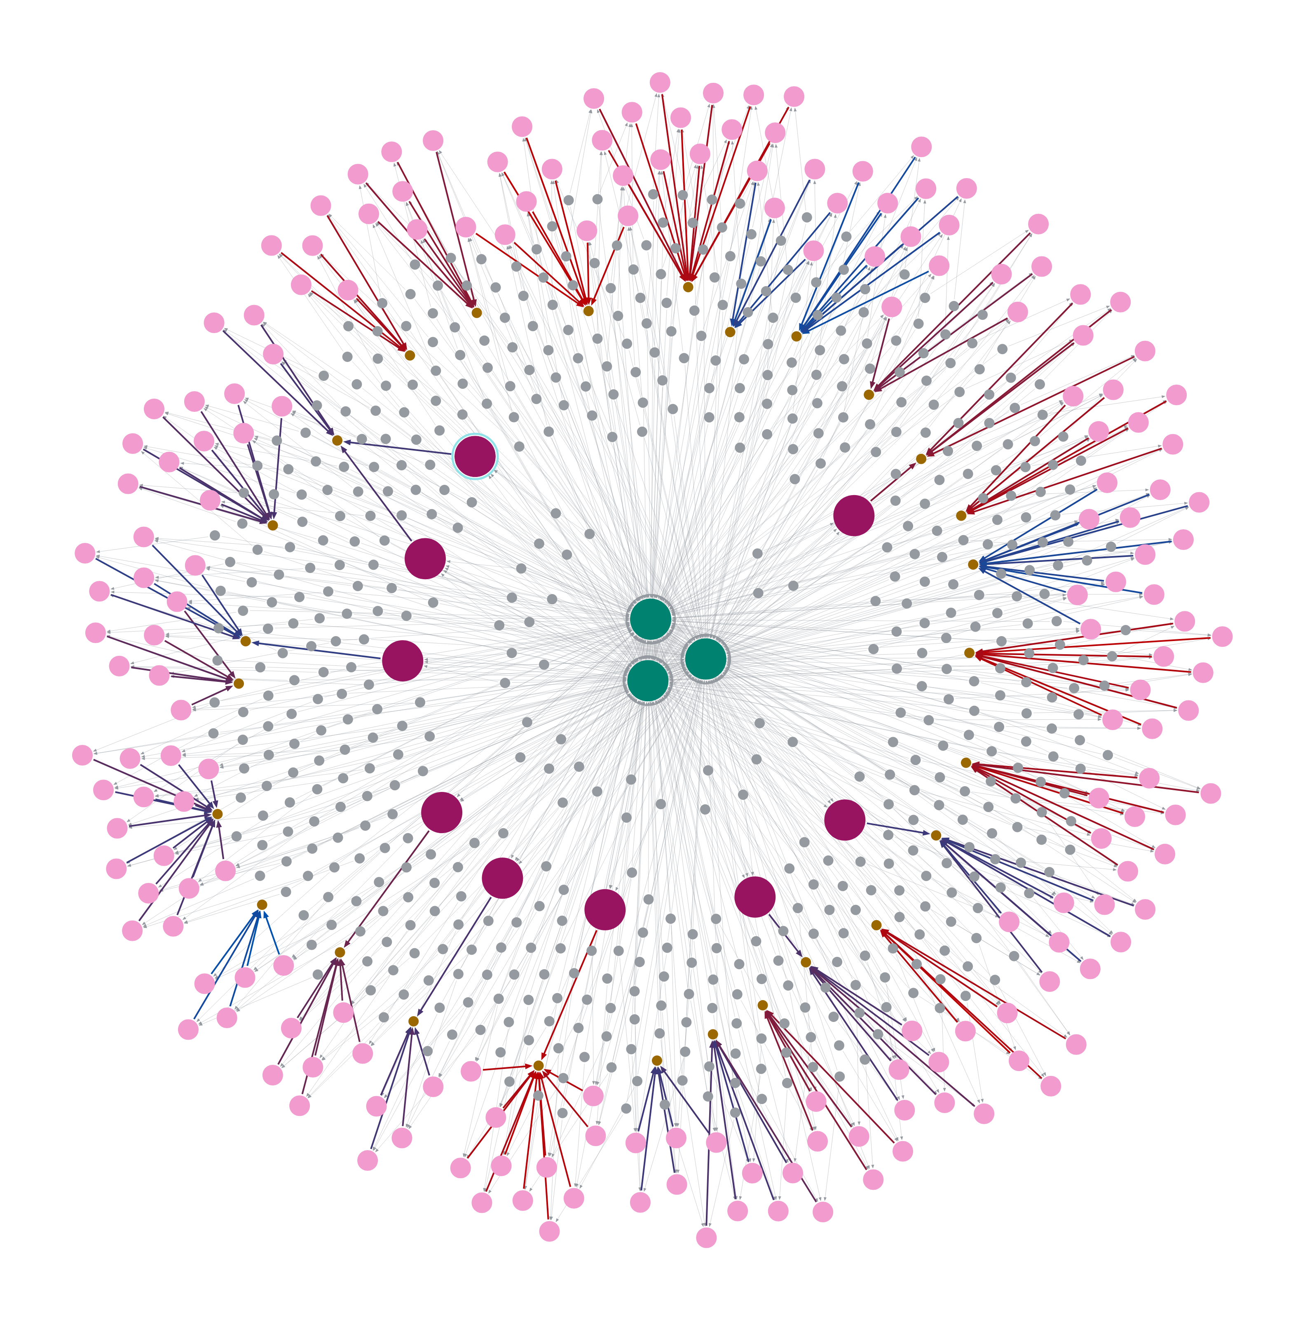
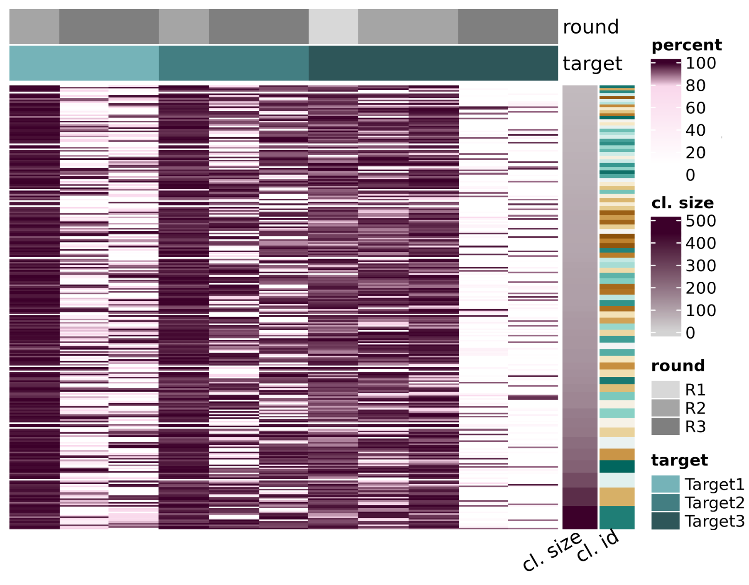
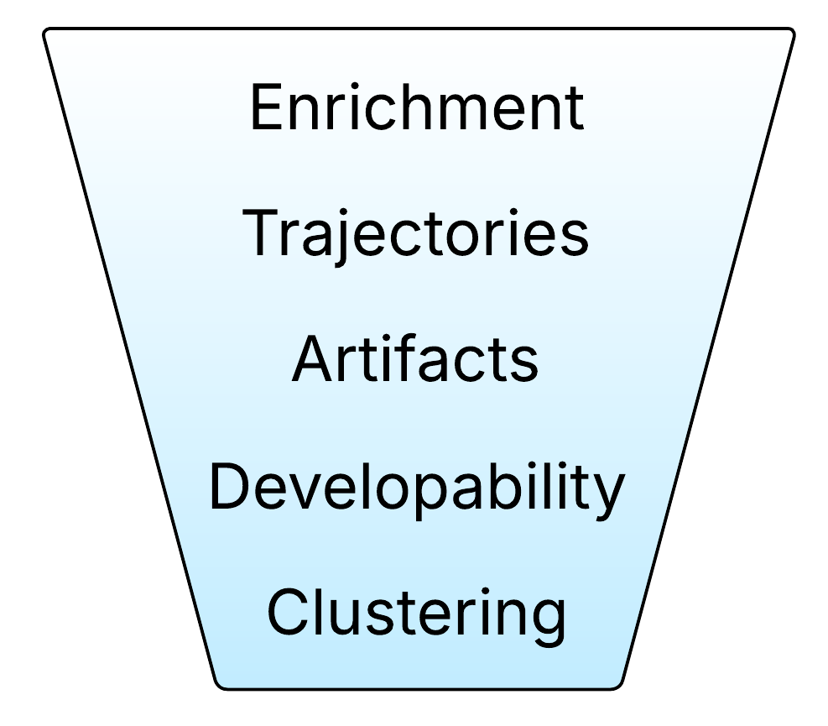
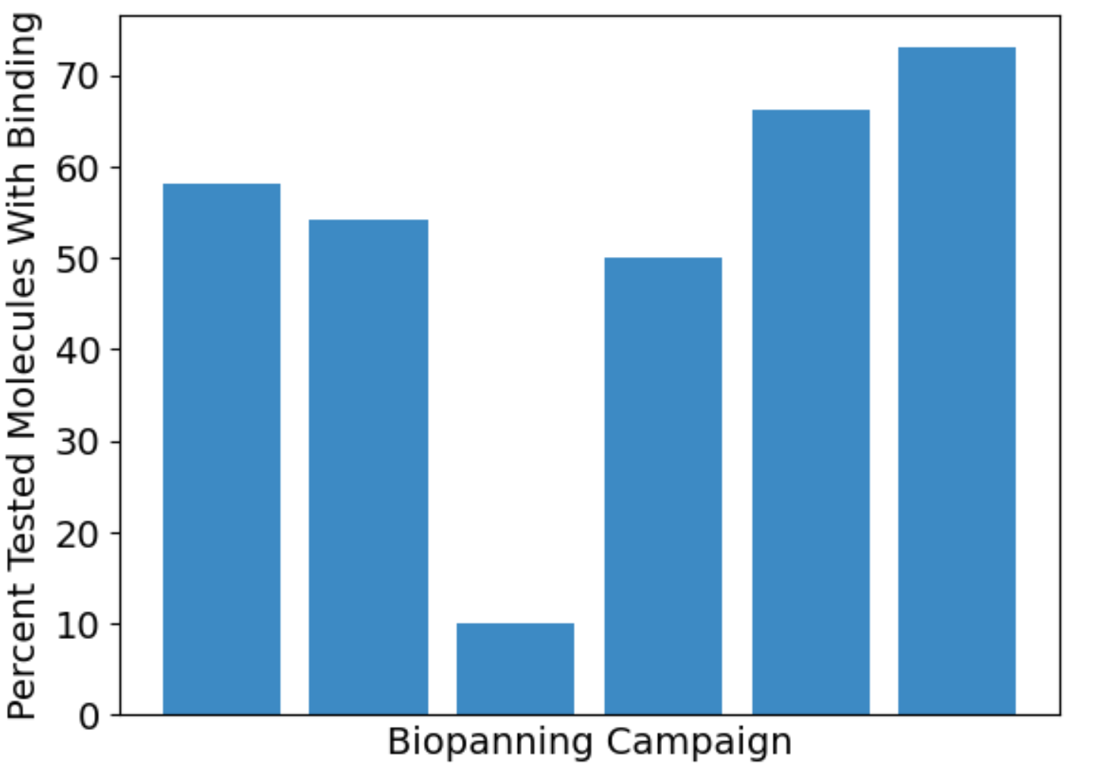
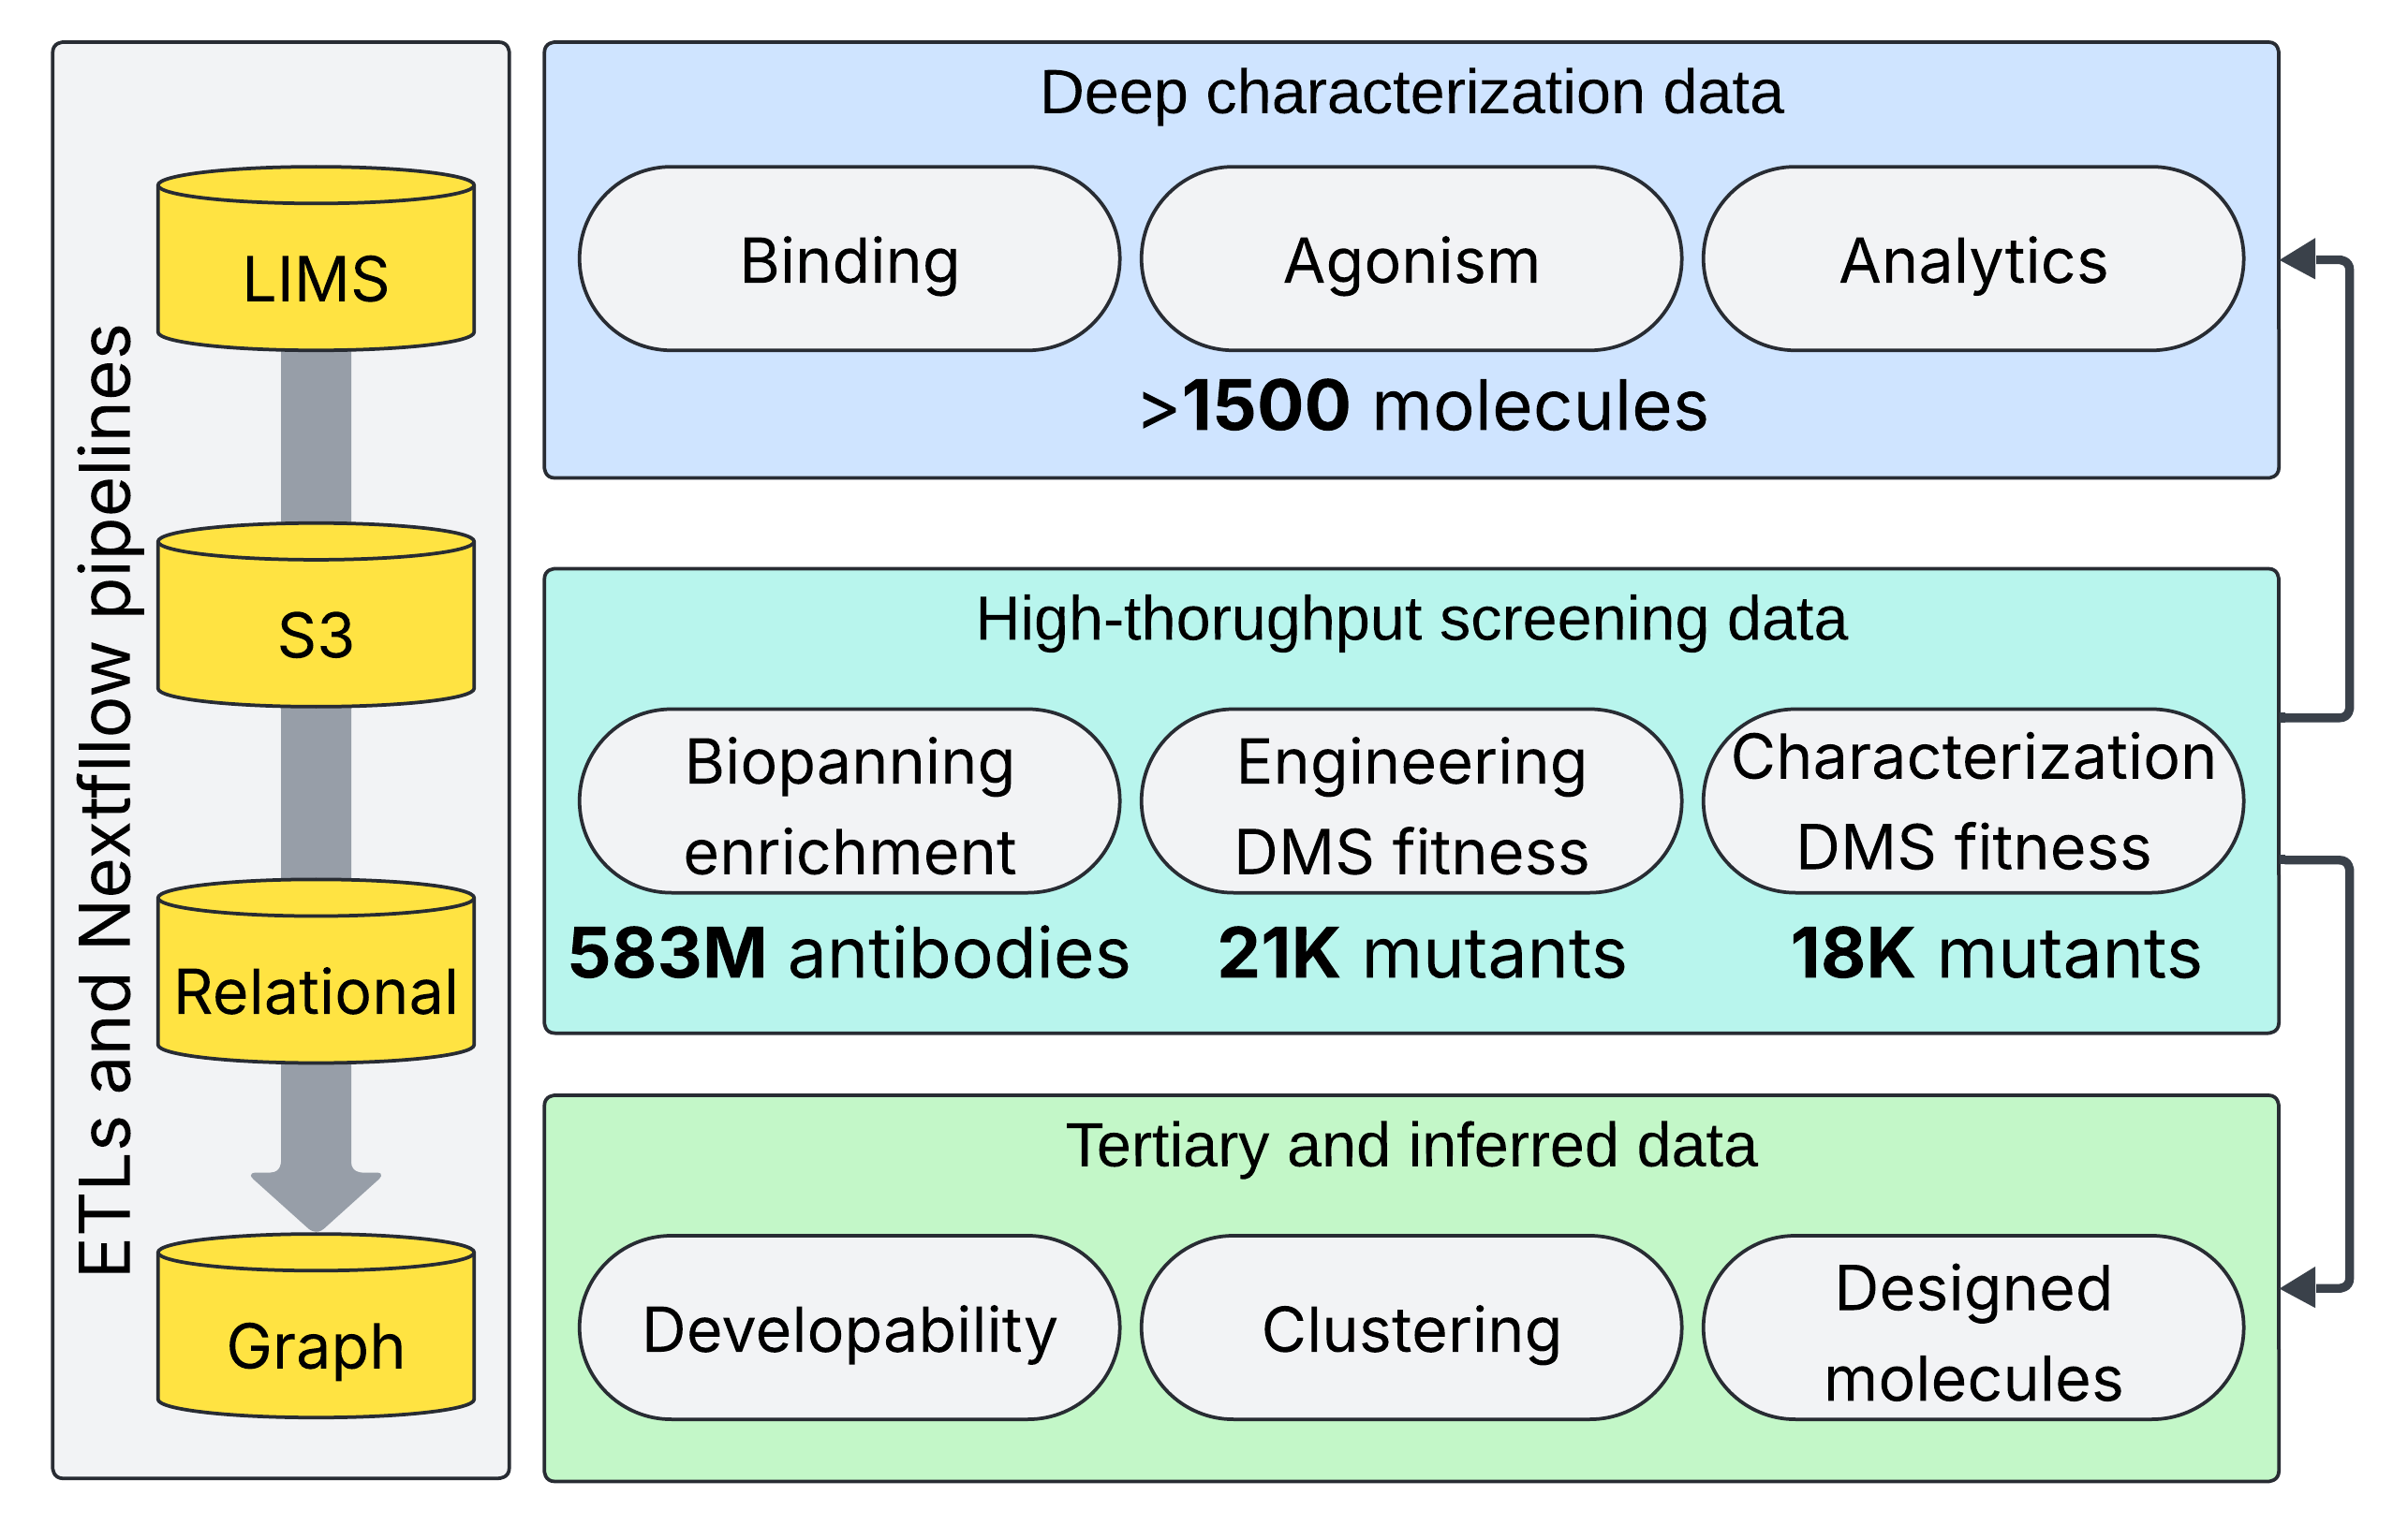
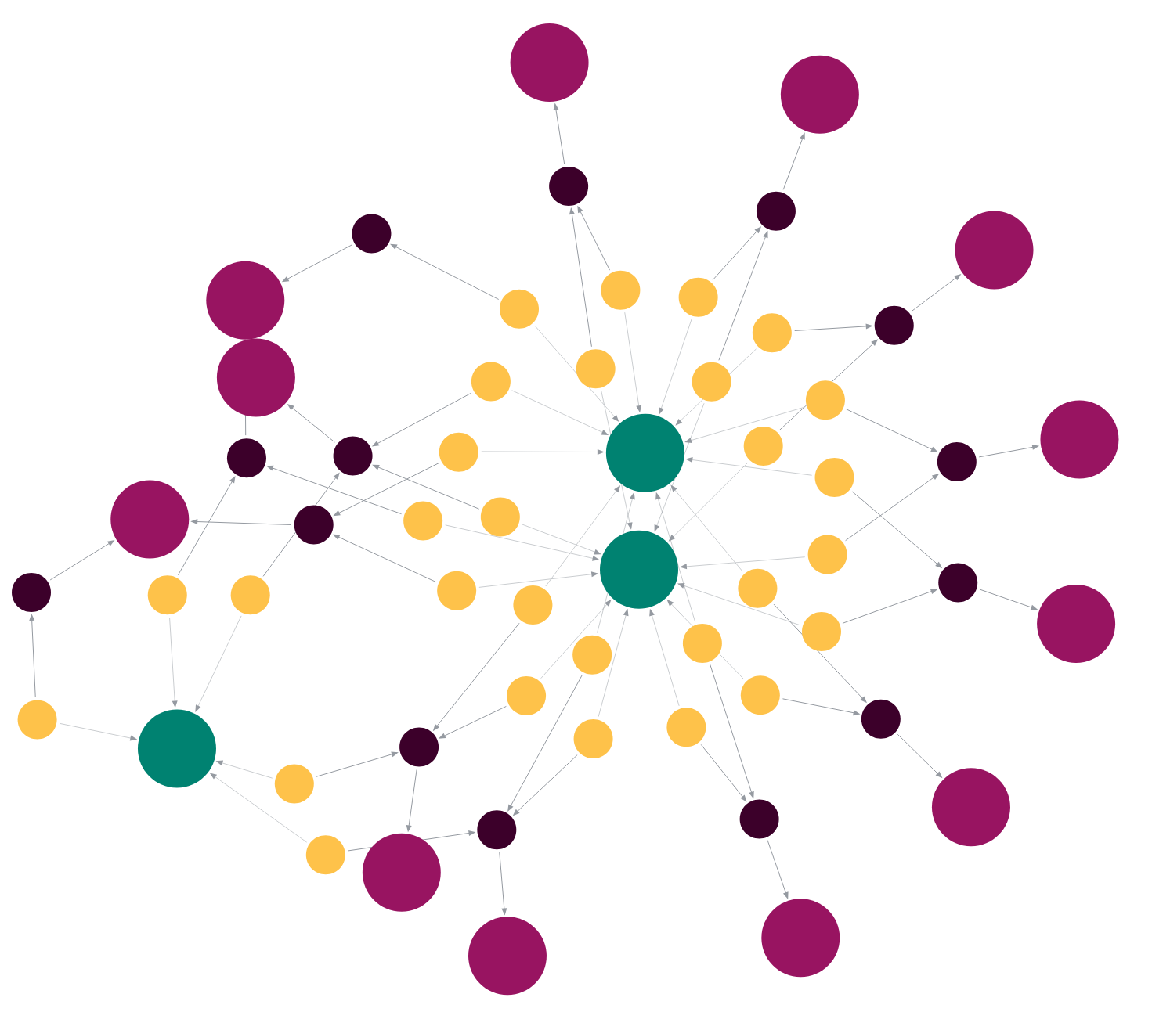
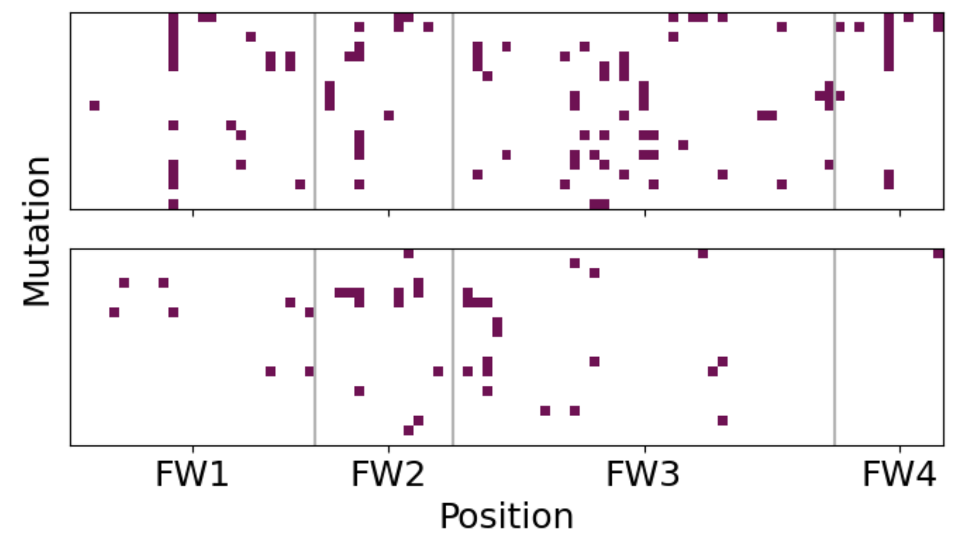
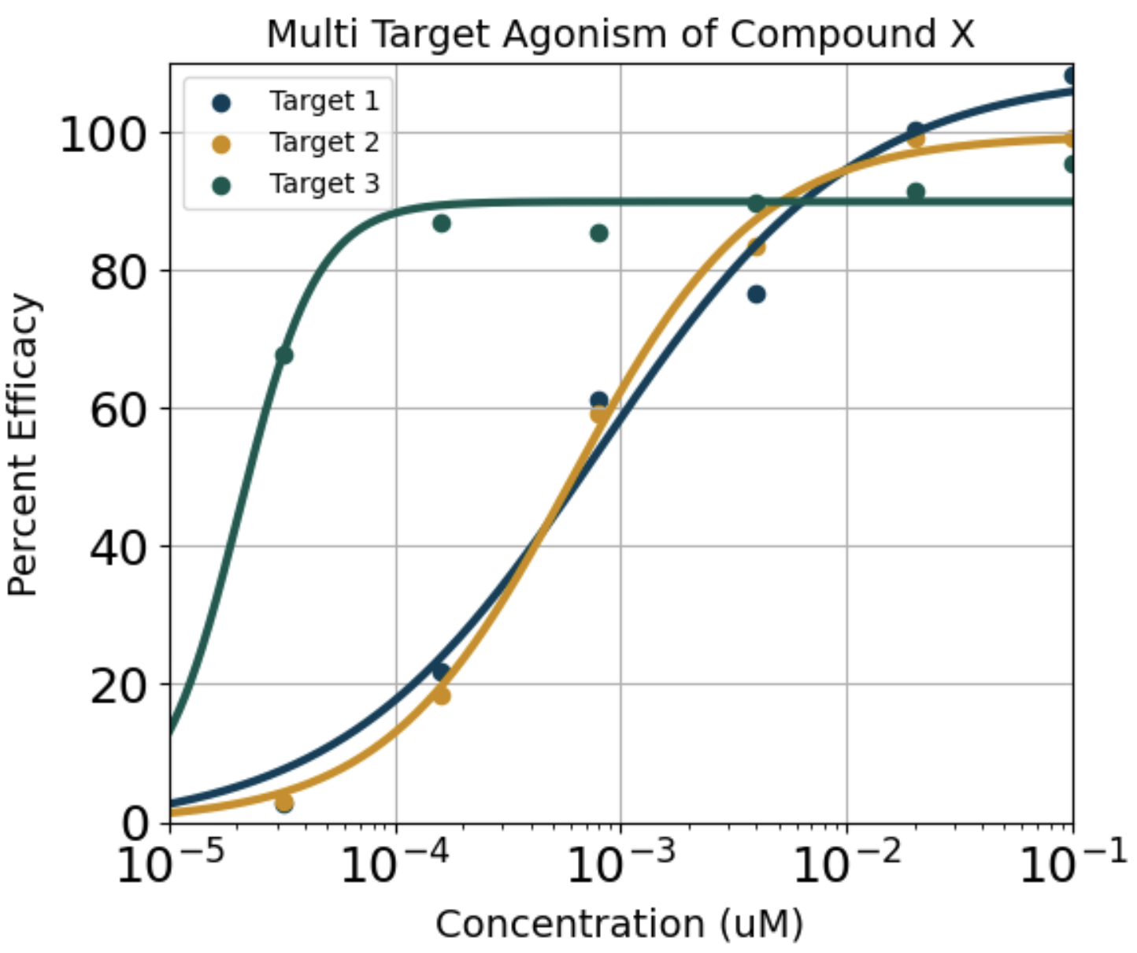
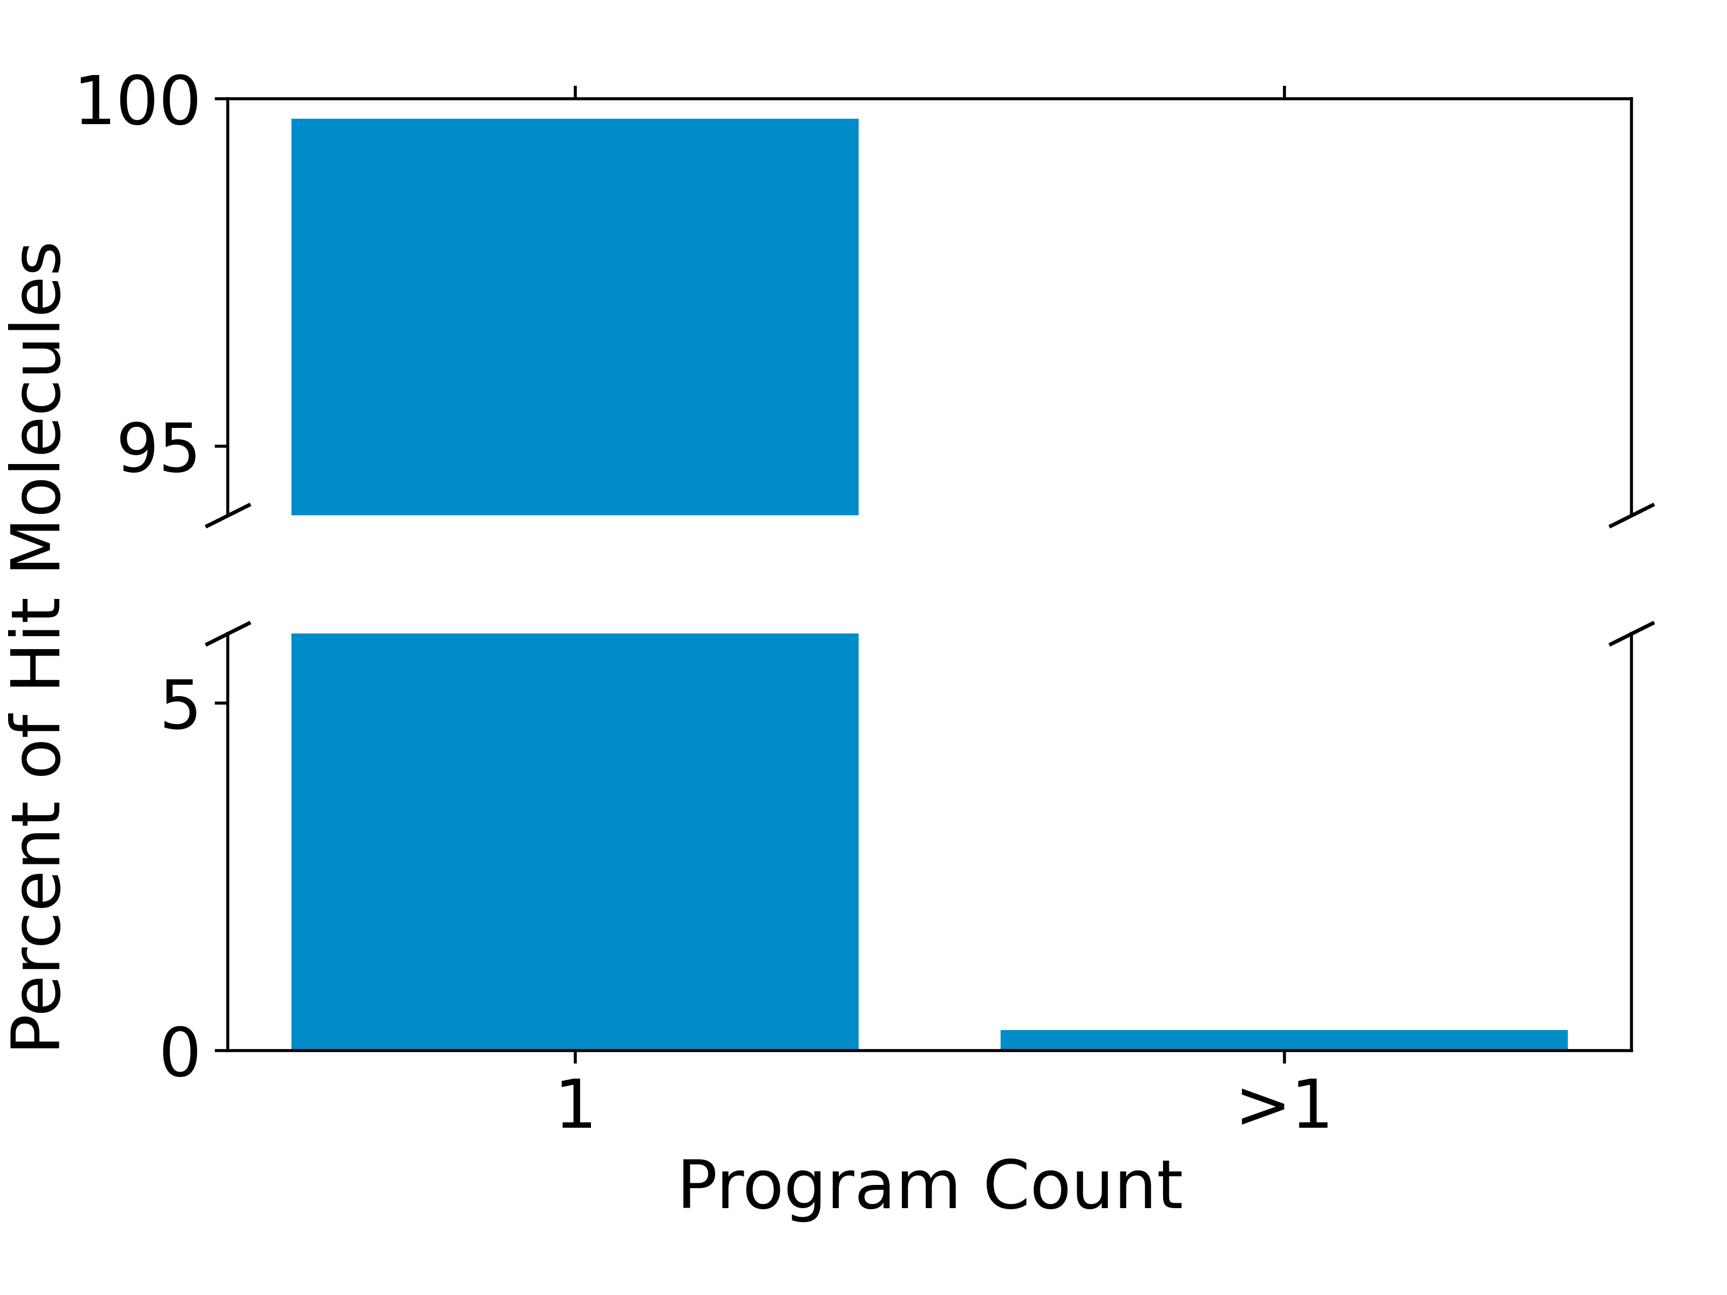
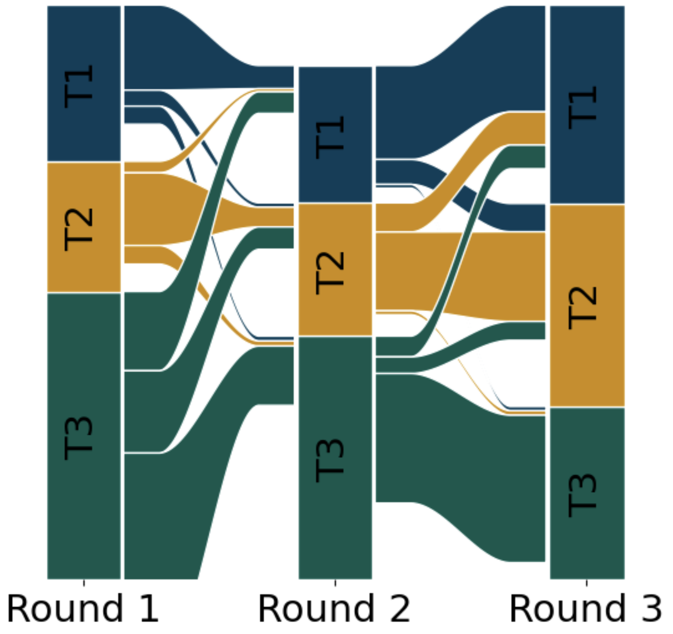
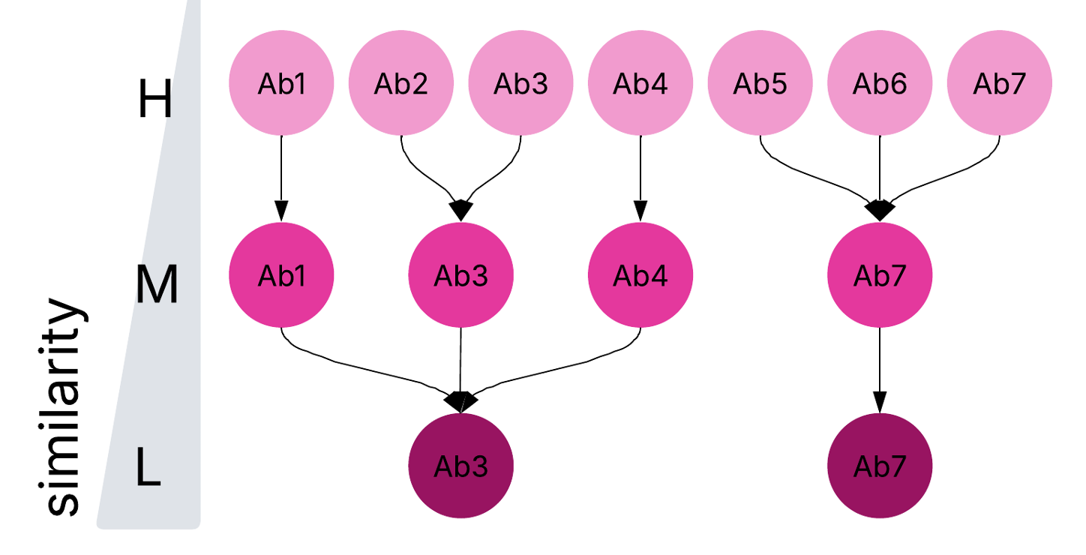
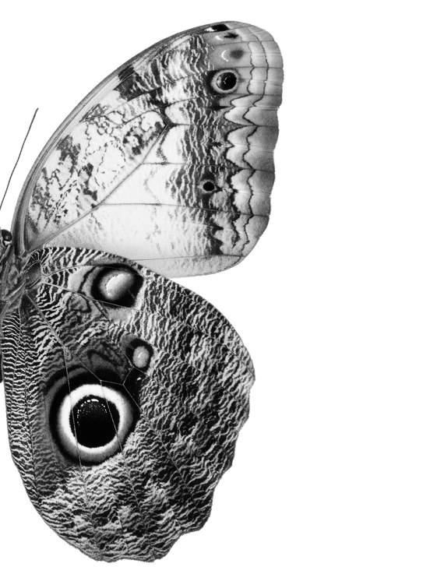
Multi-Specific Molecule Discovery With The Metaphore Knowledge Base
Brian Fochtman, Connie Brett, Todd Brett, Tara Friedrich, Adam Kraut, Pei Lin, Daniel Monaco, Katherine Norwood, Anna Lyubetskaya
Metaphore Biotechnologies, Somerville, MA
Multi-specific drug discovery – finding the needle in a haystack, with precision
Multi-targeting antibody nomination framework produces validated triple-agonists
The identification of a therapeutic antibody agonist capable of acting on multiple targets is a challenging problem, unsolved by the recent advances in high-throughput antibody screening. The Metaphore strategy to reliably pinpoint such multi-specific molecules combines 1) large screens with a range of enrichment conditions with 2) integrated analytical knowledge systems to flexibly nominate molecules for testing. Here, we demonstrate the success of this framework at identifying validated multi-targeting molecules.
Diverse biopanning strategies yield 466K early multi-targeting antibody candidates
Antibody nomination for validation accounts for sequence diversity and developability properties
Metaphore antibody prioritization strategy: from high-throughput screening to in-depth validation
Biopanning enrichment (percentile) over multiple rounds (round) and conditions (columns) for 80 select triple-specific (target) antibody families (cl. id), each including at least 50 distinct antibody sequences (rows and cl. size).
Representative 197 antibodies with strongest triple-specific target enrichment form 27 families by sequence similarity. 9 shown antibodies nominated for production, validation, and characterization.
A biopanning campaign tests a range of antibody-target specificity hypotheses.
A combination of signal enrichment and a custom prioritization pipeline yields a deep queue of strong therapeutic candidates.
An agile relational and graph-based analytical framework enables rapid refinement based on iterative rounds of validation.
Binder
Target
Big data enabled knowledge base enables rapid multi-targeting antibody nomination
1B+ measurements from a range of platforms enabled by a cutting-edge analytical stack
An antibody validation rate >50% routinely achieved for established experimental designs
The end-to-end data integration framework incorporates NextFlow-enabled analysis pipelines, relational and graph data solutions, and automated ETLs to enable iterative hypothesis testing and refinement.
An iteratively refined prioritization funnel ensures high validation rates of diverse nominated antibodies.
Family with high sequence similarity
Family with low sequence similarity
Multi-targeting antibodies validate for agonism in the context of complex molecular modalities
Further validated antibody optimization enabled by deep mutational scanning
Nominated Ab produced in the context of final constructs are successfully validated for agonism (EC50) against 3 targets.
Framework mutations increase antibody fitness to multiple targets.
Foundational characterization of molecular metadata improves candidate nomination
Improved fitness
Example 1. The biopanning analytical pipeline robustly nominates molecules, with only 0.3% of molecules having evidence of nonspecific binding.
Hierarchical, interpretability-focused MMSeqs2⁽¹⁾ clustering of all 583M antibodies enables the guided exploration of sequences of high and low similarity.
Conclusions
0.3%
The Metaphore platform robustly identifies multi-targeting therapeutic molecules.
A combination of high-throughput screening, an end-to-end analytical framework enabling dynamic data exploration (Metaphore Knowledge Base), and comprehensive characterization of molecules results in a deep queue of candidate molecules.
The continued dataset ingestion, iterative data integration and augmentation, and AI/ML extension of our toolkit ensures continuous improvement and accelerated therapeutic discovery.
Example 2. Highest validation rates are observed for molecules with strong round-to-round enrichment trajectories.
(1) Steinegger et al. NatureBiotechnology 2017
22nd Annual Protein and Antibody Engineering Summit (PEGS)
May 2026
Notes:
Fochtman, B.; Adiga, A.; Athanasopoulos, T.; Bernstein, Z.; Brett, C.; Brett, T.; Cruz-Rodriguez, O.; Dao, K.; Friedrich, T.; Gillach, Q.; Goldberg, B.; Gordo, S.; Iocolano, A.; Jaiganesh, A.; Kadli, A.;
Kate, S.; Kelly, S.; Kilby, M.; Knoll, E.; Kraut, A.; Latowsky, E.; Lin, P.; Liu, H.; Lyubetskaya, A.; Madan, B.; Monaco, D.; Norwood, K.; Putnam, R.; Rogov, P.; Siegel, J.; Teng, E.; VanDyke, D.;
Veeraraghavan, J.; Zhuravytsky, K.; Paduch, M.; Weinreb, P.; Villalobos, A.

