Slide 1
Milestone-3

Slide 2
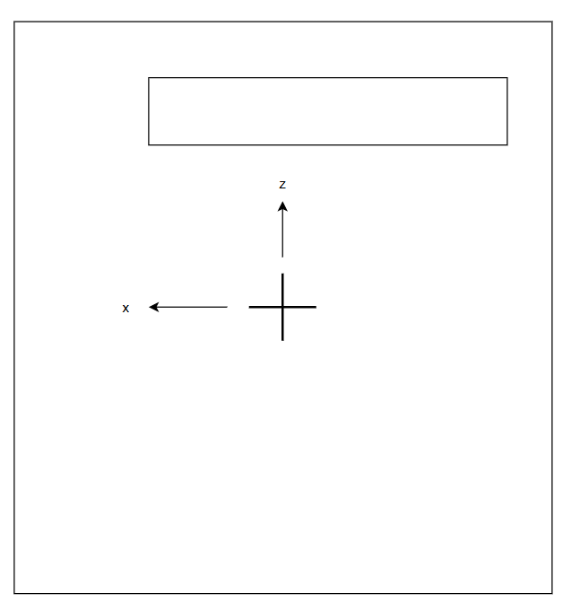
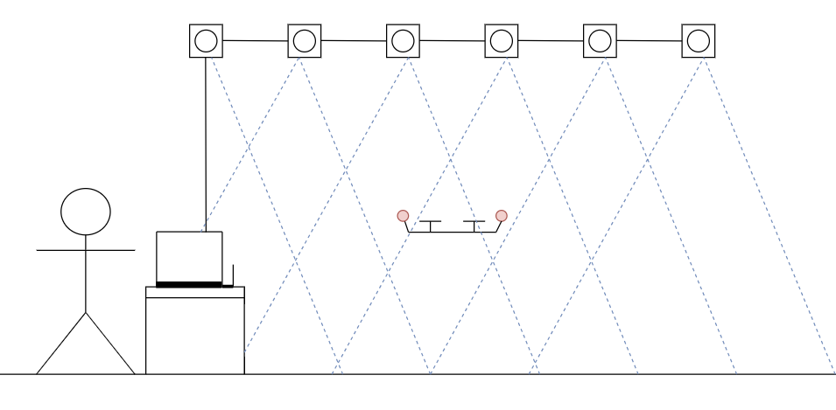
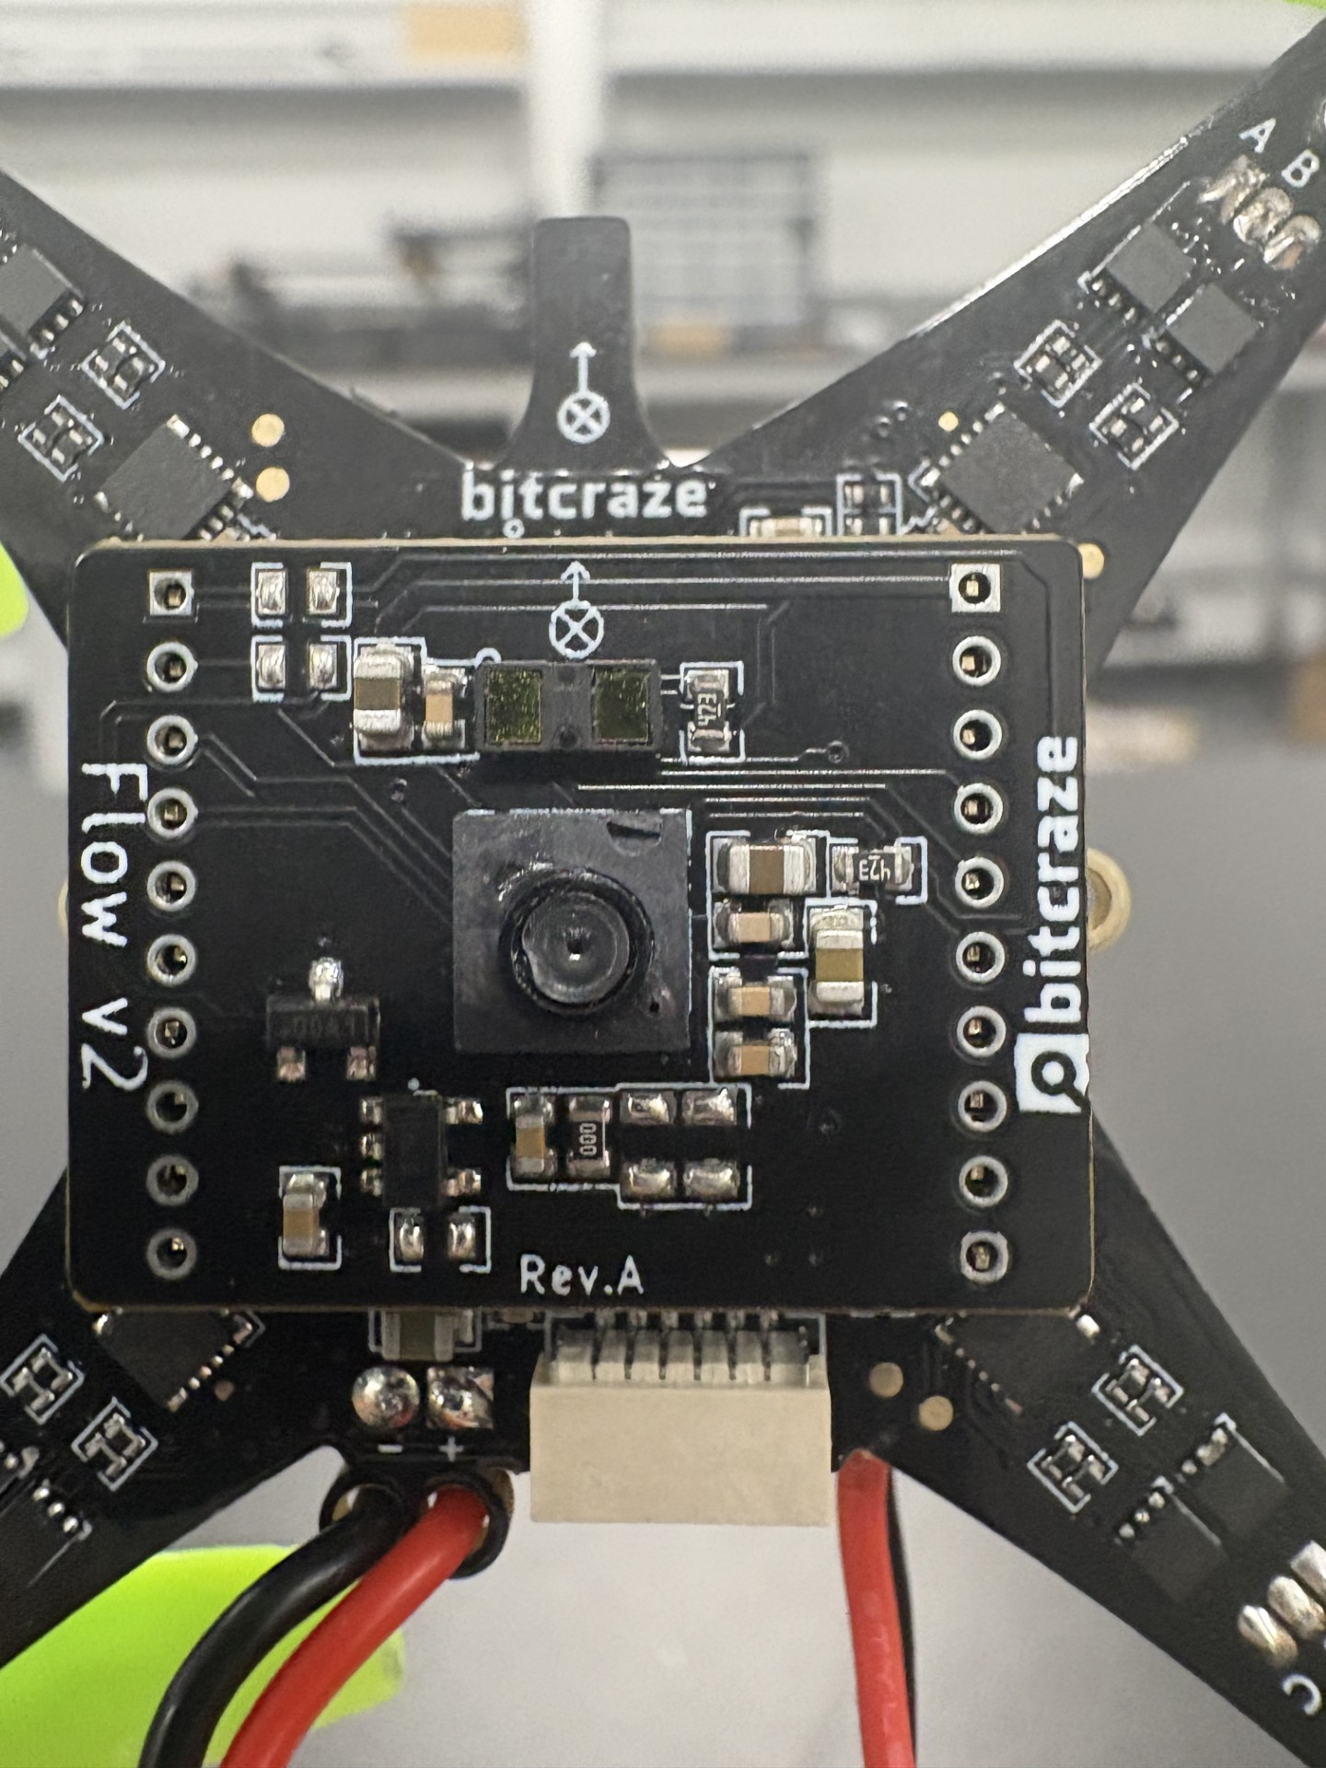
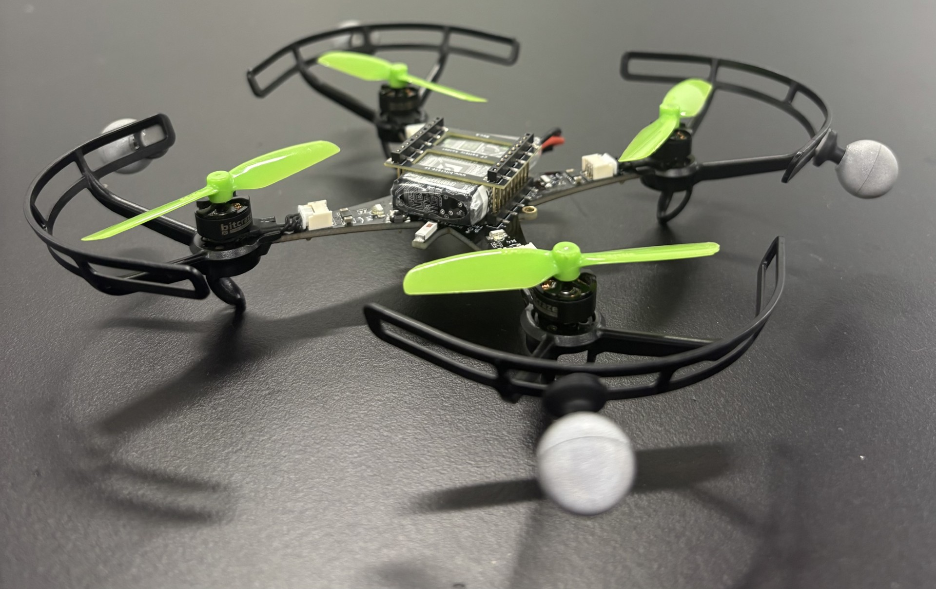
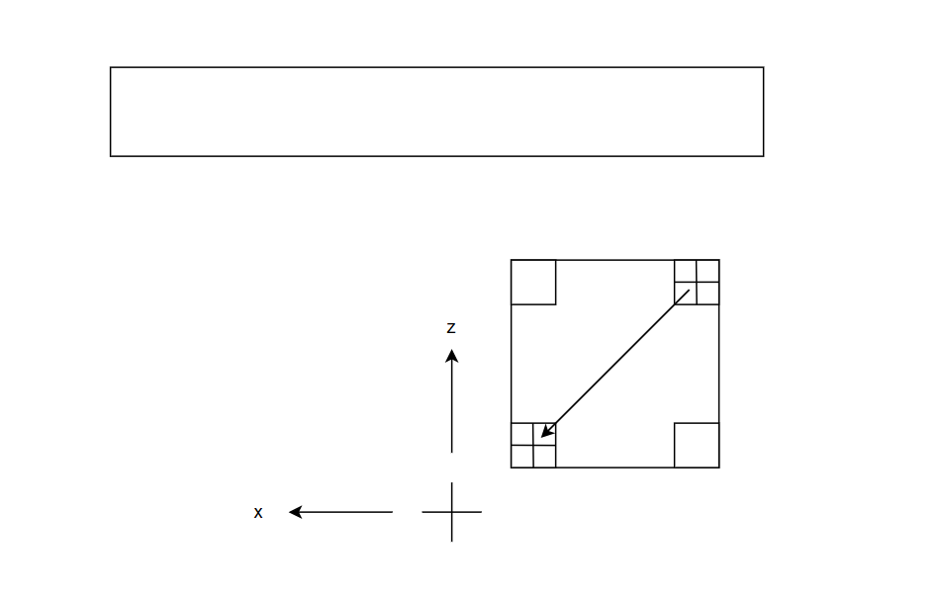
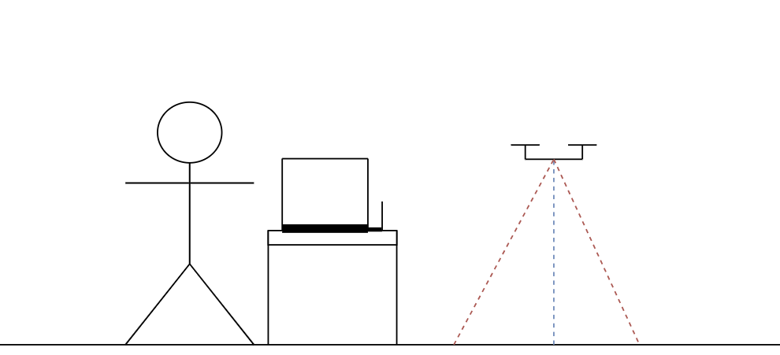
System Design
Flowdeck waypoint and Optitrack Trajectory
High-Level Commander with Optitrack
Notes:
Swith order for flowdeck slide and add text for flowdeck, include picture of actual mocap room, add picture of the mocap room for the reference diagrams.

Slide 3
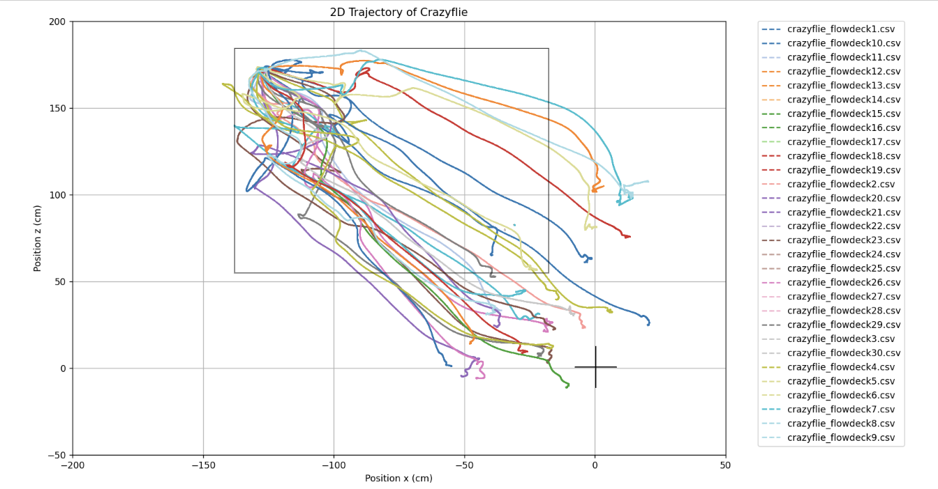
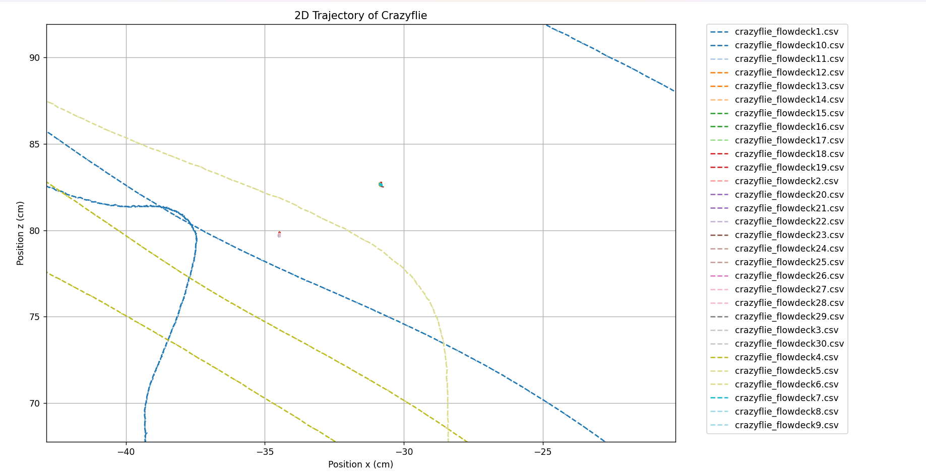
Result 1 – Flowdeck

Slide 4
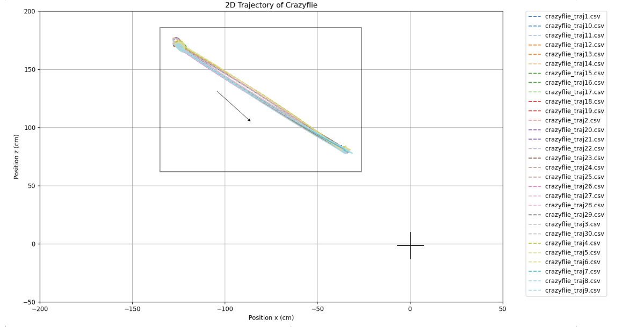
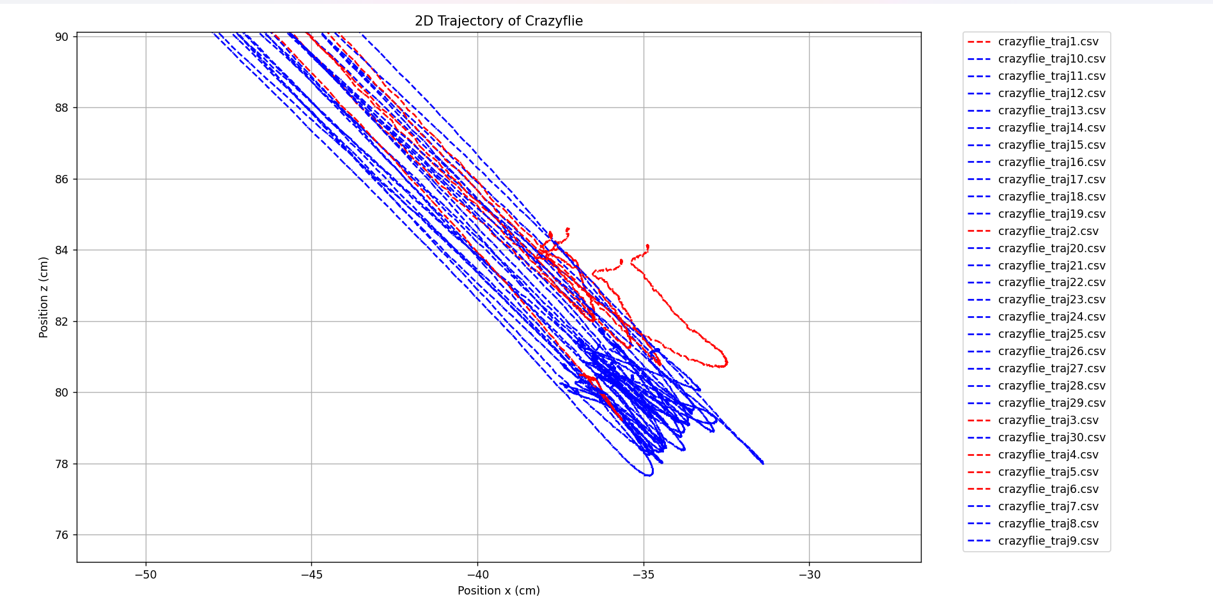
Result 2 – Optitrack Trajectory

Slide 5
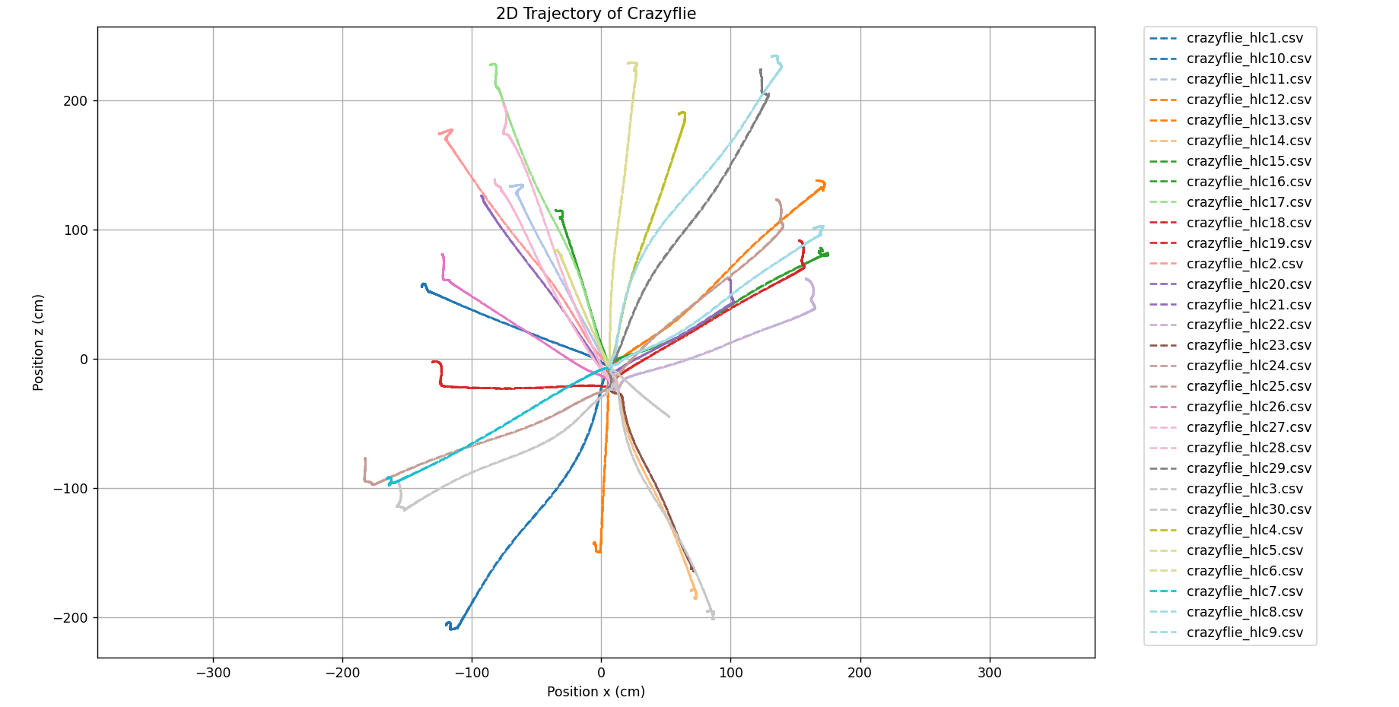
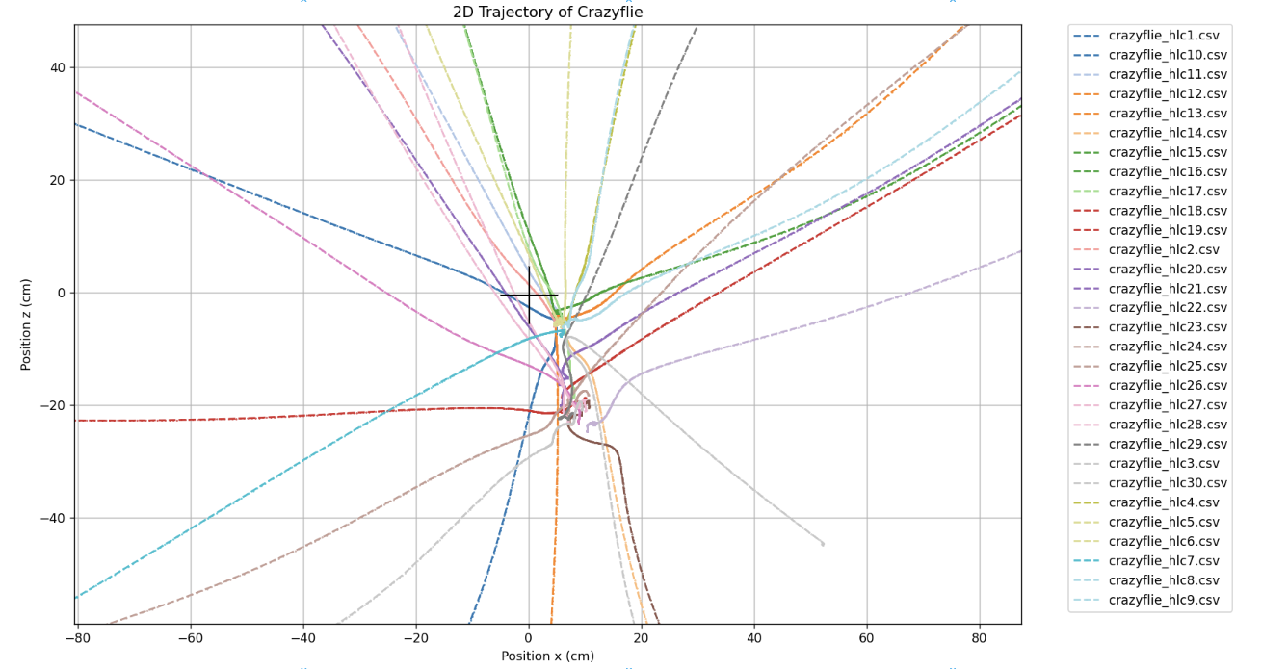
Result 3 – Optitrack HL Commander

