Slide 1


Autonomous Battery Units as an Enabling Technology for Urban Air Mobility
Khoa D. Nguyen, Dylan Hogge, John Riris, Darshan Sarojini, and Bradley Denby
Kevin T. Crofton Department of Aerospace and Ocean Engineering, Virginia Tech
2026 AIAA SciTech, January 14, 2026

Slide 2
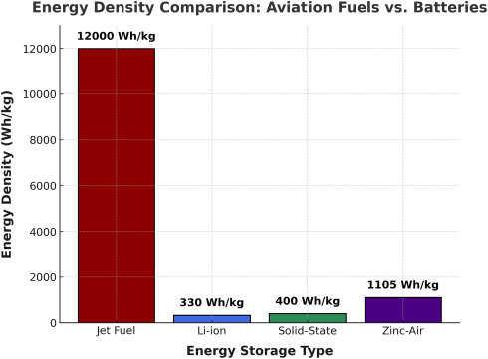
Battery Constraints in Urban Air Mobility (UAM)
Chemistry & Materials Science
Limited gains over last decade
Manufacturing & Scalability
Cost, complexity, durability
Source: https://doi.org/10.1016/j.apenergy.2025.126356
Current battery specific energy density remains insufficient for practical, economical flight.
Systems & Integration
Cell-level ≠ pack-level energy
(Integration losses)
1

Slide 3
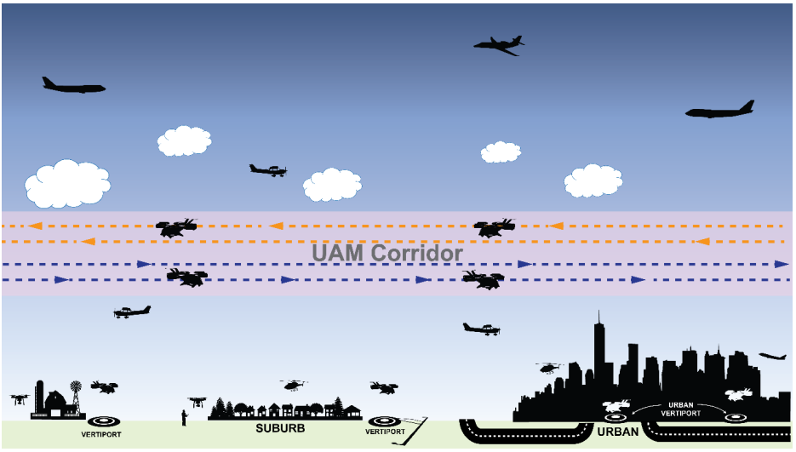
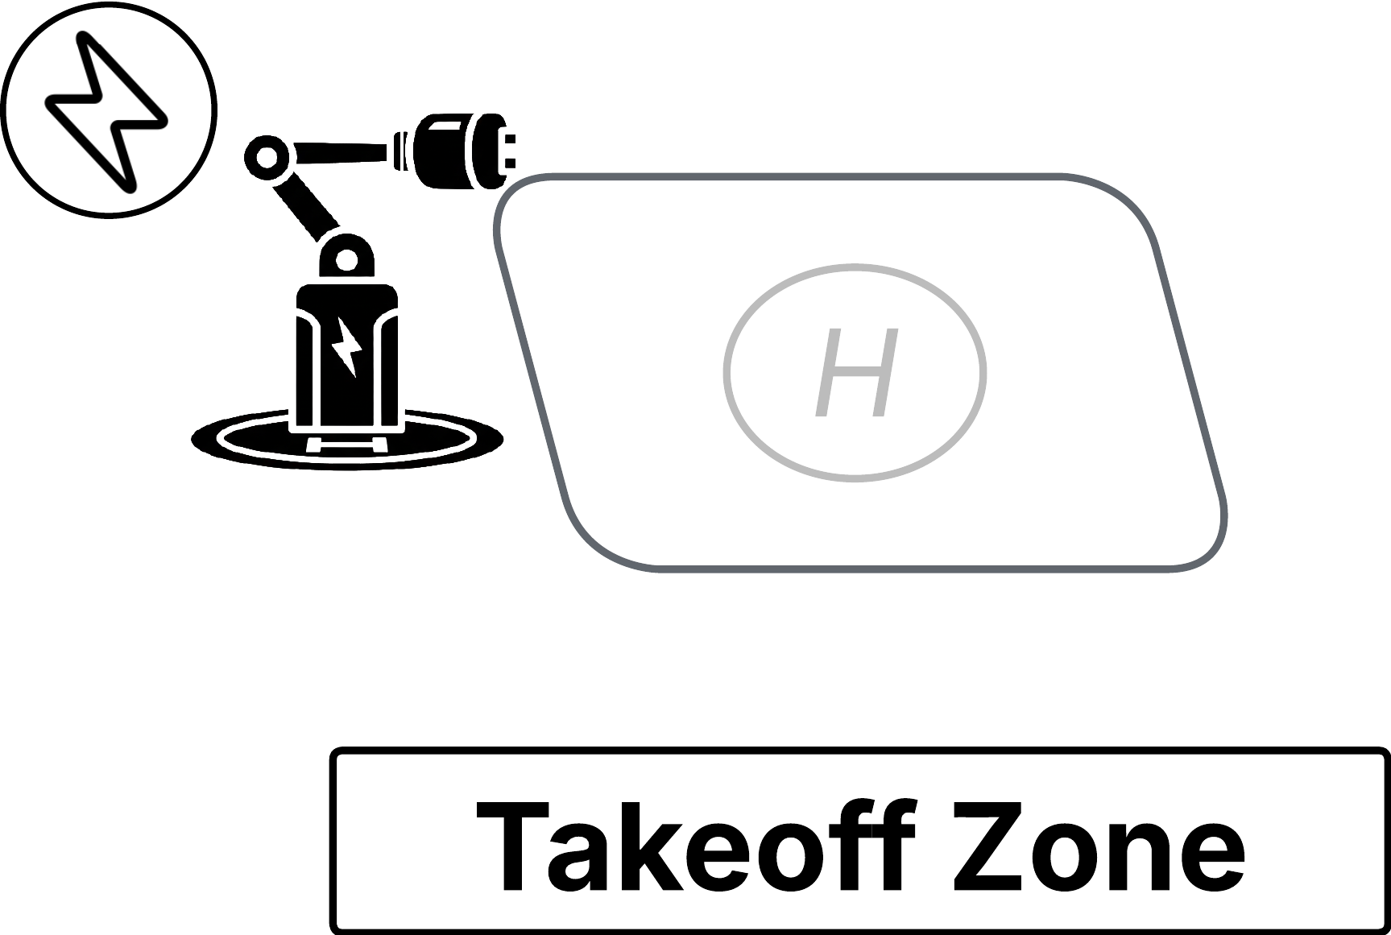

Operational Bottlenecks in eVTOL Air Taxi Systems
Source: FAA’s UAM Concept of Operations & Uber Elevate’s Mission Profile
Cruise
Charging Infrastructure
Accel. Climb
Decel. Descend
Vertiports + high-power charging
Hover Climb
Hover Descend
~ 20-50 miles
Takeoff
Cruise
Land
Charge
Next Flight
Ground Ops
2

Slide 4

Operational Bottlenecks in eVTOL Air Taxi Systems
Source: FAA’s UAM Concept of Operations & Uber Elevate’s Mission Profile
Cruise
Charging Infrastructure
Accel. Climb
Decel. Descend
Operational Cadence & Economics
Vertiports + high-power charging
Hover Climb
Hover Descend
~ 20-50 miles
Takeoff
Cruise
Land
Charge
ABUs aim to address these operational bottlenecks
Next Flight
Ground Ops
2

Slide 5

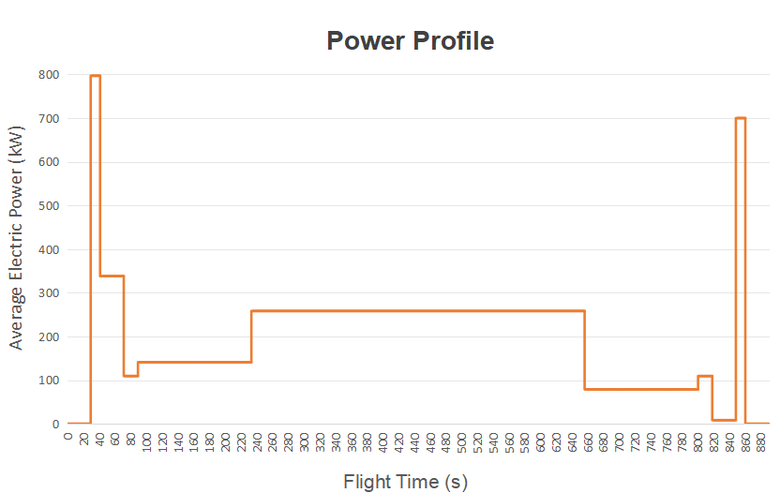
Why Autonomous Battery Units (ABUs)?
Charging
Nominal eVTOL operational timeline:
Ground Operations
Takeoff + Climb
Landing
Long idle time
Different mission phases stress batteries in different ways
Cruise
High power
Safety-critical
ABUs decouple mission energy, mass, and time
High energy
3

Slide 6

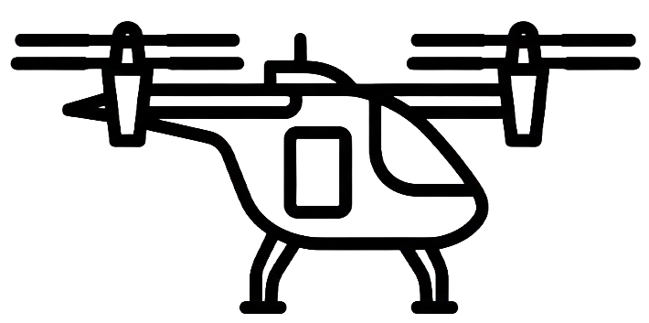




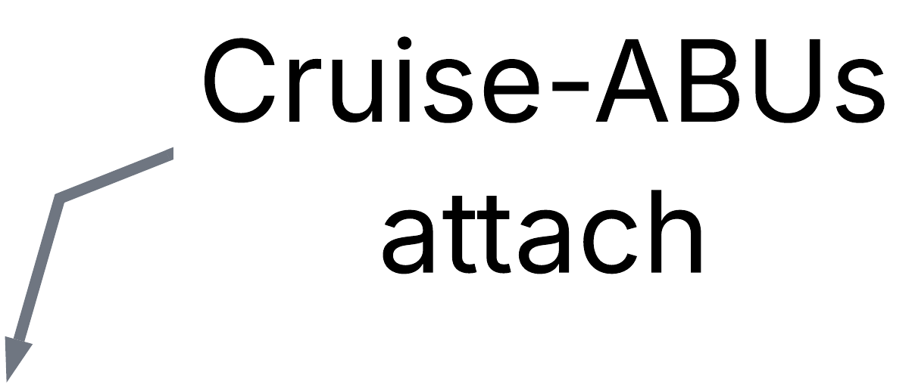



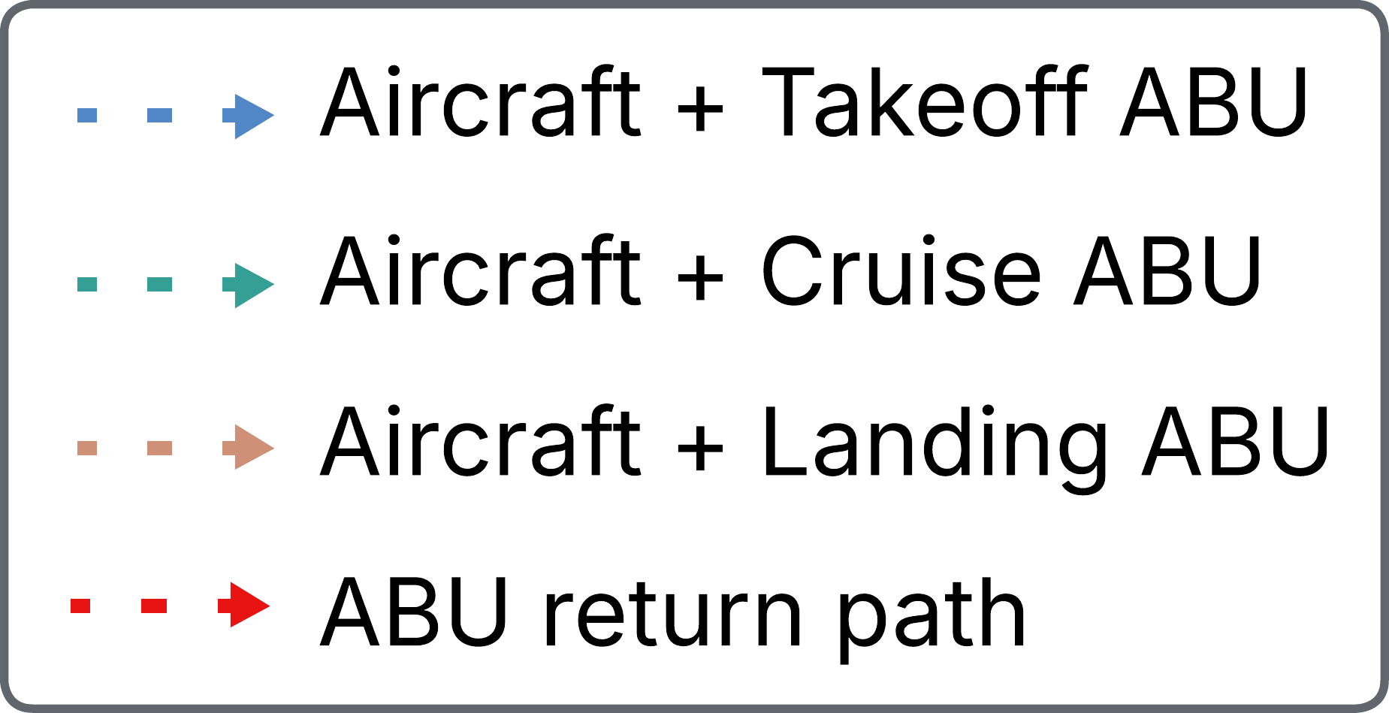

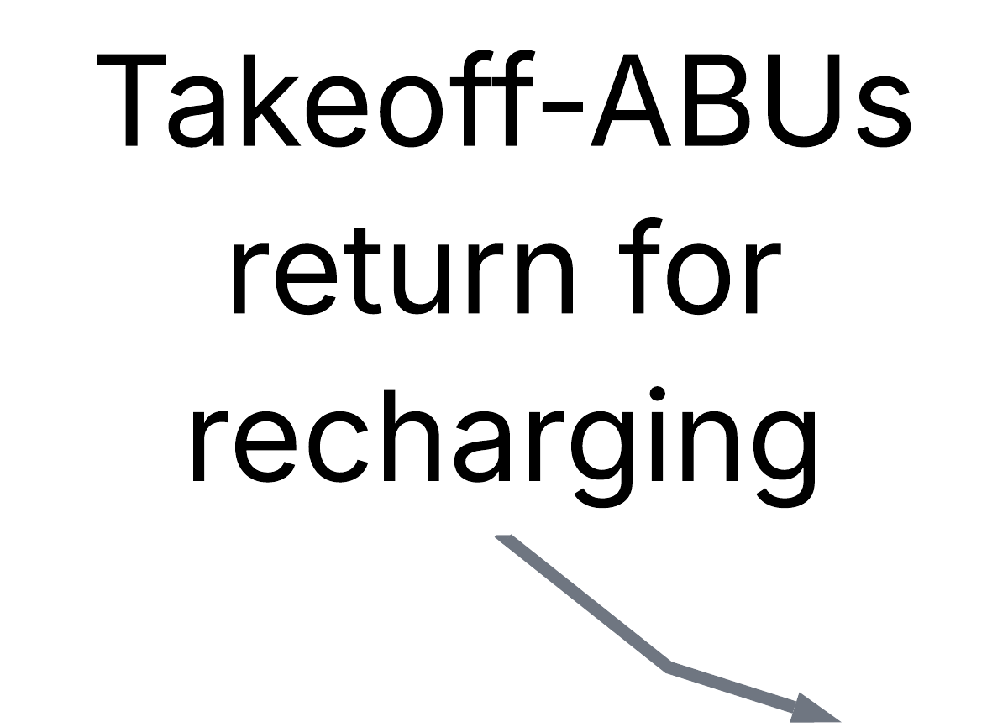
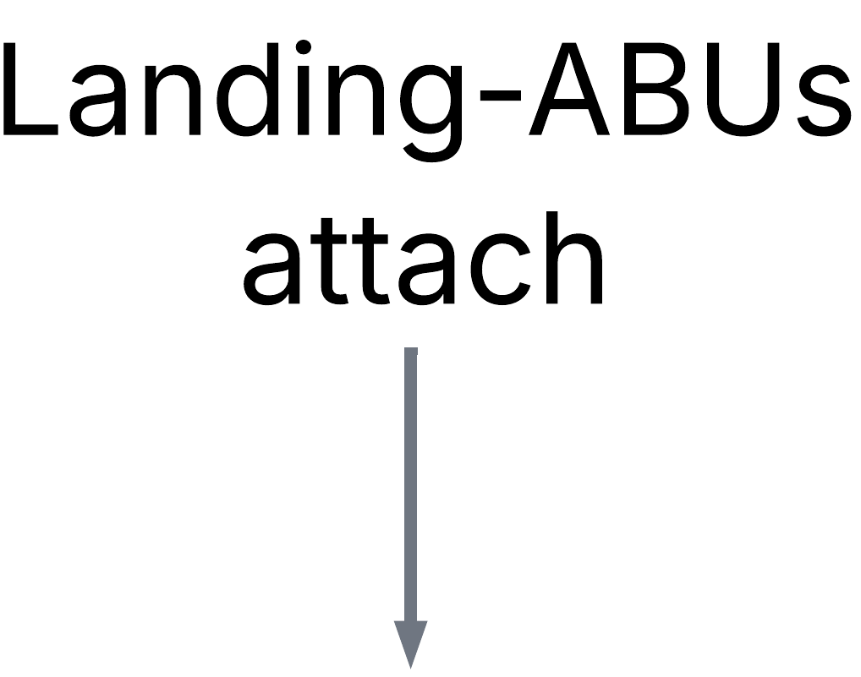

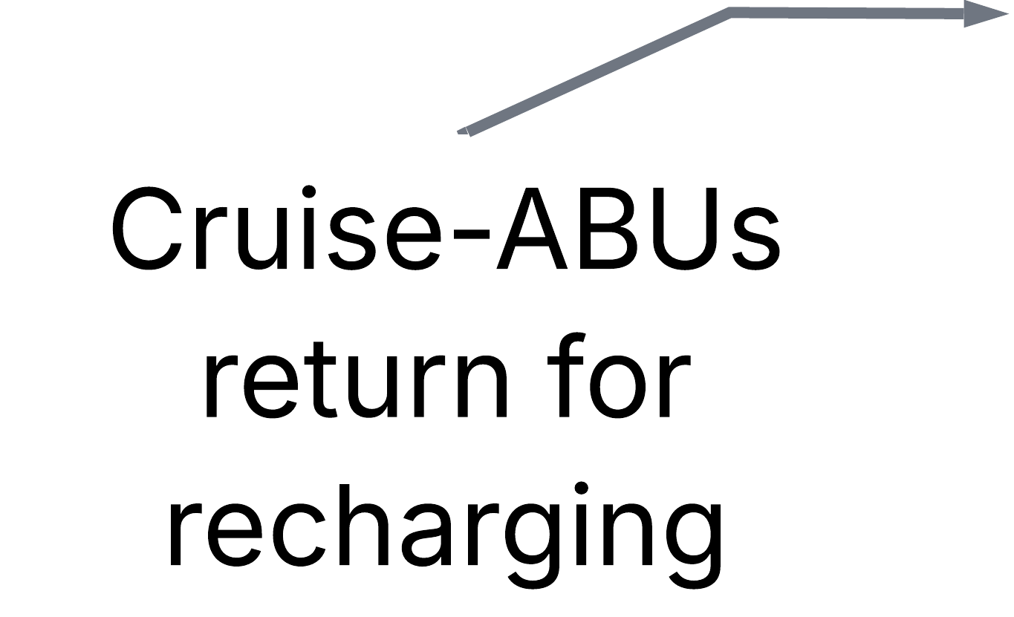


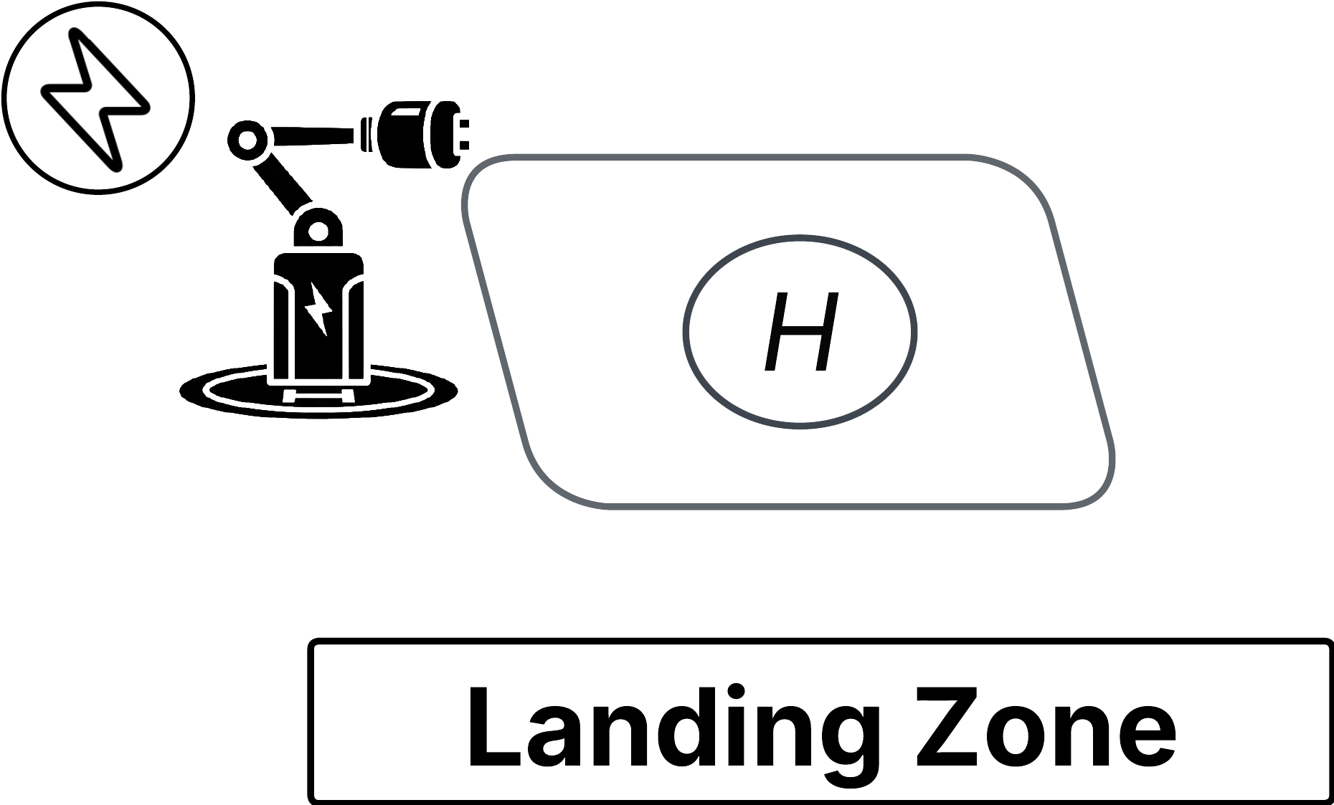
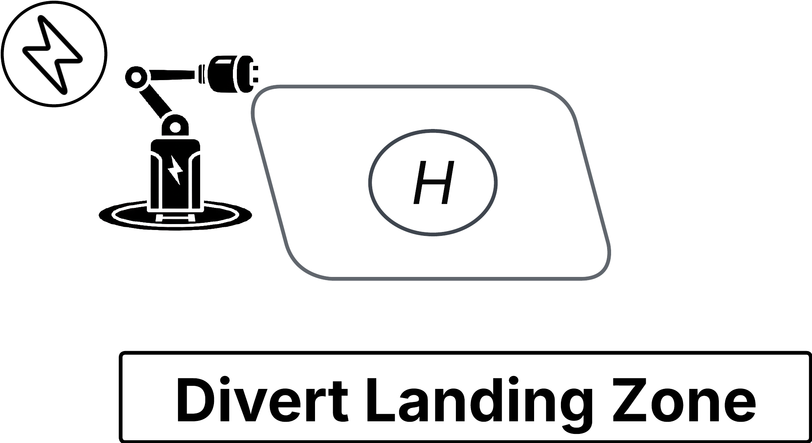

Concept of Operations for ABU-Enabled eVTOL Missions
1
Key concept: detachable, self-contained battery units
2
3
4
4

Slide 7


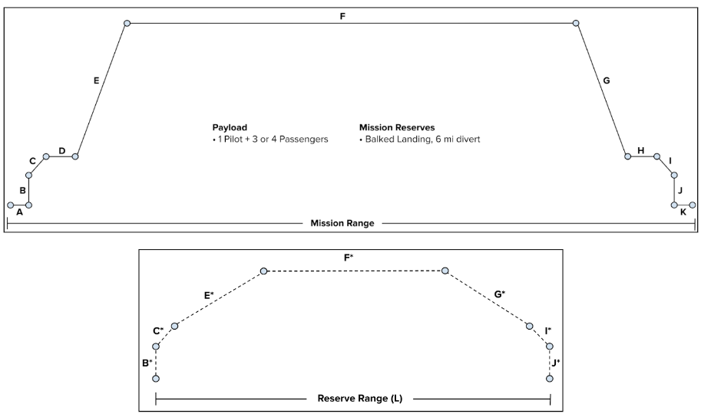
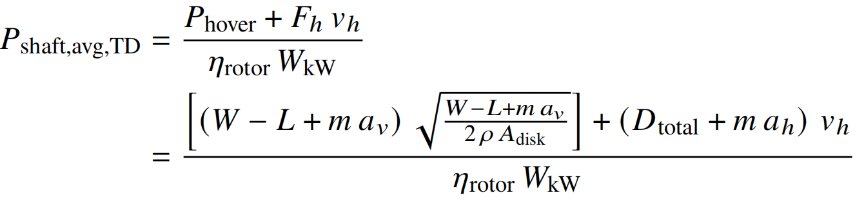

Mission-Based eVTOL Sizing Framework: evtolpy
(i) Input
(*.JSON)
(iii) Total Mission Energy
Aircraft configuration (geometry, aerodynamics, propulsion, power system)
Battery & environmental characteristics
Mission profile (e.g., Uber’s Air Taxi mission)
Energy summed across mission
Main Mission
Reserve Mission
Lift
(ii) Segment-Level Physics
(iv) Iterative Aircraft Sizing
Drag
Transition Descend:
Thrust
Weight
5

Slide 8
Mission-Based eVTOL Sizing Framework: evtolpy
(i) Input
(*.JSON)
(iii) Total Mission Energy
(v) Output
Aircraft configuration (geometry, aerodynamics, propulsion, power system)
Battery & environmental characteristics
Mission profile (e.g., Uber’s Air Taxi mission)
Energy summed across mission
Battery pack mass
Per-segment power & energy
End-of-flight battery DOD
Main Mission
→ Enables comparative design studies
Reserve Mission
Lift
(ii) Segment-Level Physics
(iv) Iterative Aircraft Sizing
Drag
Transition Descend:
Thrust
Weight
5

Slide 9
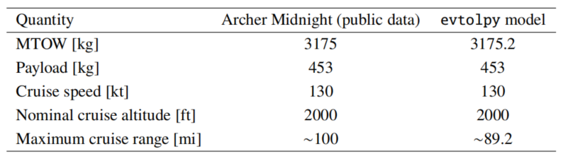
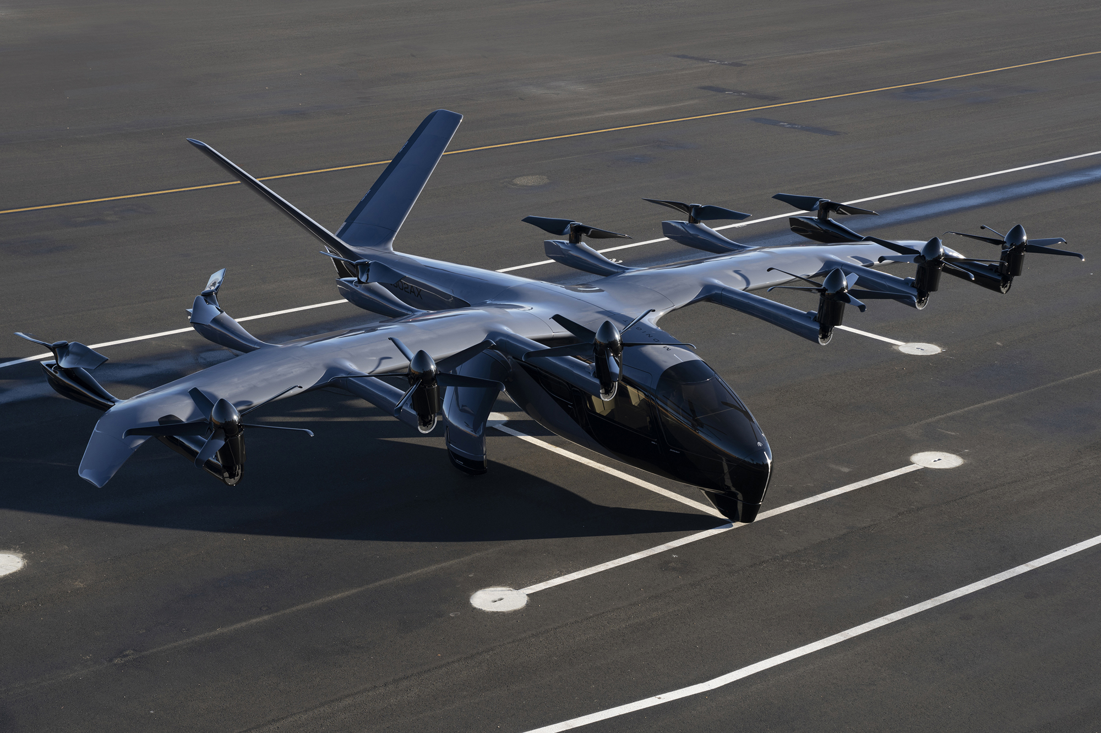
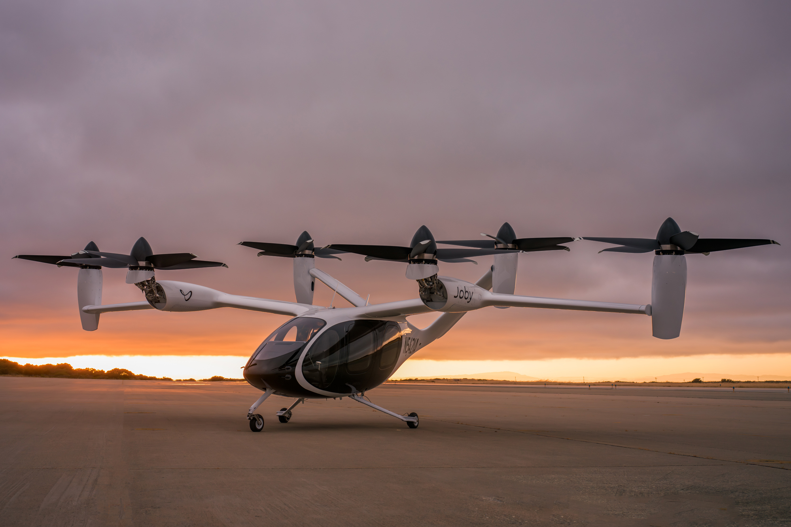
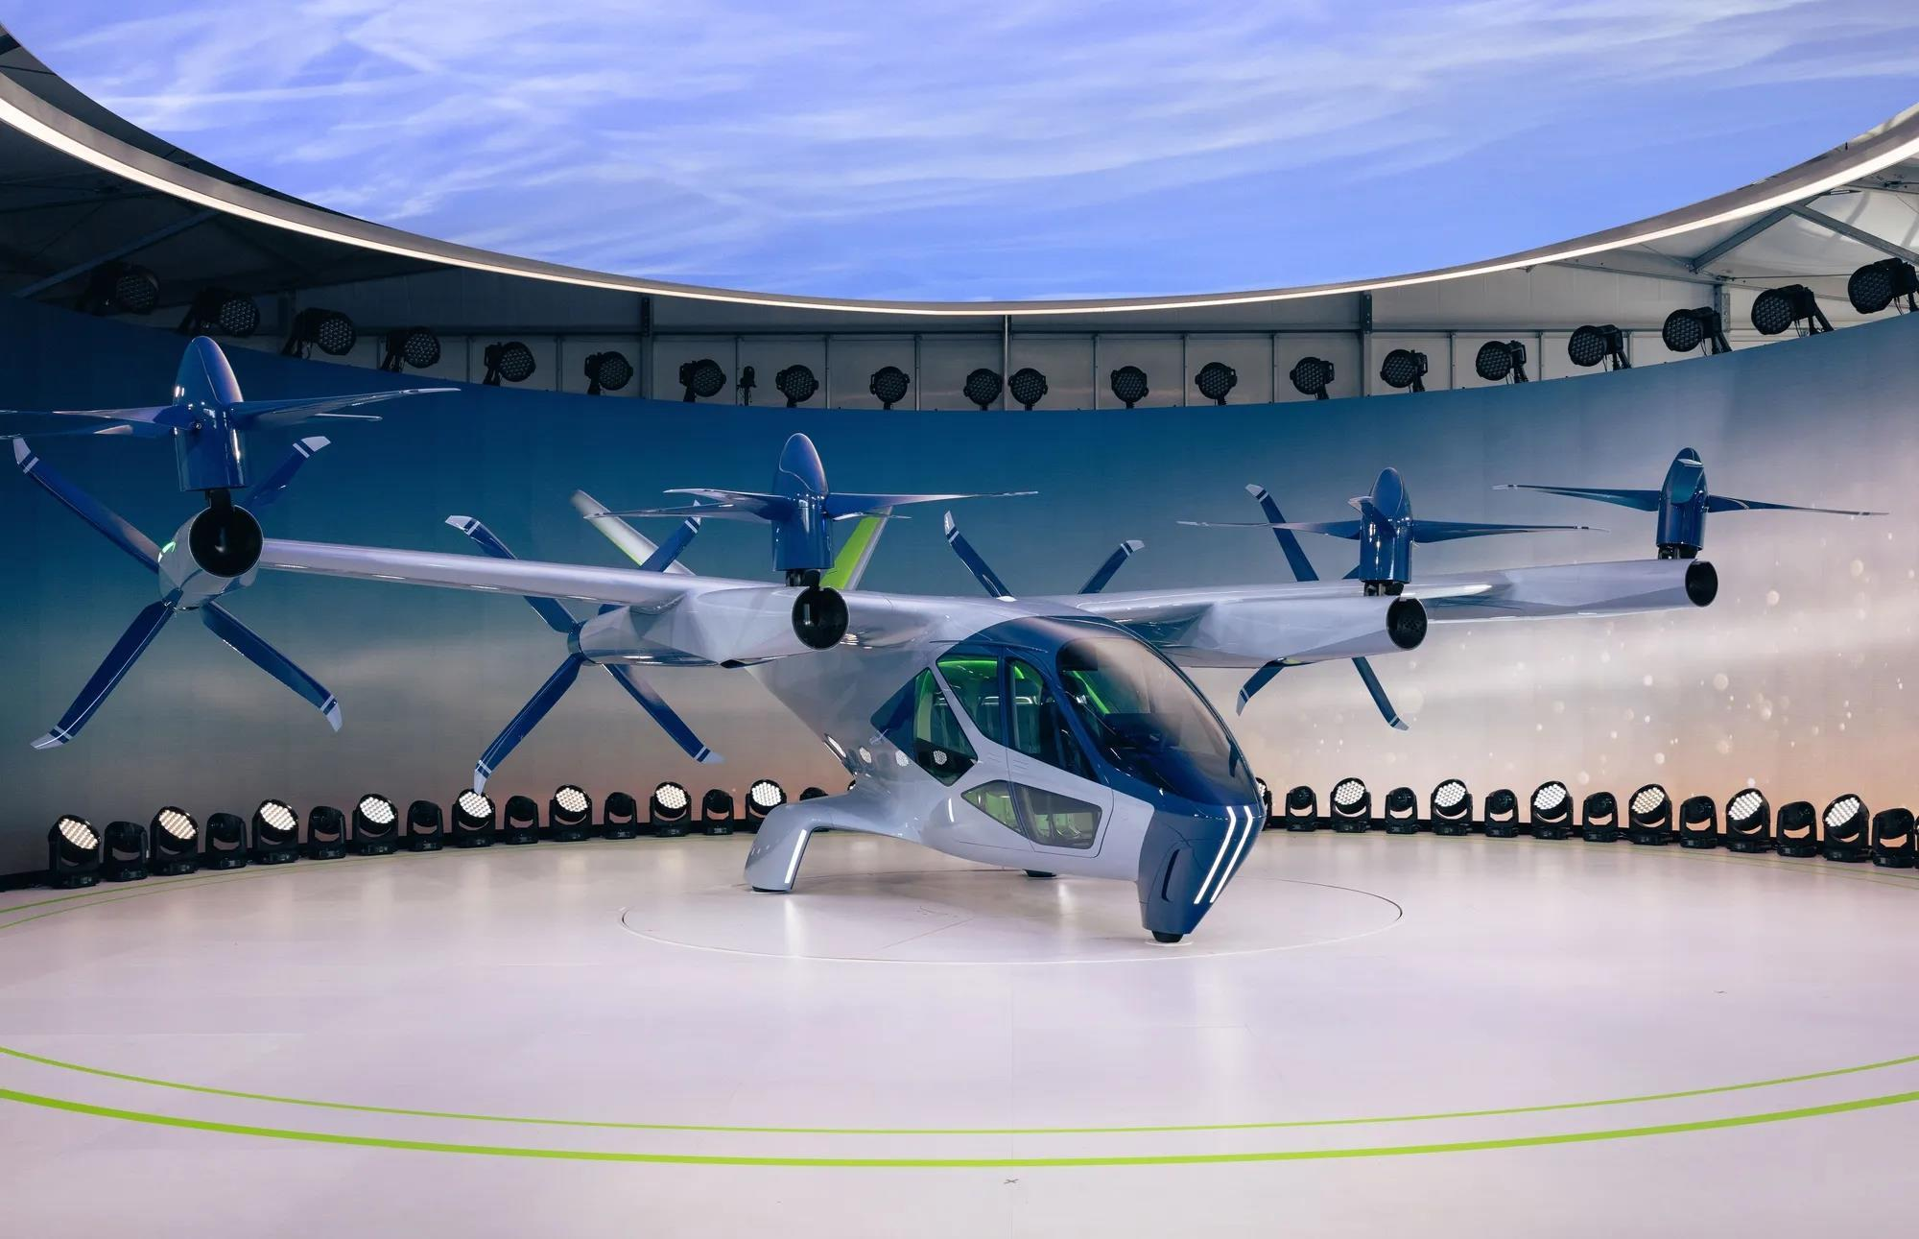
Modeling Electric UAM Aircrafts with evtolpy
Archer Midnight
Joby S4
Sufficient accuracy for conceptual design and comparative studies
Predicted range roughly matches public reports
Supernal S-A2
1500 ft
Mission Range 30 mi 45 mi 60 mi
Case study
3000 ft
6

Slide 10
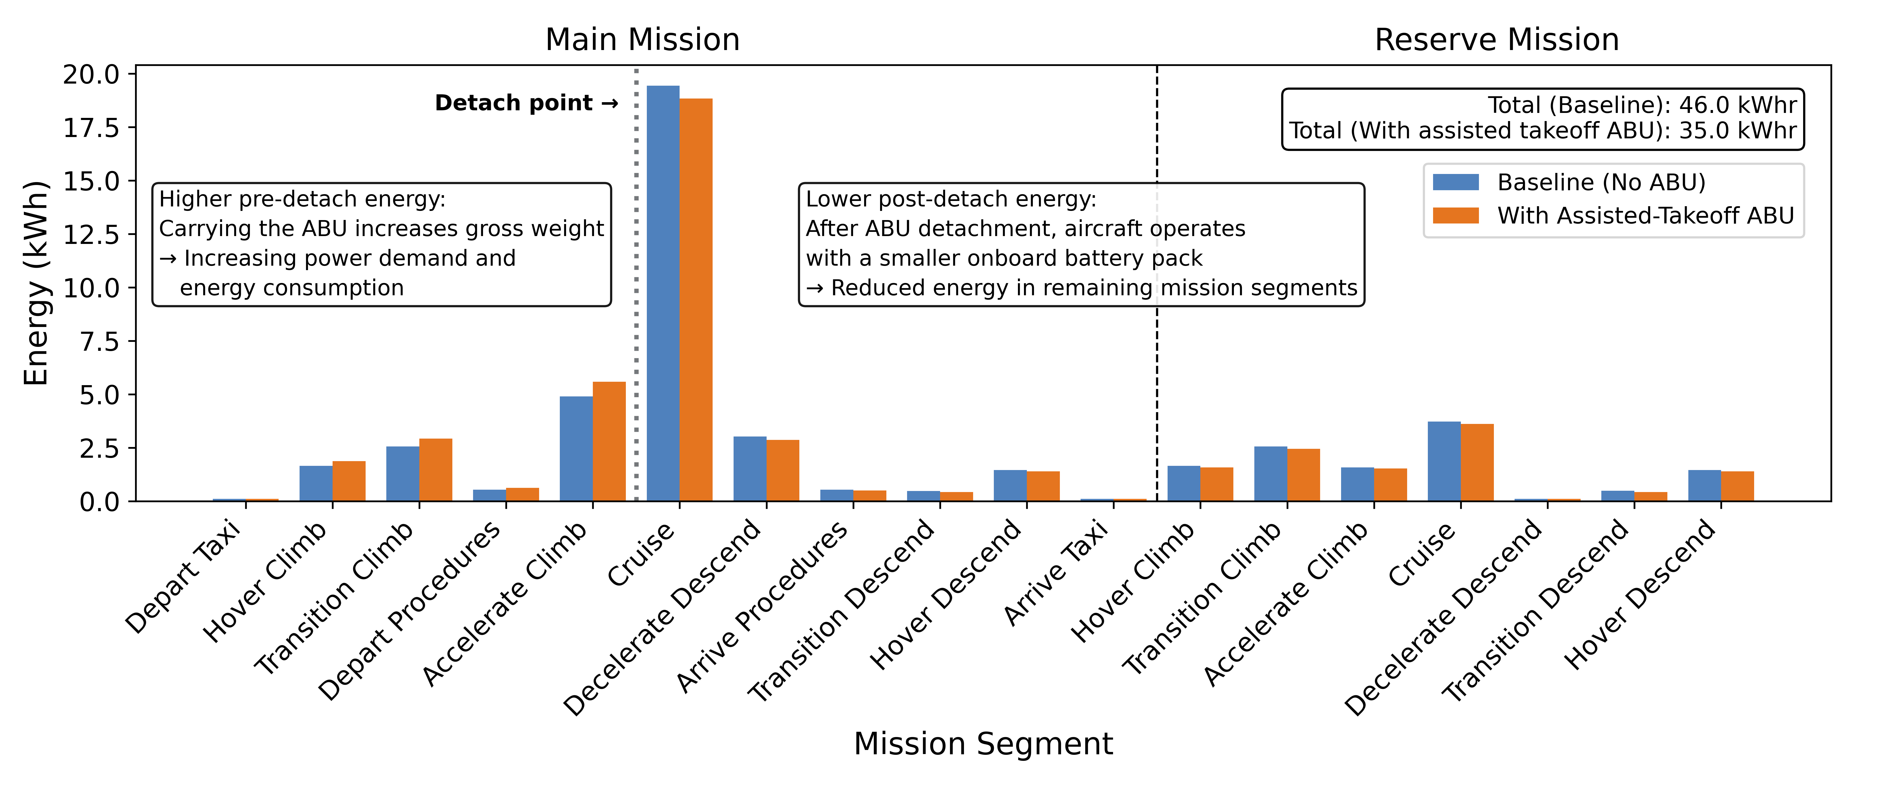
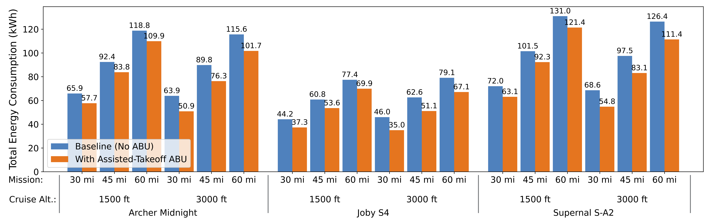
Assisted-Takeoff ABUs Reduce Mission Energy
Detach point
Joby S4 (30 mi mission, 3000 ft)
After Cruise
Before Cruise
Baseline (No ABU)
With Assisted-Takeoff ABU
Segment Energy
Takeoff ABUs reduce total mission energy 7–24% by offloading onboard battery mass.
Per-Mission Energy Consumption With and Without Assisted-Takeoff ABUs
7

Slide 11
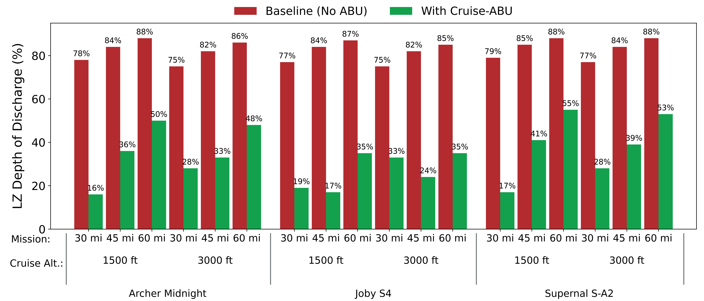
Assisted-Cruise ABUs Reduce Battery Depth-of-Discharge
Typical operational DOD limit
Percent of Battery Depleted (Higher = Worse)
Short-range missions complete
with minimal onboard battery use
8

Slide 12
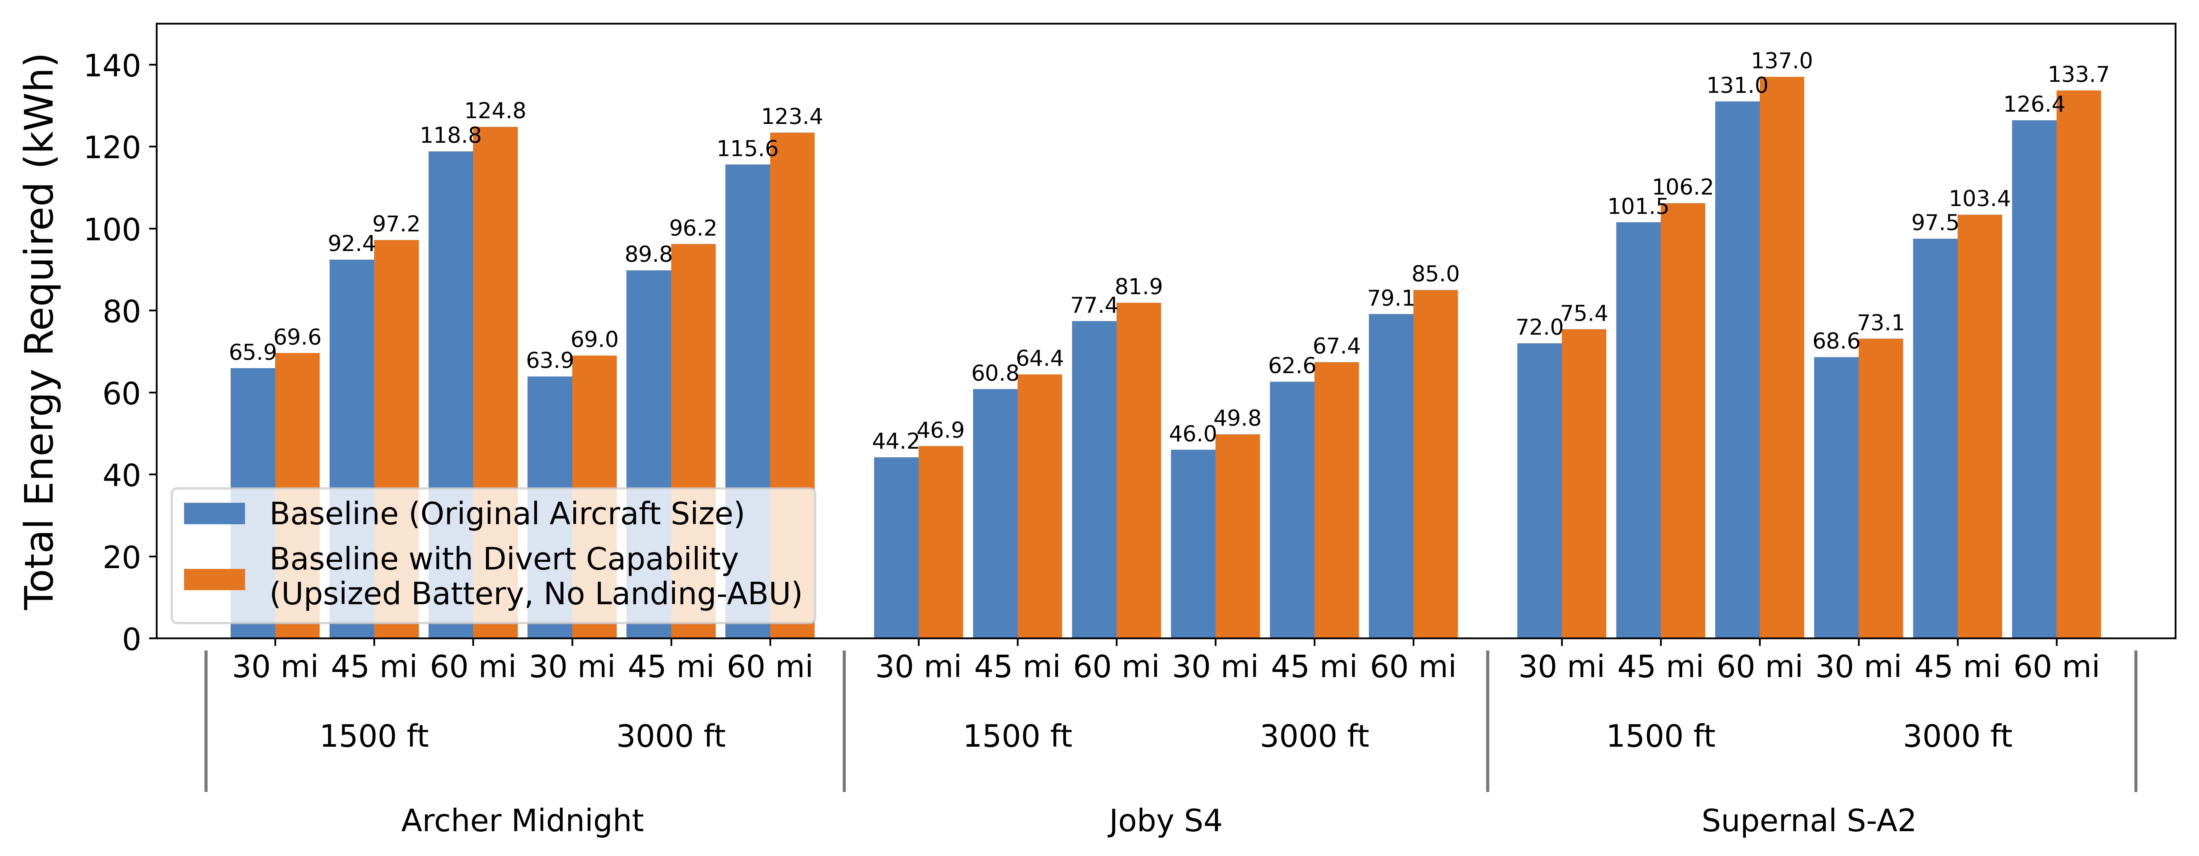
Assisted-Landing ABUs Enable Unexpected Divert Missions
Impact of Divert-Driven Battery Sizing on Total Baseline Mission Energy
Landing ABUs satisfy divert safety needs without the baseline energy penalty of extra onboard battery mass
Mission:
Cruise Alt.:
9

Slide 13
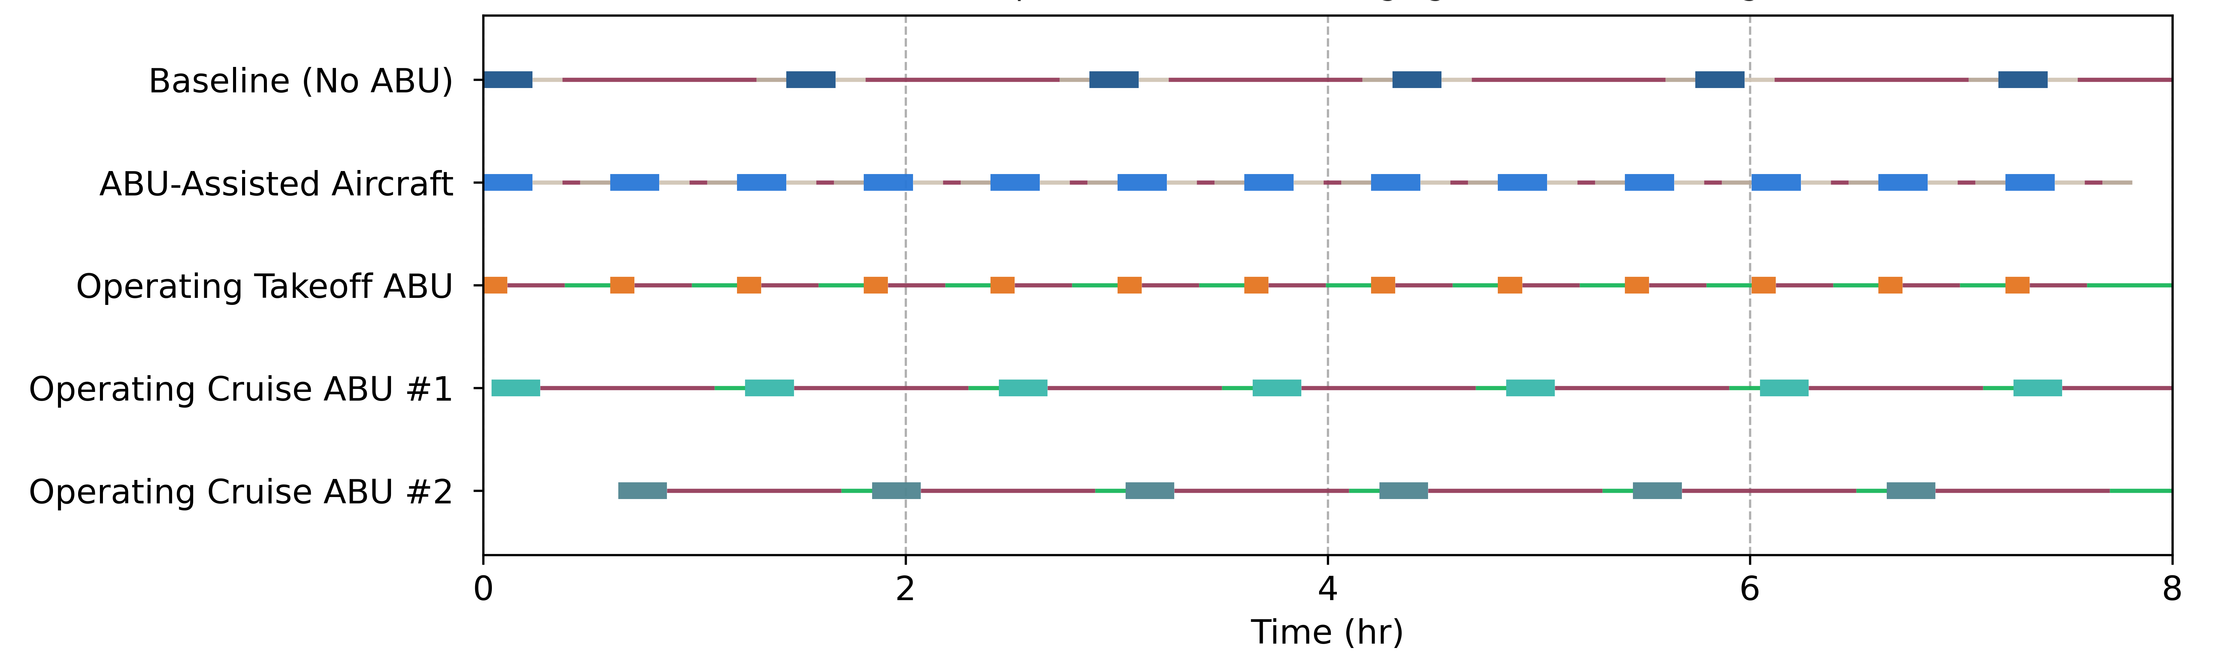
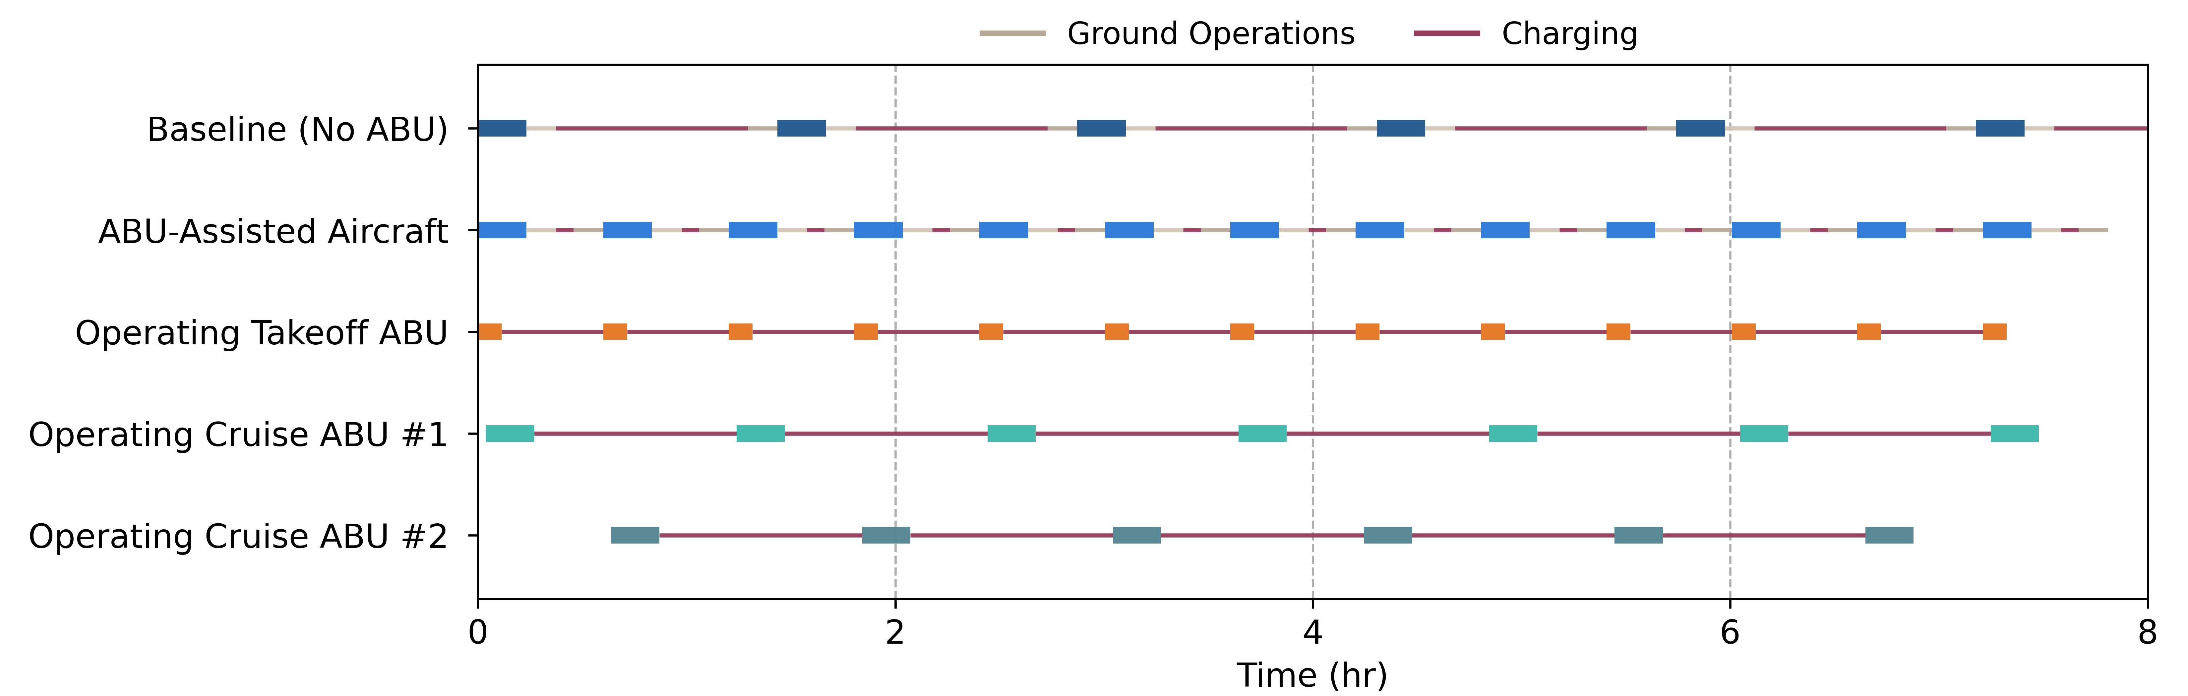
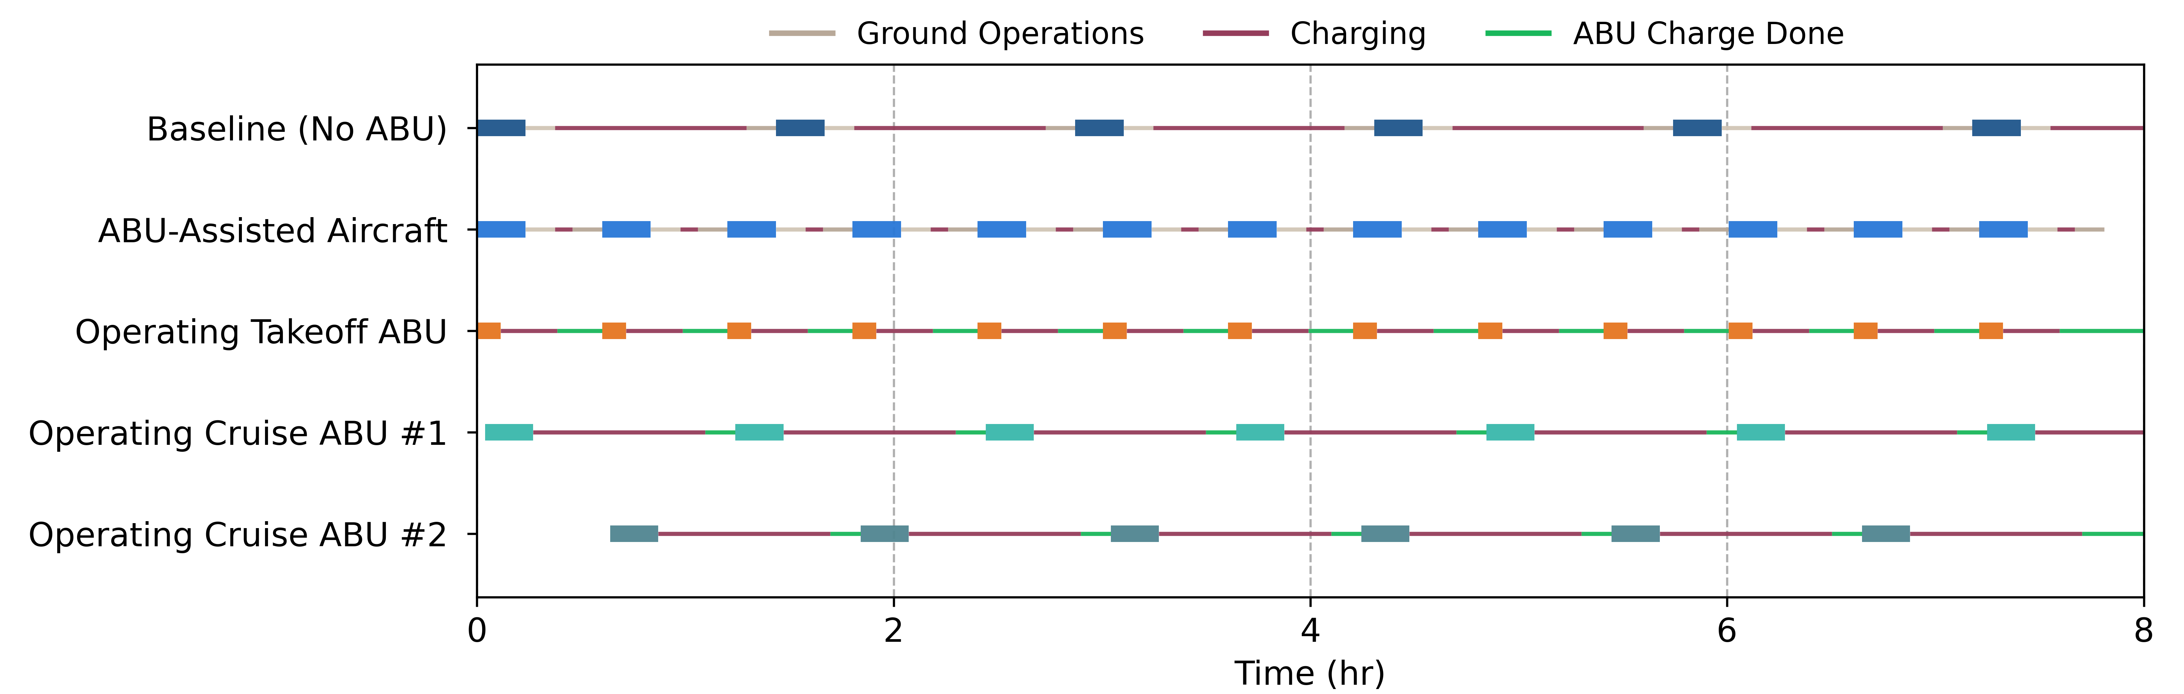
ABUs Increase eVTOL Flight Cadence
Aircraft and ABU Operating Timeline Over an 8-Hour Common-Case Scenario
Archer Midnight (30 mi mission, 1500 ft)
10

Slide 14
ABUs Increase eVTOL Flight Cadence
Aircraft and ABU Operating Timeline Over an 8-Hour Common-Case Scenario
Archer Midnight (30 mi mission, 1500 ft)
10

Slide 15
ABUs Increase eVTOL Flight Cadence
Aircraft and ABU Operating Timeline Over an 8-Hour Common-Case Scenario
Archer Midnight (30 mi mission, 1500 ft)
Higher fleet utilization with reduced charging bottlenecks.
10

Slide 16
ABUs Increase eVTOL Flight Cadence
Effects of ABUs on eVTOL Flight cadence Over an 8-Hour Period
13
6
ABUs increase UAM flights per eight-hour period by 1.5 to 2.6×
More practical and economical UAM services
11

Slide 17
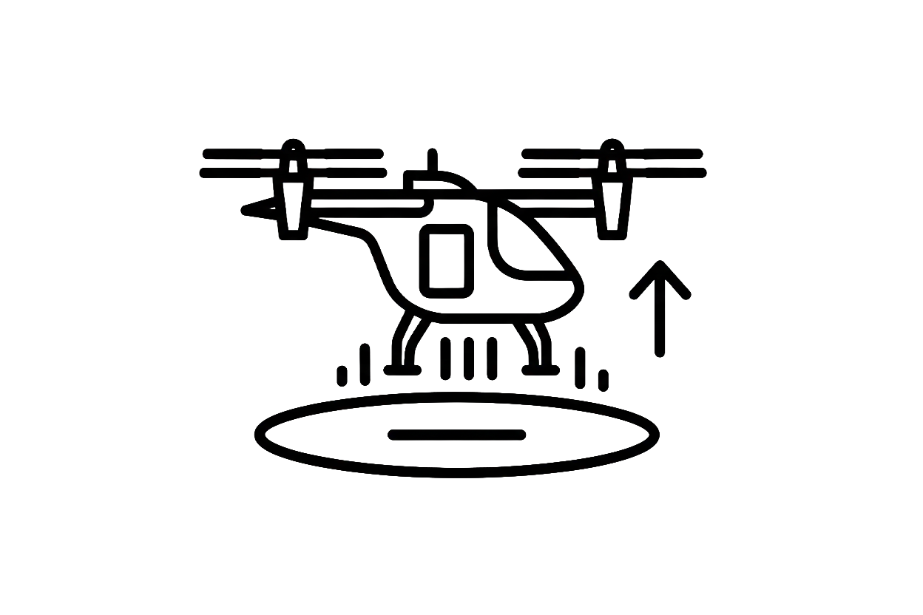
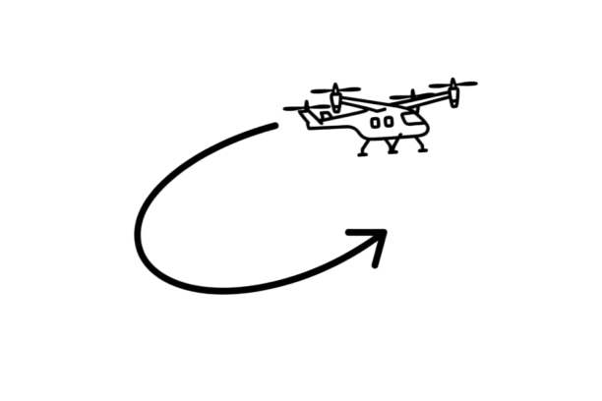
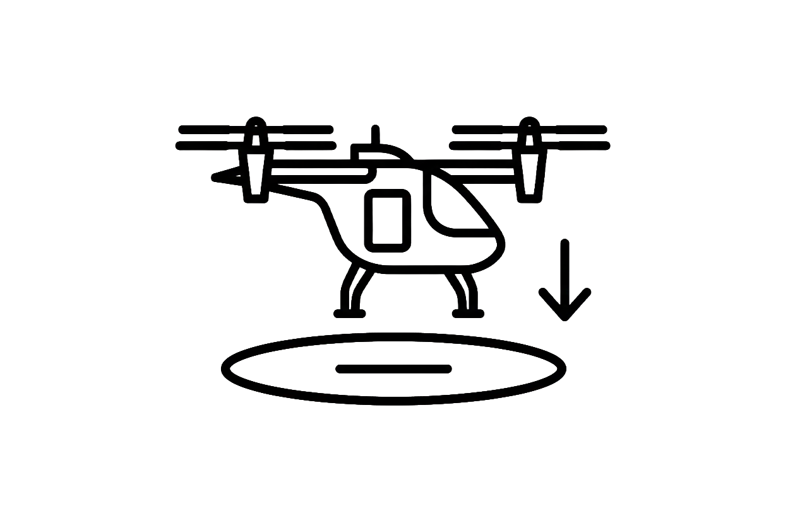

ABU Functional Analysis Recap
Supply high takeoff power
Offload main battery
Outcome: MTOW reduction, energy redistribution
Assisted Takeoff
Assisted Cruise
Provide cruise energy
Outcome: reduced depth-of-discharge (DOD)
Landing Safety
Common Case Economics
Support emergency landing situations
Outcome: supported hover/loiter/divert margin
Integrates mission energy + CC–CV charging model
Outcome: feasible flights
12

Slide 18
ABU Functional Analysis Recap
Supply high takeoff power
Offload main battery
Outcome: MTOW reduction, energy redistribution
Assisted Takeoff
Assisted Cruise
Provide cruise energy
Outcome: reduced depth-of-discharge (DOD)
Landing Safety
Common Case Economics
Support emergency landing situations
Outcome: supported hover/loiter/divert margin
Integrates mission energy + CC–CV charging model
Outcome: feasible flights
12

Slide 19

Conclusion & Future Work
Assisted-Takeoff ABU
ABUs enable scalable UAM without waiting for battery breakthroughs
Assisted-Cruise ABU
Assisted-Landing ABU
ABU structural & aerodynamic design
Next Steps:
Autonomy & docking
Airspace integration
Certification pathway, etc.
13

