Slide 1

Chittagong University of Engineering and Technology (CUET)
Department of Computer Science and Engineering
S/W Development Project (Sessional) — Course Code: CSE-300
BringIT
Peer Delivery System
Submitted By
Submitted To
Md. Abdulla Al Nishat – 2204042
Mohammad Sakib Hasan – 2204051
Ayan Barua – 2204053
Fatema Jannat Rup – 2204064
Sharmistha Chanda Tista
Assistant Professor
Department of CSE, CUET

Slide 2
01
Introduction
05
How It Works
Overview
02
Motivation
06
Implementation
03
Objectives
07
Testing
04
Tools & Technology
08
Conclusion

Slide 3
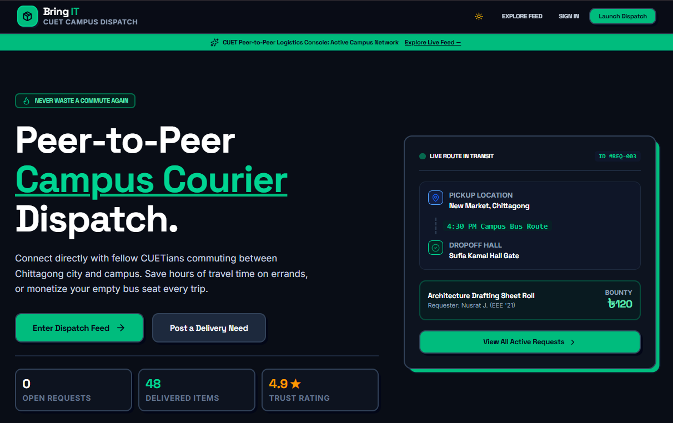
Introduction
Meet BringIT
BringIT is a web platform for CUET students. Need something from the city? Post it with a small reward. A fellow student who is already travelling picks it up and hands it over at your hall.

Slide 4
01
Go yourself
Hours of study time gone.
The
Problem
02
Ask a friend
Your message gets buried in the chat.
03
Book a courier
Extra charges for a small errand.
04
Our idea
A student already going to the city brings it for you.

Slide 5
Never waste a
commute again.
Post a need. A student helps. Meet at your hall.

Slide 6





Motivation
Save our study time
Skip the long trip to the city
Why we built it
Use trips that already happen
Commuters help out on their way
Help when it is urgent
Medicine, calculators, thesis prints
Trust among our own
Profiles, ratings, campus-only access
Grow a helpful community
Students helping students

Slide 7





Post a request
Item, route, bounty, urgency
Our
Objectives
Find requests
Browse, search and filter
Track progress
Open to Completed
Verified students
Login and profiles
Stay in touch
Alerts and chat
Our goal
A working delivery platform for CUET students.
Stay motivated
Ratings, badges, leaderboard

Slide 8






Tools & Technology
React 19
React Router v7
Vite
Builds the screens
Moves between pages
Quick to build and run
Tailwind CSS v4
Supabase
Netlify + GitHub
Makes it look good
Database, login, live updates
Puts it online, stores our code

Slide 9




The Journey of a Request
01
02
03
04
Open
Accepted
In Transit
Completed
Posted, waiting for a helper
A student says yes, chat opens
Picked up, heading to campus
Handed over, points earned
Nobody accepted yet? The request just stays listed. Delivered? The leaderboard updates.

Slide 10
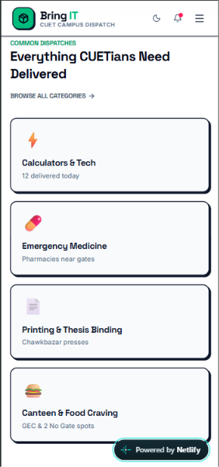
IMPLEMENTATION · 01
Landing Page
A welcome screen with a live example
Popular categories

Slide 11
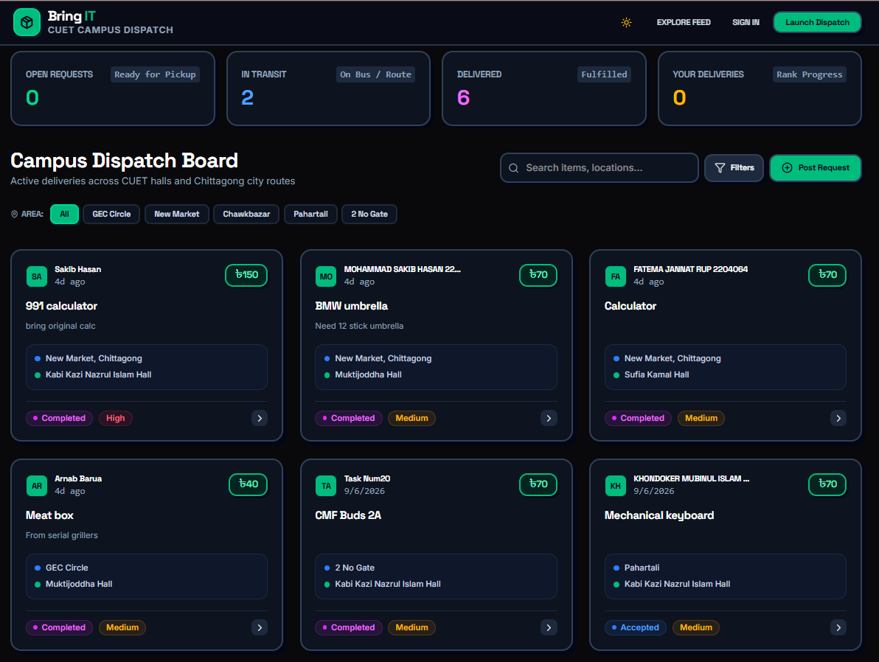



IMPLEMENTATION · 02
Dispatch Board
Search and filter
Find items by area
Pickup to your hall
Route on every card
Bounty in Taka
Know the reward upfront
Status and urgency tags
Low, Medium or High

Slide 12
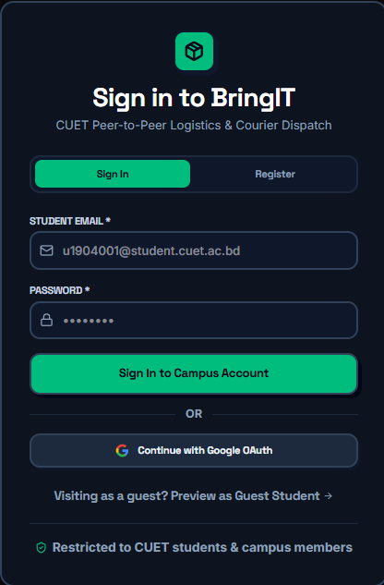
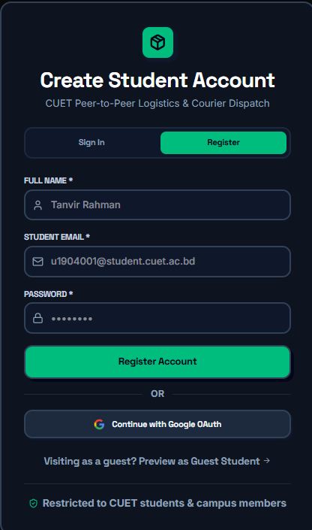



IMPLEMENTATION · 03
Sign In and Register
Use your CUET email
Simple email and password
Google sign-in
One tap and you are in
Look around first
Preview as a guest
Campus members only
A trusted community

Slide 13
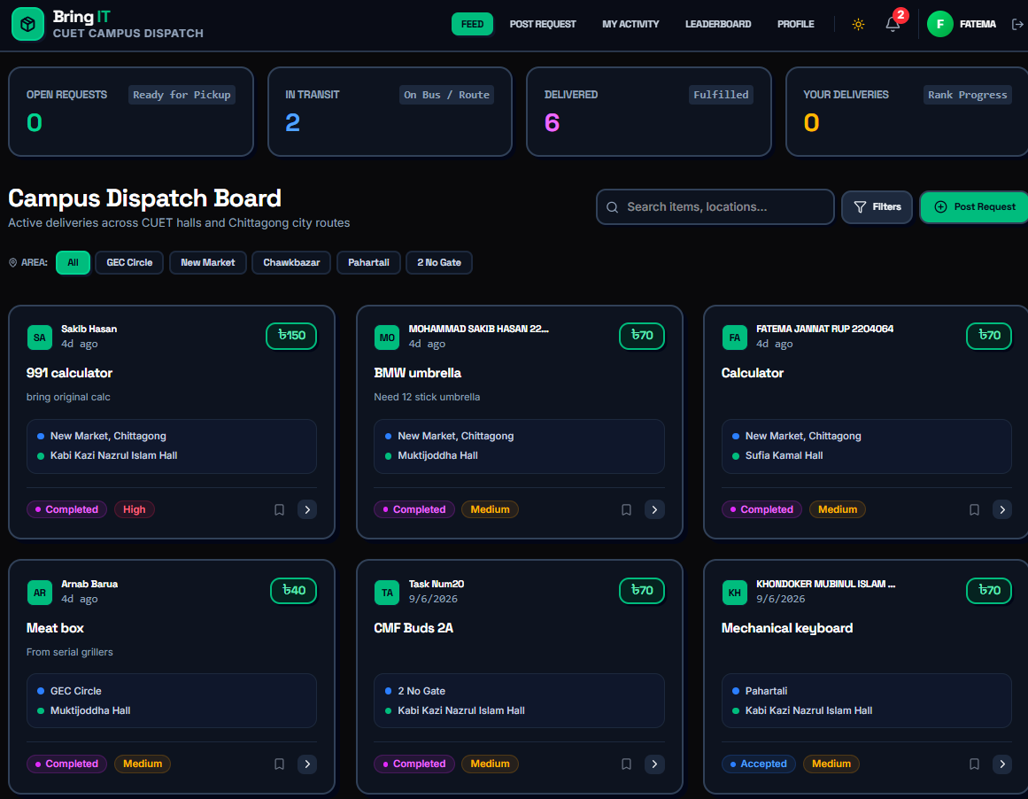




IMPLEMENTATION · 04
Signed-in Feed
Easy navigation
Feed, Post, Activity, Profile
Notification bell
See new updates at once
Save for later
Bookmark requests
Colour tags
Status and urgency at a glance

Slide 14
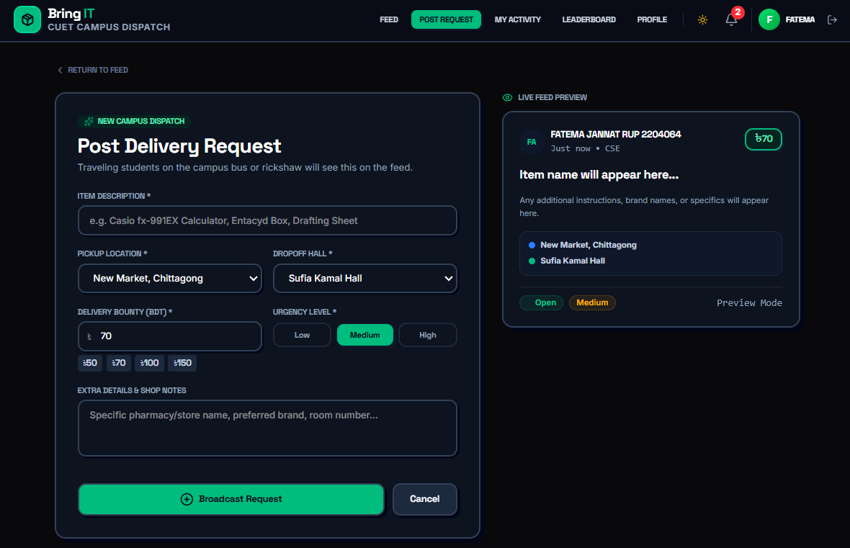
IMPLEMENTATION · 05
Posting Request
Tell us the item
Add shop notes if needed
Where from, where to
Pick from dropdowns
Set reward and urgency
50 / 70 / 100 / 150
Preview first
Check before you post

Slide 15
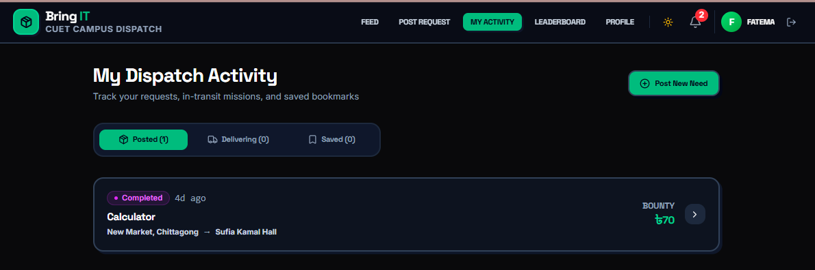
IMPLEMENTATION · 06
My Dispatch Activity
Posted
Things you asked for
Delivering
Errands you picked up
Saved
Requests to revisit

Slide 16
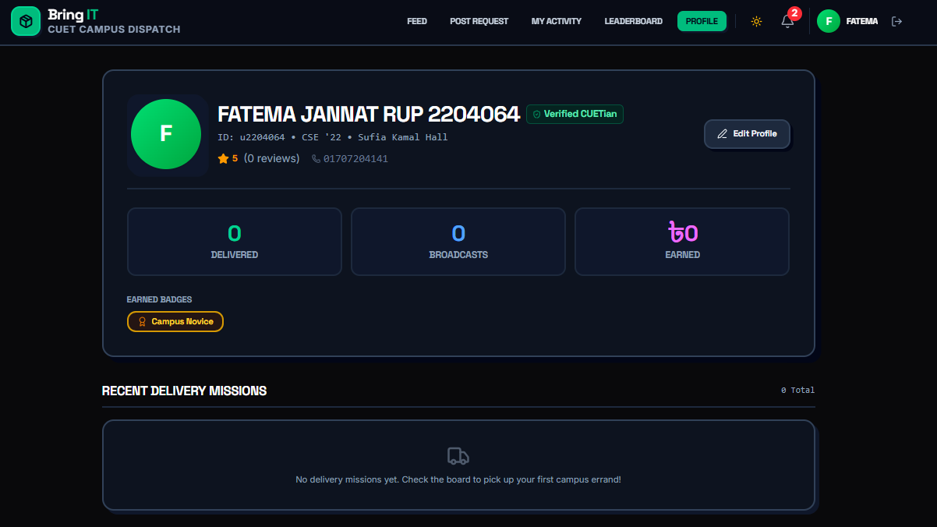



IMPLEMENTATION · 07
Profile and Rewards
A verified CUETian
ID, batch, hall, contact
Ratings and reviews
Helps build trust
Badges to earn
Like Campus Novice
Leaderboard
Celebrates top helpers

Slide 17
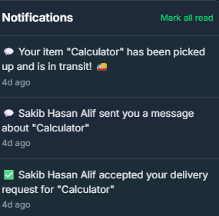

IMPLEMENTATION · 08
Live Notifications
Someone said yes
You know right away
New messages
Chat with the other student
Status updates
Picked up, on the way, delivered
No refresh needed
Live updates via Supabase

Slide 18
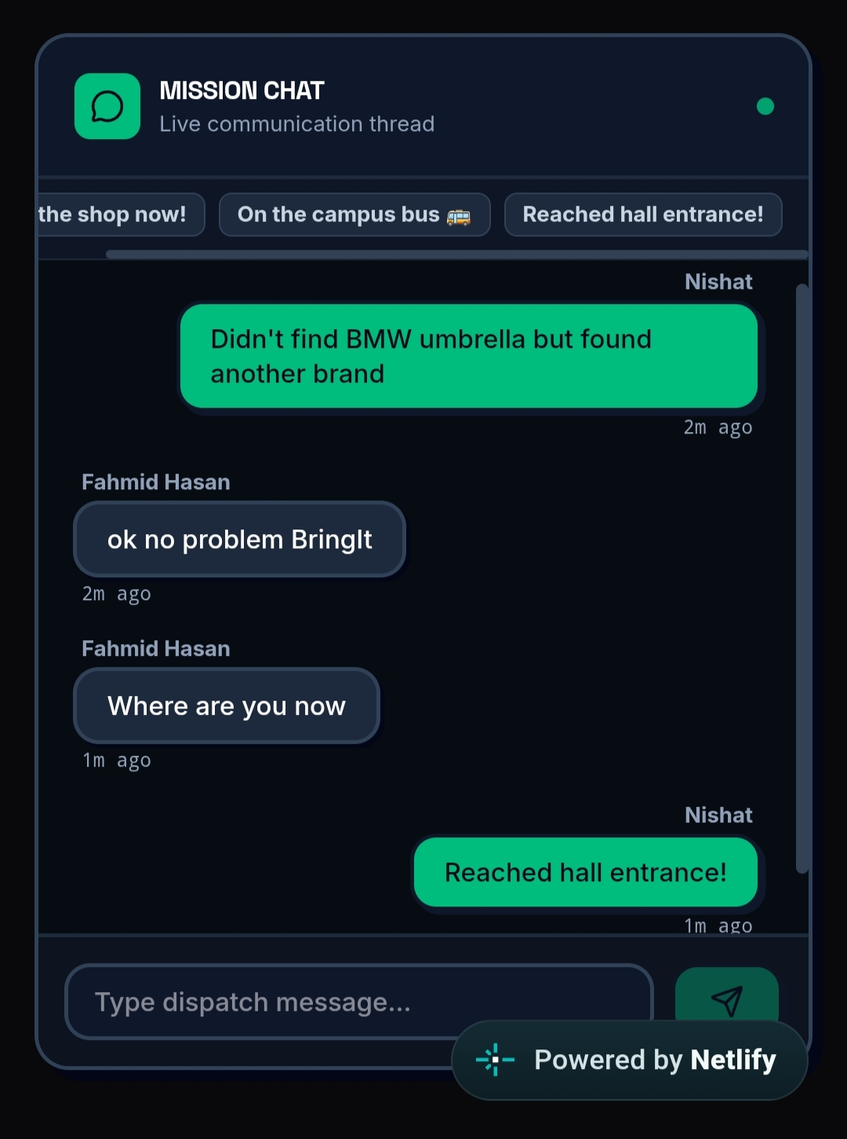

IMPLEMENTATION · 09
Live Chat
Mission chat
A private live thread for every delivery
Quick replies
One tap: On the campus bus
Instant messages
Both students see them right away
Time stamps
Know exactly when each update was sent

Slide 19
Did It Work? Yes!
Sign up
Log in
Post a request
Accept a request
Account gets created
User enters the app
Appears on the board
Status turns Accepted
Status updates
Messaging
Notifications
Activity page
Whole journey works
Messages get delivered
Show up on activity
Everything is listed

Slide 20
Conclusion
01
02
03
What we built
What is missing
Next steps
A simple way for students to help each other
Tracking, chat and alerts built in
Ratings, badges and a leaderboard
Payment happens outside the app
Tested only in a small group
No automatic route matching
In-app payment
Smart route and schedule matching
Mobile app with push alerts

Slide 21
Thank You
BringIT: bring-it-delivery.netlify.app

