Slide 1
N-Tier Demo
(03/21/2013)

Slide 2
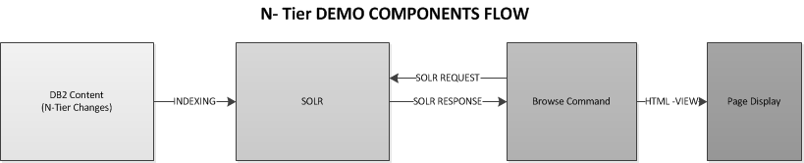
N-Tier Demo
Modified Page Url Format : http://www.sears.com/SEO-custom-name-goes-here/b-catgroupId

Slide 3
N-Tier Demo
Db2 TABLE CHANGES
S.No | TABLE NAME | ACTION
1 | CATGROUP | INSERT
2 | CATGRPDESC | INSERT
3 | STORECGRP | INSERT
4 | CATTOGRP | INSERT
5 | CATGRPREL | INSERT
6 | XCATGROUPPATH | INSERT/UPDATE/DELETE
SOLR CHANGES
N-Tier Category aggregation
N-Tier Product aggregation

Slide 4
N-Tier Demo
The Goal: Make necessary code changes to display:
1. More than 3 levels of categorization
Displaying products before level 3
Depict graph linking of categories – link to same category more than one way

Slide 5
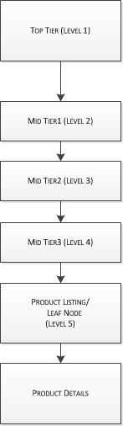
N-Tier Demo
More than 3 levels of categorization:

Slide 6
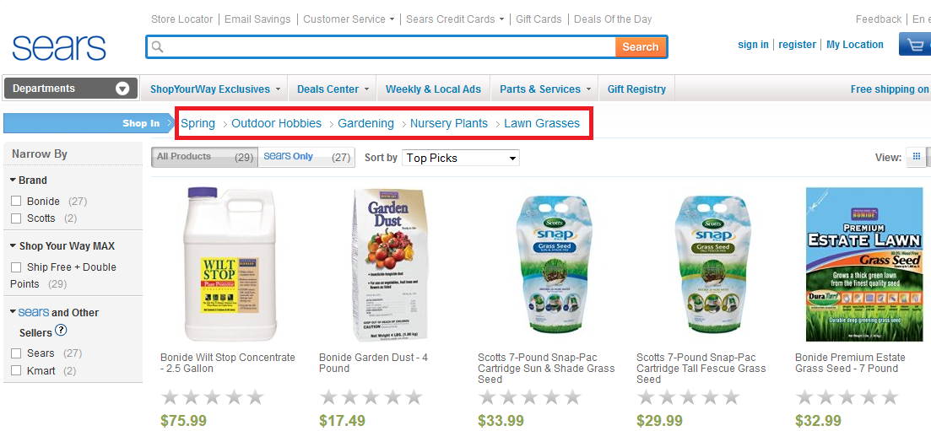
N-Tier Demo
More than 3 levels of categorization
DEMO URL:
http://wcsdevel3085p.dev.ch3.s.com/shc/s/spring-outdoor-hobbies-gardening-nursery-plants-lawn-grasses/b-1030103

Slide 7
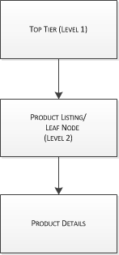
N-Tier Demo
Displaying products before level 3:

Slide 8
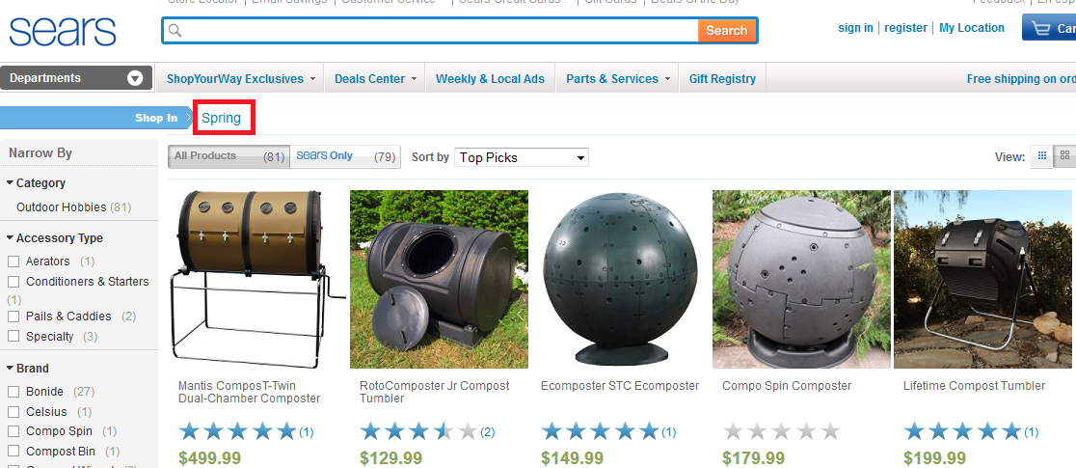
N-Tier Demo
Displaying products before level 3:
DEMO URL:
http://wcsdevel3085p.dev.ch3.s.com/shc/s/spring/b-1261720515

Slide 9
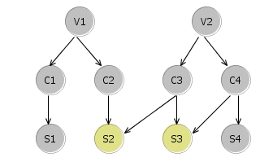
N-Tier Demo
Depict graph linking of categories:

Slide 10
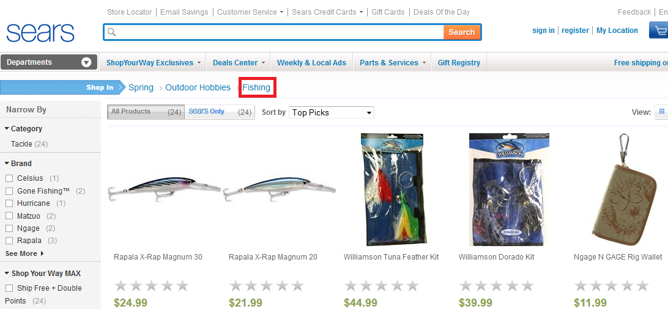
N-Tier Demo
Depict graph linking of categories:
DEMO URL:
http://wcsdevel3085p.dev.ch3.s.com/shc/s/spring-outdoor-hobbies-fishing/b-1024904

Slide 11
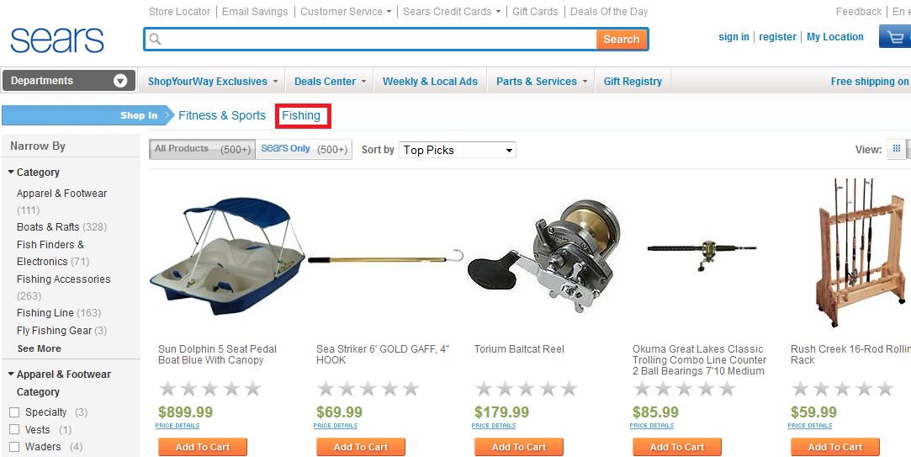
N-Tier Demo
Depict graph linking of categories:
DEMO URL:
http://wcsdevel3085p.dev.ch3.s.com/shc/s/fitness-sports-fishing/b-1024904

Slide 12
N-Tier Demo
Browse Code Changes:
No: Of Files Modified = 33
No: Of File Added = 1
Changed File Details:
file://ushofsvpnetapp1/ecomms/BrowseDiscoveries/N-LevelTaxonomy/N-Tier_Demo_Browse_File_Changes.xlsx

Slide 13
N-Tier Demo
Limitations:
a) Few scenarios of Page Title, Meta-Tag and SEO URL are bypassed to achieve the purpose of the demo. Following up with SEO team for their recommendations– [Logged in 4dfy -Discovery ]
b) Omniture changes are not implemented for the demo purpose. Following up with omniture team , for their recommendations and code implementation – [Logged in 4dfy –Discovery]
c) Dropzones for the N-Tier Category pages are yet to be implemented. This requires change in Out Of Box code and follow-up with Promo UX team - [Logged in 4dfy –Discovery]
d) Page Template based on category , implemented for selected N-Tier categories for the purpose of demo. Template need to flow from SPIN to WCS Content to Browse WCS Command, for all categories.
e) N-Tier changes are not extended for BRAT changes. Following up with BRAT team, for their recommendations - [Logged in 4dfy –Discovery]

Slide 14
Questions

