Slide 1

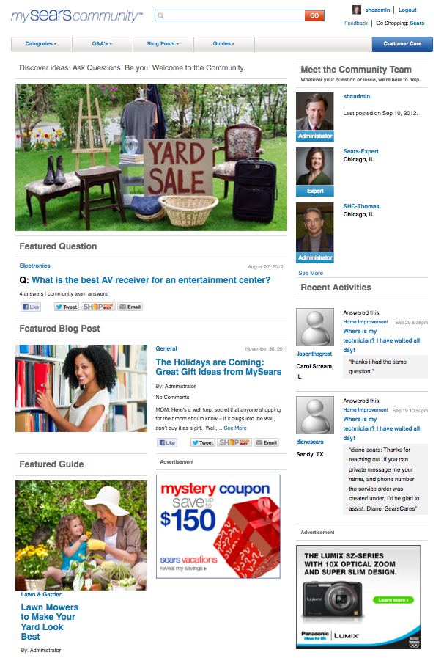

Communities Widgets
By: Hamid Shariff

Slide 2
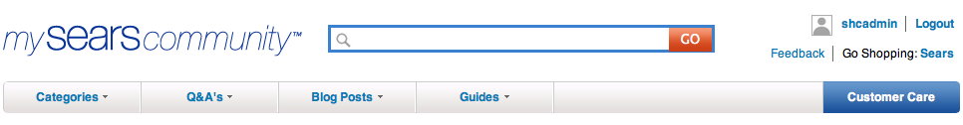
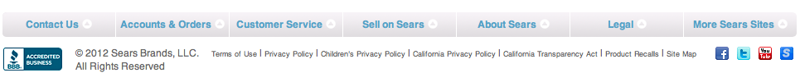
Communities Widgets
1
Showcase front-end and back-end view of communities widgets
2
Provide a brief description about widget functionality
3
Site is divided into two columns; 66% and 33% width
4
In most instances you can use the widgets on both columns

Slide 3
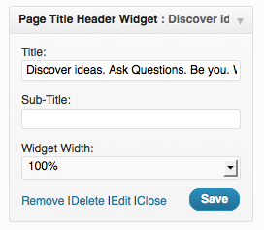
Page Title Header Widget
Front-end View
Title widget
Back-end View

Slide 4
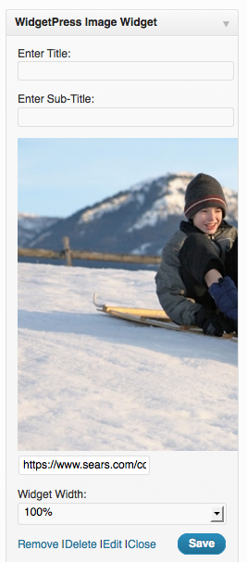
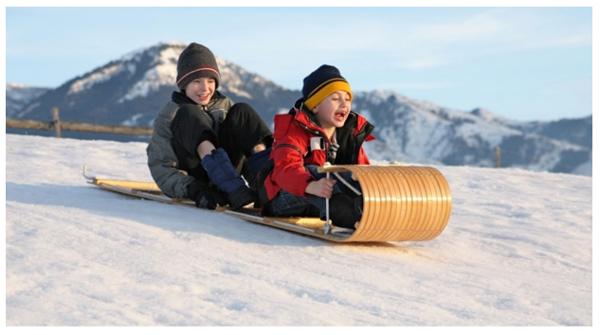
WidgetPress Image Widget
Displays an image. Example: Hero Image
Front-end View
Back-end View

Slide 5
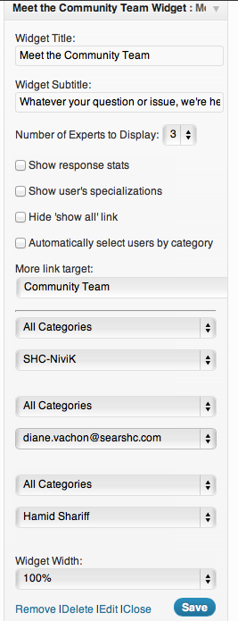
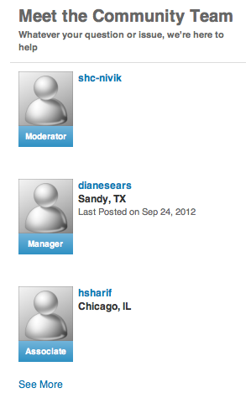
Meet the Comm. Team Widget
Communities members
Front-end View
Back-end View

Slide 6
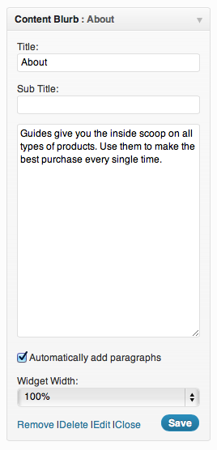
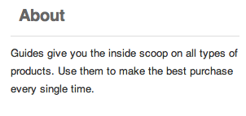
Content Blurb Widget
Arbitrary text, usually intended for the right rail. Example: About Us
Front-end View
Back-end View

Slide 7
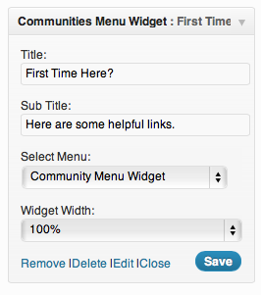
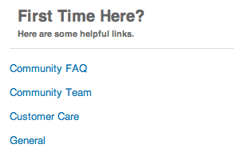
Communities Menu Widget
Used to create links
Front-end View
Back-end View

Slide 8
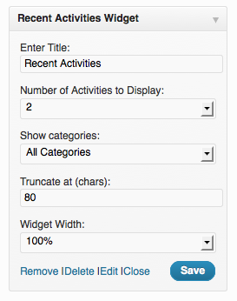
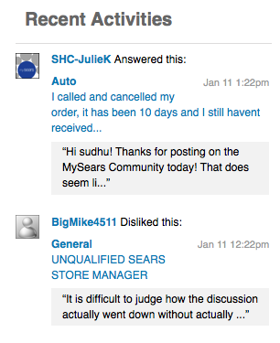
Recent Activities Widget
Recent Activities can be used for any category page (action items <SHC-JulieK Answered this> etc.)
Front-end View
Back-end View

Slide 9
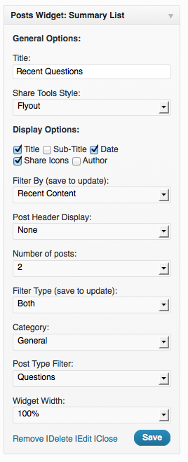
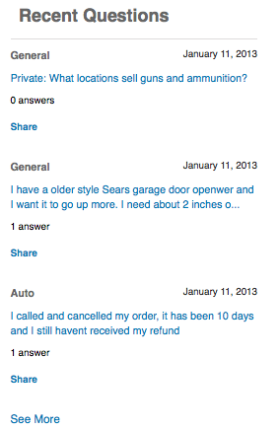
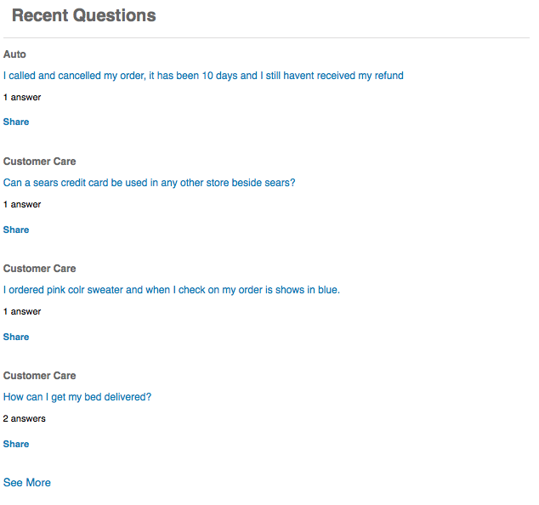
Post Widget Summary List
Related stories (recent Questions, Blogs, or Guides)
33% width
Front-end View
66% width
Back-end View

Slide 10

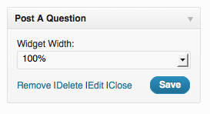
Post a Question Widget
Front-end View
Text field to ask a question
Back-end View

Slide 11
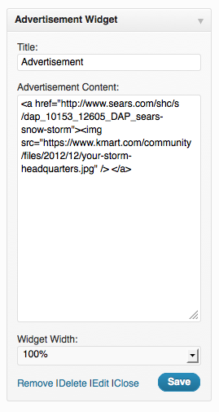
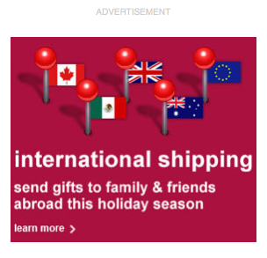
Advertisement Widget
Clickable Ad image
Front-end View
Back-end View

Slide 12
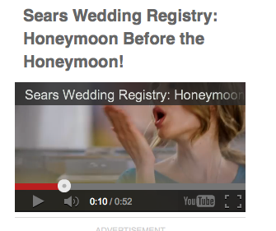
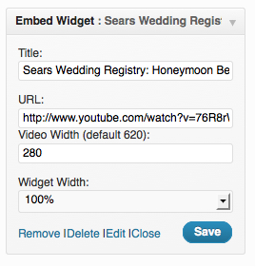
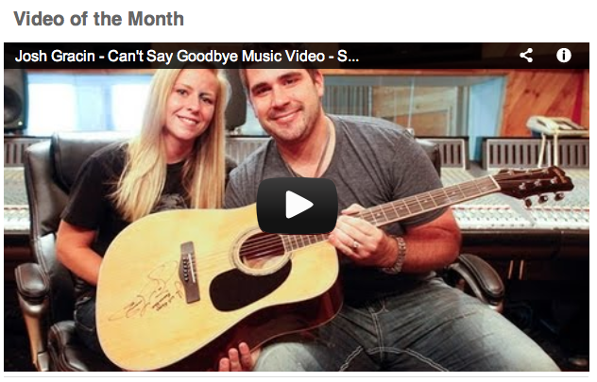
Embed Widget
Used to post videos
33% width
Back-end View
Front-end View
66% width

Slide 13
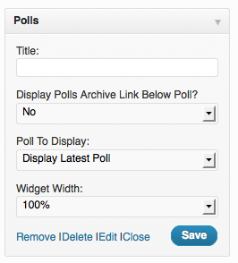
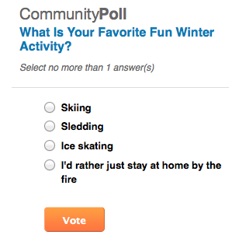
Polls Widget
Used to create Polls. You can display the latest poll or chose it by name
Front-end View
Back-end View

Slide 14
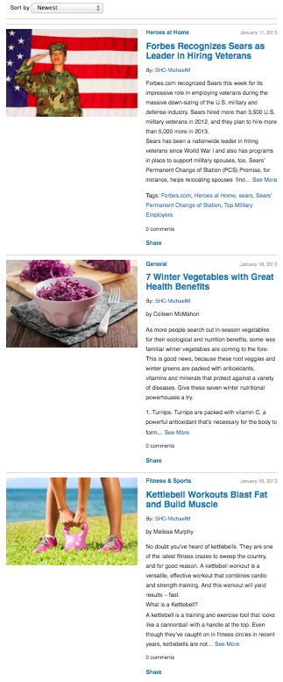
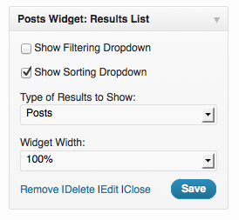
Post Widget Results List
List of Blogs/Guides/Q&As. Examples: Search results, Blog Posts and etc.
Front-end View
Back-end View

Slide 15
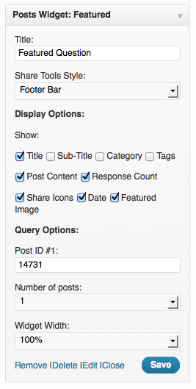
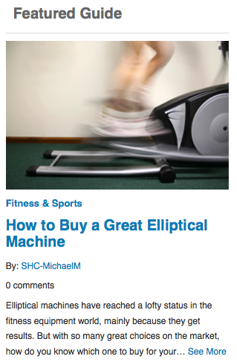
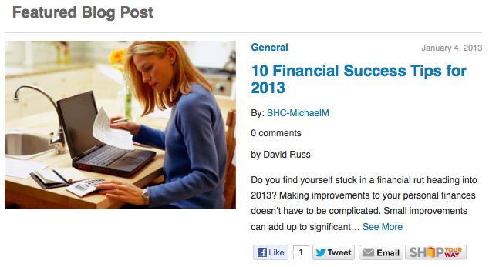
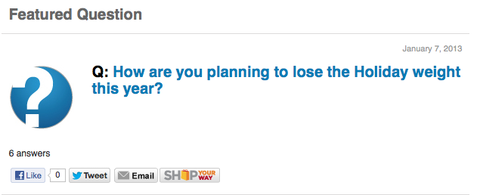
Post Widget Featured
Used to create Featured Q&A/Blog/Guides
33% width
66% width
Front-end View
Back-end View

Slide 16
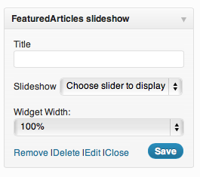
Featured Articles Slideshow, Product Widget and many more to come…

Slide 17

THANK YOU!

