Slide 1

Virtual Mirror for Fashion Retailing
Computer Science 715
Andre Diekwisch
Shawn Jiang
Yoonyong Shin
Brent Whiteley

Slide 2

Agenda
Overview & Motivation - Shawn Jiang
Related Work (Literature review) – Yoonyong Shin
Problem & Solution Outline – Andre Diekwisch
Conclusion & Future work - Brent Whiteley
Q & A

Slide 3
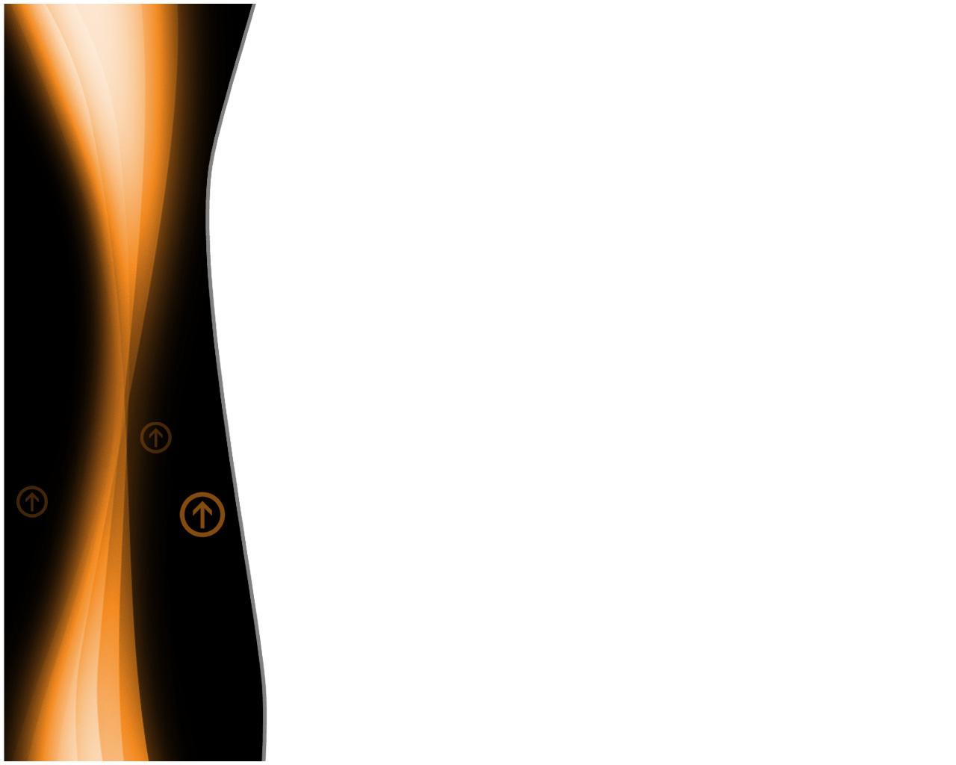
Overview
The Future of Shopping
Why Kinect?
Hardware
SDKs
Raw sensor stream
Skeletal tracking
Advanced audio capabilities

Slide 4
Problem Definition
Kinect data is noisy and captured data might be incomplete or interfered
Kinect skeleton tracking algorithm does not work well with complex poses
Kinect motion capturing does not cope well with sudden movements
Occlusion (degree of freedom is small)

Slide 5
Motivation
Commercial interests
Retailers and Customers have flexible choices
Users can interact with Kinect more naturally
Kinect can tolerate more complex inputs

Slide 6

Related Work
“A Bayesian Framework for Human Body Pose Tracking from Depth Image Sequences.” by Zhu, Youding and Fujimura, Kikuo. (2010)
“Suma, E.A., Lange, B., Rizzo, A., Krum, D.M. and Bolas, M.. FAAST: The Flexible Action and Articulated Skeleton Toolkit, Virtual Reality Conference (VR), 2011 IEEE, pages 247 -248, march 2011”

Slide 7
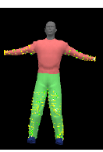
Iterative Closest Point for Human Body Pose
Iterative Closest Point (ICP) approach
Camera type : Swiss Ranger SR-3000
Characteristic
High accuracy due to dense correspondence
High rate of failure when body parts get close
Majority of time, this approach cannot recover from tracking failure
Approach
Finding a point of joint by minimizing difference between clustered depth point.
Iteratively revise the transformation
Simple and fast
Zhu, Youding and Fujimura, Kikuo. (2010)

Slide 8
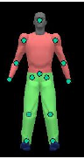
Key point based method for Human Body Pose
Key point based method
Camera type : Swiss Ranger SR-3000
Characteristic
Robust and can recover from failure
Accuracy depends solely on the image-based localisation accuracy of key-point (in other word not accurate enough
Approach
reconstruct poses from anatomical landmarks detected and tracked from depth image analysis
Zhu, Youding and Fujimura, Kikuo. (2010)

Slide 9

Bayesian framework for Human Body Pose
Bayesian framework
Developed by author that combining both key point and ICP algorithms
Characteristic
Robust and can recover from failure
Accurate
Slow speed
Approach
Integration of both key-point and ICP through error evaluation
Zhu, Youding and Fujimura, Kikuo. (2010)

Slide 10
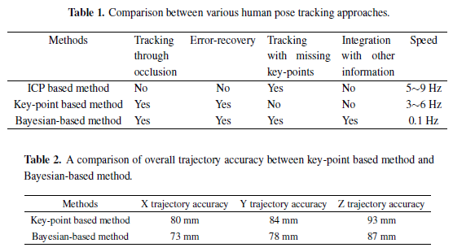
Human Body Pose Comparison
Zhu, Youding and Fujimura, Kikuo. (2010)

Slide 11
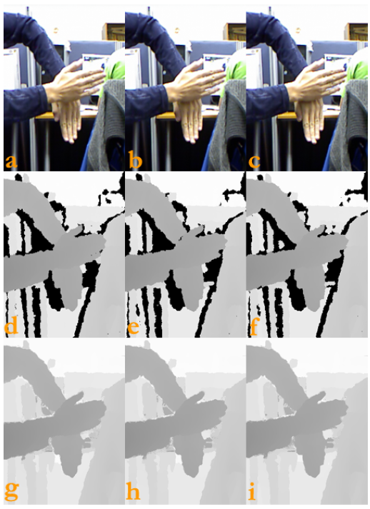
Temporal Filtering For Occlusions by Kinect
Overview
Camera type
Kinect
Problem
Missing data in depth image due to occlusion.
Solution
fill the occlusion depth data with estimation of data from neighbour
(use filter such as gauss or median function)

Slide 12

Solution
use existing Kinect tracking algorithm
combine weighted data of two individually tracked skeletons (two Kinects)
in respect of angle
in respect of occlusion
prevent unrealistic movement by applying physical constraints
predict/approximate positions for occluded body parts
use other/own tracking algorithm to improve results

Slide 13
Possible Limitations
interference between Kinects
false skeleton data when both Kinects are wrong

Slide 14
Subtasks
evaluate OpenKinect SDK
evaluate Microsoft SDK
determine relevant physical body constraints
create algorithm to recognize occlusion
further literature research

Slide 15
Future work
Virtual surgery
Surgeons do not have to attend physically.
Better game experience with better user experience
Virtual mirrors through online shopping mall
New socialising solution

Slide 16
References
Zhu, Youding and Fujimura, Kikuo. A Bayesian Framework for Human Body Pose Tracking from Depth Image Sequences. Sensors, 10(5):5280?293, 2010.
http://www.mdpi.com/1424-8220/10/5/5280/
?doi:10.3390/s100505280
Suma, E.A., Lange, B., Rizzo, A., Krum, D.M. and Bolas, M.. FAAST: The Flexible Action and Articulated Skeleton Toolkit, Virtual Reality Conference (VR), 2011 IEEE, pages 247 -248, march 2011

