Slide 1
Flight social Connect
CASE study
Notes:
Scenatio explanatiion

Slide 2
Contents
Problem Statement
Solution Approach
Revenue Model
Conclusion

Slide 3
Problem
First time travel
Real time experience
Ask experts
Hassle free service
Notes:
Talks about
Problems when first time traveling
Procedure
Where to get what?
Looking for exact help

Slide 4
Can we do better? What we will get?
Chat service
Online/offline mode
Expert discovery
Payment Transaction
Notes:
Talk about
Internal chat service
Accept / reject the request
Ask the real time experts they will guide

Slide 5

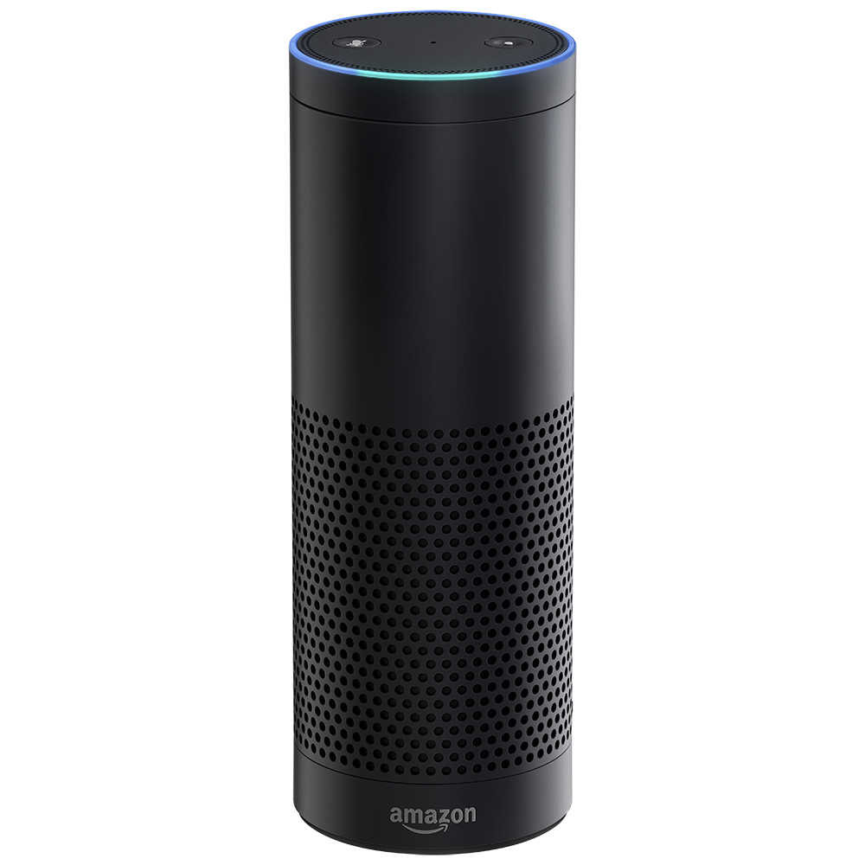

Cognitive thinking
Notes:
Talk about different solutions
Alexa
Google home

Slide 6




Revenue Model
Notes:
User to User
User to Air Asia

Slide 7

Thank You

