Slide 1

Are you ready for…

Slide 2
BLOGGING 101
Michael Okereke

Slide 3





Michael Okereke
MICHAEL OKEREKE is a young Nigerian developer, writer and profiler who has passion for technology and computers. He writes for The Living Tribute Magazine and lives in Owerri with his dog.
Developer, www.geiffth.org Developer, www.thelivingtribute.org Writer, www.brittlepaper.com
Editor, www.storried.com
fb.me/stardmich
bit.ly/stardmich
stardmich.github.io

Slide 4
SCHEME
….
Introduction to Blogging
Starting a Blog in 6 steps
Reasons why you should start a Blog
Reasons why you should not start a Blog
How to Monetize your Blog
How to Become a Successful Blogger
Additional Information
Resources

Slide 5
INTRODUCTION TO BLOGGING
….
What is a Blog?
Blog not a Website?
History of Blogging.
Blogging Today.
The Future of Blogging

Slide 6
….
WHAT IS A BLOG?
A blog is a webpage in which items (mainly in text format) are posted on a regular basis and displayed in reverse chronological order. The term blog is a shortened form of weblog or web log. Authoring a blog, maintaining a blog or adding an article to an existing blog is called “blogging”. A video blog is called a vlog, and an audio blog is called a podcast.
The purpose of writing blogs could be promotion of a product or service, awareness about social issues, information sharing about any subject or purely passion for writing. ... Company Blogs: Many companies manage a blog and share about their business, products or services.

Slide 7
….
BLOG NOT A WEBSITE?
As the saying goes: ‘All apples are fruits but not all fruits are apples.’
Similarly, ‘All blogs are websites but not all websites are blogs.’ The basic difference between a blog and a website is theoretically the difference in how data is being presented – the format. A website is a collection of related web pages, including multimedia content, typically identified with a common domain name, and published on at least one web server.
A Blog provides a Commenting System
A Blog offers a subscription system to send free email newsletters to readers.
Articles inside a Blog are organized through categories and tags.
Articles in a Blog appear in reverse-chronological order, latest to oldest.
A Blog is managed by an individual author or a team of authors often called the editorial board.

Slide 8
….
HISTORY OF BLOGGING
The History of Blogging dates back to 1994... It's generally recognized that the first blog was Links.net, created by Justin Hall, while he was a Swarthmore College student in 1994. Of course, at that time they weren't called blogs, and he just referred to it as his personal homepage. It wasn't until 1997 that the term “weblog” was coined. “Weblog” was shortened to “blog” in 1999 by programmer Peter Merholz. It’s not until five years later that Merriam-Webster declares the word their word of the year.
The original blogs were updated manually, often linked from a central home page or archive. This wasn’t very efficient, but unless you were a programmer who could create your own custom blogging platform, there weren’t any other options to begin with. During these early years, a few different “blogging” platforms cropped up. LiveJournal is probably the most recognizable of the early sites.
And then, in 23 August 1999, the platform that later became Blogger was started by Evan Williams and Meg Hourihan at Pyra Labs. Blogger is largely responsible for bringing blogging to the mainstream. In 1999, according to a list compiled by Jesse James Garrett, there were 23 blogs on the internet. By the middle of 2006, there were about 50 million blogs.

Slide 9
….
HISTORY OF BLOGGING
A couple of major blogging platforms got their start in the early 2000s. Version 1.0 of Movable Type was released in September of 2001.
WordPress was started in 2003, though parts of its development date back to 2001. TypePad was also released in 2003, based on Movable Type.
Some peripheral services to the blogosphere also started in the early 2000s. Technorati, the first major blog search engine, was launched in 2002. Audioblogger, the first major podcasting service, was founded in 2003. The first video blogs started in 2004, more than a year before YouTube was founded.
Also launched in 2003 was the AdSense advertising platform, which was the first ad network to match ads to the content on a blog. AdSense also made it possible for bloggers without huge platforms to start making money from when they first started blogging (though payments to low-traffic blogs weren’t very large).

Slide 10
….
BLOGGING TODAY
Blogs have become an integral part of online culture.. Blogging has evolved greatly, and is considered as one way to financial enrichment, in our society today. Looking at the likes of Linda Ikeji, Seun and Makinde Azeez, you’d agree that this might be true.

Slide 11
….
THE FUTURE OF BLOGGING
With new services like Quora coming onto the market, there’s the possibility that the blogosphere will shrink, and more people will turn to sites like these to get information. But services like Quora also provide valuable tools for bloggers, as they give insight into what people really want to know about a topic.
Blogs are unlikely to go anywhere in the foreseeable future. But there’s a lot of room for growth and innovation in method in which their content is found, delivered, and accessed.

Slide 12
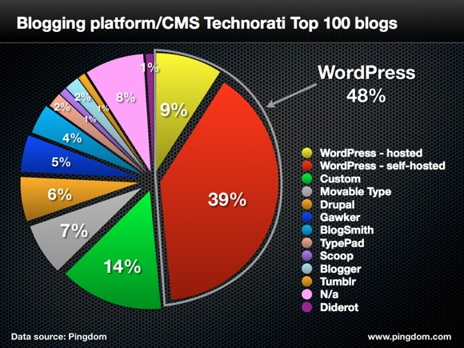

TOP BLOG HOSTS
Diagram by Michael Okereke

Slide 13
STARTING A BLOG IN 6 STEPS
….
Decide what to blog about
Choose a blogging platform, domain name, and hosting option.
Design your blog using a simple theme.
Modify your blog to get your desired look and feel.
Select the best plugins for your blog.
Write compelling and engaging contents.

Slide 14
REASONS WHY YOU SHOULD START A BLOG
….
Attract an Audience
Establish Authority
Build Rapport and Engagement
Create Opportunities
Organize Your Thoughts and Learn
Tell Your Story
Meet New People
Stand Out

Slide 15
REASONS WHY YOU SHOULD NOT START A BLOG
….
Do not blog to make a profit, Blog to make a difference.
No passion? Don’t do it!
Money.
Notoriety.
Defamation.
Fraud.

Slide 16
HOW TO MONETIZE YOUR BLOG
….
Monetize with CPC or CPM Ads
Sell Private Ads
Affiliate Marketting
Sell Digital Products
Sell Memberships
Placement of Adverts.
Promoting media files and products.
Sale of Media files and products.
Offering Service.
Google Adsense

Slide 17
One of the most common ways bloggers make money is through placing ads on their site. There are two popular types of ads: CPC/PPC Ads: Cost per click (also called pay per click) ads are usually banners that you place in your content or sidebar. Each time a reader clicks on the ad, you are paid for that click. CPM Ads: CPM Ads, or “cost per 1,000 impressions,” are ads that pay you a fixed amount of money based on how many people view your ad.

Slide 18
HOW TO BECOME A SUCCESSFUL BLOGGER
….
Be Passionate.
Keep Learning.
Engage your Audience.
Invest.
Take Risks.

Slide 19
ADDITIONAL INFORMATION
….

Slide 20
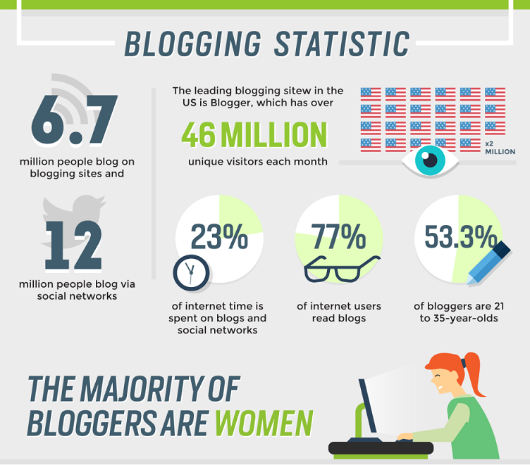

Slide 21
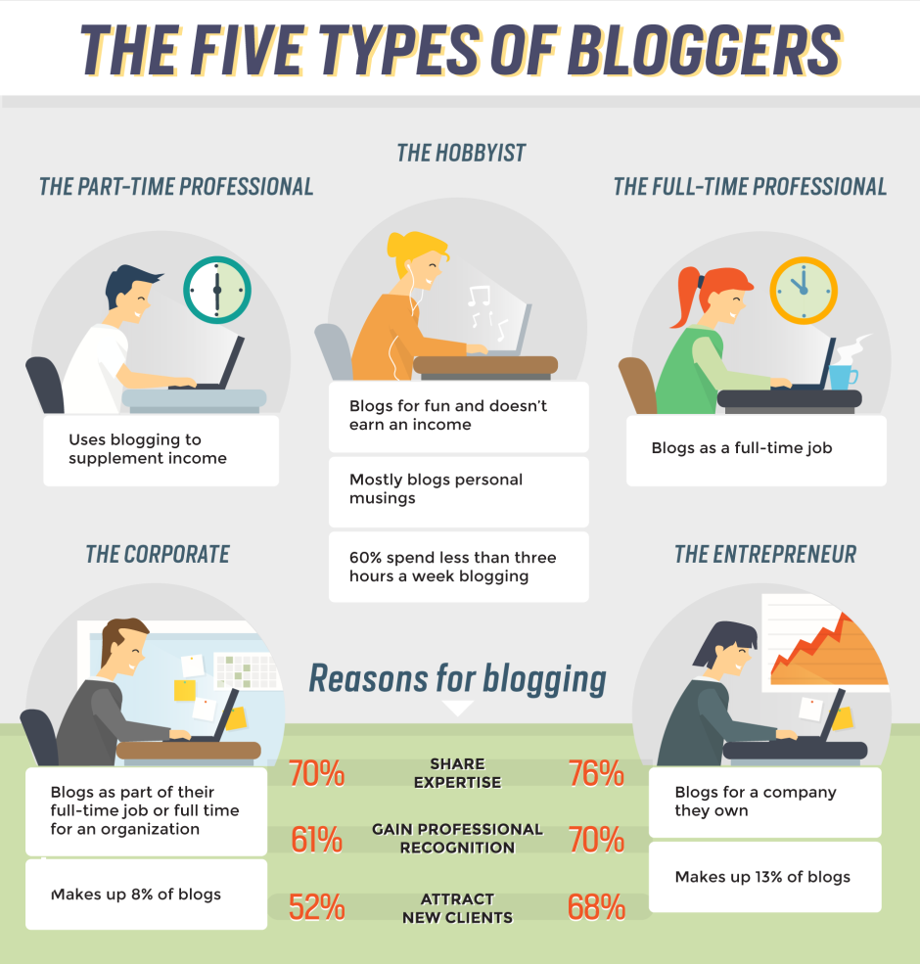

Slide 22
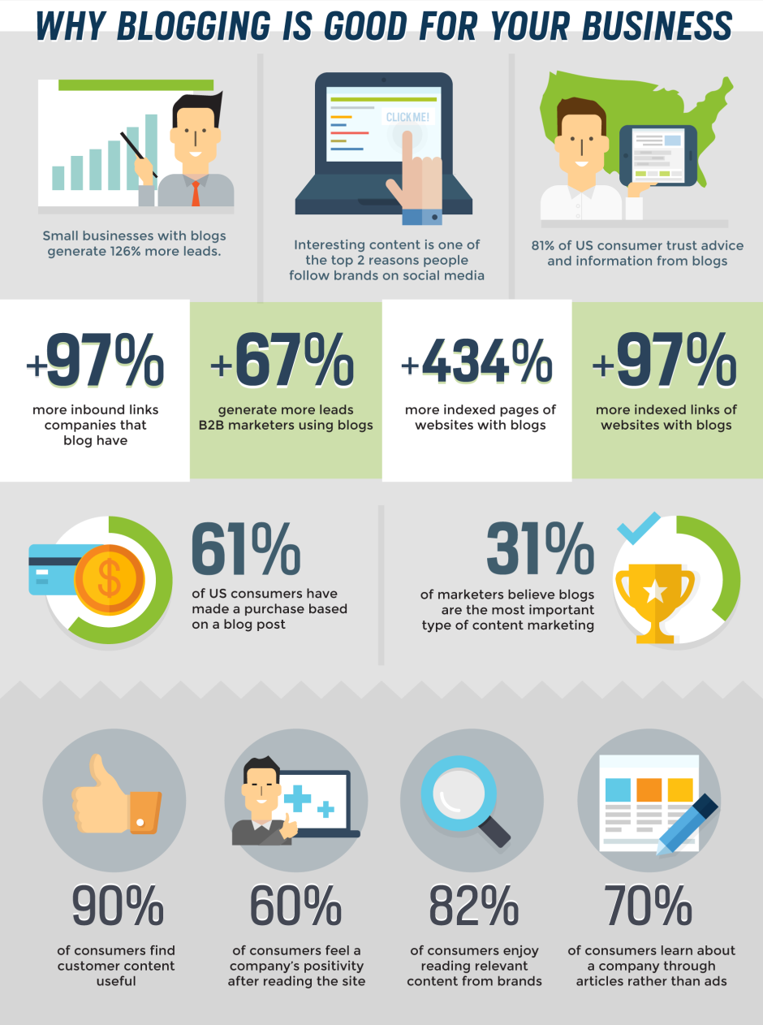

Slide 23
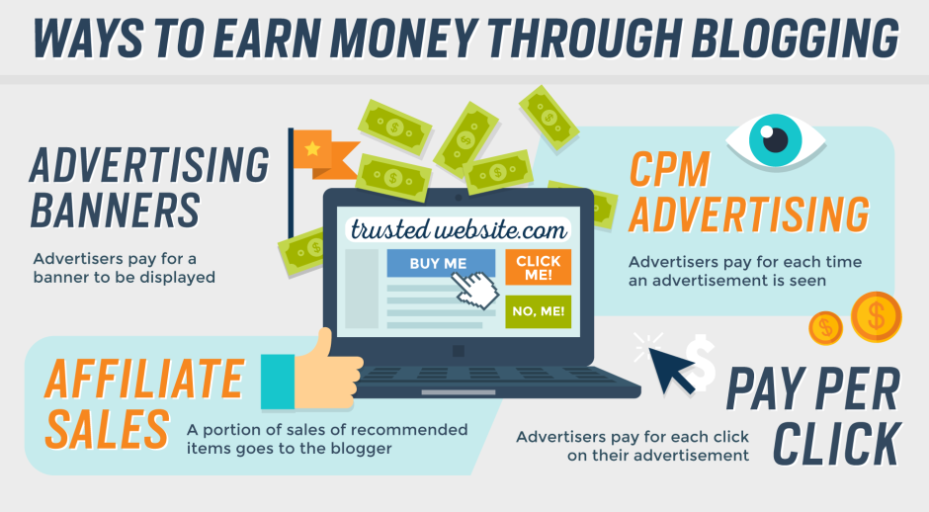

Slide 24
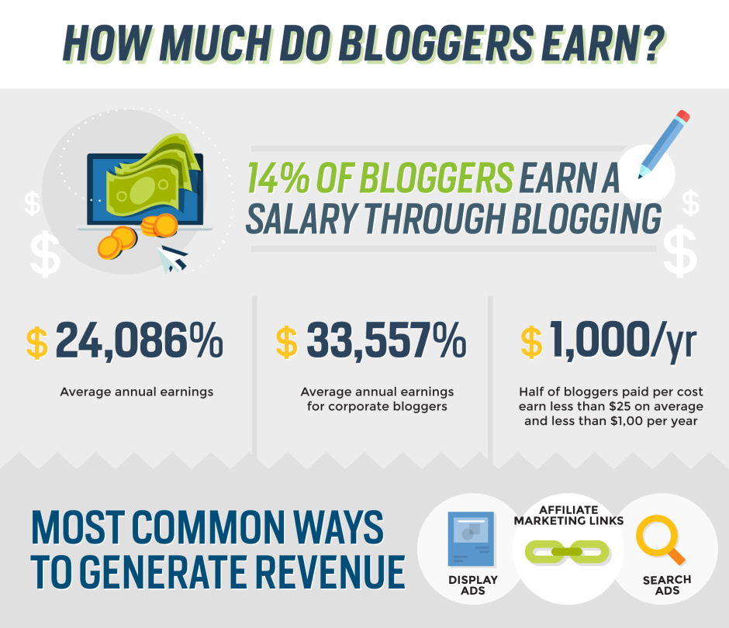

Slide 25
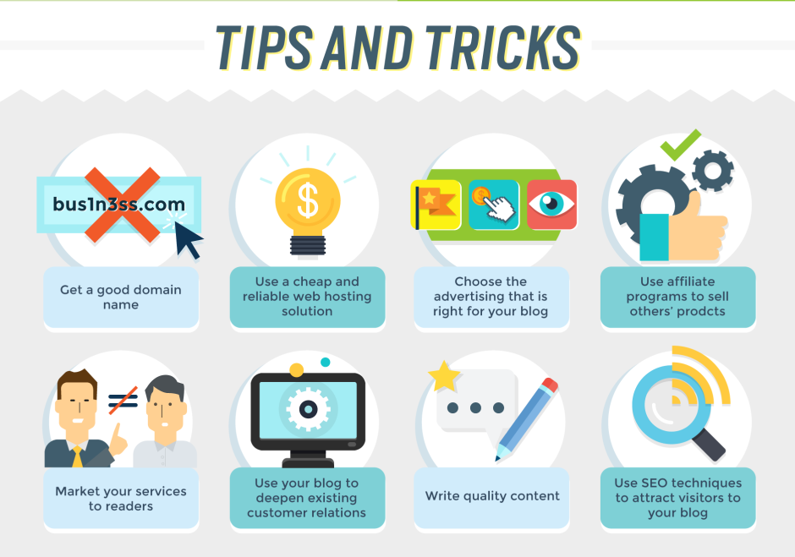
Click here, and open hyperlink in browser
TOP TEN HIGHEST EARNING BLOGS

Slide 26
RESOURCES
….
Download this presentation: bit.ly/blogging101
Join the Eastern Bloggers Facebook Community: www.bit.ly/enbnetwork
More Information about Blogging: bit.ly/moreinfoblog
Follow African Hub Magazine on Twitter: bit.ly/afrihubmag
Download video tutorials: bit.ly/stardgit

Slide 27
Money. You should not start a blog to make money. We need to get that out of the way first. If your primary objective is to replace your full-time income from blogging, forget about it. It doesn’t work that way. Do you think that Jimi Hendrix picked up his first guitar so he could “supplement his income”? No, he didn’t. Rather, he did it for the love of it, for the joy and fulfillment he received, and the income came thereafter, much later actually.
Notoriety. Don’t plan on getting “Internet famous” right away. Not every site grows as fast as ours did, but that’s totally OK. The truth is that we kind of got lucky. We got a great domain name, we cobbled together a logo and site design that people really liked, we write fairly well, and our content connects with people in a unique way. We didn’t start this site to become “famous” though. That’d be ridiculous. Our notoriety and quick rise to “fame” came as a surprise to us, and was a result of a little luck and a lot of hard, passionate work.
Traffic. Not all traffic is good.
3 REASONS WHY YOU SHOULD NOT START A BLOG

