Slide 1
Generations of Test Automation
COMP551 Week 3
Dr Mark Utting
marku@cs.waikato.ac.nz

Slide 2
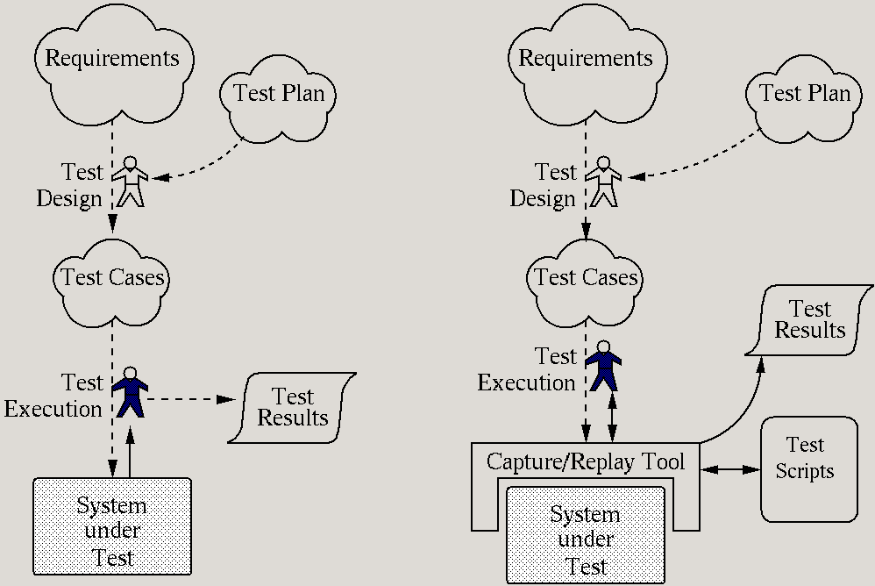
1. Manual Testing
+ easy & cheap to start
+ flexible testing
expensive every execution
no auto regression testing
ad-hoc coverage
no coverage measurement

Slide 3
2. Capture-Replay Testing
+ flexible testing
expensive first execution
+ auto regression testing
- fragile tests break easily
ad-hoc coverage
no coverage measurement

Slide 4
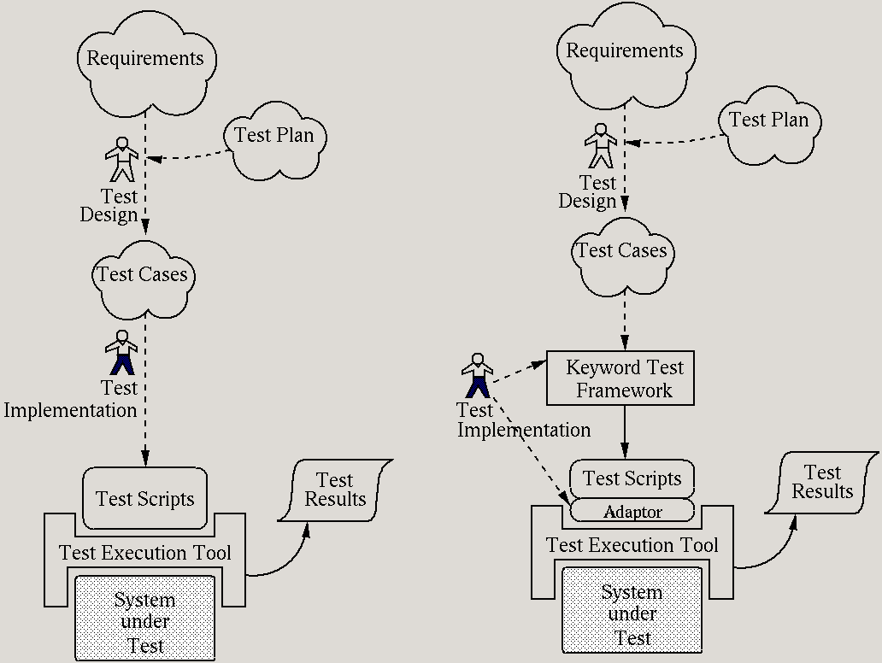
3. Script-Based Testing
+/- test impl. = programming
+ automatic execution
+ auto regression testing
fragile tests break easily?
(depends on abstraction)
ad-hoc coverage
no coverage measurement

Slide 5
4. Keyword-Driven Testing
+ abstract tests
+ automatic execution
+ auto regression testing
robust tests
ad-hoc coverage
no coverage measurement

Slide 6
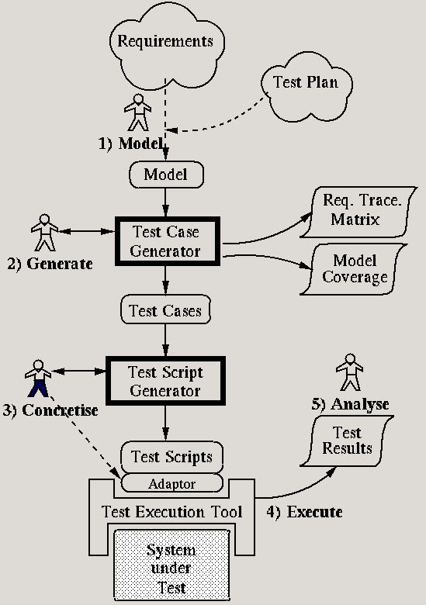
5. Model-Based
Testing
+ abstract tests
+ automatic execution
+ auto regression testing
+ auto design of tests
+ systematic coverage
+ measure coverage of model and requirements
- modelling overhead

