Slide 1
Indian Cities And What Different People Could Get From Them Naman Rastogi IBM Applied Data Science Capstone Project

Slide 2
Business Problem
India is a developing country with a very diverse group of people, and how different categories of people tend to take decisions concerning various situations from the decision of finding a good place/city to live pertaining to their needs, to the decision of how a particular city might affect a certain business or a company, become very crucial in transforming the lives of people and the overall growth of country as a whole.
Different categories of people like normal people who might want to transit to a different city based on how the other city is similar to another, which business could be more profitable in a particular city or how the city's current state might affect one's decision or business, view the city or a region with different perspectives for obvious reasons.
So, how these people could get what they want from these cities, this is what we investigate.

Slide 3
Data
The dataset required for this project and analysis has been gathered from Kaggle and it is curated by merging the census 2011 of Indian Cities with Population more than 1 Lac and City wise number of Graduates from the Census 2011, to create a visualization of where the future cities of India stands today. It lists the top 500 Indian cities.

Slide 4
Methodology
Getting the relevant data and preparing it for analysis.
Structuring the data based on top 5 venue category for each city.
Running the K-means clustering algorithm on our prepared data to see the patterns of similarity or dissimilarity between the cities and getting other insights.

Slide 5
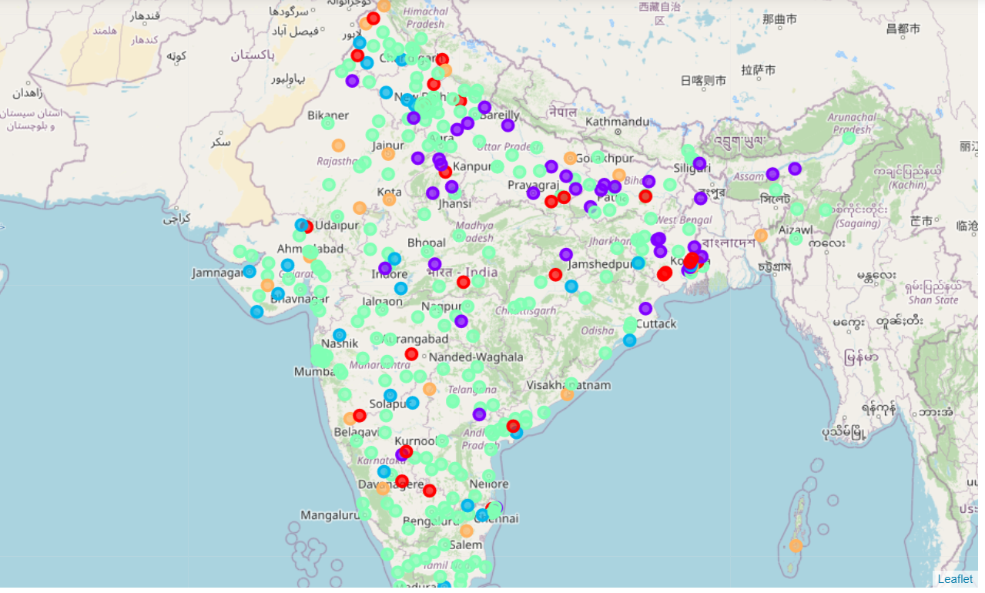
Results
6 Cluster were generated as shown on the map, revealing important insights of where actually Indian cities stand in certain factors and how people concerned with such factors could be benefitted.

Slide 6
Conclusion
Cluster 4 seems to be more promising when it comes to considering people who want to transit to a city for good standard of living, and attraction for job seekers. Top 10 or 20 of them are also major corporate hubs.
Other clusters have huge scope of development and potential centres to attract different businesses.

