Slide 1
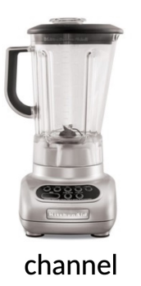
source
correct sentence
wrong sentence
decode

