Slide 1
Track A:
Card & Identity Fraud
Group 1: Chen Jian, Yuan Ruotian, Zhang Xiaohan, Zhang Yang
Notes:
Good morning. We're Track A — Card and Identity Fraud. I'm Zhang Yang, and our team is presenting for the card issuer.

Slide 2
Framing
Stakeholder
Main question
Issuer / cardholder’s bank
Can the issuer use card, address, email and match-related evidence available at transaction time to achieve ≥25% fraud recall while keeping false positives acceptable?
Notes:
Our stakeholder is the issuer — the cardholder's bank. The question we set out to answer: using the card, address, email, and identity-match evidence available at the moment of transaction, can the issuer catch at least 25% of fraud while keeping false positives low enough that legitimate customers aren't constantly interrupted?

Slide 3
Issuer Decision
Should the issuer approve normally or send the transaction for step-up authentication/review?
Notes:
That target maps to one operational decision: for every transaction, should the issuer approve it normally, or send it for step-up authentication — an extra verification step, like a one-time code — or manual review?

Slide 4
Why this matters?
01
02
03
Detects more CNP fraud to reduce fraud losses and chargebacks.
Reduces false positives and customer friction
Improves transparency and resilience
The goal is not only higher fraud detection, but a better balance between fraud loss, false positives and customer experience.
Notes:
Three things matter here to the issuer: catching more card-not-present fraud, cutting false positives so genuine customers aren't blocked, and staying transparent enough to explain a decision when challenged. So the goal isn't just "detect more frauds" — it's the right balance between fraud loss and customer friction. I'll hand it over to Chen Jian to walk through what we found in the data.

Slide 5
Findings That Shaped Our Features
Dataset used: first 70% in time-ascending order
Missing match evidence matters
Data finding: Missing match information (or even match information) was sometimes more strongly associated with fraud than a simple mismatch.
Possible explanation: Some transaction flows may provide fewer verification signals, while fraudsters can also submit information that appears internally consistent.
What it changed: We treated missing, matched and failed checks separately instead of assuming “mismatch = fraud.”
Notes:
Before we get into the models, I want to walk you through three findings from our exploratory analysis using the first 70% of transactions in time order
The first is: missing match evidence mattered more than we expected. When match information simply wasn't there, that was sometimes a stronger fraud signal than a mismatch. Our theory is that fraudsters can submit information that looks internally consistent, while some legitimate transaction flows just don't generate that verification data at all. So instead of assuming 'mismatch equals fraud,' we treated missing, matched, and failed checks as three separate signals
Our second finding pushed back on an even more common assumption.

Slide 6
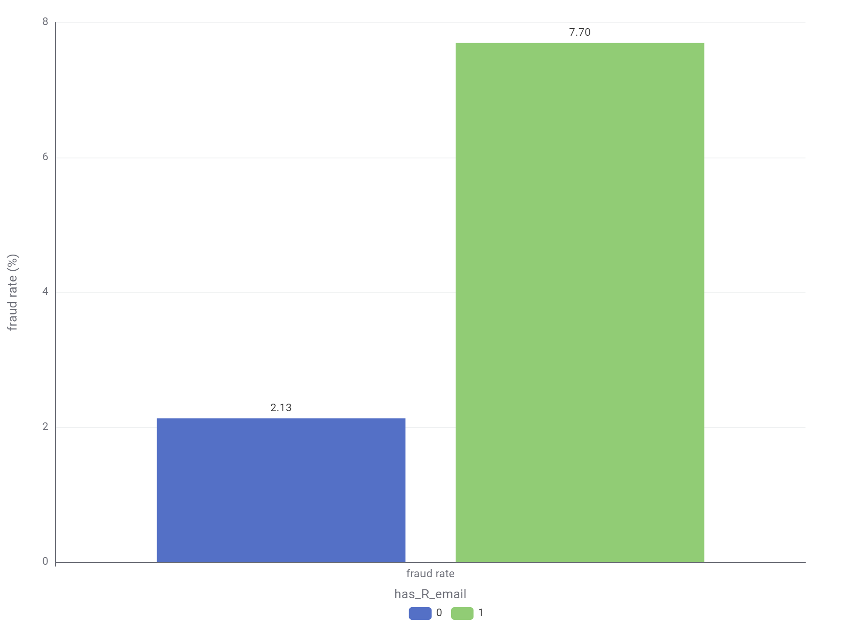
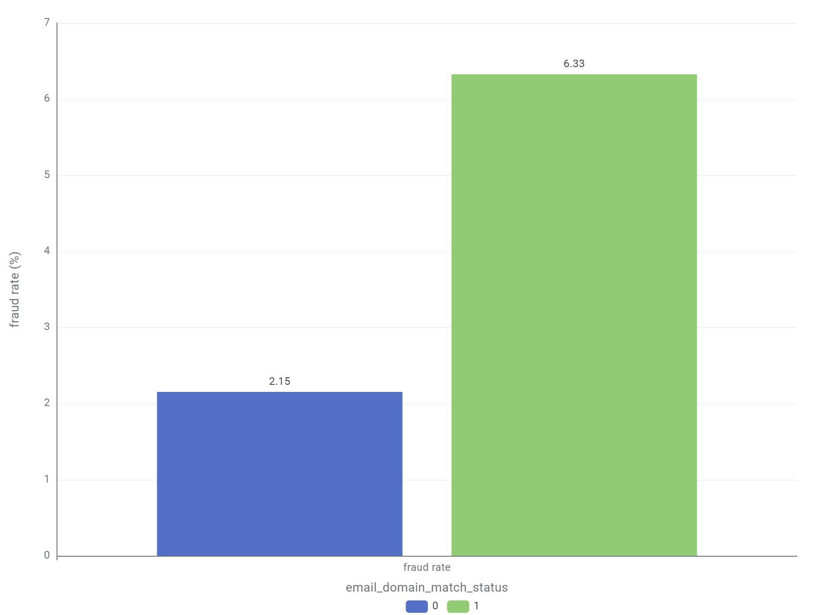
Email consistency was not always safer
Data finding: Transactions with recipient-email information, including matching domains, showed higher fraud rates.
Possible explanation: Recipient-email fields may appear in transaction contexts involving another account, while matching domains can still be controlled by the same fraudster.
What it changed: We kept matched, different and missing email relationships as separate signals instead of treating a match as automatically safe.
Notes:
We assumed a matching email meant safety. But the data disagreed that. The top chart compares fraud rates with and without a recipient email present — having one actually correlates with higher fraud. The bottom chart compares matching versus non-matching email domains — again, a match came with a fraud rate nearly three times higher. Same logic as before: consistency can be faked. So a match alone was never treated as proof of safety.
And the same pattern showed up a third time.

Slide 7
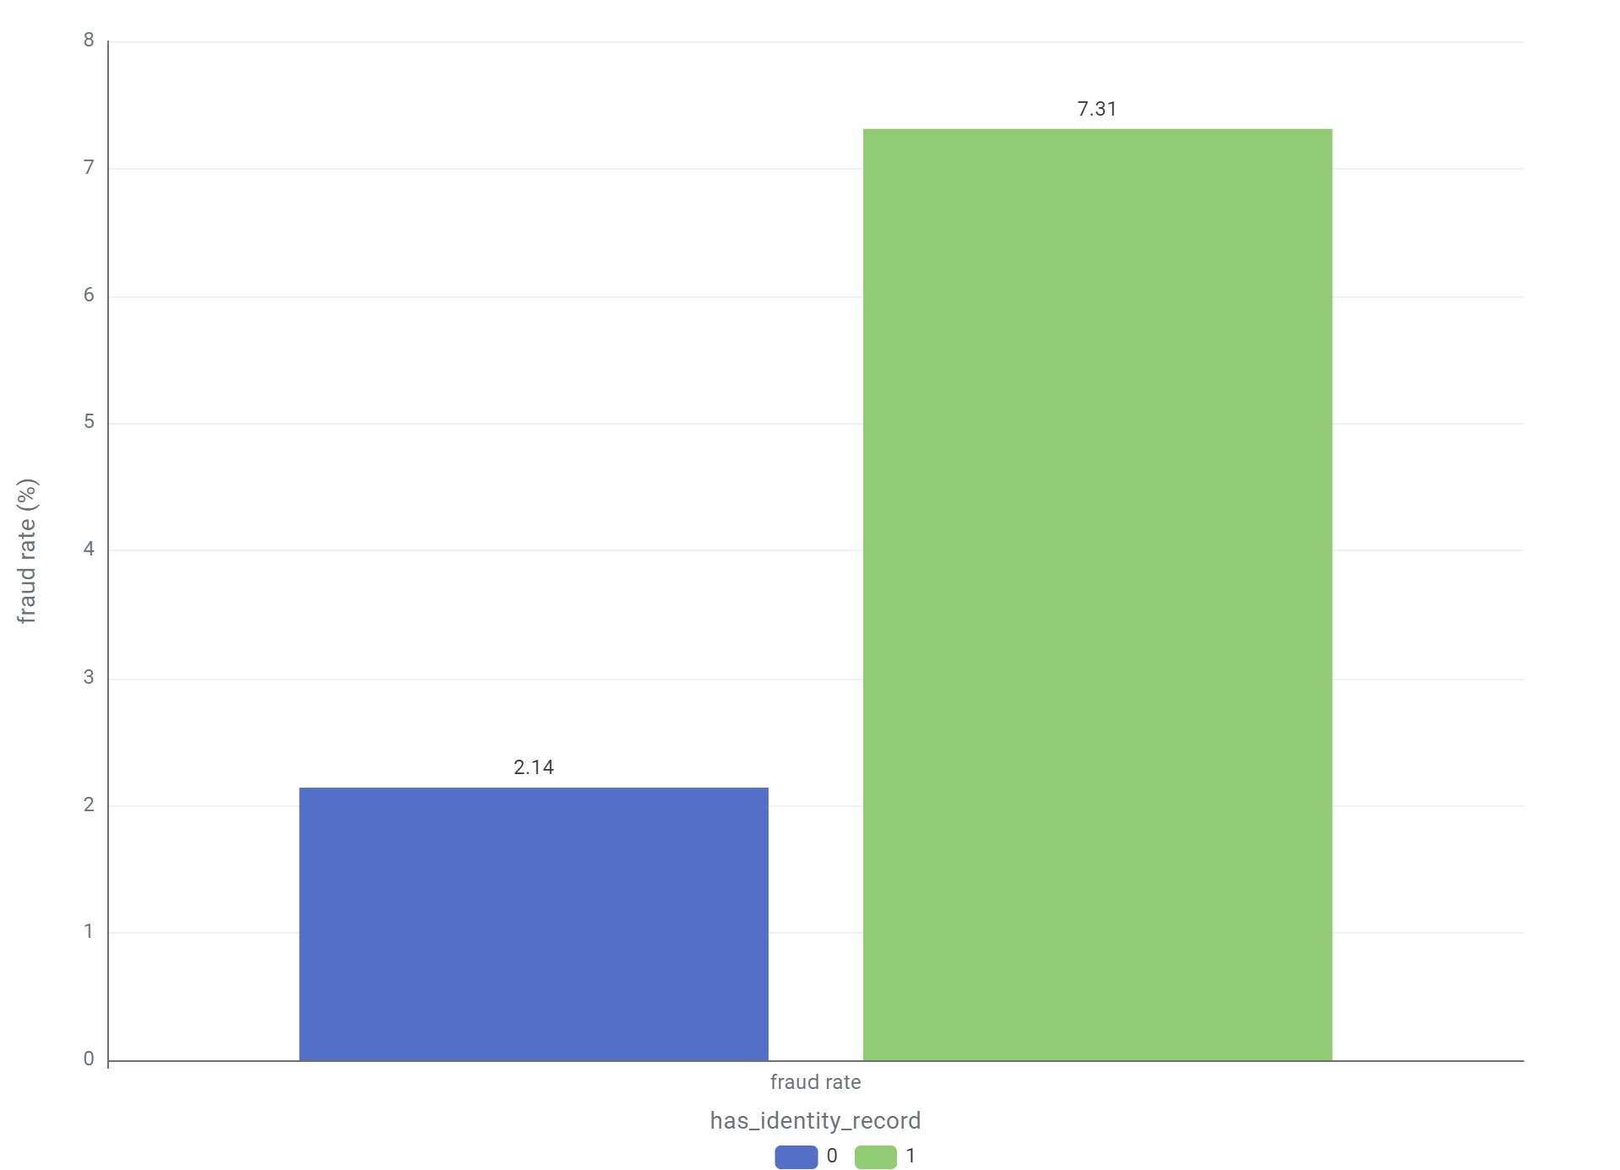
More identity data did not mean lower risk
Data finding: Transactions with identity or device information available showed higher fraud rates than transactions without it.
Possible explanation: These fields may be more common in digitally intensive or higher-risk transaction flows, where device reuse, account takeover or automated activity can occur.
What it changed: We used identity-data presence as contextual evidence, not as proof that a transaction was legitimate or fraudulent.
Notes:
Transactions with identity or device data present had a fraud rate over three times higher than those without it. Likely because these fields show up more in digitally intensive flows — where device reuse or account takeover happens. So we used identity-data presence as context, never as proof a transaction was safe.
With these insights guiding our feature choices, we split the modeling work across four pipelines.

Slide 8
Our Four Pipelines
Logistic Regression Chen Jian | M-pattern summary/related features
XGBoost Tree Yuan Ruotian | Card–address/email relationship
Rule-based points score Zhang Xiaohan | Transparent risk score
Isolation Forest Zhang Yang | Unusual transaction detection
Notes:
We built a logistic regression on the M-pattern summary features. And we also built an XGBoost tree around card-address-email relationships. A transparent rule-based points score is also created. And Isolation Forest to flag unusual transactions.
Let's zoom into the first of these.

Slide 9
Pipeline 1 - Logistic Regression
Test whether summary patterns from the M-fields can support fraud detection in a simple, explainable model.
Purpose
Contribution
Meaning for the issuer
Separates missing and failed match evidence
Shows the direction of each risk signal
Provides an interpretable comparison with more complex models
Test whether summary patterns from the M-fields can support fraud detection in a simple, explainable model.
Useful as supporting evidence, but not strong enough to drive decisions alone.
Notes:
This pipeline tested whether the summary patterns from the M-fields could support fraud detection in a simple, explainable model. it separates missing from failed match evidence, shows the direction of each risk signal, and gives us an interpretable way to check whether our reasoning about these features actually holds up. For the issuer, that means it's useful supporting evidence — but on its own, it's not strong enough to drive decisions. That's where the other three pipelines come in.

Slide 10

Pipeline 2 – XGBoost Tree
Transforms card–address and card–email relationships into frequency, novelty, breadth, and amount-behaviour signals.
What it looks at | What it learns
Frequency: How often has the relationship appeared? Novelty: Is the relationship new or unseen? Breadth: How many entities are connected? | Whether a card relationship is established, newly activated, rare, unusually broad, or amount-inconsistent.

Slide 11
Pipeline 2 Contribution: Relationship-Level Evidence
Problem
Raw fields are isolated Card / Address / Email tell us who, but not whether the combination is normal.
Contribution
Pipeline 2 adds relationship context
Frequency Common or rare?
Novelty Established or new?
Breadth Normal or unusually connected?
Action decision
Approve normally ↓ Step-up authentication ↓ Manual review
This helps the issuer catch suspicious CNP fraud patterns while avoiding unnecessary friction for legitimate customers.

Slide 12
Pipeline 3 - Rule-based risk score points
4 Risk Points
1.Converts four fraud signals into a transparent, rule-based points score.
2.Produces clear Low, Medium and High risk tiers for operational review.
3.Unlike machine-learning models, every score can be directly explained and audited.
Amount
Card category
Evidence
M-pattern
Combo Refinement
Use score-combination patterns that historically showed unusually high fraud risk.
Final Review Decision
Point Rules
Flag：
Score ≥ 3.0: Directly marked as requiring review. 2≤ Score < 3.0:Only reviewed when combo_review_flag = 1. Other cases:Not marked by this pipeline.
Convert each fraud signal into 0/1/2 points using Rule Engine.
Total Risk Score
Add the four points to create one transparent risk score.

Slide 13
Pipeline Contribution
Rule-based points score
Converts key fraud signals into a clear, auditable scoring system for issuer review.
Risk tiering
level | Fraud rate
High | 12.1%
Medium | 3.7%
Low | 2.6%

Slide 14
Pipeline 4 - Isolation Forest
What it does:
Identifies transactions with unusual combinations of amount, card, address, email, missingness, M-pattern signals, etc.
Why it is different:
It does not learn directly from fraud labels. Instead, it looks for transactions that differ strongly from normal transaction patterns.
Contribution to the system:
It can detect suspicious cases that supervised models may miss because they do not resemble previously labelled fraud.
Limitations
Unusual does not always mean fraudulent, so its threshold must be controlled to avoid excessive false positives.
Notes:
My pipeline is the fourth: an Isolation Forest. It's different from the other three because it doesn't learn from fraud labels at all — it just looks for transactions whose combination of amount, card, address, email, and match signals looks unlike normal traffic. That matters because it can catch cases the supervised models miss, since they don't resemble any fraud we've already labelled. The trade-off: unusual isn't always fraudulent, so we had to control its threshold carefully to avoid flooding the issuer with false positives.

Slide 15
Decision Layer
How the pipelines were combined
Final flow
Why this approach
Each pipeline produced one risk score:
M-pattern model score
Relationship model probability
Rule-based risk score
Isolation Forest anomaly score
These four outputs were combined using a Logistic Regression stacking model.
Four pipeline scores
combined fraud probability
↓
selected threshold approve normally or send for step-up
↓
authentication/review
Gives more weight to the strongest signals
Retains supporting evidence from the other pipelines
Produces one final and consistent issuer decision
Notes:
All four pipelines feed one score each — the M-pattern model, the relationship model, the rule-based score, and my anomaly score. We combined them with a logistic regression stacking layer, which weights the strongest signals while still keeping the others as supporting evidence. The output is one consistent number the issuer can act on: approve normally, or send for step-up authentication and review.

Slide 16
Model Results
 | Recall | False-positive rate | Precision | ROC-AUC
Baseline (XGBoost Tree on raw columns) | 25.06% | 0.33% | 73.03% | 0.858
Logistic Regression | 22.24% | 6.32% | 11.19% | 0.646
GBT/XGBoost Tree | 62.44% | 7.12% | 23.89% | 0.776
Rule-based points score | 27.48 % | 7.16% | 12.09% | 0.602
H2O Isolation Forest | 28.96% | 7.70% | 11.87% | 0.791
Decision Layer | 36.45% | 1.04% | 55.59% | 0.892
Notes:
Here's what that combined system delivers against our baseline — a simple XGBoost model on the raw columns. The baseline caught about 25% of fraud at 73% precision. Our combined decision layer catches 39% of fraud, with a false-positive rate of just 1.2%, and an AUC of 0.892 — the best separation of any single component.

Slide 17
What This Means for the Issuer
A more practical fraud-screening trade-off
36.45% fraud recall The system detects more than the project target of 25% of confirmed fraud.
1.04% false-positive rate Only a small proportion of legitimate transactions would be unnecessarily challenged or reviewed.
0.892 AUC The combined score separates higher-risk and lower-risk transactions effectively.
Compared with using XGBoost alone, the decision layer catches fewer fraud cases but reduces false positives substantially, making it more suitable for transaction-time intervention.
Notes:
In plain terms: we exceed the 25% recall target at nearly 39%, while keeping false positives to about 1 in 80 legitimate transactions. Compared to running XGBoost alone, we catch somewhat less fraud, but we cut false positives significantly — which matters, because every false positive is a real customer getting stopped at checkout.

Slide 18
Recommendation
Use the combined system for step-up decisions
We recommend using the final decision layer to decide whether a transaction should be approved normally or sent for step-up authentication.
Meets the recall target & Controls customer friction The system catches about 36.5% of fraud, exceeding the 25% target. Also, its 1.04% false-positive rate is much lower than XGBoost alone.
Combines complementary evidence XGBoost provides the main predictive signal, while the other pipelines contribute explainability, relationship context and anomaly evidence.
Avoids over-aggressive declines The output should trigger extra verification rather than automatic rejection because false positives still occur.
Notes:
Our recommendation: the issuer should use this combined decision layer to drive the step-up decision, not any single pipeline alone. It clears the recall target, keeps friction low, and combines complementary evidence — XGBoost for raw predictive power, the other three for explainability, relationship context, and anomaly detection. And importantly, its output should trigger extra verification, not an automatic decline — false positives still happen, and a decline is a harder cost to reverse than a step-up.

Slide 19
Thanks

