Slide 1
Concurrent Programming Overview
Threads
Notes:
Welcome back to the Multi-threaded overview course. In this module we are going to take a deeper look into the standard thread class.

Slide 2
Overview
Creating Threads
Information
ID
Native Handle
Concurrency Details
Joining and Detaching
this_thread
Yield
Sleep
Notes:
In this module we are going to be learning about the standard c++ thread class.
** We will start by learning how to create threads
** Next we will see how to get some information about threads such as the ID and native handle, and we will also see how to get a little information about the environment you are running in.
** We will then see how joining and detaching allow us to wait for threads to finish and also hand off control
** And finally we’ll look at the this_thread class and see how it can be used to control the execution of the currently executing thread

Slide 3
std::thread
The C++11 class used to create new threads of execution within a single process.
Notes:
When we talk about concurrent programming, we are talking about doing multiple things at once. Within a single process, threads are the building block to do this. Prior to the C++11 standard using threads meant relying on platform or compiler specific functionality, but with the introduction of the standard thread class, we can now write standard-compliant, portable, multi-threaded code.

Slide 4
Creation
thread child = thread(thread_function);
...
void thread_function()
{
cout << "Child Thread!" << endl;
}
Notes:
Creating a thread is just like creating any other object.
** Here we are creating a thread object named child.
** The constructor parameter, thread_function, is the function that will execute on the child thread.
Once child is created, the thread is created and the specified function is executed on the new thread.
When thread_function returns the child thread will end automatically.
We can see that C++ makes creating a new thread really simple – but what if we need to pass some arguments to the thread function?

Slide 5
Creation
thread child = thread(thread_function);
...
void thread_function(int count)
{
for (int iter = 0; iter < count; iter++)
{
cout << "Child Thread!"
<< iter << " of " << count << endl;
}
}
Notes:
For example – what if thread_function took an integer parameter to indicate how many times to write the output string?

Slide 6
Creation
thread child = thread(thread_function, 10);
...
void thread_function(int count)
{
for (int iter = 0; iter < count; iter++)
{
cout << "Child Thread!"
<< iter << " of " << count << endl;
}
}
Notes:
As you might hope, C++ makes this simple too. Arguments specified after the pointer are passed as arguments to the function. Here we pass the value 10 as an argument to the thread function.

Slide 7
Creation
thread child = thread(thread_function, 10, 20);
...
void thread_function(int count, int other)
{
for (int iter = 0; iter < count; iter++)
{
cout << "Child Thread!"
<< iter << " of " << count << endl;
}
}
Notes:
We can pass more than one argument as well.

Slide 8
A std::thread instance might not refer to a running thread.
Notes:
So far we’ve looked at thread instances that refer to a running thread – but it is possible to create thread instance that do not refer to a running thread.

Slide 9
Creation
thread empty = thread();
Notes:
The easiest way to create a thread instance that does not refer to a running thread, or a thread of execution, is to simply use the default, empty, constructor.
The empty thread instance does not refer to a thread of execution but is a valid thread.

Slide 10
Only one std::thread instance can refer to any given thread.
Notes:
There is another important constraint on standard threads. Only a single thread instance can refer to any thread of execution.

Slide 11
Creation
thread original = thread(thread_function);
Notes:
We can see this limitation in action by creating a thread named original. We now have a child thread running and a single thread object referring to it.

Slide 12
Creation
thread original = thread(thread_function);
thread copy = thread(original);
Compile Error!
Notes:
Now let’s use the copy constructor to create a copy of the original thread.
** Did you try it? If you did, you probably noticed that it failed to compile. The standard thread class deletes the copy constructor because if you were allowed to copy the thread there would be multiple thread objects referring to the same thread of execution and that is not allowed.

Slide 13
Creation
thread original = thread(thread_function);
thread new_owner = thread(std::move(original));
Notes:
And what if we do need to transfer ownership of one thread of execution to another thread object?
** in this case you use the standard move function to move ownership from the original thread to the new_owner thread.
After this finishes the original thread object no longer refers to any thread of execution. It is functionally the same as a thread created using the empty constructor.
In a few moments we’ll revisit this example and prove that the thread ownership moved from the original to the new thread.

Slide 14
Information
Function | Purpose
get_id() | Return the ID of the thread.
native_handle() | Returns the operating system specific handle for the thread.
hardware_concurrency() | Returns the maximum number of threads that may execute concurrently.
Notes:
Threads, and the threading system, have some information associated with them. Let’s take a look at some functions that will allow us to identify threads, get some platform specific information about the thread, and learn a bit about the environment in which we are executing.

Slide 15
Thread ID
462
2732
182
1920
std::thread::id std::thread::get_id() const
Notes:
Now that we know how to create new threads of execution, let’s start looking at what we can do with threads.
The first thing is to get a little information about the thread – the thread ID. Every thread of execution has a unique thread identifier. This identifier typically is some sort of numeric value though the exact type is platform dependent.
** You can get the thread ID for any thread instance using the get_id member function. This member function is available from any standard thread instance and also as a static member function of the this_thread class.
** Notice that the get_id function does not return an integer or other primitive value, rather it returns an instance of the standard thread id class.

Slide 16
std::thread::id
Function
operator==
operator!=
operator<
operator<=
operator>
operator>=
operator<<
std::hash<std::thread::id>
Notes:
The thread ID class is a member class of the thread class and it provides a platform neutral way of representing thread IDs and providing the basic operations that are necessary for a thread ID to be used in many scenarios.
The ID class overloads various comparison operators –
** equality
**comparisons
** serialization
And the standard hash function is overloaded – this allows the thread ID to be used as a key in a hash table or similar container.
With these overloads we are able to treat the ID similar to an integral value in a platform neutral way.

Slide 17
std::thread::get_id
thread original = thread(thread_function);
cout << "original: " << original.get_id() << endl;
thread new_owner = thread(std::move(original));
cout << "original: " << original.get_id() << endl;
cout << "new: " << new_owner.get_id() << endl;
original: 1456
original: 0
new: 1456
Notes:
Let’s revisit our earlier example of thread construction using standard move, and see how the thread IDs change in response to the move operation.
** We start by creating our original thread which is executing the function named “thread_function”
** We then write to the console the word original followed by the thread ID – in this example 1456
** Next we create the new_owner thread by calling the standard move function with the original thread
** Now our original thread instance has a thread ID of 0 and the new thread instance has the ID 1456
As you can see, at any given time there is only a single thread instance that refers to the thread with ID 1456 – after the ownership is move from the original to new_owner instance, the original instance no longer refers to any thread of execution.

Slide 18
std::thread::native_handle
#include <thread>
#include <Windows.h>
void thread_function()
{
Sleep(2000);
}
void native_handle_example(std::thread &child)
{
HANDLE hThread = child.native_handle();
WaitForSingleObject(hThread, INFINITE);
}
Notes:
Beyond the thread identifier, there is another piece of information that each thread carries – a native handle. The native handle is an operating system specific value to represent the thread in order to inter-operate with the operating system APIs. For example, in a Linux environment, the native handle function might return a POSIX thread handle. Whereas in Windows, as we’ll see in a moment, the native_handle function returns a WIn32 HANDLE.
** This example begins with a thread function that simply calls the Win32 API to sleep for 2000 milliseconds, or 2 seconds. This is a normal C++ thread callback function.
** Next we have a function that accepts an existing thread as it’s parameter.
** We next use the native_handle function to retrieve an operating system specific HANDLE from the thread. This handle is of a type that can be used with the existing operating system APIs.
** Finally we use that native handle to call the WaitForSingleObject Win32 API – this is a Windows-specific API that will return once the handle is signaled as complete. Since the handle is associated with a thread, the function will return when the thread is done executing – in about 2 seconds.
The native handle function is useful when you want the ease and portability of using the standard C++ thread library but need to either interact with existing APIs or perhaps you want to exercise some control over the threads by setting thread priority.

Slide 19
std::thread::hardware_concurrency
unsigned int max = std::thread::hardware_concurrency();
std::cout << max << std::endl;
Notes:
Another piece of information you can get from a thread is the hardware concurrency – or the number of threads that can be run concurrently. What this returns will depend on many factors – the C++ implementation, operating system, your physical or virtual hardware, and so on.
An important thing to remember about this function is that if the value cannot be determined, the function will return 0. Obviously the fact that you are calling the function means that there is at least one thread running, so if you are using this function you need to be prepared for that to happen.
In this example
** we assign an unsigned int named max to the value returned by the static function hardware_concurrency
** And then we print out the value.

Slide 20
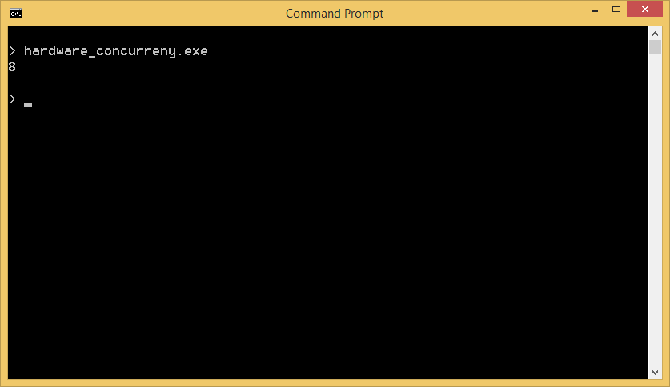
std::thread::hardware_concurrency
Notes:
On my machine this returns the value 8 so I should be able to have 8 threads executing concurrently – or at least I can be assured that I will never have more than 8 running concurrently.

Slide 21
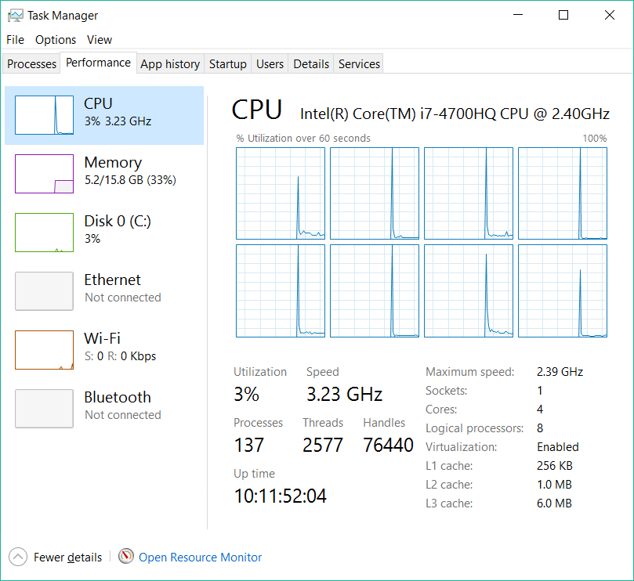
std::thread::hardware_concurrency
Notes:
It isn’t a surprise to me that the value is 8, though. My computer has a single physical processor but 8 logical processors – so it should be able to execute 8 threads concurrently. Just be careful not to think that you can use the hardware_concurrency value is a way to detect the number of physical or logical processors. While there is often a relationship between the two, there is not guaranteed to be one.

Slide 22
Joining and Detaching
Function | Purpose
join() | Wait for the thread to complete.
joinable() | Returns true if the join can be called, false otherwise.
detach() | Detaches the running thread from the thread object.
Notes:
After a thread is created there is often a need to either wait for the thread to finish or forget about the thread completely – letting it simply run in the background. This is where our next family of functions, join and detach, fit in.

Slide 23
std::thread::join
thread background = thread(thread_function);
// perform actions on the current thread
// wait for the thread to finish
background.join();
Notes:
The first function we will look at, join, allows the caller to wait until the thread has finished before continuing.
** In this example we start by creating a new thread of execution. After child thread is created, the currently running thread can move on and
** execute operations in parallel to the child thread.
Eventually the current thread needs to know the background thread is complete so it calls the join function on the thread instance. This function will return when the thread function returns, terminating the thread.

Slide 24
std::thread::join
void thread_function()
{
cout << 2 << endl;
}
...
cout << 1 << endl;
thread child = thread(thread_function);
child.join();
cout << 3 << endl;
Notes:
Let’s look at a simple join example.
** We start by printing out the value 1 and a new line.
** Next we create a child thread instance executing thread_function.
** The child thread begins and prints out the value 2.
** Since the original thread has called the join function on the child thread instance it blocks until the value 2 has been printed and the thread function returns
** Finally, the value 3 is printed by the original thread
In the end we have printed the values 1, 2, 3 in that order.

Slide 25
std::thread::join
thread db_update_thread = thread(db_update);
thread http_post_thread = thread(http_post);
update_local_state();
db_update_thread.join();
http_post_thread.join();
Notes:
Let’s look at a slightly more complex example that uses join. In this scenario we need to update a database, send an HTTP POST message and update some local state.
Since the database update and HTTP post require dealing with external systems they might take a long time to complete. So, it might make sense to run them on their own threads while updating the local state on the current thread.
** We start by creating the threads that will perform the database update and perform the HTTP POST request.
** While those are running, we call the function update_local_state on the currently executing thread.
** When the local update is done, we then call the join functions on the thread instances. After the join functions return we know that the thread is done and our operations are complete.

Slide 26
std::thread::join
thread empty;
empty.join();
Exception!
Notes:
So if join blocks execution until the thread completes, what would happen if you called join on a thread that was not associated with a thread? For example – if you created an empty thread?
** Joining on a non-existent thread isn’t a logical thing to do so the join function will throw an exception.
So how do we make that join is safe to call?

Slide 27
std::thread::joinable
thread unknown;
// unknown is possibly associated
// with an executing thread
if (unknown.joinable())
{
unknown.join();
}
Notes:
We use the joinable function.
The joinable function returns a Boolean indicating if the thread is joinable or not. Joinable threads can safely call the join function.

Slide 28
std::thread::detach
std::thread child(thread_function);
child.joinable();
child.detach();
child.joinable();
Notes:
Finally we have the detach function.
The detach function disassociates the running thread from the thread instance. After detach has been called, the thread instance is empty, as if it had been created without an associated callback. Meanwhile, the underlying thread is continuing to run, unaware that the thread instance has been detached.
** This example starts by creating a thread named child which is executing a function named thread_function.
** At this point the joinable function returns true because the thread is joinable.
** Next we call detach – this separates the thread of execution from the thread instance
** and now if we call joinable the return value will be false – because the thread instance no longer is associated with any running thread of execution, it can not be joined.

Slide 29
std::thread::detach
void take_control(HANDLE hThread)
{
// ...
}
std::thread child(thread_function);
HANDLE hThread = child.native_handle();
child.detach();
take_control(hThread);
Notes:
So why would we ever want to detach a thread? Let’s think back to our native_handle example where we were interacting with APIs that required a native handle. Perhaps we don’t just want to let a function act on the thread, perhaps we want to hand over control of thread entirely.
** In this example we have a function that takes a native HANDLE and which will manage the lifetime of the thread from this point forward.
** So we create our child thread
** And then we save off the native handle to the thread
** Next we call detach to disassociate the C++ thread instance from the underlying thread
** And then we pass the underlying handle to the function which will manage it going forward
But why call detach? Couldn’t we just let the child thread leave scope and be cleaned up? Well – it turns out that would not work.

Slide 30
The std::thread destructor will call std::terminate if the thread is joinable!
Notes:
One thing you need to keep in mind is that C++ requires you to manage your resources explicitly. For threading this means that you must explicitly join or detach all active C++ thread instances before the application terminates. If the standard thread destructor executes while the thread is still joinable, it will call standard terminate and abort the program.
So in our example, if we had not called detach, the destructor would have seen the thread has joinable and called terminate even though we had intended for someone else to manage the thread lifetime.
This is why detach is useful. If we want to create a thread that will continue to execute after the thread object has been destroyed, we must first call detach.

Slide 31
std::this_thread
Function | Purpose
get_id() | Return the ID of the current thread
yield() | The thread gives up the remainder of its scheduled time to other threads.
sleep_for() | Pause the thread execution for (at least) the specified amount of time.
sleep_until() | The thread is yielding the remainder of its scheduled time to other threads.
Notes:
You can get information about the current thread, and perform some basic operations, using static member functions on the standard this_thread class. This class exists solely to expose member functions to query and control the behavior of the currently executing thread.
Like the thread class, there is a get_id function which behaves in exactly the same way. There are also three new member functions that are only accessible via the this_thread class. These functions control the execution of the currently running thread by either pausing the thread for a duration of time or allowing other threads to run.

Slide 32
std::this_thread::get_id
void thread_function()
{
cout << "child: " << std::this_thread::get_id() << endl;
}
void main()
{
cout << "main: " << std::this_thread::get_id() << endl;
thread child(thread_function);
child.join();
}
Notes:
The get_id function on the this_thread class works just like the get_id function of the thread class.
** In this example we start with the main function printing out the currently executing thread ID.
** Next a child thread is created
** This thread prints out it’s thread ID. Because this is running on a different thread, a different value is printed than was printed in main.
** Finally the main function calls the child thread join method to wait for the child to complete

Slide 33
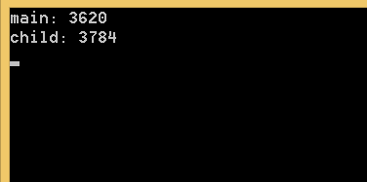
std::this_thread::get_id
Notes:
When the same code is run, we see that the main thread ID is displayed and then the child ID. As expected, the thread IDs are different because they are executing on different threads.

Slide 34
std::this_thread::yield
Notes:
The this_thread yield member function provides a hint to your C++ implementation that the currently running thread would like to allow other threads to run. Basically it’s saying “I’m done for the moment, why don’t you let someone else run.”
** Let’s say we have four threads running concurrently on a system with 2 CPU’s. We can see that two of the threads are running and two of the threads are paused, as indicated by being gray.
** As he program continues, eventually the paused threads get their chance to run
** While it is not this clean, we can see how the execution flips between threads
** allowing each thread a chance to execute.

Slide 35
std::this_thread::yield
Notes:
Exactly how the implementation determines which threads to run at which time is dependent on your operating system, hardware, C++ implementation and possibly many other factors. In general you can just trust the various parts to all work together and do the right thing.
But, there are times, though, where a thread might have enough insight into it’s work load to know that it would be better to let another thread run. The standard C++ way to do this is to call yield.

Slide 36
std::this_thread::yield
void count_iterations(
std::chrono::system_clock::time_point end_time,
long *counter,
bool polite)
{
while (end_time >= std::chrono::system_clock::now())
{
(*counter)++;
if (polite)
{
std::this_thread::yield();
}
}
}
Notes:
Here we have a simple function count_iterations which will run as a child thread.
** The function takes an a time_point which is basically a point in time – for example, 5 seconds from now. It also takes a pointer to a long whose value will be incremented as the function runs, and a finally a Boolean value which indicates if the function should be polite or greedy.
** The function executes a loop which simply checks to see if the end time has passed.
** While the end time has no been reached, the counter is incremented.
** And if the function is polite, it calls yield to allow other threads to run.
So basically we have a thread that executes a loop, incrementing a long value, until some point in the future. Since this is a tight loop executing repeatedly, the function can be polite and yield after each iteration or it can be greedy and run as quickly as possible.

Slide 37
std::this_thread::yield
auto run_until = std::chrono::system_clock::now()
+ std::chrono::seconds(5);
long greedy_count = 0, polite_count = 0;
thread greedy(count_iterations, run_until, &greedy_count, false);
thread polite(count_iterations, run_until, &polite_count, true);
polite.join();
greedy.join();
cout << "Polite: " << polite_count << endl
<< "Greedy: " << greedy_count << endl;
Notes:
We can now create a pair of threads to execute our function.
** We’ll first create the end time – in this case it is now plus 5 seconds – so each thread will execute the loop for 5 seconds.
** Next we’ll create the two threads, greedy and polite. Each has their own long to store their respective counts and they pass the polite Boolean as false and true, respectively.
** We’ll call the thread join functions to wait for them to complete
** And then we print out the polite and greedy counts.
So what is the difference?

Slide 38
std::this_thread::yield
Notes:
It turns out that on my hardware, operating system and C++ implementation, the difference is pretty significant. The greedy thread performed the increment operation 23 times more often than the polite version. One thing I want to mention is that while I’ve demonstrated how yield can be used, and I used words like polite and greedy, this should not imply that when you are writing multi-threaded code that you should be using yield like this. Because the actual behavior of yield depends on several factors, my personal opinion is that usages of yield should be kept to a minimum and only in places where careful measurements have been taken to prove that yield does in fact solve a problem that can not be better solved by other means.

Slide 39
std::this_thread::sleep_for
std::cout << "Sleeping..." << std::endl;
std::chrono::seconds length(1);
for (int i = 0; i < 5; i++)
{
std::this_thread::sleep_for(length);
std::cout << i << std::endl;
}
Notes:
The last two this_thread functions we are going to look at are related to sleeping. The first version, sleep_for, is used to sleep for a specific amount of time. Let’s look at a quick example.
** We start by printing out a message saying “Sleeping…”
** and then we define a local variable, length, which uses the standard seconds class to represent one second
** We when enter a loop which will execute 5 times.
** Inside the loop we sleep for one second and then print out the loop counter.
So what we expect to see is the word “Sleeping” displayed immediately followed by the numbers 0, 1, 2, 3, and 4. Each printed one second apart. Let’s take a look at this in action.

Slide 40
DEMO

Slide 41
std::this_thread::sleep_until
std::chrono::seconds delay(5);
auto when = std::chrono::system_clock::now() + delay;
std::cout << "Sleeping..." << std::endl;
std::this_thread::sleep_until(when);
std::cout << "Done" << std::endl;
Notes:
The sleep_until function works in pretty much the same way, except that instead of sleeping for a specific amount of time, it sleeps until the specified time.
In this example we
** start by creating a seconds object named delay which represents 5 seconds.
** Next we create a system clock object which is the current time, returned by the now function, plus 5 seconds. So this is 5 seconds in the future.
** We then print out that we are sleeping
** And then call the sleep_until function to sleep until the point 5 seconds in the future.
As you can see, this is the same basic idea, it is just using a specific point in time rather than a relative one. Let’s see this example running.

Slide 42
DEMO

Slide 43
Summary
Creating Threads
Information
ID
Native Handle
Concurrency Details
Joining and Detaching
this_thread
Yield
Sleep
Notes:
In this module we are going to be learning about the standard c++ thread class.
** We will start by learning how to create threads
** Next we will see how to get some information about threads such as the ID and native handle, and we will also see how to get a little information about the environment you are running in.
** We will then see how joining and detaching allow us to wait for threads to finish and also hand off control
** And finally we’ll look at the this_thread class and see how it can be used to control the execution of the currently executing thread

Slide 44
END

