Slide 1
Concurrent Programming Overview
Processes and Threads
Notes:
Welcome to the Multi-Threading Overview course. In this course we are going to be learning the basics of writing concurrent programs using the standard C++ multi-thread libraries defined in the most recent C++ standard.
Our first module will introduce processes and threads and lay the ground work for understanding more about how multi-threaded, or concurrent, programming works in C++.

Slide 2
Overview
Concurrency
Processes
Single and Multi Threaded
Threads
Scheduling
Cooperative and Preemptive
Managed by Operating Systems
Notes:
** In this module we will be learning about the basics of concurrency.
** We’ll learn how processes, both single and multi-threaded, can execute concurrently
** and how processes use threads to perform concurrent execution
** Finally we’ll take a brief look at how the operating system manages scheduling processes and threads

Slide 3
Concurrency
Executing multiple operations at the same time.
Notes:
Concurrency is the ability to execute multiple operations at the same time – typically with the goal of doing the overall thing faster. This might be computing a mathematical function, rendering graphics, compressing or uncompressing data, or any number of things.

Slide 4
Instructions
CPU
Notes:
Let’s imagine we have computer with a single processor
* and this processor has the ability to execute one instruction at a time.

Slide 5
CPU
Notes:
[JUST GO THROUGH THIS SLIDE]

Slide 6
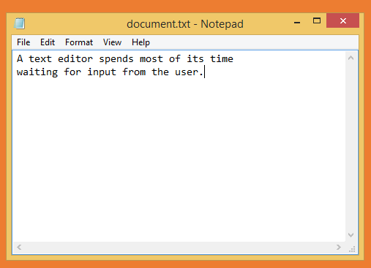
CPU
Notes:
At first we only have a single application running – a simple application for taking notes. This application spends most of its time waiting for the user to type something so it does not require a lot of CPU time.
**
The CPU spends most of its time idle.

Slide 7
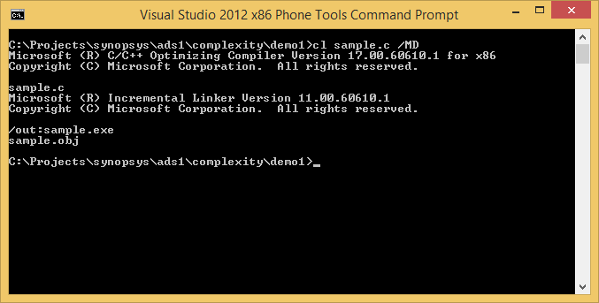
CPU
Notes:
We now start another application – a compiler.
**
This requires a bit more processing power. In fact, quite a bit more.

Slide 8

CPU
Notes:
And since we’re compiling we might as well open the web browser to pass some time.
Now there are three applications, each getting a slice of the CPU.
**
From the user’s perspective they all appear to be executing at the same time – but since there is only one CPU and it is only capable of executing a single instruction at a time, we know that this cannot be the case.

Slide 9
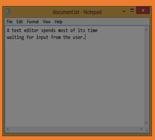
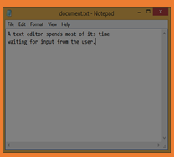
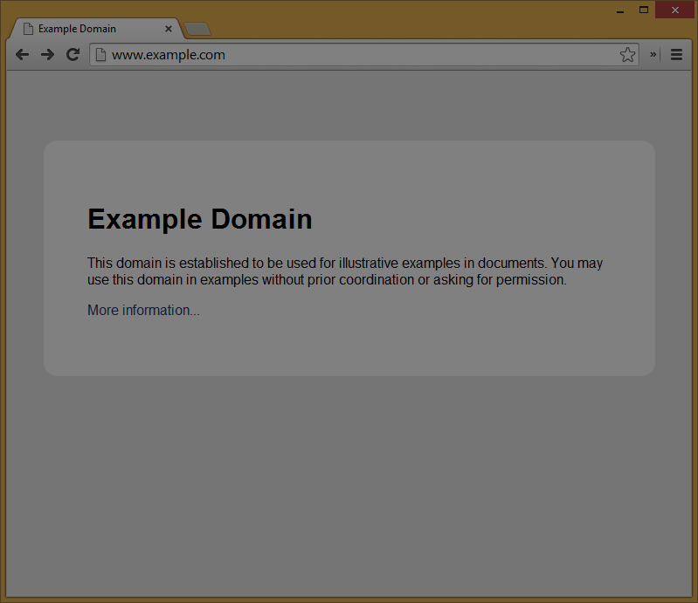
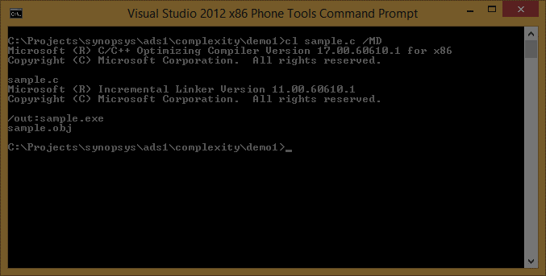
CPU
Notes:
When the note taking application is running, the browser and compiler are not.
**
And then at some point the operating system halts the note taking application, records its state and swaps it out to memory.
**
The operating system then figures out which of the other swapped out applications is waiting to run
**
and it swaps that application state in as the running application and lets it have its turn to execute.
**
This continues, each application getting their own time to run.

Slide 10
Notes:
The processes are each ignorant of the fact that they have been halted and swapped out. From their perspective they were running the whole time.

Slide 11
Preemptive Multitasking
When the operating system suspends processes and threads to give others a chance to execute.
Notes:
What we just saw is an example of preemptive multitasking. The operating system manages which process is running to create a user experience that feels like they are all running at once.

Slide 12
Cooperative Multitasking
Each running process is responsible for yielding time to allow other processes to run.
Notes:
Another model we won’t be looking at, but which is worth knowing exists, is cooperative multitasking. The difference between preemptive and cooperative multitasking, is that in the cooperative model, the operating system does not manage the scheduling of processes and threads. The cooperative model requires each process or thread to yield, or give up, time to make sure that other processes can also run. The processes are said to be cooperating.
Cooperative multitasking was used in early multitasking systems and is often used in modern real-time embedded systems.

Slide 13
Notes:
This is a simplistic overview of what most modern personal computer operating systems do. If they didn’t, then you would not able to run more than one application at a time. When you were browsing the web, your compilation would stop until you were done. When you were editing txt, the browser would be suspended.

Slide 14
CPU
CPU
Notes:
Now what if you have 2 processors?
**
Well, now things actually can be executing in parallel.
**
The compiler can be running at the same time the browser is running.
**
And when the browser is idle, the note taking application might be given more processing time.
But notice that even though we have multiple processors, the operating system is still performing preemptive multi-tasking. Having multiple processors does not replace that, it simple means that more processes can be executing at exactly time.

Slide 15
CPU
CPU
CPU
CPU
Notes:
Now what happens when we have 4 processors?

Slide 16
CPU
CPU
CPU
CPU
Notes:
Well, in this simplistic model we could now have each process assigned to its own processor leaving one processor idle

Slide 17
CPU
CPU
CPU
CPU
Notes:
or perhaps the operating would continue to schedule all the processes on a single processor.
**
We don’t necessarily know what will happen but we can have a degree of trust that our operating system will attempt to the do the right thing.

Slide 18
Thread
A single sequence of instructions to execute
Notes:
So far we’ve looked at executing process concurrently – but in our example it was assumed that each process had only a single sequence of instructions being executed. This sequence of instructions is known as a thread of execution, or, more simply a thread.

Slide 19
void linear_execution()
{
int x = 10;
cout << x << endl;
x *= 2;
cout << x << endl;
}
Notes:
Every time something is executing in a process, whether it is gathering data from the network or displaying results on the screen, it is executing within a thread.
For example, we can look at this code and know with absolute certainty that the output will be the values 10 and 20, in that order. The compiler will execute these instructions in a linear sequence, without question, regardless of what thread the function executes on.

Slide 20
Single Threaded
CPU
Multi Threaded
CPU
Notes:
Processes can often be thought of as falling into one of two camps –
**
either they are single threaded
**
or they are multi-threaded. Multi-threaded processes are ones that have multiple, concurrent, threads of execution.

Slide 21
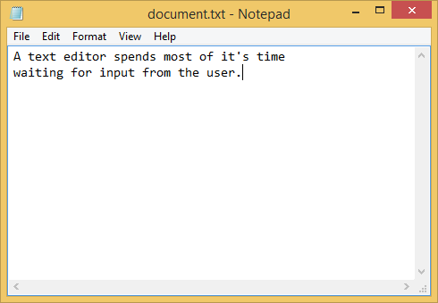
Notes:
Much of what we saw with concurrent processes applies to process with concurrent threads.
**
Multiple threads from the same process can run concurrently.
**
Multiple multi-threaded processes can be executing concurrently.
The operating system schedules the processes and threads to run when they have work to do. And just like with processes, the halting and restarting of threads by the operating system is transparent to the thread.

Slide 22
Scheduling
How the operating system manages the execution of processes and threads.
Notes:
Now that we have a high-level understanding of processes and threads, let’s take a minute to talk briefly about thread and process scheduling.
It is important to understand that I’m not talking about specifically how any particular operating system actually schedules the execution of processes and threads, but rather conceptually what is happening.

Slide 23
void thread_function(int id)
{
for (int i = 1; i <= 500; i++)
{
cout << "THREAD " << id << " " << i << endl;
}
}
Notes:
Let’s think about a process which will have multiple threads executing concurrently. Each will run the same function. The function will print out a message displaying a numeric thread ID and an integer counter.

Slide 24
THREAD 0 1
THREAD 0 2
THREAD 0 3
THREAD 0 4
THREAD 0 5
THREAD 0 6
THREAD 0 7
Notes:
When only thread is executing we see exactly what we expect:
The running thread has the ID 0 and prints the numbers 1 to 500 – with only 1 to 7 being shown here.

Slide 25
THREAD 0 1
THREAD 0 2
THREAD 0 3
THREAD 0 4
THREAD 1 1
THREAD 1 2
THREAD 1 3
THREAD 1 4
THREAD 0 5
THREAD 0 6
THREAD 0 7
Notes:
Now let’s increase the number of threads to 2.
**
Here we can see that thread 0 ran for 4 iterations
**
before thread 1 began printing output.

Slide 26
THREAD 1 204
THREAD 1 205
THREAD 1 206
THREAD 1 207
THREAD 1 THREAD 0 267
THREAD 0 268
Notes:
But if we keep running we eventually see something a little odd.
**
Notice that the last line has the word thread and the ID 1, but then before printing the integer counter, the word THREAD and ID 0 are printed.
What is happening here is that thread 1 was running and got to the point where it had printed the word “THREAD” and the value 1 but before it could print the counter value, the operating system suspended the thread and thread 0 began executing.
While this might seem surprising at first – it is really quite predictable. The operating system is going to give each thread some fragment of time – let’s say 10 milliseconds, during which it can run. When that 10 milliseconds is up, the thread is suspended and another thread takes control.

Slide 27
void thread_function(int id)
{
00F312C0 push ebp
00F312C1 mov ebp,esp
00F312C3 and esp,0FFFFFFF8h
00F312C6 push esi
00F312C7 push edi
for (int i = 1; i <= 500; i++)
00F312C8 mov edi,dword ptr [id]
00F312CB mov esi,1
{
cout << "THREAD " << id << " " << i << endl;
00F312D0 push 0F31950h
00F312D5 push esi
00F312D6 push edi
00F312D7 push ecx
00F312D8 mov ecx,dword ptr ds:[0F33078h]
00F312DE mov edx,0F331E0h
00F312E3 call std::operator<<<std::char_traits<char> > (0F31980h)
00F312E8 add esp,4
00F312EB mov ecx,eax
00F312ED call dword ptr ds:[0F33060h]
00F312F3 mov edx,0F331DCh
00F312F8 mov ecx,eax
00F312FA call std::operator<<<std::char_traits<char> > (0F31980h)
00F312FF mov ecx,eax
00F31301 call dword ptr ds:[0F33060h]
00F31307 mov ecx,eax
00F31309 call dword ptr ds:[0F33064h]
00F3130F inc esi
00F31310 cmp esi,1F4h
00F31316 jle thread_function+10h (0F312D0h)
00F31318 pop edi
00F31319 pop esi
}
}
00F3131A mov esp,ebp
00F3131C pop ebp
00F3131D ret
Notes:
Here is the disassembly of the thread function – notice that despite being 2 lines of code, there are more than 30 instructions being executed. Any one of these instructions could be a point where execution is suspended and another thread takes control.
Well – we know that the word THREAD and the thread ID were displayed so we know we made it at least
**
to this location – this is the call instruction where the standard output stream was displayed in the terminal window.
**
The call instruction to display the counter value is here – so we know that either we did not make it to this call instruction yet or we are suspended somewhere inside the call but before the stream is displayed to the terminal.
We don’t know exactly where the operating system suspended the thread – and the specifics don’t really matter. The operating system does not care what our thread was doing or how this suspension might affect the output of our program – that is not it’s job. Its job is to make sure that every thread gets a fair chance to execute when it needs to do so.
We will see later in this course that there are mechanisms to ensure that your threads and processes execute in a consistent, predictable, manner regardless of how the threads are scheduled. But for now, it is important that you understand that when you are running processes or threads in a shared environment, your threads of execution can be scheduled in ways that you cannot necessarily predict.

Slide 28
Summary
Concurrency
Processes
Single and Multi Threaded
Threads
Scheduling
Cooperative and Preemptive
Managed by Operating Systems
Notes:
** In this module we learned the basics of concurrency.
** We learned about processes, both single and multi-threaded, can execute concurrently
** and how processes use threads to perform concurrent execution
** Finally we took a brief look at how the operating system manages scheduling processes and threads

