Slide 1
Fundamental Algorithms and Data Structures
Sets
Notes:
Welcome to the “Fundamental Algorithms and Data Structures” course.
In this module we are going to be learning about the set container and several set algorithms.

Slide 2
Summary
Set Concepts
Basic Container Implementation
Set Algorithms
Union
Intersection
Difference
Symmetric Difference
std::set
Notes:
** We will start by learning about some basic set concepts
** Next we will look at a basic set implementation
** With the basic container built, we will implement four common set algorithms – union, intersection, difference and symmetric difference.
** Finally we will look at the standard C++ set class and algorithms.

Slide 3
Set
A container that holds unique values in sort order.
Notes:
A set is a container that holds distinct values in sort order. Let’s look a little deeper at some properties of sets.

Slide 4
Set Properties
Container that holds 0..N distinct items.
Attempting to add a duplicate item does not change the container’s contents
Items are iterated in ascending (in-order) order
Items are (typically) stored in a balanced tree
Search: O(log n)
Insert: O(log n)
Delete: O(log n)
Notes:
** As I just mentioned, sets contain 0 or more distinct items. By this I mean that a specific value can only appear within a set once. If you attempt to add a second instance of that value the set will be unchanged.
** Items in a set are stored, or at least iterated, in ascending sort order. We will see that this property becomes very important when implementing the set algorithms.
** Because of this trait, sets are often implemented as a balanced tree – such as an AVL tree. This means that set operations such as search, insert and delete are all O(log n) operations. It would be possible to use other container types, such as a linked list or vector, but they would not have the same search, insert and delete complexity making a balanced tree an attractive option.

Slide 5
Set Examples
Name | Values
Integers | …-4, -3, -2, -1, 0, 1, 2, 3, 4…
Positives | 0, 1, 2, 3, 4, 5, 6, 7, 8, 9…
Negatives | …-7, -6, -5, -4, -3-, -2, -1
Evens | …-6, -4, -2, 0, 2, 4, 6, 8…
Odds | …-7, -5, -3, -1, 1, 3, 5, 7…
Notes:
Here are some example sets where the values are integers.
The first example is all integers- this includes all values from negative infinity to positive infinity.
The set of positive integers includes all values from 0 to positive infinity.
The set of negative integers is all the values from negative infinity to negative one.
And then we have the even and odd sets – which include all the event and odd integers respectively.
As you can see a value can exist in more than one set, but that value can only exist in each set once.

Slide 6
Example Set
A non-production set class for example purposes.
Notes:
Now that we understand what a set is at a high level, let’s look at how we might implement a set class of our own.

Slide 7
template<class T>
class set {
avl<T> *tree;
public:
typedef typename avl<T>::iterator_type iterator_type;
set();
set(set<T>&& other);
~set();
size_t size() const;
bool contains(const T& value) const;
void insert(const T& value);
bool remove(const T& val);
iterator_type begin();
iterator_type end();
};
Notes:
Here is the basic implementation of a set class.
** The first thing to notice is that our set contains an AVL tree. This is our backing store and, as we’ll see, makes implementing the set actually quite simple.
** The set has a default constructor, move constructor and destructor – each of these are simply maintaining the reference the avl tree.
** Size and contains are const member functions that return the number of items currently in the set and whether or not a value is in the set.
** Insert and remove add and remove items from the set.
** And the begin and end iterators implement the standard iterator pattern.
Let’s take a quick look at how these functions are implemented.

Slide 8
set() {
tree = new avl<T>();
}
set(set<T>&& other) : tree(other.tree) {
other.tree = nullptr;
}
~set() {
if (tree) {
delete tree;
}
}
Notes:
** The set default constructor simply allocates the AVL tree that will store the data contained in the set.
** The move constructor moves the tree from another set to this set – and then removes the tree from the other set.
** And the destructor deletes the tree if it is assigned to this set.

Slide 9
void insert(const T& value) {
if (!tree->contains(value)) {
tree->add(value);
}
}
bool remove(const T& val) {
return tree->remove(val);
}
size_t size() const {
return tree->size();
}
bool contains(const T& value) const {
return tree->contains(value);
}
Notes:
The next set of member functions pretty much defer to the AVL tree.
** The insert function checks if the tree already contains the value and, if not, adds the value. Remember that a set can only contain distinct values so we need to enforce this.
** Remove, size and contains simply defer to the tree class.

Slide 10
iterator_type begin() {
return tree->begin();
}
iterator_type end() {
return tree->end();
}
Notes:
Finally the begin and end member functions defer to the tree class as well, returning the begin and end iterators as an in-order traversal.
So as we’ve seen, the set class is really a thin veneer over a balanced tree.

Slide 11
Set Algorithms
Algorithms applied to two distinct sets which create a third set containing the appropriate items.
Notes:
Now that we’ve have the basic set container implementation out of the way, let’s look at the four set algorithms we’re going to be learning about.

Slide 12
Chem 101
Calc 1
Notes:
During the following examples we are going to be using the same dataset representing the students enrolled in two different classes – Chemistry 101 and Calculus 1.

Slide 13
Chem 101
Cathy, Evelyn, Franklin, Jim, Mary, Steve
Calc 1
Abby, Cindy, Evelyn, Fredrick, Jim, Mary
Notes:
There are six students in Chem 101 – Cathy, Evelyn, Franklin, Jim, Mary and Steve.
Calc 1 also has six students – Abby, Cindy, Evelyn, Fredrick, Jim and Mary
Let’s see how to build our sets with these values.

Slide 14
Chem 101
Cathy, Evelyn, Franklin, Jim, Mary, Steve
set<std::string> get_chem101() {
set<std::string> students;
students.insert("Cathy");
students.insert("Evelyn");
students.insert("Franklin");
students.insert("Jim");
students.insert("Mary");
students.insert("Steve");
return std::move(students);
}
Notes:
Here we have a function get_chem101. It creates a set containing the students in Chem 101 and returns the set using std::move.
You can see that the empty set is created and the set insert function is used to add the students.

Slide 15
Calc 1
Abby, Cindy, Evelyn, Fredrick, Jim, Mary
set<std::string> get_calc1() {
set<std::string> students;
students.insert("Abby");
students.insert("Cindy");
students.insert("Evelyn");
students.insert("Fredrick");
students.insert("Jim");
students.insert("Mary");
return std::move(students);
}
Notes:
Get_calc1 is the function which returns the members of the calc 1 class. It differs from get_chem101 only by the names of the students.
With our the functions to create our sample sets defined, let’s dig into our first set algorithm.

Slide 16
Union
The set of items that exist in either of the input sets.
Notes:
The union of two sets is a third set contain every distinct item contained in either input set.

Slide 17
Chem 101
Calc 1
Notes:
What this means is that when we start with our two input sets – the students in Chem 101 or Calc 1

Slide 18
Chem 101
Calc 1
Notes:
Where the two sets overlap is the values that exist in both sets – for example the name Evelyn appears in both lists.

Slide 19
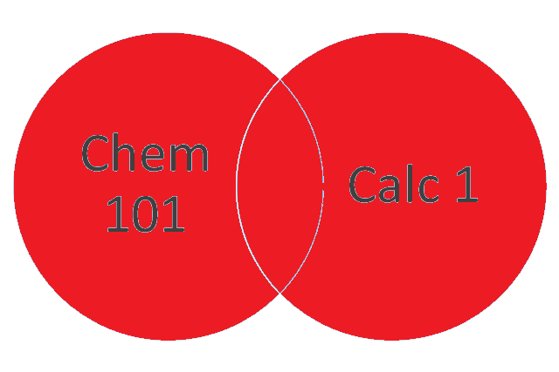
Chem 101
Calc 1
Union
Notes:
So the union is all of the distinct values in both sets. In this case – all of the values.

Slide 20
Chem 101
Cathy, Evelyn, Franklin, Jim, Mary, Steve
Calc 1
Abby, Cindy, Evelyn, Fredrick, Jim, Mary
Notes:
Another way to think about it is to look at the values in each set – the names of the students.

Slide 21
Chem 101
Cathy, Evelyn, Franklin, Jim, Mary, Steve
Calc 1
Abby, Cindy, Evelyn, Fredrick, Jim, Mary
Notes:
Pay attention to note that there are some students who are container in both sets.

Slide 22
Chem 101
Cathy, Evelyn, Franklin, Jim, Mary, Steve
Calc 1
Abby, Cindy, Evelyn, Fredrick, Jim, Mary
Union of Chem 101 and Calc 1
Abby, Cathy, Cindy, Evelyn, Franklin, Fredrick, Jim, Mary, Steve
Notes:
The union contains all of the distinct values in the two input sets

Slide 23
Chem 101
Cathy, Evelyn, Franklin, Jim, Mary, Steve
Calc 1
Abby, Cindy, Evelyn, Fredrick, Jim, Mary
Union of Chem 101 and Calc 1
Abby, Cathy, Cindy, Evelyn, Franklin, Fredrick, Jim, Mary, Steve
Notes:
But only one instance of each of the values contained in both sets.

Slide 24
Union Implementation
set<T> set_union(set<T>& other) {
set<T> result;
for (auto i : *this) {
result.insert(i);
}
for (auto i : other) {
result.insert(i);
}
return std::move(result);
}
Notes:
The implementation of the union class is pretty straight-forward.
** Add all of the values from the first input set to the output set.
** And then add all of the values from the second input set to the output set.
Because the set container insert function enforces that duplicates are not added, we don’t need to perform a check here.
** When these two loops are done, we have an output set containing the union of the two input sets and we can return it using the standard move function.

Slide 25
Union Example
set<std::string> get_all_students() {
set<std::string> chem101 = get_chem101();
set<std::string> calc1 = get_calc1();
set<std::string> result = chem101.set_union(calc1);
return std::move(result);
}
Notes:
Now that we know how to write a union function, let’s create a function that will return all of the students attending either class.
** We first get our sample sets contain the students in chem 101 and calc 1.
** Then we call the set_union member function on the chem101 instance passing the calc1 instance as a parameter. The resulting set contains all of the students in either class.
** Finally we return the result set.
Pretty straight forward.

Slide 26
Intersection
The set of items which exist in both the input sets.
Notes:
The next algorithm we are going to look at is set intersection. The intersection of two sets is the items that exist in both input sets.

Slide 27
Chem 101
Calc 1
Notes:
Going back to our sample data, here we can see the overlap between the chem 101 and calc 1 enrollment.

Slide 28
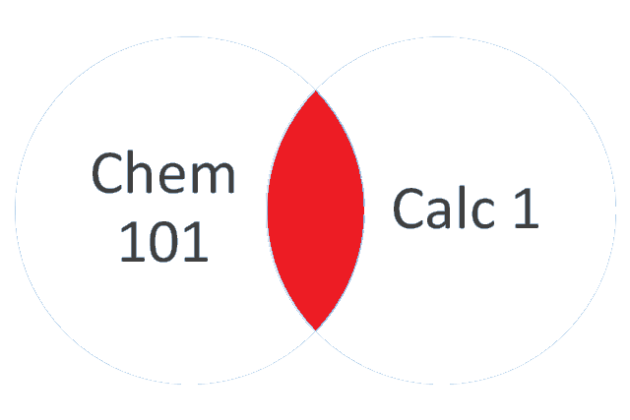
Intersection
Notes:
And it is this overlap, or intersection, that we are interested in. These are the students in both classes.

Slide 29
Chem 101
Cathy, Evelyn, Franklin, Jim, Mary, Steve
Calc 1
Abby, Cindy, Evelyn, Fredrick, Jim, Mary
Notes:
Let’s look at the set values to see this more explicitly. We again have the enrollment for both classes.

Slide 30
Chem 101
Cathy, Evelyn, Franklin, Jim, Mary, Steve
Calc 1
Abby, Cindy, Evelyn, Fredrick, Jim, Mary
Notes:
And here I’ve highlighted the students who are in both classes.

Slide 31
Chem 101
Cathy, Evelyn, Franklin, Jim, Mary, Steve
Calc 1
Abby, Cindy, Evelyn, Fredrick, Jim, Mary
Intersection of Chem 101 and Calc 1
Evelyn, Jim, Mary
Notes:
So the intersection of the chem 101 and calc 1 classes are the students in both – Evelyn, Jim and Mary.

Slide 32
Intersection Implementation
set<T> set_intersection(set<T>& other) {
set<T> result;
for (auto i : *this) {
if (other->contains(i)) {
result.insert(i);
}
}
return std::move(result);
}
Notes:
Here is a simple implementation of the intersection algorithm.
** We enumerate over each of the values in the current set
** And if the other input set contains that value, we add it to the output set
** Finally we return the output result
This implementation will work fine but there is a simple modification we can make that can improve performance a little.
Imagine our current set has one million items in it and the other input set has 1 item in it. In that case we will execute the for loop one million times – it would make more sense to loop over the smaller container.

Slide 33
Intersection Implementation
set<T> set_intersection(set<T>& other) {
set<T> result;
set<T>* smaller = (this->size() < other.size())
? this : &other;
set<T>* larger = (this == smaller) ? &other : this;
for (auto i : *smaller) {
if (larger->contains(i)) {
result.insert(i);
}
}
return std::move(result);
}
Notes:
** This can be done pretty easily by figuring out which input set has fewer items
** And then iterating over that set. For comparably sized sets this optimization won’t make a meaningful difference but for sets that have disproportionate sizes this can be a very useful optimization.

Slide 34
Intersection Example
set<std::string> get_students_in_both_classes() {
set<std::string> chem101 = get_chem101();
set<std::string> calc1 = get_calc1();
set<std::string> result = chem101.set_intersection(calc1);
return std::move(result);
}
Notes:
In this example we are finding the set of students who are enrolled in both classes using the set_intersection member function.
Calling our intersection member function is pretty much the same as calling the set_union member function. We create our sample sets and then simply call the set_intersection member function providing the other set as the parameter.

Slide 35
Difference
The set of items that exist in one set (A), but which do not exist in the other set (B).
Notes:
The third set algorithm we are going to look at is set difference. The difference of input set A and B is a third set whose members are those items that are in set A but not set B.

Slide 36
Chem 101
Calc 1
Notes:
Looking at our sample data

Slide 37
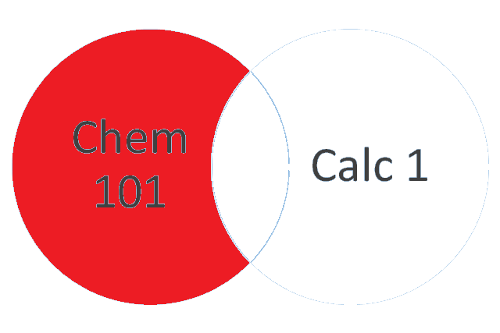
Difference
Notes:
the difference of Chem 101 and Calc 1 is the students who are in Chem 101 who are not in Calc 1.

Slide 38
Chem 101
Cathy, Evelyn, Franklin, Jim, Mary, Steve
Calc 1
Abby, Cindy, Evelyn, Fredrick, Jim, Mary
Notes:
Let’s look at it another way – using the names of students in each class. Taking the difference of Chem 101 and Calc 1 means we want to create an output set whose values are those students in Chem 101 who are not in Calc 1.

Slide 39
Chem 101
Cathy, Evelyn, Franklin, Jim, Mary, Steve
Calc 1
Abby, Cindy, Evelyn, Fredrick, Jim, Mary
Notes:
To do this we will need to identify each of the values that are in both sets

Slide 40
Chem 101
Cathy, Evelyn, Franklin, Jim, Mary, Steve
Calc 1
Abby, Cindy, Evelyn, Fredrick, Jim, Mary
Difference of Chem 101 and Calc 1
Cathy, Franklin, Steve
Notes:
And create an output set which does not contain any of those values. Here we can see the output is Cathy, Franklin and Steve. These are the three students in Chem 101 who are not also in Calc 1.

Slide 41
Difference Implementation
set<T> set_difference(set<T>& other) {
set<T> result;
for (auto i : *this) {
if (!other.contains(i)) {
result.insert(i);
}
}
return std::move(result);
}
Notes:
The implementation of difference is pretty simple – in fact it looks a lot like our first implementation of set intersection but with one important difference.
** We start by enumerating over the list of items in the current list
** And then if the item does NOT exist in the other set, it is inserted into the result set. The NOT is the key difference from intersection.
** Once the result set is built is can be returned to the caller.

Slide 42
Difference Example
set<std::string> get_students_only_in_chem101() {
set<std::string> chem101 = get_chem101();
set<std::string> calc1 = get_calc1();
set<std::string> result = chem101.set_difference(calc1);
return std::move(result);
}
Notes:
Now we can use our difference function to find all of the students who are only in Chem 101.
After we create our sample data
** We simple call the chem101 instance set_difference member function providing the calc 1 set as the other input set.
The resulting set is those students only in chem 101.

Slide 43
Symmetric Difference
The set of items that exist in either of the two input sets but which are not in their intersection.
Notes:
The final set algorithm we are going to look at is symmetric difference. The symmetric difference of two input sets is an output set whose members are in either input set, but not both.

Slide 44
Chem 101
Calc 1
Notes:
So given our input sample data

Slide 45
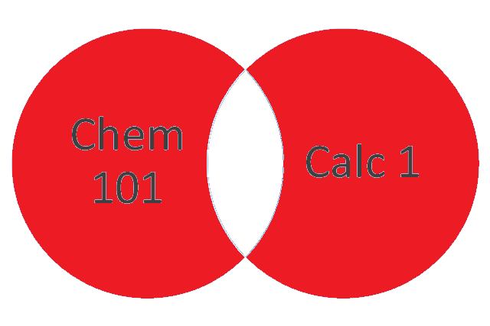
Symmetric Difference
Notes:
The symmetric difference is those students who are in Chem 101 or Calc 1 but not in both. You may notice that the symmetric difference contains every item not contained in the set intersection.

Slide 46
Chem 101
Cathy, Evelyn, Franklin, Jim, Mary, Steve
Calc 1
Abby, Cindy, Evelyn, Fredrick, Jim, Mary
Notes:
Looking at the names again, the symmetric difference is the members of either input set

Slide 47
Chem 101
Cathy, Evelyn, Franklin, Jim, Mary, Steve
Calc 1
Abby, Cindy, Evelyn, Fredrick, Jim, Mary
Notes:
Who are not in both input sets.

Slide 48
Chem 101
Cathy, Evelyn, Franklin, Jim, Mary, Steve
Calc 1
Abby, Cindy, Evelyn, Fredrick, Jim, Mary
Symmetric Difference of Chem 101 and Calc 1
Abby, Cathy, Cindy, Franklin, Fredrick, Steve
Notes:
Giving us an output set contain every student except Evelyn, Jim and Mary.

Slide 49
Symmetric Difference Implementation
set<T> set_symmetric_difference(set<T>& other) {
auto intersection = this->set_intersection(other);
auto this_diff = this->set_difference(intersection);
auto other_diff = other.set_difference(intersection);
auto result = this_diff.set_union(other_diff);
return std::move(result);
}
Notes:
The implementation of symmetric difference will make use of the algorithms we have created so far.
** First we get the intersection of the two input sets. These are the items in both sets which means we don’t want them in our output set.
** Next we use set_difference to find all of the items in the current input set which are not in the intersection set.
** Then we use set_difference to find all of the items in the other input set which are not in the intersection set.
At this point the this_diff and other_diff sets contain all of the items in either input set which are not in the other.
** That means the result is the union of these two intermediate sets.
** And we can now return the result set to the caller.

Slide 50
Symmetric Difference Example
set<std::string> students_only_in_one_class() {
set<std::string> chem101 = get_chem101();
set<std::string> calc1 = get_calc1();
set<std::string> result =
chem101.set_symmetric_difference(calc1);
return std::move(result);
}
Notes:
With set symmetric different implemented we can now implement a function that finds all of the students currently enrolled in only one class.
** After building up our sample data we call the set_symmetric_difference function getting the result set.

Slide 51
std::set
A standard implementation of the set container.
Notes:
Now that we’ve created our own sample set and implemented four set algorithms, let’s look a the standard set container and see how to perform the four set algorithms using the C++ standard library.

Slide 52
std::set
Function | Description
begin/end | Returns iterators to the beginning or end of the container.
insert/emplace | Inserts or emplaces the new values into the set (if the value does not already exist in the set)
size | Returns the numbers of elements in the set
clear | Removes all items from the set
erase | Removes the specified item from the set
Notes:
The standard set class is a standard container and therefore has all of the standard container member functions are used to seeing. Things like begin and end to perform iteration using the standard iterator patterns. Insert and emplace add items to the container, size returns the number of items in the set, clear removes all items from the set and erase removes a single item from the set. It’s the set algorithms that are a little different than what we’ve done so far – and that’s because they are not member functions.

Slide 53
std::set_union
std::set<string> get_all_students() {
std::set<string> chem101 = get_chem101();
std::set<string> calc1 = get_calc1();
std::set<string> all_students;
std::set_union(chem101.begin(), chem101.end(),
calc1.begin(), calc1.end(),
std::inserter(all_students,
all_students.end()));
return std::move(all_students);
}
Notes:
To use the standard set_union function, to get the set containing all students enrolled in either class, we
** first create our sample data.
** Next we define our result set
** We can now call the standard set_union function passing in five arguments.
** The first four are the beginning and end iterators for both input sets
** And the fifth is a standard inserter that allows inserting into the result set.
The reason the standard algorithms are implemented this way is because they are container agnostic. The set union algorithm is operating on a pair of sets here, but it would be vectors or lists or any container that implements the standard iterator pattern. Likewise the output could be any type compatible with standard inserter.

Slide 54
std::set_intersection
std::set<string> get_students_in_both_classes() {
std::set<string> chem101 = get_chem101();
std::set<string> calc1 = get_calc1();
std::set<string> in_both_classes;
std::set_intersection(
chem101.begin(), chem101.end(),
calc1.begin(), calc1.end(),
std::inserter(in_both_classes,
in_both_classes.end()));
return std::move(in_both_classes);
}
Notes:
To get the set of students who are enrolled in both classes
** we will use the standard set intersection function. Like set_union, this function accepts the four input iterators and the standard inserter. In fact, we’ll see that the remaining algorithms all follow this pattern. This makes it easy to create replace one algorithm with another.

Slide 55
std::set_difference
std::set<string> get_students_only_in_chem101() {
std::set<string> chem101 = get_chem101();
std::set<string> calc1 = get_calc1();
std::set<string> only_in_chem;
std::set_difference(
chem101.begin(), chem101.end(),
calc1.begin(), calc1.end(),
std::inserter(only_in_chem,
only_in_chem.end()));
return std::move(only_in_chem);
}
Notes:
Here we are using
** standard set difference to get the set of students who are only in chem 101. We’ve simply swapped out our usage of set_union or set_intersection with the usage of set_difference.

Slide 56
std::set_symmetric_difference
std::set<string> get_students_only_in_one_class() {
std::set<string> chem101 = get_chem101();
std::set<string> calc1 = get_calc1();
std::set<string> only_one_class;
std::set_symmetric_difference(
chem101.begin(), chem101.end(),
calc1.begin(), calc1.end(),
std::inserter(only_one_class,
only_one_class.end()));
return std::move(only_one_class);
}
Notes:
Finally to get the set of students who are either class but not both,
** we will use standard set_symmetric_difference function using the same arguments we have been using for all the preceding algorithms.

Slide 57
Summary
Set Concepts
Basic Container Implementation
Set Algorithms
Union
Intersection
Difference
Symmetric Difference
std::set
Notes:
** In this module we learned about the basics of the set container
** We implemented a very basic set using a balanced tree as the backing store
** We learned about, and implemented, four common set algorithms – union, intersection, difference and symmetric difference.
** And finally we saw learned the basics of the standard c++ set class and the how to use the standard set algorithms.

