Slide 1
Threading Building Blocks Programming
Concurrent Containers
Notes:
Welcome to the concurrent containers module of the Threading Building Blocks programming course.

Slide 2
Overview
Concurrent Containers
Vector
Queues
Map
Set
STL Differences
Notes:
During this module we are going to learn about the concurrent contain types provided by TBB. This will include concurrent vectors, queues, maps and sets.
** It is assumed that you are familiar with the analogous STL containers so we won’t spend time learning the basics of the containers. Rather we will focus on the differences between the STL and TBB containers.

Slide 3
Concurrent Containers
Concurrent containers provide thread-safe alternatives to the STL containers.
Notes:
Concurrent containers are thread-safe alternatives to the STL containers. But why do we need thread safe alternatives?

Slide 4
Thread 1
Thread 2
Capacity: 4
Size: 0
Notes:
Let’s think about a scenario where two threads are concurrently adding items
** to a single STL vector
** The vector has an initial capacity of 4 and a size of 0.

Slide 5
Thread 1
Thread 2
Capacity: 4
Size: 2
Capacity: 4
Size: 1
Capacity: 4
Size: 0
Notes:
Thread 1 starts
** by adding an item to the vector. This changes the size of the vector to 1.
** Next, thread 2 adds an item to the vector. The vector size is now 2.

Slide 6
Thread 1
Thread 2
Capacity: 4
Size: 2
Capacity: 4
Size: 4
Notes:
So far, so good, right? But what would happen if both threads tried to concurrently add items to the vector? Both threads look at the vector and see a size of 2.
** So they both attempt to add an item to the third index. Now this is a problem – two threads wrote to the same location resulting in the vector,
** in the best case, storing only one of the values – but we really don’t know. The value is undefined.
** Each thread also increased the size of the vector – this results in the size going from 2 to 4. So we have a vector with three items in it, one of which is undefined, and a size indicating four items.
** This means or forth index is totally unknown. This is just as bad as undefined value in the third index.
Our application is still running, though. So let’s keep going.

Slide 7
Thread 1
Thread 2
Capacity: 4
Size: 4
Notes:
Thread 1 is now going to add another item to the vector. The problem is that the vector is full – so
** it first needs to allocate a new, larger, backing array for the vector.

Slide 8
Thread 1
Thread 2
Notes:
As part of the growing process the vector
** begins copying the values from the original vector backing array
** to the new, larger, backing array

Slide 9
Thread 1
Thread 2
Notes:
Before it finishes, thread 2 tries to add an item. Since thread 1 has not finished updating the backing store, it still sees the old, smaller, backing array.
** Because of this it also tries to create a new, larger, backing array.

Slide 10
Thread 1
Thread 2
Notes:
Now both threads
** are concurrently adding items into their
** respective backing arrays

Slide 11
Thread 1
Thread 2
Notes:
Thread 1 finishes updating it’s backing array before thread 2 – so it starts to replace the old array with the new one.

Slide 12
Thread 1
Thread 2
Notes:
The first step is to free the memory held by the old backing array. The old array, the one that thread 2 is still reading from, is no longer valid.

Slide 13
Thread 1
Thread 2
Notes:
So when thread 2
** attempts to read another value from the old array it is accessing
** memory that is no longer valid to access. This will result in undefined behavior.

Slide 14
Concurrent Access Problems
Data Loss
Two threads writing to the same location.
Data Corruption
The vector size was not consistent with the vector indexes that had actual data.
Access Violation
Thread 1 deleted the backing array while Thread 2 was still accessing it causing an access violation.
Notes:
In this example we saw three different problems resulting from concurrent access of an STL vector.
We saw data loss when both threads wrote to the same index.
Data corruption occurred when the vector size and the vector’s contents were out of sync
And we access invalid memory when thread 2 attempted to access the backing store after thread 1 had deleted it.

Slide 15
std::vector<int> values;
auto add_values = [&values](int min, int max) {
for (int i = min; i < max; i++) {
values.push_back(i);
}
};
std::thread threads[] = {
std::thread(add_values, 1, 100000),
std::thread(add_values, 100001, 200000)
};
for (std::thread& t : threads) {
t.join();
}
Notes:
What would an example of this look like?
** First we’d create our vector that will be shared between both threads.
** We’ll be accessing this vector from our thread function – which in this case is a lambda function
** We create our threads which starts them executing the lambda function
** And then within the lambda function we call push_back on the vector – this is where our example hits the various bugs we just saw.
Running this code on my machine results in an access violation, or segfault, pretty much every time.

Slide 16
std::vector<int> values;
std::mutex values_mutex;
auto add_values = [&](int min, int max) {
for (int i = min; i < max; i++) {
std::lock_guard<std::mutex> lock(values_mutex);
values.push_back(i);
}
};
std::thread threads[] = {
std::thread(add_values, 1, 100000),
std::thread(add_values, 100001, 200000)
};
for (std::thread& t : threads) {
t.join();
}
Notes:
The standard C+ way to address this would be to use a locking mechanism to serialize access to the vector.
** We’d create a mutex at the same scope as the vector
** And then use a lock_guard to ensure that only one thread calls push_back at any given time.
This fixes our problem but it does so at the expense of creating a point of serialization in our code and it requires that anyone who ever uses that vector know that they need to protect access using the mutex. Both of which are a good recipe for performance problems and bugs.

Slide 17
tbb::concurrent_vector
Vector class that can be concurrently grown and accessed.
Notes:
Let’s start by looking the TBB concurrent vector class. This is a vector class that is very similar to the STL vector class but which safely supports concurrent growth and access.

Slide 18
tbb::concurrent_vector
Member | Note
grow_by | Atomically grows the vector size by the specified amount. Returns the previous size. New elements are created as T().
grow_to_at_least | Atomically grows the vector to at least the specified capacity. New elements are created as T(). Calls to size() include the number of items that are currently being constructed as a result of calling grow_by and grow_to_at_least.
push_back | Atomically appends a copy of the specified value to the back of the vector. Returns the index of the copy.
operator[] | Returns reference to the element at the specified index.
Notes:
The concurrent vector class has four member functions that are thread-safe – two of which do not exist in the STL vector class.
Grow by atomically grows the vector size by the specified amount – creating default initialized values in the new indexes.
Grow to at least atomically adds items to the vector to ensure the size is at least the amount specified – again it adds default initialized values to any created indexes.
Pay special attention to the note – when you call one of the grow functions it is possible that the vector size will be reported to include the items being created before those items are fully constructed.
The next two member functions are ones that should be familiar. Push back atomically appends a single value to the vector.
The brackets, or index, operator provides thread-safe direct read and write access to individual items.

Slide 19
tbb::concurrent_vector<int> values;
auto add_values = [&values](int min, int max) {
for (int i = min; i < max; i++) {
values.push_back(i);
}
};
std::thread threads[] = {
std::thread(add_values, 1, 100000),
std::thread(add_values, 100001, 200000)
};
for (std::thread& t : threads) {
t.join();
}
Notes:
Let’s fix our earlier example where we performed non-thread-safe STL vector access.
** We’ll start by replacing the stl vector with a tbb::concurrent vector
** Our lambda function no longer needs to use a lock_guard to protect access to the vector
** So when we create our threads
** and call push_back, our access is thread-safe and we no longer experience any of the bugs we saw previously.

Slide 20
tbb::concurrent_vector<int> values;
auto grow_by = [&values](int growth) {
values.grow_by(growth);
};
std::thread threads[] = {
std::thread(grow_by, 100),
std::thread(grow_by, 100),
};
for (std::thread& t : threads) {
t.join();
}
// 200
std::cout << values.size() << std::endl;
Notes:
Using grow_by is equally easy.
** We create our concurrent vector
** an define a lambda function which calls grow_by passing a specified amount to grow.
** Next we create two threads each of which is growing the vector by 100.
In a non-thread-safe world this is where might go wrong. For example, both threads might try to grow the vector from a size of 0 to a size of 100.
But because grow_by is an atomic, thread-safe, operation we know that after the threads completed, regardless of what order they executed in,
** when we check the size of the vector that the result will be 200.

Slide 21
tbb::concurrent_vector<int> values;
auto grow_to_at_least = [&values](int growth) {
values.grow_to_at_least(growth);
};
std::thread threads[] = {
std::thread(grow_to_at_least, 250),
std::thread(grow_to_at_least, 500),
};
for (std::thread& t : threads) {
t.join();
}
// 500
std::cout << values.size() << std::endl;
Notes:
Grow to at least works similarly.
** We first create our concurrent vector
** and define our thread callback which calls grow_to_at_least with the specified minimum size.
** Next we create two threads – one of which grows to at least 250 and one of which grows to at least 500.
Again, this is where non-thread safe code might have problems. If both threads tried to grow from 0 to a larger size, it is possible that the changes made by the smaller growth amount, 250, would over-write the changes made by the larger, 500, resulting in the ending vector size being 250 – and the potential memory leak of 500 items.
** But because this is a thread-safe, atomic, operation, we know that then the threads are complete that the resulting vector size will be 500.
What we don’t know is how exactly it got there.
If the 250 thread called grow_to_at_least first, then it would have grown the array from 0 to 250. Then the 500 thread would have grown it from 250 to 500.
But if the 500 thread started called grow_to_at_least first, then it would have grown the vector from 0 to 500. When the 250 thread was called, the size would already exceed 250 and nothing would be done. The same result in the end, but different paths to get there.

Slide 22
tbb::concurrent_vector
Member | Note
range_type | A range type compatible with parallel_for, parallel_scan and parallel_reduce.
const_range_type | A const range type compatible with parallel_for, parallel_scan and parallel_reduce.
range() | Returns a range with the specified grain size.
range() const | Returns a const range with the specified grain size.
Notes:
The other area where concurrent vector differs from the STL vector, is that it provides members for ranged iteration using the TBB parallel_for, parallel_scan and parallel_reduce algorithms. Since concurrent_vector is a TBB container, it makes sense that it would provide functions to make it easier to work with other parts of the TBB library.
The range_type and const_range_type members expose the types of the respective ranges, and the range and const range member functions return an instance of a range with the specified grain size.

Slide 23
typedef tbb::concurrent_vector<int>::const_range_type range;
tbb::concurrent_vector<int> values;
for (int i = 0; i < 10000; i++) {
values.push_back(i);
}
tbb::parallel_for(values.range(1000),
[](const range& range) {
std::cout << "parallel_for range size "
<< range.end() - range.begin()
<< std::endl;
}
);
Notes:
Let’s look at an example of using a concurrent vector with parallel for.
** First we typedef a local range type to be the vector’s const range type.
** We need add 10,000 items to our concurrent vector.
** We call parallel_for, passing in a range from our vector with a grain size of 1000.
** Finally, ever time the parallel_for block is called, we print out the size of the provided range to see how the partitioning was actually done. Since we provided a grain size of 1000, we can be sure that the range size will never exceed that.

Slide 24
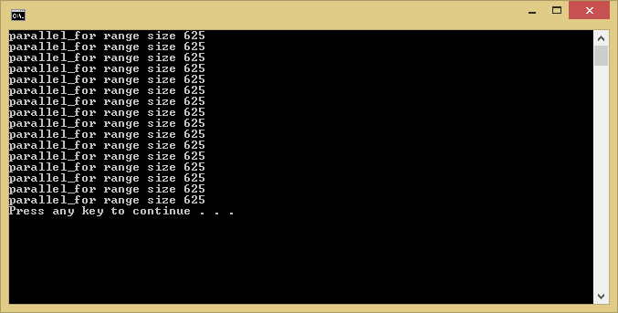
Notes:
It turns out that the actual range size ended up being 625. It might seem odd that it wasn’t 1000 since that is the grain size we asked for.
Let’s think about why for a minute.

Slide 25
1000
1000
1000
1000
1000
1000
1000
1000
1000
1000
Notes:
Let’s assume we have 10,000 items which have been put into 10 blocks of 1000.
And let’s assume the length of the block is indicative of the amount of time that processing will take in milliseconds. So 1000 items is 1000 milliseconds.

Slide 26
1000
1000
1000
1000
1000
1000
1000
1000
1000
1000
Notes:
I have an 8 core machine which means that TBB could process 8 of the blocks in parallel. So after 1000 milliseconds 80% of the operation is complete.

Slide 27
1000
1000
1000
1000
1000
1000
1000
1000
1000
1000
Notes:
Now the last two blocks can run – taking another 1000 milliseconds. So our total runtime is 2000 milliseconds.

Slide 28
625
625
625
625
625
625
625
625
625
625
625
625
625
625
625
625
Notes:
Now let’s look at this again using the block size that TBB picked – 625. This leaves us with 16 blocks that will take 625 milliseconds each to execute.

Slide 29
625
625
625
625
625
625
625
625
625
625
625
625
625
625
625
625
Notes:
The first round of execution begins with 8 threads running for a total over 625 milliseconds. When they finish 50% of the work has been completed.

Slide 30
625
625
625
625
625
625
625
625
625
625
625
625
625
625
625
625
Notes:
Then the next 8 run – this takes another 625 milliseconds.

Slide 31
1000
1000
625
625
37.5% Faster
Notes:
In the end, using blocks of size 625 instead of 1000, results in executing in 1250 milliseconds rather than 2000 – or 37.5% faster.
So we can see that even though we asked for a grainsize of 1000, TBB respected our upper limit but choose a more efficient number for us.

Slide 32
Queues
First-In-First-Out (FIFO) containers that support concurrent push and pop operations.
Notes:
TBB provides concurrent queues as well = several, in fact. These are First-In-First-Out containers that support concurrent push and pop operations.

Slide 33
Concurrent Queues
Type | Description
concurrent_queue | A first-in-first-out (FIFO) container supporting concurrent push and pop operations.
concurrent_priority_queue | A concurrent queue whose items are popped in priority order according to a template parameter.
concurrent_bounded_queue | A concurrent queue whose maximum size is bounded by a constructor parameter. Push and pop operations will block when the queue is full (at bounds limit) or empty, respectively.
Notes:
TBB provides three different concurrent queue types.
Concurrent_queue is a basic FIFO queue that support concurrent push and pop operations.
Concurrent priority queue adds priority based popping – so no matter what order you add items, you can be assured that the next pop will get the highest priority item.
Concurrent bounded queue adds the ability to define a maximum queue size - the explanation doesn’t sound that interesting, but I think you’ll agree that it’s actually pretty neat when you start to look at the details.

Slide 34
tbb::concurrent_queue
A first-in-first-out (FIFO) container supporting concurrent push and pop operations.
Notes:
We’ll start with concurrent queue – a basic first-in-first-out container.

Slide 35
tbb::concurrent_queue
Member | Difference
T (queue template type) | tbb:concurrent_queue<T> must be default constructable. std::queue<T> does not have this limitation.
queue::front/back | Not available. These functions are unsafe in a concurrent environment.
size_type unsafe_size() | Gets the queue size. May return an incorrect value if called while a push or try_pop operations occurs concurrently.
bool try_pop(T& destination) | If the queue is not empty, the next element is returned via the destination parameter. True is returned if a value is popped, false otherwise.
Notes:
As I mentioned earlier, the focus of this module is on the differences between the STL and TBB containers – so let’s start with those.
In the TBB concurrent queue, the template type parameter must be default construcutable. The STL queue does not have this requirement.
Also, the concurrent queue does not have front or back members. Those operation’s are not thread-safe in a queue that supports concurrent push and pop.
Instead of a size member function, concurrent_queue has an unsafe_size member function. The name is to remind you that calling size is unsafe because the result could be incorrect if there were any concurrent push or try_pop operations.
Finally we have try_pop. The concurrent_queue class does not have a pop function – I has an atomic try_pop which takes a reference to set the returned element too and it returns a Boolean indicating if a value was popped or not.

Slide 36
tbb::concurrent_queue<int> values;
auto push_values = [&values](int count) {
for (int i = 0; i < count; i++) {
values.push(i);
}
};
std::thread pusher = std::thread(push_values, 10000);
int temp, popped = 0;
while (popped < 10000) {
popped += values.try_pop(temp) ? 1 : 0;
}
pusher.join();
std::cout << "Popped: " << popped
<< " items" << std::endl;
Notes:
Let’s look at the basic usage.
** We start by creating our concurrent queue
** Next we define a lambda function which pushes items onto the queue – this function will be executed on a background thread – pushing 10,000 values onto the queue.
** While the background thread is pushing items, the foreground thread is popping them off
** using the try_pop member function. If an item was popped, the counter is increment, otherwise it is not. This continues until 10,000 items have been popped.
The importance of try_pop instead of pop, front or back should now be clearer. It is possible that the main thread will pop items faster than they are pushed – eventually it migh empty the queue and try to access the next element before it has been pushed. What would pop, front or back do in that case? They have no way to communicate that the queue is empty other than to throw an exception.
Try_pop, though, allows the queue to communicate that nothing could be popped but to try later.
In fact, try_pop returning false might not even mean the queue is empty – it might just mean that it was unable to pop something because another operation was occurring that conflicted with the attempt to pop. We’ll see this pattern of trying an operation in other concurrent container types.

Slide 37
tbb::concurrent_priority_queue
A concurrent queue whose items are popped in priority order according to a template parameter.
Notes:
Next we have the concurrent priority queue. While this is a queue, it is not a first-in-first-out container. In a priority queue, items are popped in a priority order – for example you could be sure that the largest integer in the queue is the next one popped regardless of the order it was pushed.

Slide 38
tbb::concurrent_priority_queue
Member | Difference
priority_queue::top | Not available. Similar to queue::front/bank, top is unsafe in concurrent environments. Use try_pop instead.
priority_queue::size | Returns the current size of the priority queue. May return an inaccurate value if there are push or try_pop operations executing.
Notes:
FAIL

Slide 39
// shuffle the values 1..10 randomly
int values[] = { 1, 2, 3, 4, 5, 6, 7, 8, 9, 10 };
std::random_shuffle(std::begin(values), std::end(values));
print_array(std::begin(values), std::end(values));
tbb::concurrent_priority_queue<int, std::greater<int>> gq;
tbb::concurrent_priority_queue<int, std::less<int>> lq;
// add the shuffled values to the priority queues
for (int i = 0; i < 10; i++) {
gq.push(values[i]);
lq.push(values[i]);
}
// print the queues in priority order
print_pq(gq);
print_pq(lq);
Notes:
Let’s look at the basic usage.
** We start by creating creating an array of integers with the values 1 through 10 and shuffling them randomly – we’ll print them out to see they are shuffled
** Next we’ll create a pair of concurrent priority queues. One is ordered with standard greater and one with standard less – this means that the queues will prioritize the values using these functions.
** The randomly shuffled values are now added to both queues
** And finally we’ll print out the values from both priorities queues in priority order. The print_eq function is a simple helper function that pops each item it the queue and prints space-separated values.
Let’s take a look at what gets printed.

Slide 40
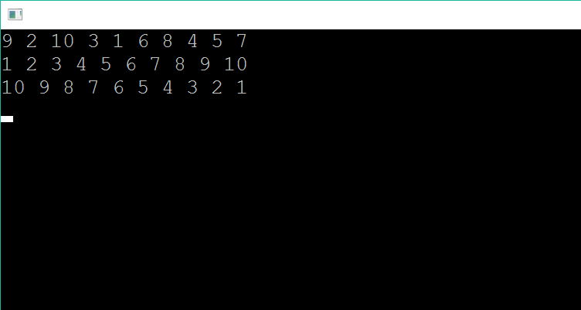
// shuffle the values 1..10 randomly
int values[] = { 1, 2, 3, 4, 5, 6, 7, 8, 9, 10 };
std::random_shuffle(std::begin(values), std::end(values));
print_array(std::begin(values), std::end(values));
tbb::concurrent_priority_queue<int, std::greater<int>> gq;
tbb::concurrent_priority_queue<int, std::less<int>> lq;
// add the shuffled values to the priority queues
for (int i = 0; i < 10; i++) {
gq.push(values[i]);
lq.push(values[i]);
}
// print the queues in priority order
print_pq(gq);
print_pq(lq);
Notes:
We can see that three lines of data were printed.
The first line is the randomly shuffled values.
The second line is the priority queue sorted by standard greater – the values were popped in ascending order.
The third line is the priority queue sorted by standard less – the values were popped in descending order.

Slide 41
Hash Maps
Associative containers that support some concurrent operations.
Notes:
Hash maps are an associative container that support concurrent operations.

Slide 42
Concurrent Accessors
Member | Description
accessor | Writer lock – permits read-write access to the key/value pairs contained in the concurrent hash map.
const_accessor | Reader lock – permits read-only access the key/value pairs container in a concurrent hash map.
Notes:
To perform concurrent operations on TBB hash maps we have to start by looking at accessors. Accessors allow multiple threads to access the key/value pairs in a shared concurrent hash map.
The accessor type provides writer lock semanatics over the concurrent hash map key/value pairs. This accessor allows both reading and updating the value of the hash map pair.
The const_accessor type provides reader lock semantics over the concurrent hash map key/value pairs. The const_accessor allows concurrent reading of the key/value pairs in the hash map.

Slide 43
Accessor Members
Member | Description
empty | Returns true if the accessor references a key/value pair, false otherwise.
release | If not empty, releases the lock held by the accessor, otherwise no action.
operator* | If not empty, returns a const reference to the key/value pair, otherwise raises an assertion.
operator-> | Returns &operator*()
~dtor | If not empty, the lock is released.
Notes:
Both accessors and const_accessors have access to several member functions which we will see in use shortly.
Empty returns true if the accessor references a key/value pair, and false otherwise. When an accessor is first created it is empty. An accessor could also be empty, for example, when the hash map find function is called but the key was not found.
Release is used to release any lock currently held. This could be either a reader or writer lock depending on the accessor type and how the lock was acquired. If release is called when no lock is held, no action occurs.
The indirection operator, or asterick, returns a reference to the key/value pair. If the accessor is empty an assertion is raised.
The dereference operator, or arrow, returns a reference to the return value of the indirection operator.
Finally the destructor releases any lock held by the accessor before the object is destroyed.

Slide 44
accessor
void add_values(
tbb::concurrent_hash_map<std::string, int>& map,
int min,
int max) {
for (int i = min; i < max; i++){
concurrent_hash_map<string, int>::accessor ac;
string key = std::to_string(i);
if (map.insert(ac, key)) {
ac->second = i;
}
}
}
Notes:
Here we have an example of using an accessor to add a value to a hash map.
** This function accepts a hash map and a range of integers – the values from min to max will be added to the hash map using the string representation of the integer as the key and the integer as the value.
** Inside the for loop we first create the accessor instance. Notice there is no connection between the accessor and the hash map it is providing concurrent access to.
** The association happens when insert is called. The accessor is provided as well as the key being inserted. If the insert function returns true the accessor is now holding a writer lock on the map
** and the value of the key/value pair can be set.
When the for loop continues the destructor for the accessor is called and the lock is released.

Slide 45
accessor
void add_values(
tbb::concurrent_hash_map<std::string, int>& map,
int min,
int max) {
tbb::concurrent_hash_map<std::string, int>::accessor ac;
for (int i = min; i < max; i++){
std::string key = std::to_string(i);
if (map.insert(ac, key)) {
ac->second = i;
ac.release();
}
}
};
Notes:
To avoid the repeated creation of an accessor object
** The creation can be moved outside the loop – so the same accessor instance will be reused repeatedly
** And lock can be released explicitly using the release accessor member function.

Slide 46
const_accessor
void find_values(
tbb::concurrent_hash_map<std::string, int>& map,
int min,
int max) {
for (int i = min; i < max; i++) {
concurrent_hash_map<std::string, int>::const_accessor ac;
std::string key = std::to_string(i);
if (map.find(ac, key)) {
std::cout << key << " found" << std::endl;
}
else {
std::cout << key << " NOT found" << std::endl;
}
}
};
Notes:
Here we have an example of using a const_accessor to find a value to a hash map.
** This function accepts a hash map and a range of integers to search for. The integers will be searched for in order from min to max.
** Inside the for loop we first create the const_accessor instance.
** The const_accessor instance is passed to the hash map’s find member function.
** If find returns true, the const_accessor instance is holding a reader lock so that the value can be safely accessed.
Like with the accessor, when the const_accessor is destructed the reader lock is released.

Slide 47
tbb::concurrent_hash_map<std::string, int> map;
std::thread insert_threads[] = {
std::thread(add_values, map, 1, 100000),
std::thread(add_values, map, 100001, 200000),
std::thread(add_values, map, 200001, 300000),
std::thread(add_values, map, 300001, 400000),
};
std::thread find_threads[] = {
std::thread(find_values, map, 1, 1000),
std::thread(find_values, map, 100000, 101000),
std::thread(find_values, map, 1000000, 1001000),
};
for (std::thread& t : insert_threads) t.join();
for (std::thread& t : find_threads) t.join();
Notes:
In the previous few slides we saw example of how to add values and find values in a hash map. Let’s assume those functions exist and are named add_values and find_values respectively.
** We start by creating our hash map – the key type is a string and the value is an integer.
** Next we’ll create four threads – each adding one hundred thousand values to the hash map. Each thread will be adding one forth of the values concurrently.
** We’ll now create three reader threads – each one check for a range of values. Some of the values, like 1 to 1000 could be in the hash map because they are being added by an add_values thread. But some, like as those from one million and up, will never be found.
** Finally we wait for all the threads to finish by calling join on each of the threads
So what happens when this runs?

Slide 48
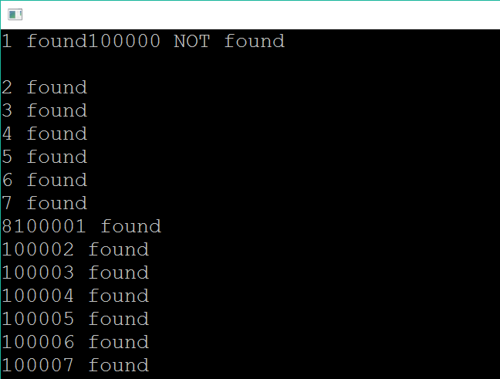
tbb::concurrent_hash_map<std::string, int> map;
std::thread insert_threads[] = {
std::thread(add_values, map, 1, 100000),
std::thread(add_values, map, 100001, 200000),
std::thread(add_values, map, 200001, 300000),
std::thread(add_values, map, 300001, 400000),
};
std::thread find_threads[] = {
std::thread(find_values, map, 1, 1000),
std::thread(find_values, map, 100000, 101000),
std::thread(find_values, map, 1000000, 1001000),
};
for (std::thread& t : insert_threads) t.join();
for (std::thread& t : find_threads) t.join();
Notes:
You can see that as this runs, at the beginning we see that a value is not found – this means that the find_values thread got ahead of the add_values thread for that range. And wee see a bunch of found values. This says those find_values threads were trailing the add_values thread for that range. You can also see some of the console printing issues we encounter when multiple threads are printing to the console at the same time.

Slide 49
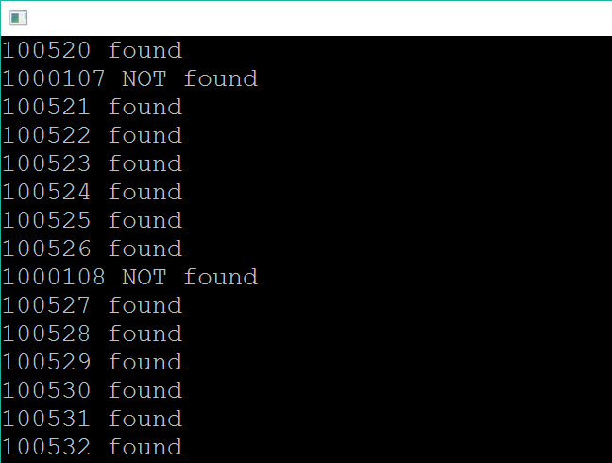
tbb::concurrent_hash_map<std::string, int> map;
std::thread insert_threads[] = {
std::thread(add_values, map, 1, 100000),
std::thread(add_values, map, 100001, 200000),
std::thread(add_values, map, 200001, 300000),
std::thread(add_values, map, 300001, 400000),
};
std::thread find_threads[] = {
std::thread(find_values, map, 1, 1000),
std::thread(find_values, map, 100000, 101000),
std::thread(find_values, map, 1000000, 1001000),
};
for (std::thread& t : insert_threads) t.join();
for (std::thread& t : find_threads) t.join();
Notes:
As we go further, we start to see the range that includes values that were never added to the hash map. As expected, these values are not found.

Slide 50
Sets
Set contains that support concurrent insertion and traversal.
Notes:
The TBB library includes support for set containers such as the concurrent_unordered_set. These sets are comparable to the STL set classes but have concurrent-safe operations.

Slide 51
Set Members
Member | Description
insert and emplace | Adds a new item to the set. Like with the STL, insert adds a copy of the item and emplace constructs the item. In either case, if the item exists, the set is unchanged.
find | Returns an iterator to the found value or end() if the value is not found.
unsafe_erase | Removes the value, if it exists, from the set. Erase is not concurrency safe.
empty | Returns true if the set is empty, false otherwise.
size | Returns the number of items in the set.
Notes:
The set classes have several members that are useful for modify and querying the set and it’s members. Unlike the map types, there are no concurrency-specific types or operations – for example there is not an accessor class. Instead the set retains internal consistency using various techniques. We’ll see that not all operations are concurrency-safe, however.
The insert and emplace functions are used to add items to the set. Similar to the STL, insert creates a copy of the item and adds it to the set whereas emplace constructs the item to avoid the copy operation. They both behave the same way if the value already exists in the set, leaving the set unchanged.
Find returns an iterator to the item that was being searched for. If the item was not found, the end() iterator is returned. Iterators are not invalidated by other concurrent operations.
Unsafe_erase removes the value from the set if it exists. Notice that the function is named unsafe_erase, not erase. This follows the TBB convention of prefixing non-concurrency safe operations, or unsafe operations, with the word unsafe. To safely erase something from a set you must provide your own synchronization to ensure safe concurrency safe operation.
Empty returns true if the set is empty and false otherwise.
Size returns the number of items in the set.
As you can see, the set operations are nearly identical to the STL set operations with the exception being that erase is now named unsafe_erase.

Slide 52
insert
void add_values(
tbb::concurrent_unordered_set<int>* set,
int min,
int max) {
for (int i = min; i < max; i++) {
set->insert(i);
}
}
Notes:
The insert function behaves the same as in the STL set classes. In our example function
** we accept a pointer to a concurrent set as well as a range of values to insert
** The function then executes a for-loop
** adding each value in the range from min to max into the set

Slide 53
find
void find_values(
tbb::concurrent_unordered_set<int>* set,
int min,
int max) {
for (int i = min; i < max; i++) {
tbb::concurrent_unordered_set<int>::iterator found;
found = set->find(i);
if (found != set->end()) {
std::cout << "Found " << i << std::endl;
}
else {
std::cout << "NOT Found " << i << std::endl;
}
}
}
Notes:
In this example function, we’re searching for values within the set.
** Our function accepts a pointer to the set instance as well as a range of values to search.
** We begin by creating an iterator named found
** which is set to the return value of the set find member function.
** If find does not return the set end iterator then the value was found, otherwise the value was not found.
All of this is just like how the STL works.

Slide 54
unsafe_erase
void remove_all(tbb::concurrent_unordered_set<int>* set) {
// prefer: set->clear();
while (!set->empty()) {
set->unsafe_erase(set->begin());
}
}
Notes:
Now let’s look at the unsafe_erase function. It’s important to remember that this function is not concurrency safe meaning we cannot be removing items from the collection while performing concurrency safe operations such as insert and find.
** This sample function will remove all of the items in the set
** If you actually want to perform this action, you should use the set clear function – this is a very inefficent way to perform this operation.
** Our logic is simple – while the set is not empty
** get the iterator to the first item in the set and pass it to unsafe_erase removing it from the set.
If you run this code you will notice that it executes very, very, slowly. On my machine, a relatively modern computer with Intel i7 processors, it takes more 4 minutes to remove all the items from a set with 200,000 items. As opposed to clear, which executes in about one millisecond.

Slide 55
tbb::concurrent_unordered_set<int> set;
std::thread insert_threads[] = {
std::thread(add_values, &set, 1, 100000),
std::thread(add_values, &set, 100001, 200000),
};
std::thread find_threads[] = {
std::thread(find_values, &set, 1, 1000),
std::thread(find_values, &set, 100000, 101000),
};
for (std::thread& t : insert_threads) t.join();
for (std::thread& t : find_threads) t.join();
remove_all(&set);
Notes:
Let’s now tie those three functions together into a series of concurrently executed operations.
** We start with our set – it’s an unordered set of integers.
** We next create multiple threads to add a few hundred thousand items to the set
** And a pair of threads to search for some items within the set. Depending on the thread ordering items may or may not be found.
** finally, once all the threads are complete, we remove all of the threads using the remove_all function which calls unsafe_erase. Because unsafe_erase is used, we need to ensure that the insertion and find threads are all complete before we begin.

Slide 56
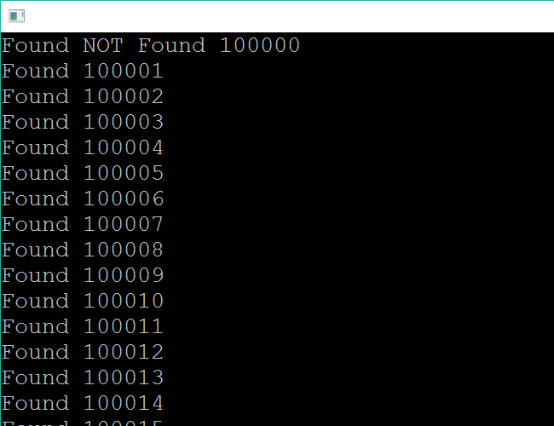
tbb::concurrent_unordered_set<int> set;
std::thread insert_threads[] = {
std::thread(add_values, &set, 1, 100000),
std::thread(add_values, &set, 100001, 200000),
};
std::thread find_threads[] = {
std::thread(find_values, &set, 1, 1000),
std::thread(find_values, &set, 100000, 101000),
};
for (std::thread& t : insert_threads) t.join();
for (std::thread& t : find_threads) t.join();
remove_all(&set);
Notes:
As you can see, like with the map example, we start with the find thread not finding the values it is looking for but then eventually the insertion thread gets ahead of the find thread and the values are all found.

Slide 57
Summary
Concurrent Containers
Vector
Queues
Map
Set
STL Differences
Notes:
In this module we looked at several types of concurrent containers that the TBB library provides. We saw concurrent vectors, queues, priority queues, hash maps and sets.
** We saw how the container types are generally very similar to the STL types but have a few changes to support concurrent operations. Hopefully this makes it clear that the path for porting existing STL-based code to the TBB library can be made easier by using the TBB container types.

