Slide 1
Threading Building Blocks Programming
Tasks
Notes:
Welcome to the Tasks module of the Threading Building Blocks programming course.

Slide 2
Overview
Task Scheduler
Overview
Blocking versus Continuations
Task Groups
Contexts
Cancellation
Notes:
** In this module we are going to be learning more about the task scheduler and the difference between blocking and continuation passing execution.
** Next we will be looking at task groups and seeing how task group contexts can be used to cancel groups of tasks.

Slide 3
Task Scheduler
The engine that executes tasks and drives the task-based algorithms.
Notes:
The task scheduler is the engine that drives the execution of tasks and task-based algorithms.

Slide 4
Added to queue using spawn(task) function.
Thread 1
Running Task
Ready Pool (deque)
Thread 2
Running Task
Ready Pool (deque)
Shared Queue
Added to queue using enqueuer(task) function.
Notes:
Let’s start by looking at the general architecture of the task scheduler
** In this example we’ll be looking at two threads – thread 1 and thread 2 –
** Each thread potentially has an already running task – or perhaps a running task that just finished
** And each thread has an associated double ended queue – this is the queue of tasks that were spawned on this thread but which have not yet been executed.
** There is also a shared queue – this queue contains tasks that were scheduled using the enqueue function rather than the spawn function. This queue is not associated with any thread but rather with the scheduler as a whole.

Slide 5
Thread 1
Running Task
Ready Pool (deque)
Thread 2
Running Task
Ready Pool (deque)
Shared Queue
Notes:
Let’s now look at how Thread 1 will figure out what task to run next.

Slide 6
1. The task returned by the running task execute() function.
Thread 1
Running Task
Ready Pool (deque)
Thread 2
Running Task
Ready Pool (deque)
Shared Queue
Notes:
If the currently executing task returns a non-null task from it’s execute function then that will be the next task executed. The benefit of this approach is that the task object is much more likely to be in the CPU cache and ready to execute. This is the most efficient option.

Slide 7
2. The successor of the running task after all predecessors complete
Thread 1
Running Task
Ready Pool (deque)
Thread 2
Running Task
Ready Pool (deque)
Shared Queue
Notes:
If the currently running task returns null and there are no remaining predecessor tasks in the ready pool, then the successor of the running task is executed.

Slide 8
3. A task popped from the end of this thread’s ready pool deque.
Thread 1
Running Task
Ready Pool (deque)
Thread 2
Running Task
Ready Pool (deque)
Shared Queue
Notes:
If the running task returns null and there ARE remaining predecessors, the most recently spawned predecessor is scheduled. The reason for picking the most recently spawned is to improve locality.

Slide 9
4. A task with affinity to the current thread.
Thread 1
Running Task
Ready Pool (deque)
Thread 2
Running Task
Ready Pool (deque)
Shared Queue
Notes:
If there are no tasks in the ready pool for the current thread, the task scheduler then looks for any task that has been scheduled with affinity to the current thread.

Slide 10
Thread 1
Running Task
Ready Pool (deque)
Thread 2
Running Task
Ready Pool (deque)
Shared Queue
5. A task taken from (approximately) the beginning of the shared queue.
Notes:
If there are no tasks with thread affinity, then the scheduler will look at the shared queue and pick a task from approximately the beginning of the queue. In general it will be first-in-first-out, but because there are multiple threads interacting with the shared queue it is possible that the tasks won’t execute in strictly first-in-first-out order. You may notice that when taking from the thread-specific queue the scheduler was biased towards the most recently added for locality reason – but when grabbing from the shared queue it took the oldest item in the queue. This is because the shared queue is biased towards fairness whereas the thread-specific queue is biased towards locality and performance.

Slide 11
6. A task popped from the beginning of a randomly chosen thread.
Thread 1
Running Task
Ready Pool (deque)
Thread 2
Running Task
Ready Pool (deque)
Shared Queue
Notes:
Finally, if there are no tasks in the shared queue, the scheduler will grab a task from the beginning of another random threads queue. This idea of taking from another thread is known as work stealing and is a important part of how the task scheduler operates. Also, notice that in this case the task was taken from the beginning of the owning thread’s pool – this means it took the oldest task leaving the newest one, the one with the best locality, in place for the other thread. This is important because it means that when stealing work, the scheduler steals in a way that is least likely to negatively impact the locality and performance of other threads.

Slide 12
Scheduler Notes
spawn() adds the task to the end of the ready pool deque
enqueue() adds the task to the start of the shared queue.
spawn() favors data locality
enqueue() favors execution fairness
In general, favor spawn().
Work stealing is critical to concurrency.
Notes:
So let’s run through a few of the points we just saw
** Spawn adds tasks to the end of the ready pool deque
** Whereas equeue adds tasks to the start of the shared queue
** Spawn favors data locality
** Whereas enqueuer favors fairness
** In general you should favor spawn over enqueue
** Finally, work stealing is critical to concurrency. The ability to steal work from other threads means that threads won’t sit idle when there is work to do and that tasks won’t sit idle when there are available threads.

Slide 13
0 … 199,999
0 … 99,999
100,000 … 199,999
0 … 49,999
50,000 … 99,999
100,000 … 149,999
150,000 … 199,999
etc…
0 … 389
390 … 779
780 … 1169
1170 … 1559
etc…
Sum 1
Sum 2
Sum 3
Sum N
Sum 1 + Sum 2
Sum 3 + Sum N
All Sums Added
Notes:
Let’s take a look at an example that uses tasks to sum up a large number of values.
** We start by allocating a root task that has a range of 200,000 integers to sum
** This task splits the range in half, and two child tasks each get 100,000 integers to sum
** Those children further split the range in half
** This continues over and over
** until the range is 500 integer, or less, in size.
** Once the ranges are small enough they are summed together
** Each level of the graph of tasks adding to the sum
** Until eventually all of the tasks have been joined back together and the single value found.
This is very similar to the parallel reduce function we saw in the parallel algorithms module. Let’s look at the code for this algorithm.

Slide 14
Demo
Blocking parallel sum

Slide 15
root
child
child
child
child
child
child
child
child
child
child
child
child
child
child
Notes:
What we just saw is an example of a blocking algorithm.
** We created the root
** Which created children
** Which created more children
** An so on …
This means that the root task has to remain alive as long as any of it’s children are alive. This is a conceptually easy model because spawning and waiting is pretty straight-forward. We’ll see in a few moments, though, that this simplicity comes at a cost – a cost that can be avoided by using continuations.

Slide 16
Continuation
A task executed after all of its predecessors have completed.
Notes:
Continuation passing is an alternative to the blocking model. In this model a continuation, or a task that is executed after it’s predecessors have executed, is used to join child tasks together while allowing the parent task to be destroyed. Let’s look at an example of this an see why it can be beneficial.

Slide 17
root
Notes:
Thinking back to our example of splitting a range of integers, let’s look at a minimalized version of this.
We start with our root task. This tasks has 200,000 integers to sum together.

Slide 18
root
cont
Notes:
This time, though, before creating it’s child tasks it creates a continuation task.

Slide 19
root
cont
child
child
Notes:
The root task then creates it’s two child tasks – the ones that will sum one half of the input range.

Slide 20
root
cont
child
child
Notes:
But unlike the blocking model, the root task will not wait on the children. Instead the continuation task will become the successor of the children. This means that the root task is now eligible to be destroyed once it’s ref count hits 0.

Slide 21
root
cont
child
cont
child
cont
Notes:
The child tasks now need to split the range again. So they create their own continuation tasks. These continuation tasks are now predecessors of the root continuation task.

Slide 22
root
cont
child
cont
child
cont
child
child
child
child
Notes:
With the child continuation tasks created, each child can now create two children – each handling one half of their respective input range.

Slide 23
root
cont
child
cont
child
cont
child
child
child
child
Notes:
The second level children are now done – and the third level children can execute. When they return, their successor tasks, the second level continuations, will be executed.

Slide 24
root
cont
child
cont
child
cont
child
child
child
child
Notes:
Let’s say one set of children finishes first. That continuation can now execute while the other children continue executing.

Slide 25
root
cont
child
cont
child
cont
child
child
child
child
Notes:
Once the remaining children are done, the two second level continuations can finish

Slide 26
root
cont
child
cont
child
cont
child
child
child
child
Notes:
And the root level continuation can now complete – when it finishes the root task ref count hits 0 and the task graph is completed.
So the question is – why would I want to use this model? It doesn’t create fewer overall task nodes – in fact it creates the same number of children and also has to create continuations. And it is more complex to manage. So what’s the benefit?

Slide 27
Blocking Successors
Continuations
Thread 1
Running Task
Ready Pool (deque)
Thread 2
Running Task
Ready Pool (deque)
Shared Queue
Notes:
The reason comes back to the concept of work stealing that we learned about earlier.
** Blocking successors are tasks that have already run and are waiting on their children to complete. These tasks are already executing on a thread – and once a task has started on a thread, it will continue on that thread until execute returns.
** Continuations, on the other hand, are scheduled in the thread ready pool. This means that if another thread was idle, it could steal the continuation and execute it. This improves our potential concurrency and, in general, will result in better performance.
Let’s go see how we can modify our blocking solution to make use of continuations.

Slide 28
Demo
Continuation parallel sum

Slide 29
Demo
Recycled parent continuation parallel sum

Slide 30
Task Groups
A group of tasks that can be cancelled, or have their priority set, together.
Notes:
Task groups are another important aspect of task based programming. They represent a collection of tasks that can be acted upon as a single group. Specifically they allow collections of tasks to be cancelled in unison.

Slide 31
tbb::task_group
Member | Note
run(Func) | Creates a task for the provided function and schedules the task for execution.
wait() | Waits for all of the tasks in the group to complete or be cancelled.
run_and_wait(Func) | Creates a task for the provided function, schedules the task for execution and waits for the tasks in the group to be complete or cancelled.
cancel() | Cancels the tasks in the group.
is_canceling() | Returns true if the group is currently canceling.
Notes:
The task group class makes it really easy to manage groups of tasks – including creating them from functions and lamdbas.
The run function creates a task for the provided function and schedules it. Wait will wait for all the tasks in the group to finish.
Run and wait runs is a combination of run and wait – but can be slightly more efficient than calling them separately because it ensures that the function will execute on the current thread. Cancel will cancel any task running in the task group that has not already started and is_canceling will return true if the task group is currently cancelling.

Slide 32
void Task(int taskId) {
cout << "Task " << taskId << " starting" << endl;
this_thread::sleep_for(chrono::seconds(taskId));
cout << "Task " << taskId << " done" << endl;
}
tbb::task_group group;
group.run([]() { Task(1); });
group.run([]() { Task(2); });
group.run([]() { Task(3); });
group.wait();
cout << "group complete" << endl;
Notes:
Here’s an example of using a task group to schedule 3 tasks and wait for them to compelte.
** We have a task function that accepts an ID. It prints out a message, sleeps for a few seconds, and then prints out another message.
** We start by creating out task group
** And then we call run three times – scheduling three tasks
** Finally we wait on our tasks to complete.

Slide 33
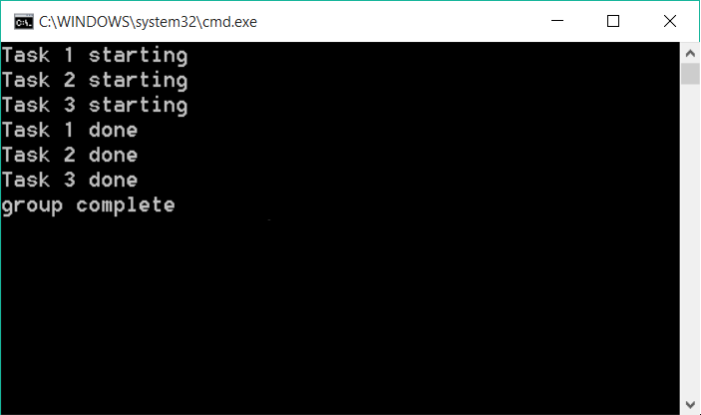
Notes:
When this executes we can see the tasks begin and, after a period of waiting, print that they are complete. We then see the group complete message.

Slide 34
void Task(int taskId) {
cout << "Task " << taskId << " starting" << endl;
this_thread::sleep_for(chrono::seconds(taskId));
cout << "Task " << taskId << " done" << endl;
}
tbb::task_group group;
group.run([]() { Task(1); });
group.run([]() { Task(2); });
group.run([]() { Task(3); });
group.cancel();
cout << "group complete" << endl;
Notes:
So what would happen if instead of waiting in our group,
** we cancel it instead?

Slide 35
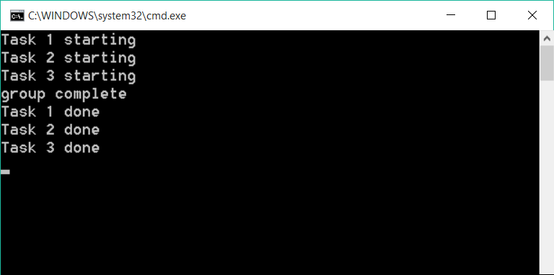
Notes:
As expected, the tasks begin – and then since the group has been cancelled the group complete message prints … but what happens next might be surprising. The tasks kept running. Why would this happen if we cancelled the tasks? This is because when tasks are cancelled the currently executing tasks continue running to completion – any scheduled tasks that have not yet start executing will never execute.
But what if I’m not using task_group, but just scheduling tasks manually?

Slide 36
tbb::task_group_context
Member | Note
cancel_group_execution() | Cancels the task group
is_group_execution_cancelled() | Returns true if group execution has been cancelled, false otherwise.
set_priority() | Sets the task group priority. Higher priority items are removed from the shared task queue before lower priority items.
priority() | Returns the task group priority.
Notes:
When a task is scheduled it is associated with task group via a task group context. Task group contexts provide the underlying operations for cancelling tasks and setting task group priority.

Slide 37
class infinite_task : public tbb::task {
public:
tbb::task* execute() {
while (true) {
cout << "running..." << endl;
this_thread::sleep_for(chrono::milliseconds(500));
}
return nullptr;
}
};
Notes:
Let’s assume we have a task class which executes an infinite loop – it printings the word running and then sleeps for a while. This task would run indefinitely – and while that may be desirable, it really would be better if we had a way to notify the task that it should shut down.

Slide 38
class cancellable_infinite_task : public tbb::task {
public:
tbb::task* execute() {
while (!is_cancelled()) {
cout << "running..." << endl;
this_thread::sleep_for(chrono::milliseconds(500));
}
return nullptr;
}
};
Notes:
We can modify our task so that instead of having a while-true loop,
** we instead calling the task is_cancelled function in the loop, continuing as long as the task is not cancelled.
This works because every task is a part of a task group – one explicitly defined when the task root is created, or an implicit one if none is provided.

Slide 39
tbb::task_group_context group;
auto& root =
*new(tbb::task::allocate_root(group))
cancellable_infinite_task();
tbb::task::spawn_root_and_wait(root);
Notes:
And how do we provide an explicit task group when creating a root task?
** First we need to create our task group
** and then we provided the group as a parameter to the allocate_root function. This associates the allocated task with the group. We can when spawn the root and wait on it just like any other task.

Slide 40
void schedule_cancel(tbb::task_group_context& group) {
thread kill_thread([&group, seconds](){
this_thread::sleep_for(chrono::seconds(3));
cout << "Cancelling task group..." << endl;
group.cancel_group_execution();
});
kill_thread.detach();
}
tbb::task_group_context group;
auto& root =
*new(tbb::task::allocate_root(group))
cancellable_infinite_task();
schedule_cancel(group);
tbb::task::spawn_root_and_wait(root);
Notes:
Now let’s modify that code a little to see this in action.
** We’ll call a function, schedule cancel, after allocating the task but before waiting.
** This function accepts the task group context as an argument and creates a thread
** which sleeps for a few seconds
** And then cancels the group
** Once the thread is created, the main thread detaches from the thread because it does not need to be joined.
When this is done we have a task that will run from the main thread and be cancelled from a background thread after a few seconds.

Slide 41
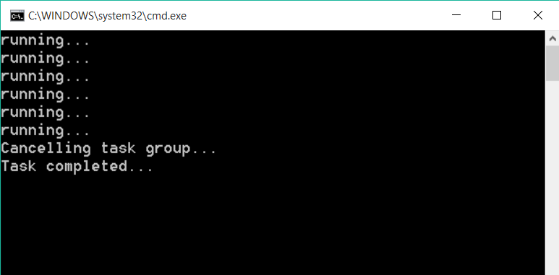
Notes:
When we run the code we can see that the word running was displayed several times before the group was cancelled – at which point the task ended. Using a task group context allowed us to convert our infinite loop to a cancellable one.

Slide 42
tbb::task_group_context group;
vector<int> data(200000);
int count = 0;
generate(data.begin(), data.end(), [&count]{return count++; });
schedule_cancel(group);
tbb::parallel_do(data, [](int value) {
this_thread::sleep_for(chrono::milliseconds(250));
cout << value << endl;
}, group);
cout << "Cancelled: "
<< group.is_group_execution_cancelled() << endl;
Notes:
And don’t think that cancellation is only available if you hand-roll your own tasks. You can also use it with the parallel algorithms we learned about earlier in this course. Here we’ll cancel the execution of a parallel_do loop.
** We start by creating our task group context
** and then fill a vector with 200,000 values. We’ll re-use the schedule_cancel function we saw a few moments ago –this will cancel the group after three seconds
** We then call parallel_do with a lambda that will wait 250 milliseconds before printing out the current value.
** When we call parallel_do, we pass the task group context as a parameter to the function
** When the group is cancelled parallel_do returns. We can then see that the group has been cancelled by calling is group execution cancelled. So how does this look?

Slide 43
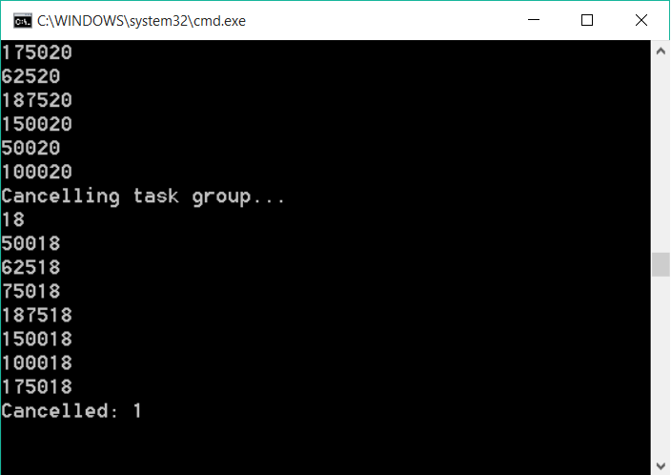
Notes:
While the parallel_do is running numbers are being printed for several seconds. Eventually we can see that the task group is being cancelled. Because cancellation does not abort currently running tasks, the numbers that print last are the tasks that were running when the cancellation occurred.
Finally we see that the operation has been cancelled because is group execution cancelled returns true.

