Slide 1
Threading Building Blocks Programming
Mutexes and Thread Local Storage
Notes:
Welcome to the mutexes and thread local storage module of the Threading Building Blocks programming course.

Slide 2
Overview
Timing Operations
tbb::tick_count
Mutex Concept
Mutex
Read Write Mutex
Others
Thread Local Storage (TLS)
Notes:
In this module we are going to be learning about a few different parts of the Intel TBB library.
** We’ll start by learning about the tick_count class and how it can be used to time code execution.
** Next we’ll learn about the TBB Mutex concept and some of the mutex types that TBB provides.
** Finally we’ll learn about thread-local-storage and how it can be used to improve the quality and performance of your application.

Slide 3
tbb::tick_count
A TBB utility class used to measure time intervals
Notes:
The tick count class is used to perform wall-clock measurement of time intervals. We will be using this class throughout this module to time code samples.

Slide 4
auto start = tbb::tick_count::now();
timed_operation();
double elapsed = tbb::tick_count::now() - start;
std::cout << elapsed.seconds() << std::endl;
Notes:
Tick count is a very simple class – so the easiest way to understand how to use it might be to just look at a quick example.
Our goal here is to time how long the function timed_operation takes to execute.
** WE start by using the tick_count now function to capture the current time.
** Next we execute the operation we want to time.
** Finally we capture the amount of time that has elapsed by calling the tick_count now function and subtracting the starting time from it. So our elapsed time is the difference between when the timed function began and ended.
** The elapsed instance represents an interval of time – from which we can retrieve the total elapsed time as a double representing the seconds that have elapsed. Note that elapsed is a double so we will be able to represent fractions of seconds.

Slide 5
template<class Func>
double time_it(Func function){
auto start = tbb::tick_count::now();
function();
auto elapsed = tbb::tick_count::now() - start;
return elapsed.seconds();
}
void long_operation() {
std::this_thread::sleep_for(std::chrono::seconds(2));
}
int main()
{
double seconds = time_it(long_operation);
std::cout << "Elapsed: " << seconds << std::endl;
}
Notes:
In this example we want will create a simple function, named time_it, which will be used to time the execution of other functions.
** We define our time_it function as a template function that accepts a argument, function,
** whose execution will be timed using the tick_count class to measure the elapsed time.
** To test this out we will create a function named long_operation which simply sleeps for two seconds.
** Finally we call our time_it function passing the long_operation function as an argument. The returned value is the elapsed time in seconds.

Slide 6
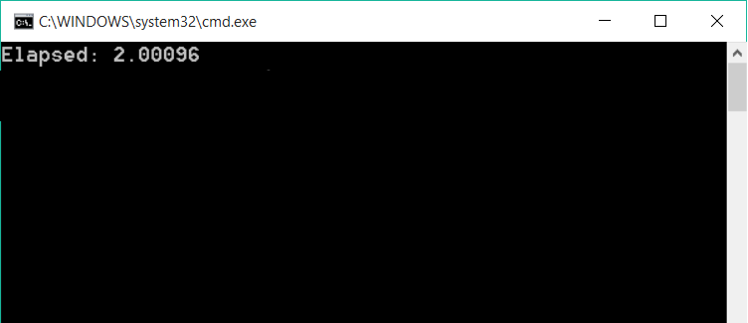
Notes:
When we execute this we see that our elapsed time was just over two seconds. This is pretty much what we would expect – since we slept for 2 seconds, the remainer is the overhead associated with the function calls and the non-exact nature of sleeping.

Slide 7
Mutex
Scoped locks that provide synchronous access to shared data or sections of code.
Notes:
The TBB library provides several types of mutexes – or locks which ensure synchronous access to shared data or code.

Slide 8
total (0)
total (10)
long temp = total;
temp = temp + 10;
total = temp;
Notes:
Let’s review why we might want to use a mutex.
In this example we have a global variable named total which has an initial value of 0. We also have code running on one thread.
** The code first creates a local variable named temp which is assigned the value of total. So at this point temp is equal to 0.
** We then assign temp to be temp plus 10 – or 10 more than total.
** And then we assign temp back to total.
In the end our total value is now equal to 10. This is what we would expect.

Slide 9
total (0)
total (10)
long temp = total;
temp = temp + 10;
total = temp;
long temp = total;
temp = temp + 10;
total = temp;
Notes:
But what if there had been two threads running, both of which were reading and writing to the total global variable.
** Both threads create a copy of the value of total – so both threads have a value named temp which is set to the value 0.
** Now both threads add ten to their temp value.
** And both threads assign the value temp back to the total
And this leaves us with the total value set to 10. Hmmm … this probably isn’t what intended. We probably meant for total to have an eventual value of 20.

Slide 10
total (0)
total (10)
total (20)
long temp = total;
temp = temp + 10;
total = temp;
long temp = total;
temp = temp + 10;
total = temp;
Notes:
But to make that happen we would need to make sure the threads were not executing at the same time.
** The first thread would need to read the total
** Update the value
** and save it back
** leaving the global variable total with a value of 10.
** The second thread could now copy the value 10 into temp
** Update temp
** and then write the updated value, 20, back to the global variable 20.
Let’s see a real example where this problem might be hit and see how we can solve it.

Slide 11
long linear_sum(std::vector<int>& data) {
return std::accumulate(data.begin(), data.end(), 0);
}
Notes:
Here we have some code to perform a linear summation of a range of values. This code does not have any threading issues.

Slide 12
long parallel_for(std::vector<int>& data) {
long total = 0;
tbb::parallel_for(size_t(0), data.size(), [&](size_t index) {
total += data[index];
});
return total;
}
Notes:
But let’s say we wanted to take advantage of multiple threads while summing the value – we might decide to use the tbb parallel_for algorithm. Here we are using parallel_for to split the work over multiple threads and then adding each of the values in the vector to the total using the plus-equals operator.

Slide 13
long parallel_for(std::vector<int>& data) {
long total = 0;
tbb::parallel_for(size_t(0), data.size(), [&](size_t index) {
long temp = total;
temp = temp + data[index];
total = temp;
});
return total;
}
Notes:
The problem is that the plus-equals operator really does something like this.
** The value of the total is stored into a temp variable
** The temp variable is updated with the new value
** And the temp variable is stored back to the total
This is where we have the race condition we saw earlier.

Slide 14
total (0)
total (10)
long temp = total;
temp = temp + 10;
total = temp;
long temp = total;
temp = temp + 10;
total = temp;
Notes:
** When two thread are running
** They are both reading from
** and writing to the shared variable concurrently.

Slide 15
long parallel_for_mutex(std::vector<int>& data) {
long total = 0;
tbb::mutex total_mutex;
tbb::parallel_for(size_t(0), data.size(), [&](size_t index) {
total_mutex.lock();
total += data[index];
total_mutex.unlock();
});
return total;
}
Notes:
Using a mutex is one way to make our code thread-safe.
** We start by creating a mutex object total_mutex – this object exists at the same scope as the shared value, total
** Within our parallel_for lambda expression we take the mutex lock. Once the lock function returns, the current thread is guaranteed that no other thread will be accessing the total variable at the same time.
** After we have performed our update of the shared data we can release the lock, allowing another thread to have access to the shared variable.

Slide 16
long parallel_for_mutex(std::vector<int>& data) {
long total = 0;
tbb::mutex total_mutex;
tbb::parallel_for(size_t(0), data.size(), [&](size_t index) {
total_mutex.lock();
total += data[index];
total_mutex.unlock();
});
return total;
}
Notes:
One thing to think about, though, is what would happen if our code threw an exception after the lock was taken,
** but before the lock was released? In this case the unlock function would never be called and we would not be able to take the lock again resulting in a deadlock.

Slide 17
long parallel_for_mutex(std::vector<int>& data) {
long total = 0;
tbb::mutex total_mutex;
tbb::parallel_for(size_t(0), data.size(), [&](size_t index) {
total_mutex.lock();
try {
total += data[index];
}
finally {
total_mutex.unlock();
}
});
return total;
}
Notes:
Some languages have a notion of a try-finally block.
** This programming style would allow us to use a try/finally block to ensure that the unlock function was called regardless of whether or not an exception were thrown.
** C++, however, does not have this concept.

Slide 18
long parallel_for_mutex(std::vector<int>& data) {
long total = 0;
tbb::mutex total_mutex;
tbb::parallel_for(size_t(0), data.size(), [&](size_t index) {
tbb::mutex::scoped_lock scope(total_mutex);
total += data[index];
});
return total;
}
Notes:
Instead, C++ uses a concept known as RAII, or Resource Acquisition is Initialization, to handle this.
** Here we create a scoped lock passing in our mutex as the constructor parameter.
Within the constructor the lock is taken. When our constructor returns we are assured that the mutex is locked and our code is now free to safely read and write from the shared variable, total.
** When the lambda function ends, the scoped_lock destructor is called, releasing the mutex lock.
What RAII guarantees us is that the scoped lock destructor will be executed when the scoped lock goes out of scope. It does not matter if this happens because the function returns or an exception is thrown – in either case the mutex will be unlocked preventing a deadlock.

Slide 19
Mutex Concepts
Scalability
Fairness
Recursive Behavior
Long Wait Behavior
Read/Write
Notes:
In the TBB library, mutexs have a few properties we need to be thinking about when deciding which one to use.
Scalability, fairness, recursive behaviors, long wait behaviors and whether a mutex is read-write or not. Let’s look into each of these concepts a little deeper.

Slide 20
Scalability
A scalable mutex performs no worse than linear code. A non-scalable mutex could perform worse than linear code because of the overhead associated with waiting.
Notes:
The first concept is scalability. A mutex is said to be scalable if the mutex causes the code to perform no worse than simply having written linear code. Typically scalability comes down to how the mutex waits. We’ll see the difference when we talk about yielding versus blocking mutexes in a few moments.

Slide 21
Fairness
A fair mutex allows thread through in the order they arrive. An unfair mutex allows running threads to continue running. Unfair mutexes favor performance over fairness.
Notes:
Fairness is another concept associated with mutexes. A fair mutex will let threads through in the order that they attempted to take the mutex lock. Unfair mutexes allow the most recent request through, favoring performance over fairness.

Slide 22
Notes:
To imagine this –
** let’s assume we have four threads running,
** and a single mutex that all four will attempt to use.
As the threads execute the first thread attempts to lock the mutex. Since no other thread has the mutex locked, it succeeds.

Slide 23
Notes:
Now thread 2 requests the mutex
** but thread 1 still is holding the mutex so thread two is blocked until thread one releases the mutex
** When thread 1 finally does release the mutex, thread two can now lock it and continue running

Slide 24
FAIR
UNFAIR
Notes:
While thread two is running
** thread three requests the mutex
** and then a few moments later, thread four requests it as well.
So when thread 2 releases the mutex who should get it next?
** If the mutex is a fair mutex, then thread three will get it next because it requested access to the mutex before thread 4.
** But if the mutex is unfair, thread four will get access first because the mutex will favor the most recently running thread – the assumption being that the thread code and ata is more likely to still be in the processor cache and ready to run.
The risk of an unfair mutex is starvation.

Slide 25
UNFAIR
Notes:
If the mutex is unfair then thread four will take the mutex lock and begin executing. Now thread three should get it next, right?
** Well – what if thread 1 requested access again?
Now when thread four releases the mutex, thread 1 has requested access more recently than thread 3 – and since the mutex is unfair, it will take the lock
** causing thread three to have wait even longer. In theory this could continue indefinitely – starving thread three.

Slide 26
Recursive Behavior
A recursive mutex allows the thread holding a mutex to acquire the mutex multiple times. This is useful for recursive algorithms but can add performance overhead.
Notes:
A recursive mutex is one that can be locked and unlocked multiple times by the same thread. This can be very useful when writing recursive algorithms such as a tree traversal.

Slide 27
Long Wait Behavior
A yielding mutex repeatedly polls whether the mutex is available – also known as busy waiting. A blocking mutex stops processing until notified that the mutex is released. Prefer yielding for small waits and blocking for long waits.
Notes:
How a mutex waits is another factor that directly relates to scalability.
When we talk about TBB mutexs, we have yielding mutexes and blocking mutexes. A yielding mutex continually checks if the mutex has been released whereas a blocking mutex stops processing until externally notified that the mutex is available.

Slide 28
Yield
bool available = false;
int owning_thread_id = -1;
void lock()
{
while (!owning_thread_id = my_thread_id) {
while (!available) {
yield();
}
try_to_take_ownership();
}
}
Notes:
Here’s some sample code that might help explain it a bit more. Please note that this is not what a yielding mutex is really doing – this is just a conceptual example.
We can see we have a lock function – and like the mutex lock function we want this to return only once the lock is held by the current thread.
** So we start our loop saying “while the owning thread ID is not my thread ID”
** And while the mutex is not available
** Yield – and what we mean by yield is to just let another thread run before returning back to this thread. If there are no other threads ready to run, yield will return immediately. This loop is a very tight, very busy loop. This is known as spin waiting or busy waiting.
** Once available is true, we try to take ownership of the mutex. If we do, then owning_thread_id will be equal to our thread id and we will exit the loop and return, otherwise we will keep waiting.
It should be clear that because we are spinning in a tight, continuous, loop that this style of waiting is going to be very CPU intensive. This is an example of a non-scalable lock because the act of waiting steals CPU power from other threads. On the other hand, when the lock is available or when it becomes available in just a few CPU cycles, this style of locking is very efficient because the thread stays active in the CPU cache which helps performance dramatically.

Slide 29
Block
void lock()
{
while (!owning_thread_id = my_thread_id) {
block_until_released();
try_to_take_ownership();
}
}
Notes:
A blocking mutex takes a different approach.
** Like with the yielding mutex, we start by checking if the owning thread ID matches my thread ID.
** If it doesn’t then the current thread blocks until the mutex is released. Notice that there is no loop here. What we’re doing is using operating-system specific behaviors to essentially put our thread to sleep, requesting that it be woken up once the mutex is available. This means that the CPU would be free to process other threads – which is why this style of mutex is considered scalable – other threads are able to make progress while this one waits.
** Finally, like with the yielding mutex, we try to take ownership and loop until we do.

Slide 30
Read/Write
A read/write mutex allows multiple threads read-only access to the protected region. When a writer requests access, all readers must exit and only a single writer is allowed.
Notes:
The final concept we’ll talk about is read/write mutexes.
A read/write mutex is one that actually allows more than one reader to take a lock – but only allows a single writer to take the mutex lock, and even then only once all the readers have released their locks. This is very useful when you are using a mutex to protect something that is frequently read from, but infrequently changes – for example a cache of system configuration values.
We’ll look at an example of a reader/writer lock later in this module.

Slide 31
Mutex Behaviors
Type | Scalable | Fair | Recursive | Wait | RW
mutex | Platform | Platform | No | Blocks | No
recursive_mutex | Platform | Platform | Yes | Blocks | No
spin_mutex | No | No | No | Yields | No
queuing_mutex | Yes | Yes | No | Yields | No
spin_rw_mutex | No | No | No | Yields | Yes
queuing_rw_mutex | Yes | Yes | No | Yields | Yes
null_mutex | N/A | Yes | Yes | N/A | No
null_rw_mutex | N/A | Yes | Yes | N/A | Yes
Notes:
In this chart we can see a break/down of what mutexes have what behaviors.

Slide 32
Mutex Behaviors
Type | Scalable | Fair | Recursive | Wait | RW
mutex | Platform | Platform | No | Blocks | No
recursive_mutex | Platform | Platform | Yes | Blocks | No
spin_mutex | No | No | No | Yields | No
queuing_mutex | Yes | Yes | No | Yields | No
spin_rw_mutex | No | No | No | Yields | Yes
queuing_rw_mutex | Yes | Yes | No | Yields | Yes
null_mutex | N/A | Yes | Yes | N/A | No
null_rw_mutex | N/A | Yes | Yes | N/A | Yes
Notes:
We can see that the mutex and recursive mutex types have platform dependent attributes for both scalable and fair. This is because, in general, these are the mutexes you should favor when you don’t have a specific reason to choose something else. They generally provide the best balance of behaviors given the constraints of your operating environment.

Slide 33
Mutex Behaviors
Type | Scalable | Fair | Recursive | Wait | RW
mutex | Platform | Platform | No | Blocks | No
recursive_mutex | Platform | Platform | Yes | Blocks | No
spin_mutex | No | No | No | Yields | No
queuing_mutex | Yes | Yes | No | Yields | No
spin_rw_mutex | No | No | No | Yields | Yes
queuing_rw_mutex | Yes | Yes | No | Yields | Yes
null_mutex | N/A | Yes | Yes | N/A | No
null_rw_mutex | N/A | Yes | Yes | N/A | Yes
Notes:
We can see that the spinning mutexes are neither scalable nor fair – we saw a few minutes why this makes sense.

Slide 34
Mutex Behaviors
Type | Scalable | Fair | Recursive | Wait | RW
mutex | Platform | Platform | No | Blocks | No
recursive_mutex | Platform | Platform | Yes | Blocks | No
spin_mutex | No | No | No | Yields | No
queuing_mutex | Yes | Yes | No | Yields | No
spin_rw_mutex | No | No | No | Yields | Yes
queuing_rw_mutex | Yes | Yes | No | Yields | Yes
null_mutex | N/A | Yes | Yes | N/A | No
null_rw_mutex | N/A | Yes | Yes | N/A | Yes
Notes:
The queuing mutexes are fair and scalable – these mutexes are fair because they queue the lock requests to ensure that they are processed in the order they were requested. This is why they are called queuing mutexes.

Slide 35
Mutex Behaviors
Type | Scalable | Fair | Recursive | Wait | RW
mutex | Platform | Platform | No | Blocks | No
recursive_mutex | Platform | Platform | Yes | Blocks | No
spin_mutex | No | No | No | Yields | No
queuing_mutex | Yes | Yes | No | Yields | No
spin_rw_mutex | No | No | No | Yields | Yes
queuing_rw_mutex | Yes | Yes | No | Yields | Yes
null_mutex | N/A | Yes | Yes | N/A | No
null_rw_mutex | N/A | Yes | Yes | N/A | Yes
Notes:
Finally we have the null mutex. A null mutex implements the mutex concepts – they provide the lock and unlock functions and can use RAII to implement scoped locks – but they don’t actually do anything. They can be useful if you have code that, for whatever reason, doesn’t actually need the safety the mutex provides but which requires a mutex to execute.

Slide 36
Mutex Behaviors
Type | Scalable | Fair | Recursive | Wait | RW
mutex | Platform | Platform | No | Blocks | No
recursive_mutex | Platform | Platform | Yes | Blocks | No
spin_mutex | No | No | No | Yields | No
queuing_mutex | Yes | Yes | No | Yields | No
spin_rw_mutex | No | No | No | Yields | Yes
queuing_rw_mutex | Yes | Yes | No | Yields | Yes
null_mutex | N/A | Yes | Yes | N/A | No
null_rw_mutex | N/A | Yes | Yes | N/A | Yes
Notes:
All of the mutexes that are not read/write mutexes have identical interfaces and behaviors. They all provide a lock and unlock function, they all provide scoped locking. You could pick or choose any of them and have essentially identical behavior in your program. What would potentially differ is their performance characteristics as the contention for the mutex increased. Whether they yielded or blocked, or were fair or unfair, could eventually become important – but each could be swapped out for another without changing your code.

Slide 37
long parallel_for_mutex(std::vector<int>& data) {
long result = 0;
tbb::mutex result_mutex;
tbb::parallel_for(size_t(0), data.size(), [&](size_t index) {
tbb::mutex::scoped_lock scope(result_mutex);
result += data[index];
});
return result;
}
Notes:
Here we can see a vanilla tbb mutex in use

Slide 38
long parallel_for_mutex(std::vector<int>& data) {
long result = 0;
tbb::queuing_mutex result_mutex;
tbb::parallel_for(size_t(0), data.size(), [&](size_t index) {
tbb::queuing_mutex::scoped_lock scope(result_mutex);
result += data[index];
});
return result;
}
Notes:
And now we’ve swapped it out with a queuing mutex.

Slide 39
long parallel_for_mutex(std::vector<int>& data) {
long result = 0;
tbb::spin_mutex result_mutex;
tbb::parallel_for(size_t(0), data.size(), [&](size_t index) {
tbb::spin_mutex::scoped_lock scope(result_mutex);
result += data[index];
});
return result;
}
Notes:
And now a spin mutex.

Slide 40
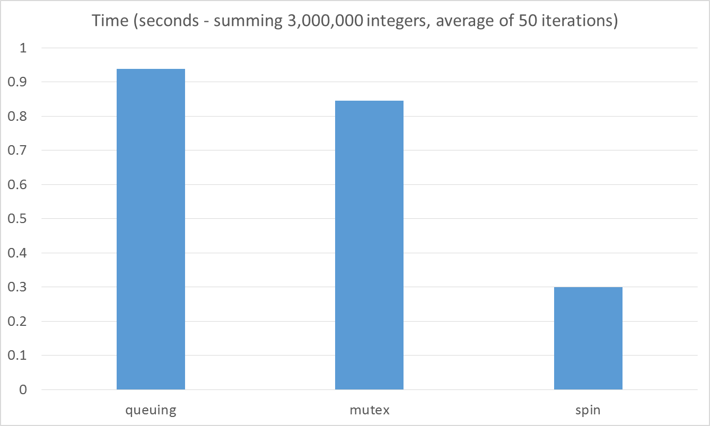
Notes:
And just how much of a difference could it make? Well, using our earlier example of summing a vector of integers, here are some timings measuring the usage of parallel_for with the three different mutex types. You can see how the spin mutex performed significantly better than the queuing mutex or the vanilla mutex. This makes sense when you think about what the thread was doing – adding a pair of values would take just one or two CPU cycles so spinning means that the active threads will stay active and get more done quickly. Had the thread been doing more complex calculations, ones requiring hundreds or thousands of CPU cycles, and the spin mutex would have caused the CPU to spend more time spinning than calculating – in which case the queuing or vanilla mutex would been more appropriate.

Slide 41
Mutex Behaviors
Type | Scalable | Fair | Recursive | Wait | RW
mutex | Platform | Platform | No | Blocks | No
recursive_mutex | Platform | Platform | Yes | Blocks | No
spin_mutex | No | No | No | Yields | No
queuing_mutex | Yes | Yes | No | Yields | No
spin_rw_mutex | No | No | No | Yields | Yes
queuing_rw_mutex | Yes | Yes | No | Yields | Yes
null_mutex | N/A | Yes | Yes | N/A | No
null_rw_mutex | N/A | Yes | Yes | N/A | Yes
Notes:
The same is true of the read/write mutexes. Each of them have identical interfaces and behaviors – but their scalability and fairness differences could affect how your application performs at scale.

Slide 42
Thread Local Storage
Memory associated with a single thread of execution.
Notes:
Thread local storage is memory that has been allocated for usage by a single thread of execution.

Slide 43
long linear_sum(std::vector<int>& data) {
return std::accumulate(data.begin(), data.end(), 0);
}
Notes:
Let’s look at our linear summation example again.
** Here we have a vector of integers
** Which will be added starting at the beginning
** through to the end

Slide 44
long parallel_for(std::vector<int>& data) {
long result = 0;
tbb::parallel_for(size_t(0), data.size(), [&](size_t index) {
result += data[index];
});
return result;
}
Notes:
Now we want to run the algorithm in parallel so we replace our for loop with our trusty parallel_for algorithm.
** Now we have two or more threads,
** each processing values
** until they are out of values

Slide 45
long temp = result;
temp += data[100];
result = temp;
long temp = result;
temp += data[1000];
result = temp;
Notes:
But as we learned earlier in this module, that this is not a safe way to add the values –
** When we load the value
** and then update the value
** We run the risk of losing one of the calculations when multiple threads update the shared variable at the same time.

Slide 46
Thread 1
Thread 2
long temp = result;
temp += data[100];
result = temp;
long temp = result;
temp += data[101];
result = temp;
long temp = result;
temp += data[1000];
result = temp;
long temp = result;
temp += data[1001];
result = temp;
Notes:
One way to address this is to linearize our updates. We saw how to do this with mutexes, but we could have also done it using an atomic operation.

Slide 47
long parallel_for_atomic(std::vector<int>& data) {
std::atomic<long> result = 0;
tbb::parallel_for(size_t(0), data.size(), [&](size_t index) {
result.fetch_add(data[index]);
});
return result;
}
Notes:
** By using an atomic long for our result,
** we could use the fetch_add operation to update the shared variable in an atomic manner – this ensures that no updates will be lost.

Slide 48
long parallel_for_mutex(std::vector<int>& data) {
long result = 0;
tbb::mutex result_mutex;
tbb::parallel_for(size_t(0), data.size(), [&](size_t index) {
tbb::mutex::scoped_lock scope(result_mutex);
result += data[index];
});
return result;
}
Notes:
Or we could use a mutex as we saw earlier. So which option would be better?

Slide 49
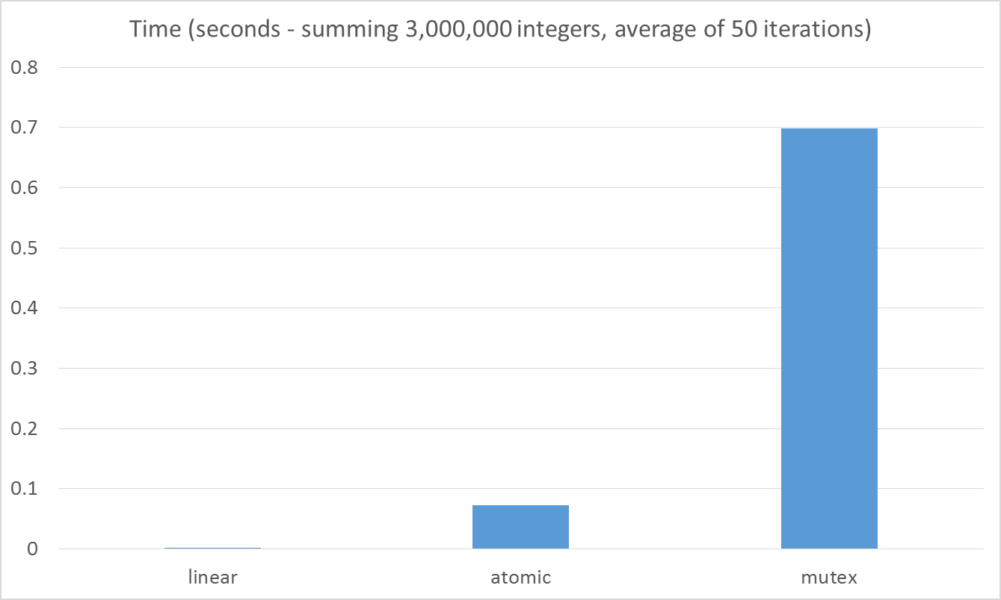
Notes:
In this case the atomic updates are several times more expensive than the linear algorithm, and the mutex protected updates are several times more expensive than the atomic updates. In both cases we are still slower than linear.
So how do we do better?

Slide 50
long temp = result;
temp += data[100];
result = temp;
long temp = result;
temp += data[1000];
result = temp;
result (Global)
Notes:
Fundamentally, the problem is that we are updating shared state between multiple threads.
** We have a shared variable, result,
** that both thread need to be updating.
This means that both threads need to be constantly serializing access to the variable to ensure that they are functioning correctly.

Slide 51
long temp = result;
temp += data[100];
result = temp;
long temp = result;
temp += data[1000];
result = temp;
result (TLS)
result (TLS)
result (Global)
Notes:
But what if instead of using a shared variable
** each thread had it’s own result
** that was only ever updated by the current thread. This would mean that no synchronization would ever be necessary – no mutexes and no atomic operations.
** Once each thread was completed, the result could be added to a shared variable that was only ever accessed once for each thread’s final value.

Slide 52
long parallel_for_tls(std::vector<int>& data) {
tbb::combinable<long> result;
tbb::parallel_for(size_t(0), data.size(), [&](size_t index) {
result.local() += data[index];
});
return result.combine(std::plus<long>());
}
Notes:
In TBB we would do this using a combinable.
** A combinable wraps the shared variable and provides each thread with their own instance. This instance will only ever be written to by that thread so there are no thread safety issues.
** And each thread will access their instance of the variable by calling the combinable local function. This function returns a reference to the thread-local version of the value.
** Once all the child threads are done, each thread’s local copy can be added together, or reduced, using the combinable’s combine function – in this case applying the plus operation to each thread-local value.

Slide 53
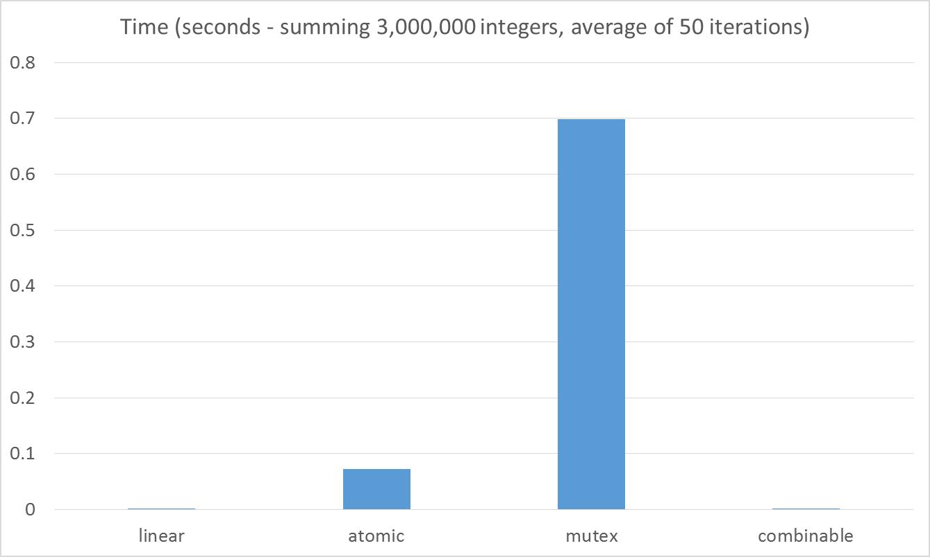
Notes:
And what performance difference does using thread-local storage make? Well- it’s pretty significant. In fact, let’s get rid of the atomic and mutex data to make the difference easier to see.

Slide 54
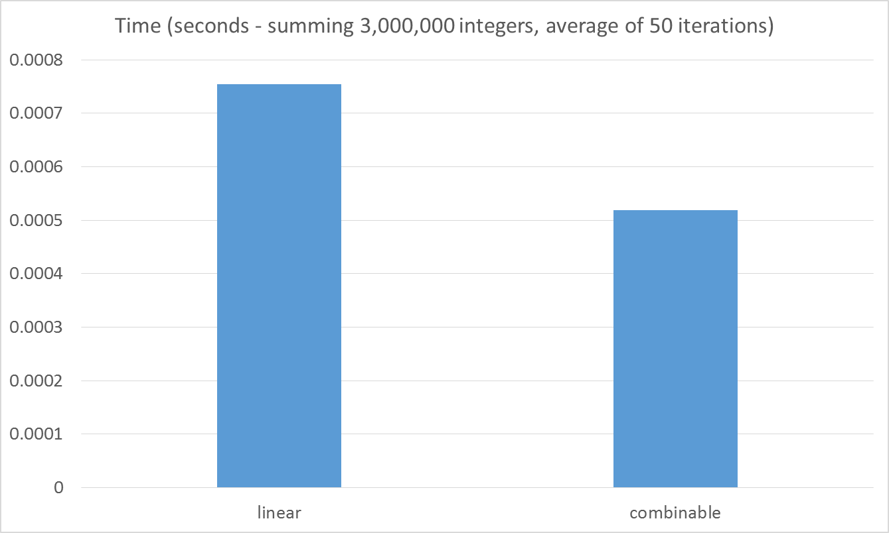
Notes:
Here we can see that the combinable code is actually faster than the linear code – so we’ve finally improved on our linear function by using a parallel algorithm – and we did it in a way that did not require any locks or explicit serialization.
But can we do even better?

Slide 55
typedef blocked_range<vector<int>::const_iterator> range_t;
long parallel_for_tls_grain(std::vector<int>& data) {
tbb::combinable<long> sums;
int grain_size = data.size() / 16;
range_t range = range_t(data.begin(), data.end(), grain_size)
tbb::parallel_for(range,
[&sums](range_type rng) {
long sum = std::accumulate(rng.begin(), rng.end(), 0);
sums.local() += sum;
});
return sums.combine(std::plus<long>());
}
Notes:
I think so. One way is to reduce the overhead of the parallel processing by using an optimal grainsize.
** Here I define the grainsize to be the data size divided by 16 – I choose 16 because I am on an 8 core machine and trial and error showed this to be a good value. Ideally this would not be a hardcoded value.
** With my grainsize defined, I now create a blocked_range from my vector of integers.
** And I call the parallel_for version that accepts the blocked_range as it’s parameter.
** Since we’re using a range now, we can change the algorithm to use standard accumulate to add the range before updating the combinable result.

Slide 56
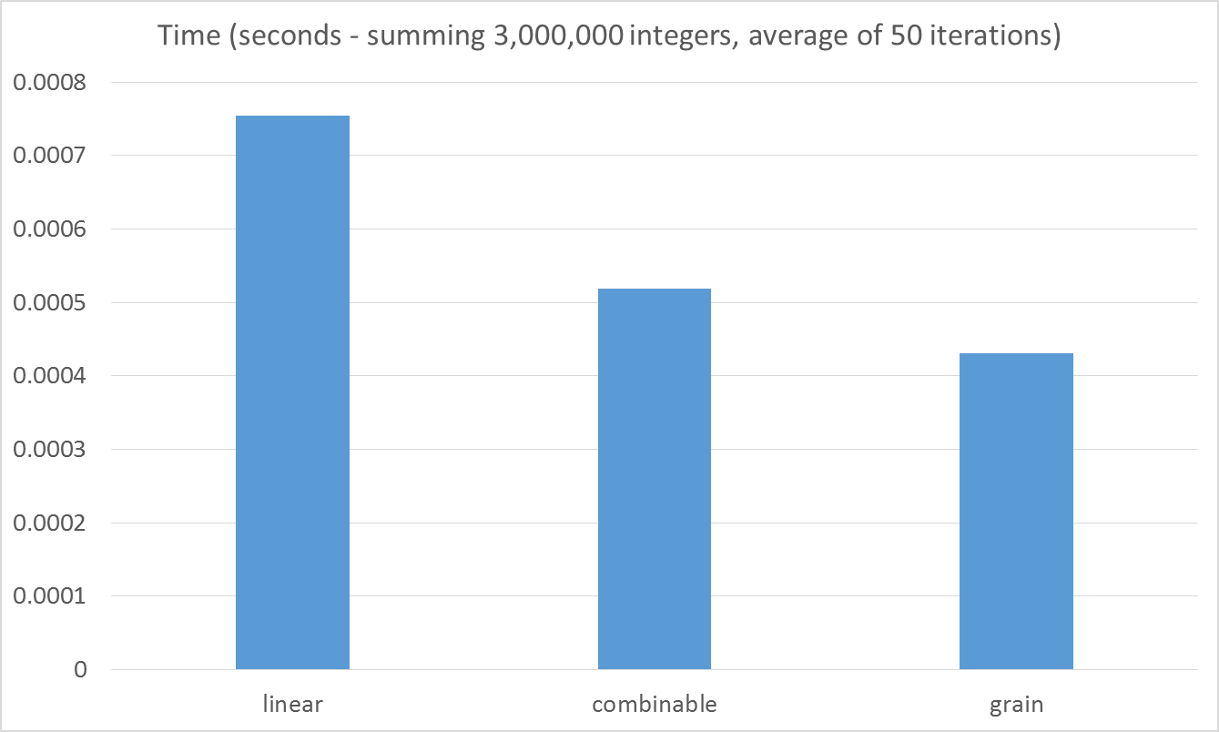
Notes:
And did this help? Yeah, it a little.
Using a more optimal grain size in conjunction with a combinable has cut the runtime nearly in half over the original linear algorithm.

Slide 57
tbb::combinable<T>
Member | Note
local | Returns a reference to the thread local element. If the element does not exist it is created.
local(bool&) | Identical to local() except it set the boolean reference parameter to true if the value had already been created or false if the value did not exist prior to this call.
combine(FCombine) | FCombine is an associative binary function that is called for each thread-local instance. Used to reduce the thread values to a single value.
combine(Func) | Func is a unary function that is called for each thread-local instance.
Notes:
The combinable class has two functions we really need to understand.
The local function returns a reference to the thread-local element. If the element has never been accessed before then it is created and returned. There is a version of the local function that accepts a reference to a Boolean – this Boolean value is set to true if the element was created, or is set to false if not.
The combine function is the function that combines the thread-local values together once all the threads are done processing. It contains two versions – the first accepts an associative binary function that is called for each thread-local instance. This is used to perform a reduction of each thread value to a single value. We saw this when we used standard plus – we were reducing all of the values down to a single result – the sum of all of the thread-local values.
The second version of combine accepts a unary function that is called once for each thread-local instance. It is used when you simply want to process each result without needing to reduce them to a single value. For example if we simply had wanted to print out the thread-local value rather than summing them together.

