Slide 1
Corrigendum: The Crowd-Emotion Amplification Effect
群体情绪放大效应
Elaine Zhang 222302056
Jiachen Liu 222312030
Qingren Yang 222312024
June 19, 2023
Goldenberg, A., Weisz, E., Sweeny, T. D., Cikara, M., and Gross, J. J. (2021). The crowd-emotion-amplification effect. Psychological Science, 32(3), 437–450.https://doi.org/10.1177/0956797620970561

Slide 2

Crowd-emotion-amplification effect
People are often tasked with making split-second judgments about the emotions of a crowd.
But how do people rapidly estimate crowds’ emotions?

Slide 3

Ensemble coding
Ensemble coding, the process by which perceivers quickly extract representative summaries of visual information.
Ensemble representations may be arrived at by sampling a subset of items and using them to extrapolate summary statistics about the entire set.
Perceivers appear to preferentially sample the most salient objects in a set, which in turn biases the summary percept toward extreme or amplified values.

Slide 4

Crowd-emotion-amplification effect
Highly emotional faces are more salient than neutral faces.
People preferentially attend to faces conveying strong emotions over faces with neutral expressions.
If perceivers manifest an attentional bias toward more emotional faces, their estimation of a crowd’s overall emotion could therefore be greater than it actually is.

Slide 5

Crowd-emotion-amplification effect
The valence of the expression
positive or negative
The number of the faces
From 12 to 1

Slide 6
Hypothesis
Hypothesis 1: Participants would show a crowd emotion-amplification effect, estimating a crowd’s average emotion as more intense than it actually is.
Hypothesis 2: The amplification effect would be stronger as the number of faces within an array increased.
Hypothesis 3: Amplification would be more robust for negative emotions than for positive emotions.

Slide 7
Studies
Study 1: Establishing the Crowd-Emotion Amplification Effect
Tested all three hypotheses
Study 2: Modifying Exposure Time
Replicated and extended Study 1 to test whether increased exposure time represents a boundary condition to the three effects observed in Study 1
Study 3: Understanding the Mechanism for Amplification Using Eye Tracking
Used eye tracking to examine the particular pattern of attentional bias that gives rise to the crowd-emotion amplification effect.

Slide 8
Study 1: Establishing the Crowd-Emotion Amplification Effect
The goal of Study 1 was to test the crowd-emotion amplification hypothesis by asking participants to estimate the mean emotion of sets of faces (set range = 1–12 faces) that appeared on a screen for 1 s.
In the present study, we varied both the number of faces (using arrays that contained between one and 12 faces) and the emotions expressed by these faces (angry, happy).
Our final sample therefore consisted of 50 participants (23 men, 27 women; age: M = 19.52 years, SD = 1.69)

Slide 9
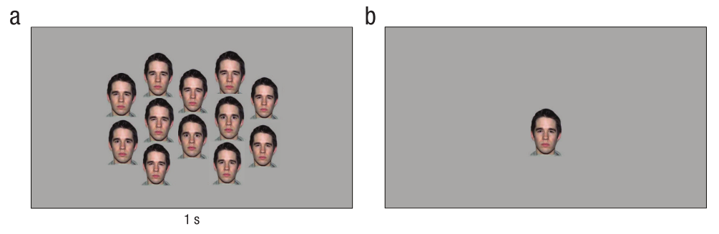
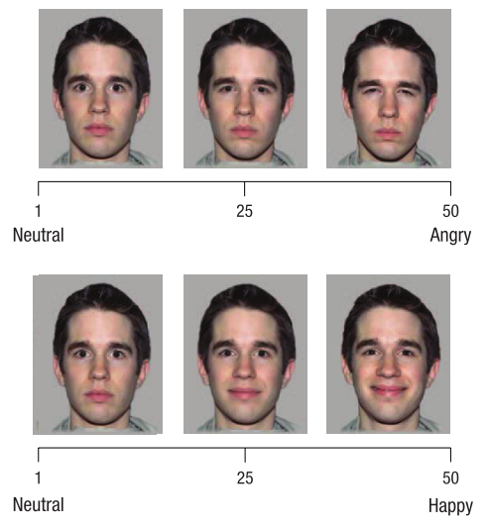
Study 1: Establishing the Crowd-Emotion Amplification Effect
Participants saw an array of one to 12 faces expressing different degrees of either anger or happiness; the arrays appeared on the screen for 1 s. Participants were then asked to evaluate the average emotion expressed by these faces by adjusting the intensity of a single morphed face on a scale from 1 to 50.

Slide 10
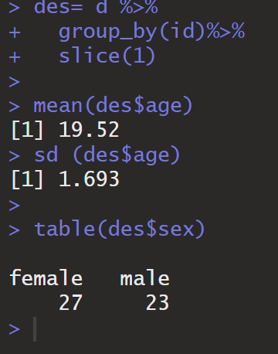
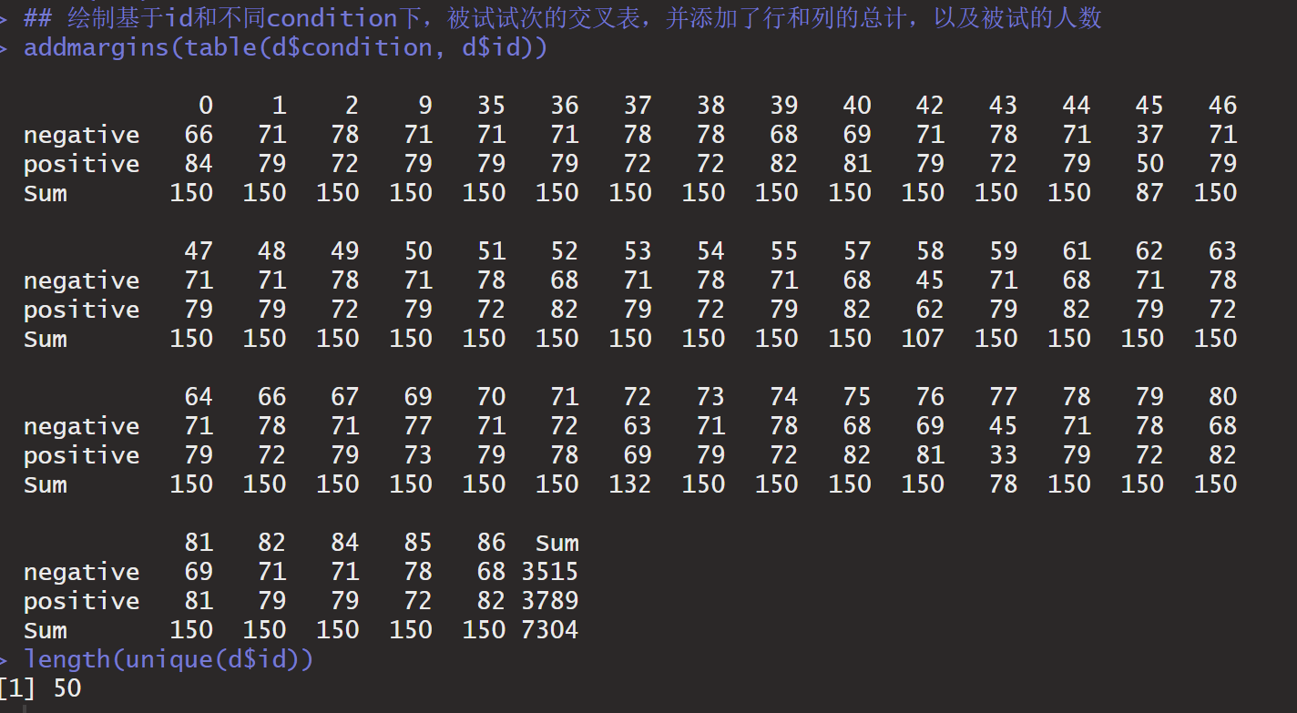

Slide 11

Analysis and result
To measure amplification in estimation of the face sets, we conducted a mixed-model analysis of repeated measures, comparing the actual mean emotion. Supporting the crowd-emotion-amplification hypothesis, results showed that the estimated mean crowd emotion was 2.87 points higher (scale from 1 to 50) than the actual mean crowd emotion, b = 2.87, 95% confidence interval (CI) = [2.53, 3.21], SE = 0.17, t(14533) = 16.8, p < .001, R2 = .05.

Slide 12
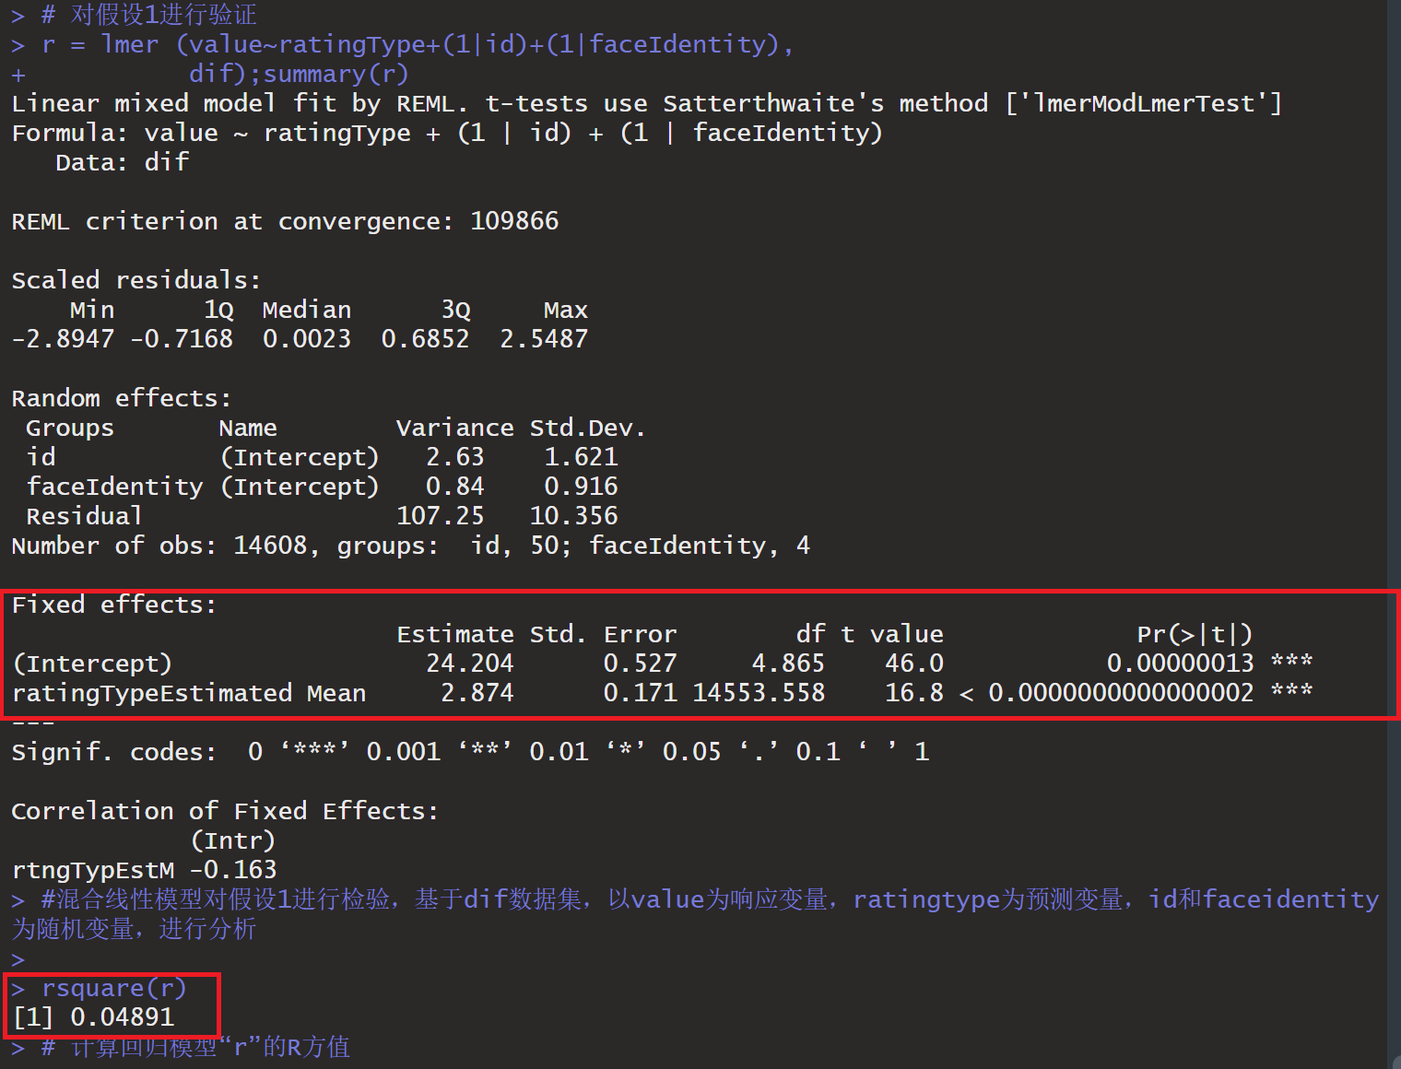
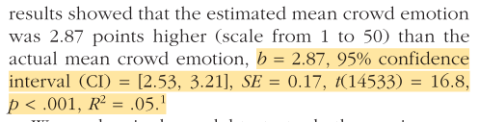
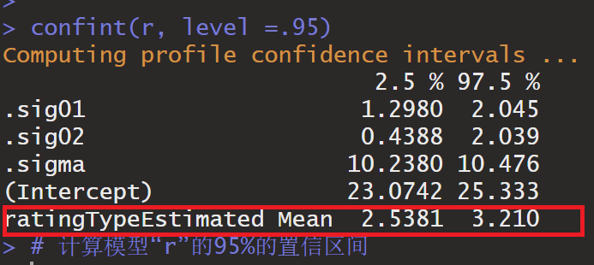
Analysis and result

Slide 13
Analysis and result
We used a single model to test whether an increase in the number of faces (Hypothesis 2) or the type of emotions expressed by the faces (Hypothesis 3) influenced the crowd-emotion-amplification effect.
We then conducted a mixed-model analysis for repeated measures, with number of faces, valence of the faces, and their interaction predicting the degree of the difference between estimated and actual mean emotions.

Slide 14
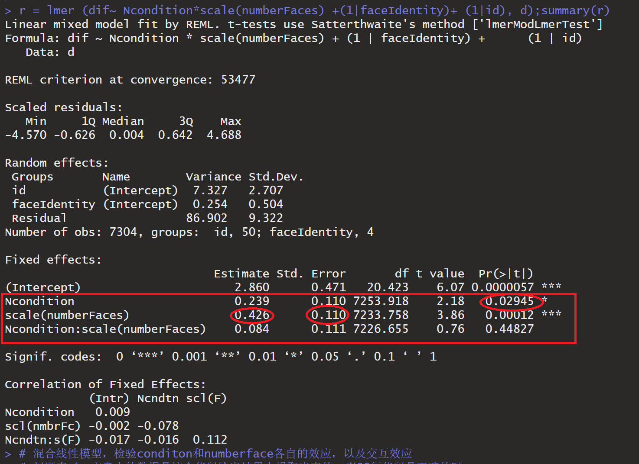
Analysis and result
Results were in line with our second hypothesis: Number of faces significantly predicted an increase in amplification, b = 0.42, 95% CI = [0.21, 0.64], SE = 0.03, t(7233) = 3.86, p < .001, R2 = .08
Supporting our third hypothesis, results showed that amplification was stronger for crowds expressing negative emotions than crowds expressing positive emotions, b = 0.24, 95% CI = [0.02, 0.45], SE = 0.11, t(7253) = 2.18, p = .02, R2 = .08.
The interaction between number of faces and the valence expressed by the faces was not significant, b = 0.08, 95% CI = [−0.13, 0.30], SE = 0.11, t(7226) = 0.76, p = .44, R2 = .08.

Slide 15
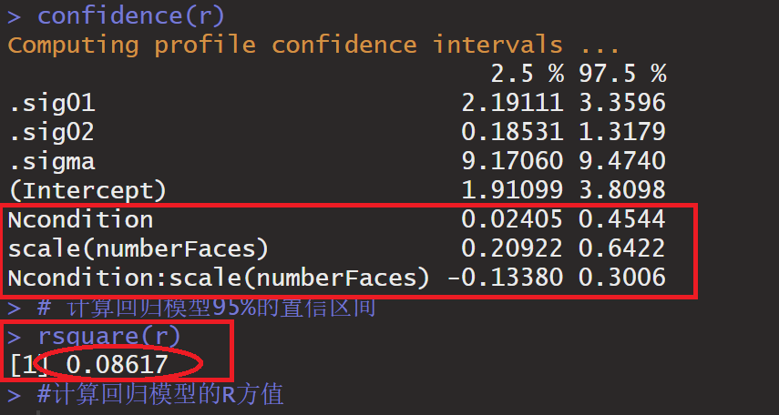

Slide 16
