Slide 1
PSYCHOLOGICAL SCIENCE, 2021
Lara Maister, Sophie De Beukelaer, Matthew R. Longo, and Manos Tsakiris
Replication of The Self in the Mind’s Eye: Revealing How We Truly See Ourselves Through Reverse Correlation
Reporter: Wen Jiahui
Group Member: Han Xiang, Lin Wangjing, Wu Meihui
Honorary Member: ChatGPT

Slide 2
Outline
Author
Introduction
Replication
Discussion
Preparation Schedule

Slide 3
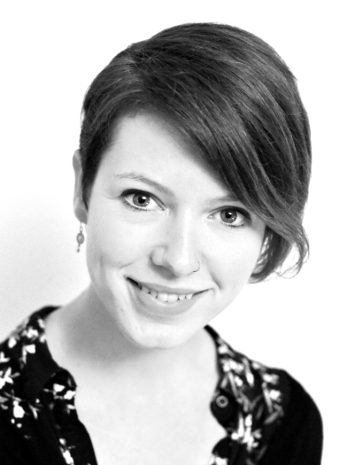
Author
Lara Maister
lecturer in Bangor University
explores self-representation, self-awareness and embodiment
focussed on the representation of our own bodies in terms of both our physical appearance and interoceptive sensitivity to internal bodily sensations
https://www.bangor.ac.uk/staff/human-behavioural-sciences/lara-maister-480151/en

Slide 4
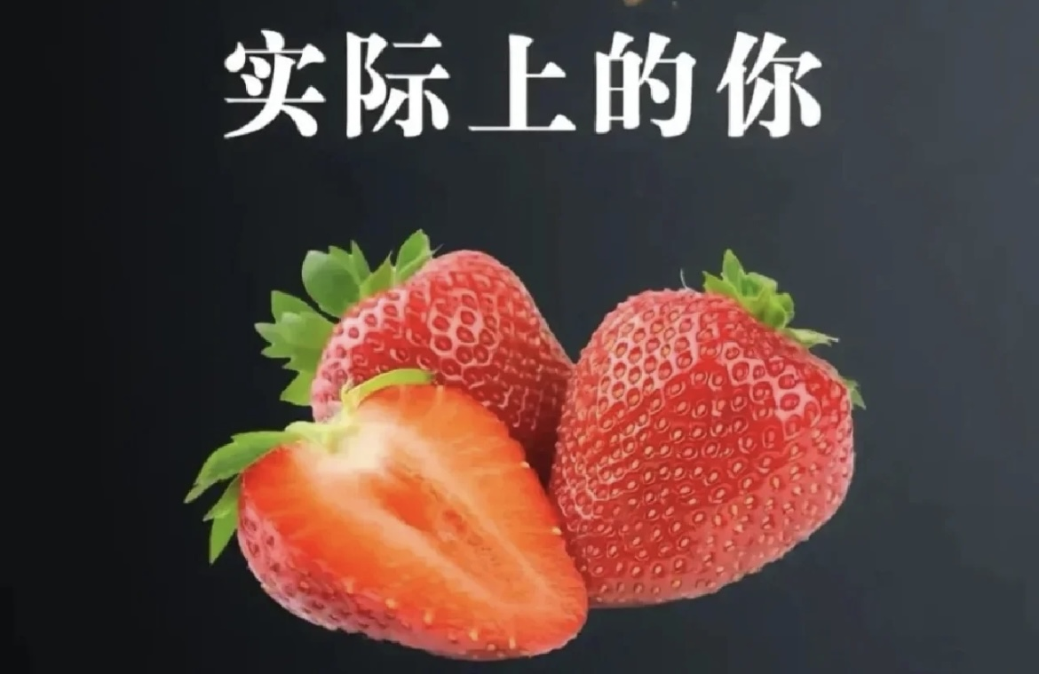
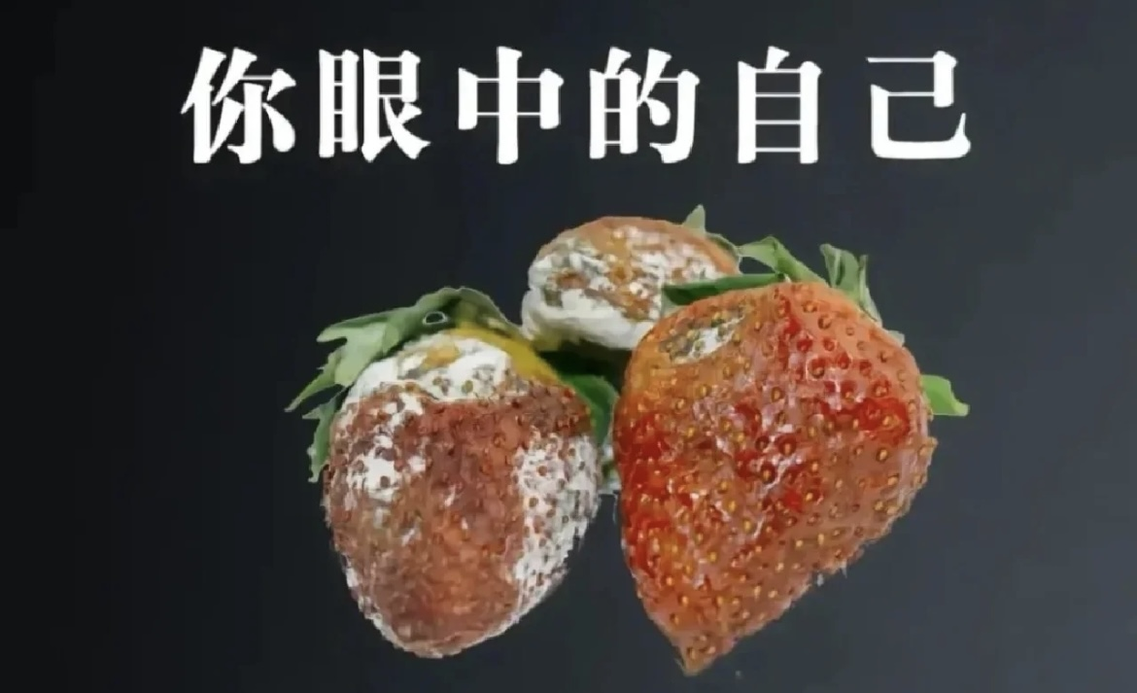
Introduction
What Problem does the paper talk about?
the real face
self portrait
a way to visually depict the image people “see” of themselves
what does the self image tell? ACC
relationship with self esteem, personailty
Notes:
主要复制s1

Slide 5
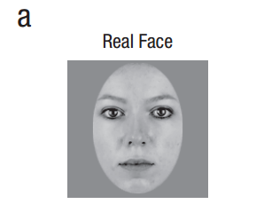
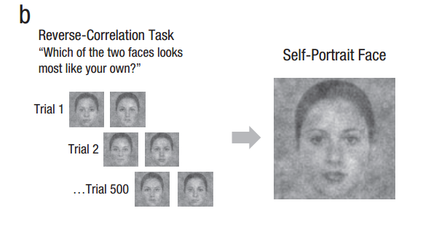
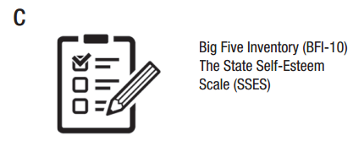
Introduction
How did they measure?
add different noise patterns(rcicr)
open face algorithm

Slide 6
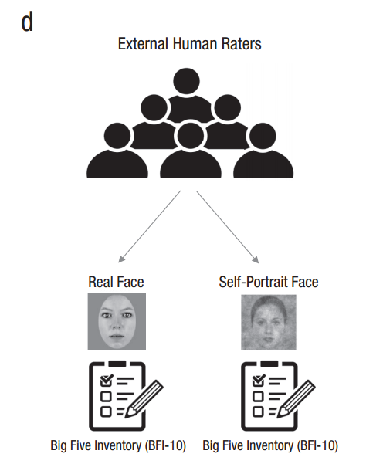


Introduction
How did they measure?
Is Open face Valid?
external human subjects
simulation

Slide 7
Introduction
Main Questions
Q1: Does the self-portrait look like the participant?
Q2: Can external observers reliably infer personality traits from self-portraits?
Q3: Are self-portraits influenced by the psychological self?
Q4: Which individual traits might be related to differences between participants in self-portrait accuracy?

Slide 8
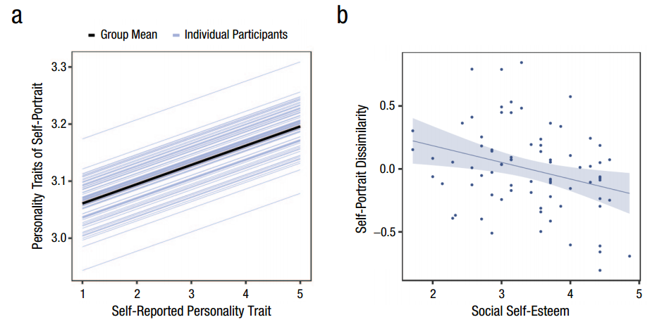
Introduction
What did they get?

Slide 9
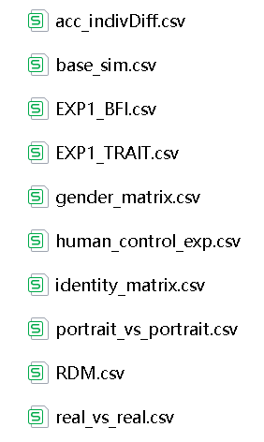
Replication
Data Structure
readme.txt
not raw data, have oringal code(short of annotation)
mean scores of trials for each participant under different condition
lack of information(Q2, control variables)

Slide 10
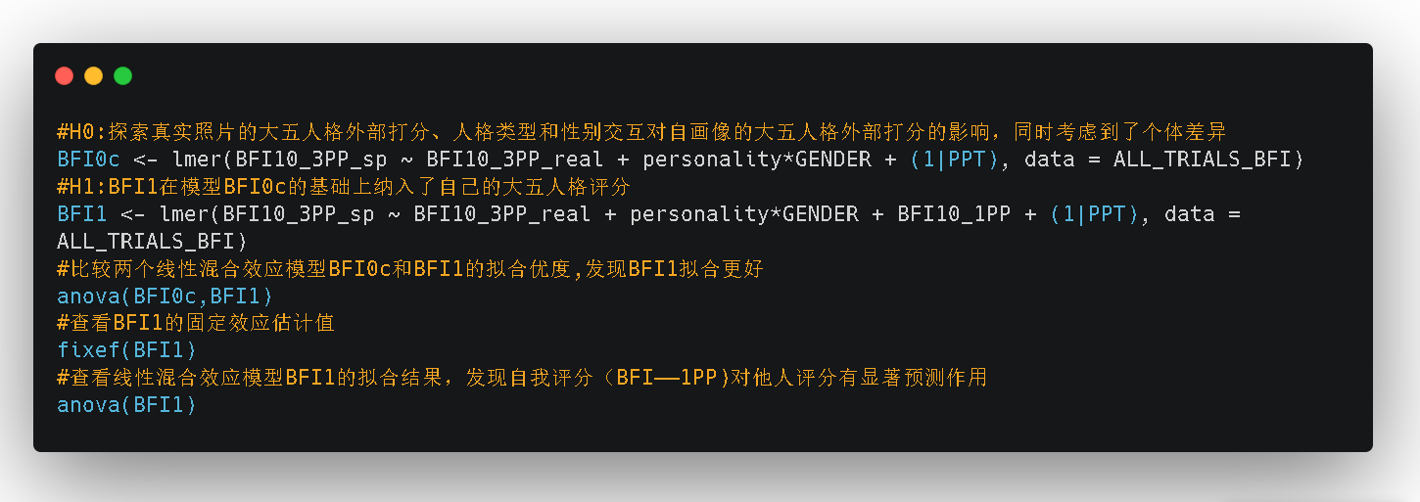
Replication
Code for Q3(personailty → self portrait)
used a linear mixed-effects analysis(interactions, repeated many times)

Slide 11
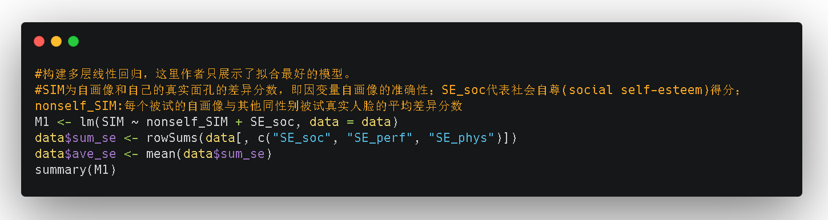
Replication
Code for Q4(self-esteem → difference)
used a hierarchical multiple linear regression(interactions, repeated many times)

Slide 12
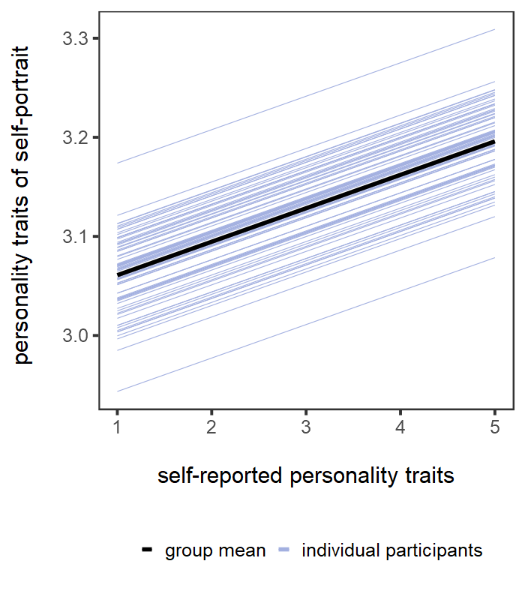
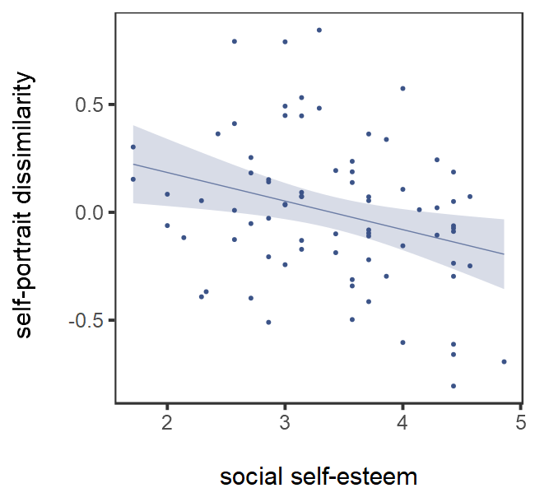
Replication
Results

Slide 13
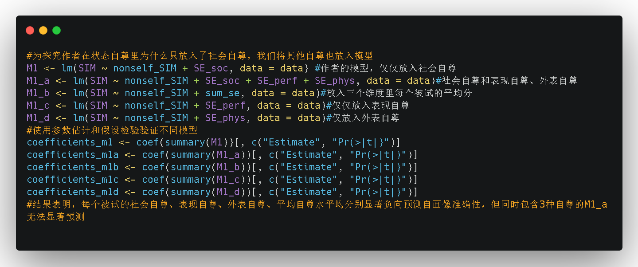
Discussion
Do we have any methods to improve?

Slide 14
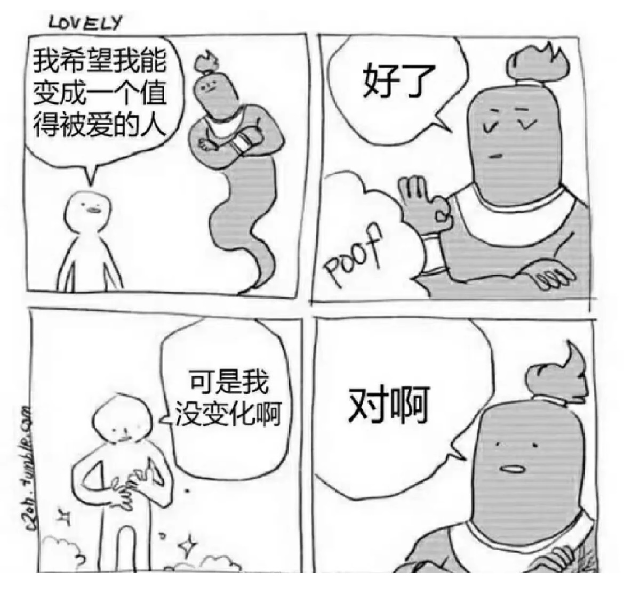
Discussion
Our comments
replicate successfully, except for the part lack of data
not easy to replicate
not enough explaination for the choice of self-esteem and model comparation
strictness

Slide 15
Preparation Schedule
引言
整合补充
方法
原文献领读
讨论
改进代码
结果
数据结构梳理
PPT制作与汇报
代码领读
思路梳理
进一步明确思路
6.2 确定文献与分工讨论
6.5 确定要复制的效应
温佳慧
韩香
6.7 原文献讨论
6.9 数据代码讨论，确定复制思路
6.12 整理代码，重复代码分工
6.16 代码、ppt思路讨论
吴美慧
林王静
6.19 汇报

Slide 16
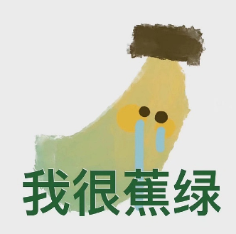
Thanks for attention!
Any questions?

