Slide 1
Surprisingly Happy to Have Helped: Underestimating Prosociality Creates a Misplaced Barrier to Asking for Help
汇报人：唐圆
汇报日期：2023年6月19日
Notes:
意外地乐于助人:低估亲社会性给寻求帮助制造了错误的障碍

Slide 2
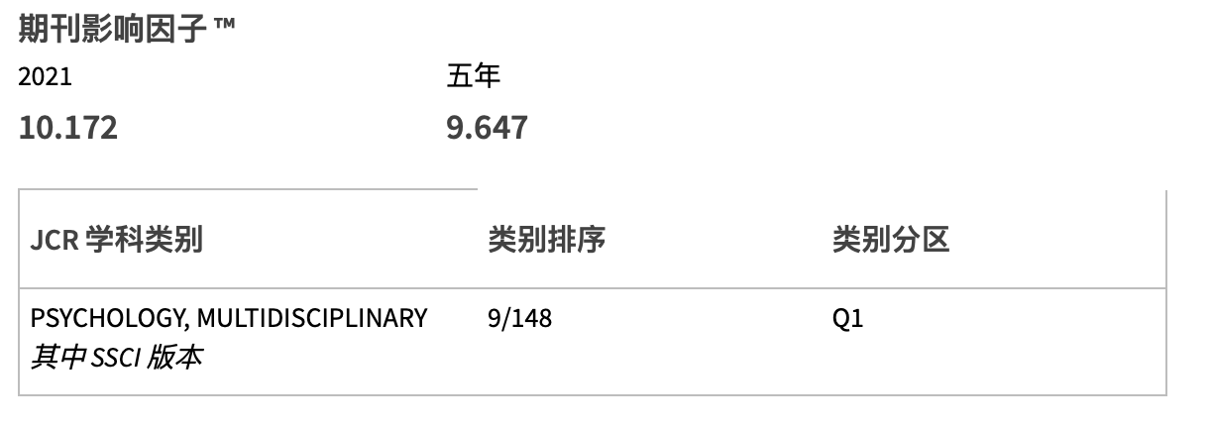
期刊信息
Psychological Science
成员分工
唐 圆——文档撰写，课堂汇报
谢梦菲——编写代码，复现实验结果
安 迪——确定文献，PPT制作，修订审阅内容

Slide 3


作者信息
Xuan Zhao
Department of Psychology, Stanford University
Research Interests：Computational approaches; Decision science; Self & Identity; Social cognition
Nicholas Epley
Booth School of Business, University of Chicago
Research Interests：Experimental study of social cognition; perspective taking; and intuitive human judgment.

Slide 4
成员分工
组长
唐 圆——文档撰写，课堂汇报
组员
谢梦菲——编写代码，复现实验结果
安 迪——确定文献，PPT制作，修订审阅内容

Slide 5
Introduction
Helping others in need seems to be an intuitive response (Zaki & Mitchell, 2013) that tends to leave helpers feeling positive (Andreoni, 1990; Curry et al., 2018; Dunn et al., 2008; Harbaugh et al., 2007).
People misunderstand others’ reactions to a direct request for help (Bohns, 2016). Specifically, we hypothesize that those in need of help underestimate the strength of others’ prosocial motivation to help when asked directly —— consequently underestimating how willingly others will help and how positively others will feel about helping.
Notes:
在日常生活中，每个人都有需要向他人求助的时刻。相比于帮助他人，开口求助也可能是一件更加困难的事？
但是，当人们遇到麻烦，身边又正好有人能帮上忙，“不要麻烦别人”的想法却往往会阻碍人们提出帮助请求。而且，在求助后，如果对方表现得不够热情，人们还会感到失落：觉得ta其实并不愿意提供帮助，只是不好意思拒绝罢了。然而，事实真的如此吗？
人们误解了他人对直接请求帮助的反应（Bohns，2016）。具体来说，我们假设那些需要帮助的人在直接请求时低估了他人的亲社会动机的强度--因此低估了他人愿意帮助的程度以及他人对帮助的积极感受

Slide 6
Introduction
Existing findings
people may systematically underestimate how positively others respond to one’s own sociality, which creates a barrier to engaging with others more often; people tend to assume others’ behaviors are guided by self-interested motivation (Epley & Dunning, 2000; Kruger & Gilovich, 1999; Miller, 1999; Ratner & Miller, 2001).
experiments across a variety of contexts indicate that people reliably underestimate the likelihood that others will agree to their direct requests (Bohns, 2016). This underestimation-of-compliance effect has been interpreted as a failure among requesters to fully appreciate the strength of compliance motivation among recipients.
Notes:
以往研究对此现象的解释是低估依从效应(underestimation-of-compliance effect)，即请求者低估了帮助者的依从动机(compliance motivation)，特别是感觉被他们拒绝时自己会很不舒服，因此低估了他人同意帮助请求的可能性。

Slide 7
Introduction
Researchers predicts that people do not simply misunderstand the likelihood that others will agree to a direct request for help but that they misunderstand the psychological experience of those asked directly for help.
Notes:
然而这一“低估依从效应”缺乏足够的实证支持。
如果帮助者比请求者预期的更亲社会，那么这就预示着帮助者也会比请求者预期的有更积极体验。
如果帮助者比请求者预期的更具依从性，那么这就预示着帮助者也会比请求者预期的有更少的消极体验。
我们的理论预测，人们不仅误解了别人会同意直接请求帮助的可能性，而且误解了那些被直接请求帮助的人的心理体验。

Slide 8
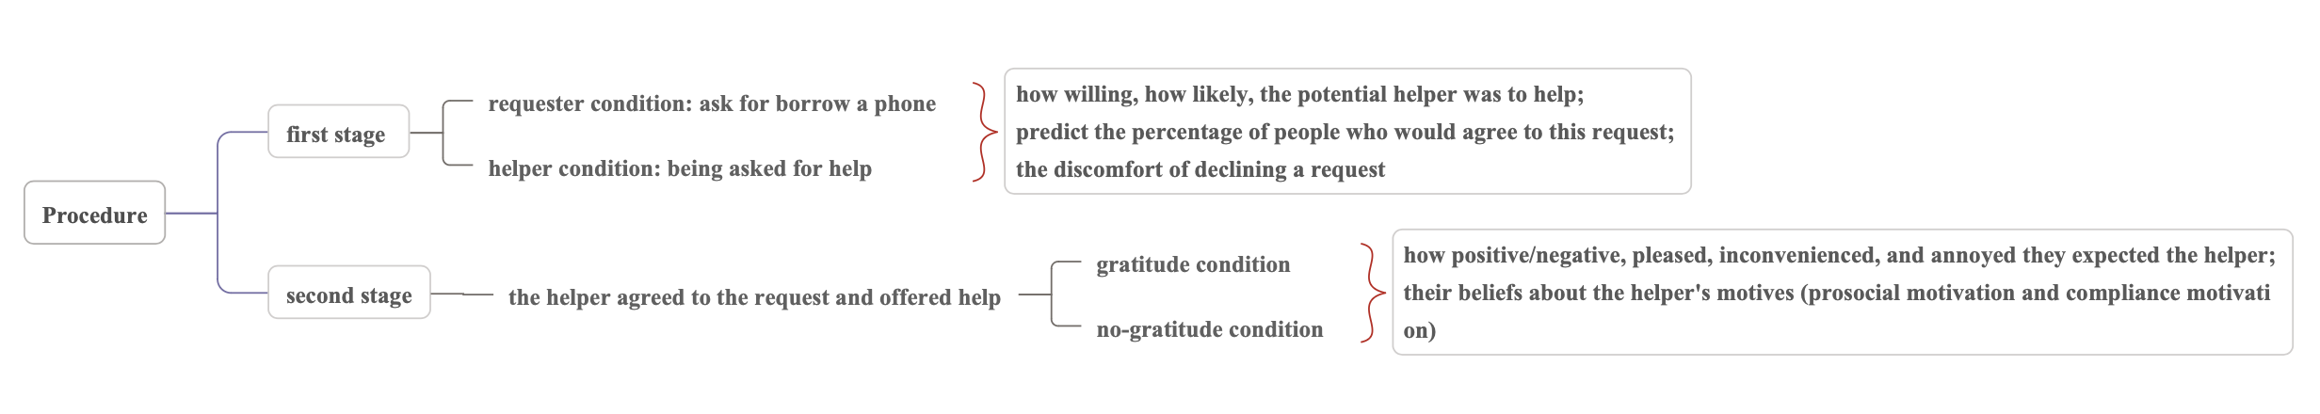
Experiment 1a: Can I Use Your Phone?
Method
Participants: N = 201 (excluded 5 additional participants who reported being younger than 18 years old)
Procedure: 2 (perspective: requester vs. helper) × 2 (gratitude: mentioned vs. not mentioned) between-participants design

Slide 9
Experiment 1a: Can I Use Your Phone?
Results
Willingness to help: how willing and how likely the helper would be to help were highly correlated (r = .86, p < .001); participants in requester condition expected the other person to be significantly less willing and likely to offer help than participants in helper condition, t(199) = −4.30, p < .001, d = −0.61.
Estimated percentage of agreement: people who would agree to help did not differ significantly between requester condition and helper condition, t(199) = 1.12, p = .26, d = 0.16.
Discomfort rejecting request: the estimated discomfort of rejecting a request did not differ between requester condition and helper condition, t(196) = −0.36, p = .72, d = −0.05.

Slide 10
Experiment 1a: Can I Use Your Phone?
Results
Helping experience: the four items are measuring different components of helping experience, therefore conducted a principal components analysis (PCA) and found that they loaded onto two separate components (Positive mood and Inconvenience).
2 (perspective) × 2 (gratitude) analysis of variance (ANOVA) on positive mood ➡️ both perspective (F(1, 197) = 7.36, p = .007, η_{p}² = .036) and gratitude expression (F(1, 197) = 7.97, p = .005, η_{p}² = .039) have a significant main effect; and a nonsignificant interaction, F(1, 197) = 2.16, p = .14.
2 × 2 ANOVA on perceived inconvenience ➡️ a significant main effect of perspective, F(1, 196) = 51.29, p < .001, η_{p}² = .21.

Slide 11
Experiment 1a: Can I Use Your Phone?
Results
Motivation: the four items are measuring different components of motivation, therefore conducted a PCA and found that they loaded onto two separate components (prosocial motivation and compliance motivation).
2 × 2 ANOVA on prosocial motivation ➡️ a significant main effect of perspective, F(1, 194) = 42.13, p < .001, η_{p}² = .18.
2 × 2 ANOVA on compliance motivation ➡️ a significant main effect of perspective, F(1, 193) = 41.77, p < .001, η_{p}² = .18.

Slide 12
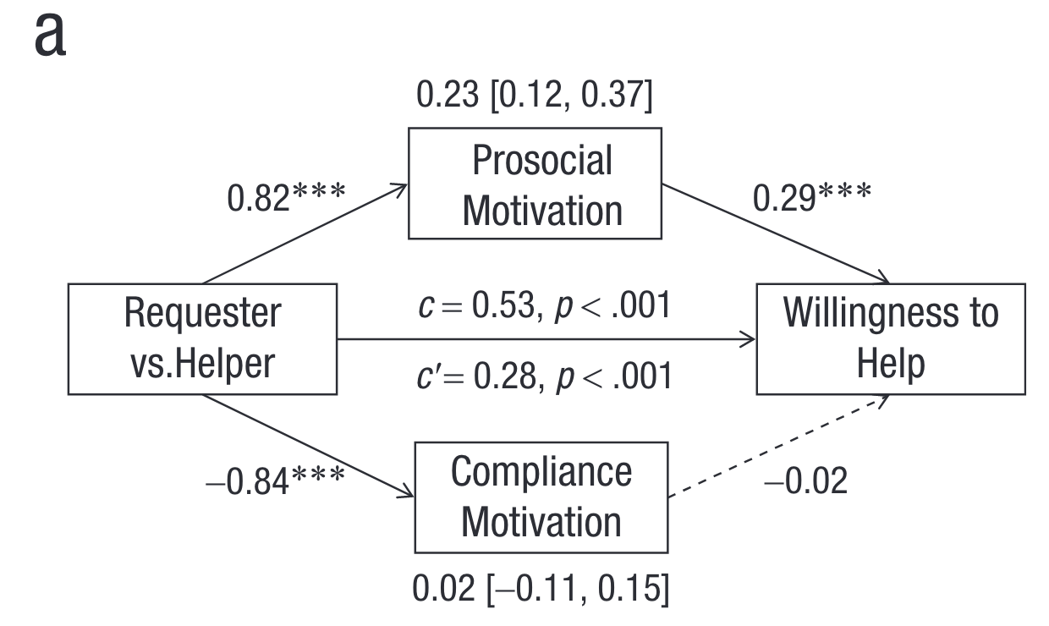
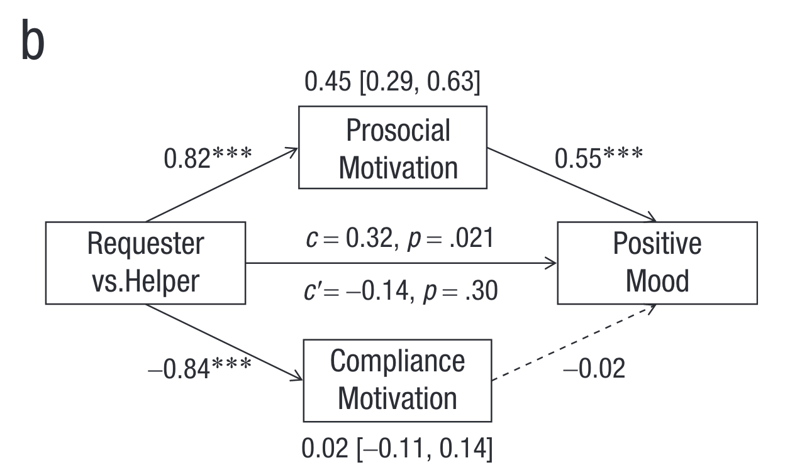
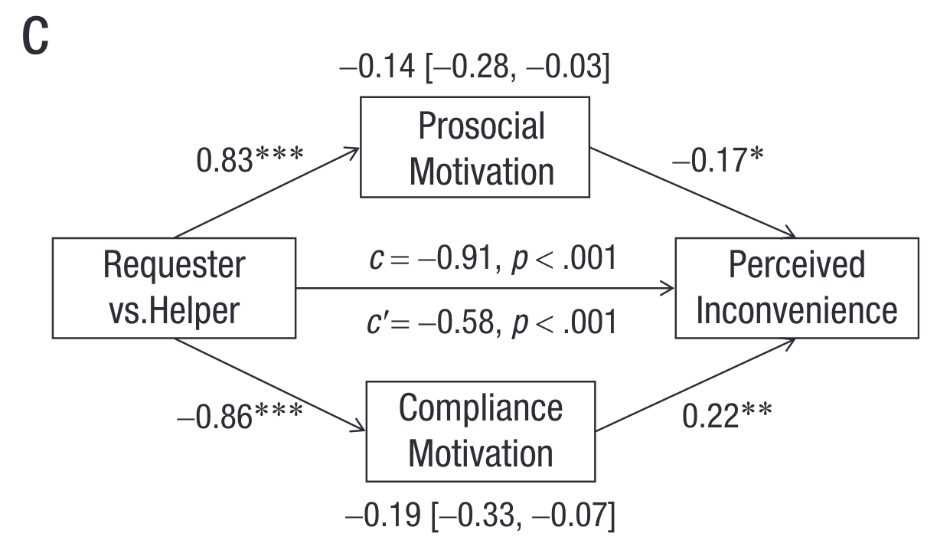
Experiment 1a: Can I Use Your Phone?
Results
Mediation analysis: examine the extent to which motivation attributions mediated perspective differences in helpers’ (a) willingness to help, (b) positive mood from helping, and (c) perceived inconvenience of helping.

Slide 13
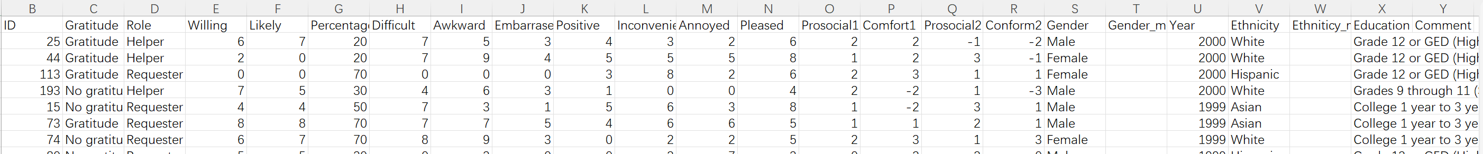
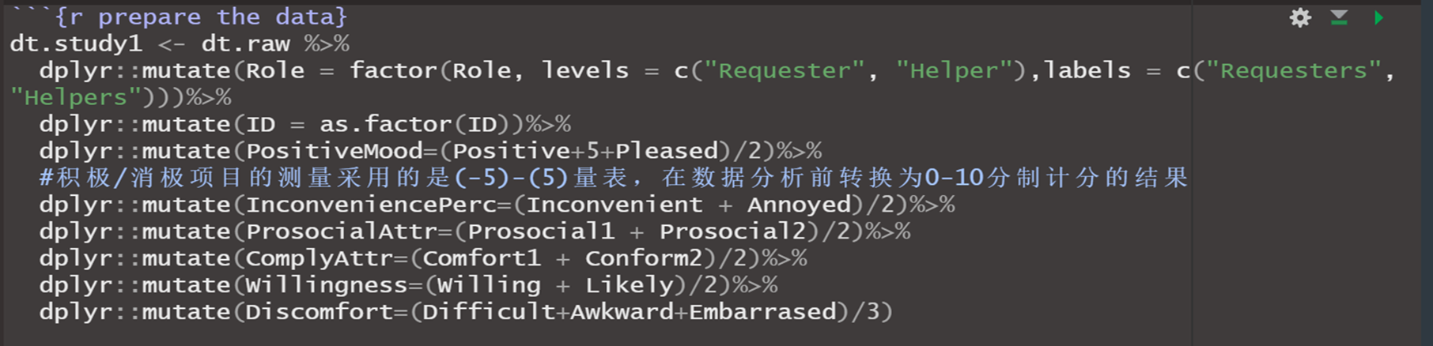
Research Replication Process
Importing raw data and cleaning data
Willingness to help | Willing; likely
Estimated percentage of agreement | Percentage
Discomfort rejecting request | Difficult; Awkward; Embarrassed
Helping experience | Positive; Inconvenience; Annoyed; pleased
prosocial motivation | Prosocial1; Prosocial2
compliance motivation | Comfort1; Conform2

Slide 14
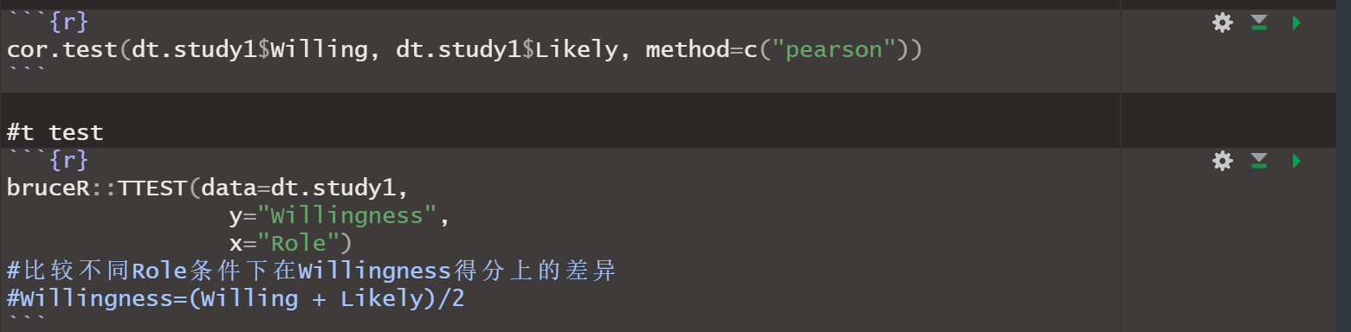
Willingness to Help
Estimates of how willing and how likely the helper would be to help were highly correlated (r = .86, p < .001).
Participants who imagined asking for help expected the other person to be significantly less willing and likely to offer help (M = 5.16, SD = 2.38) than participants who imagined being asked for help (M =6.66, SD = 2.56), t(199) = 4.30, p < .001, d = 0.61.

Slide 15
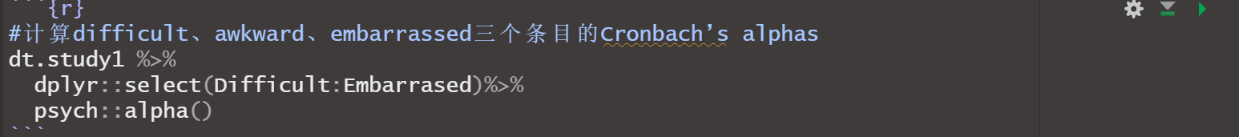
Estimated percentage agreement
The estimated percentage of people who would agree to help did not differ significantly between those who imagined asking for help (M =50.3%, SD = 21.7%) and those who imagined being asked for help (M = 46.9%, SD = 21.6%), t(199) = -1.12, p = .26, d =-0.16.
Discomfort rejecting request
The estimated discomfort of rejecting a request did not differ between those who imagined asking for help (M = 4.74, SD = 2.34) and those who imagined being asked for help (M = 4.87, SD = 2.76), t(196) = 0.36, p =.72, d = 0.05.
α = .82

Slide 16
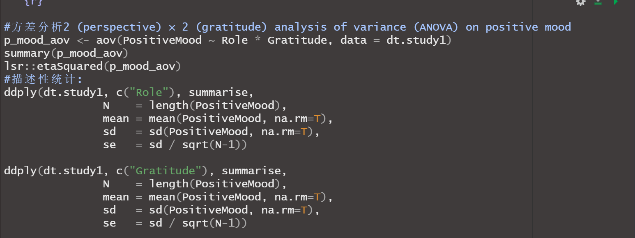
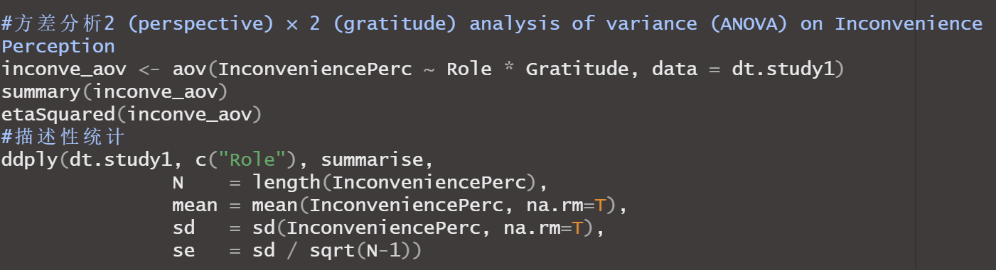
Helping experience

Slide 17
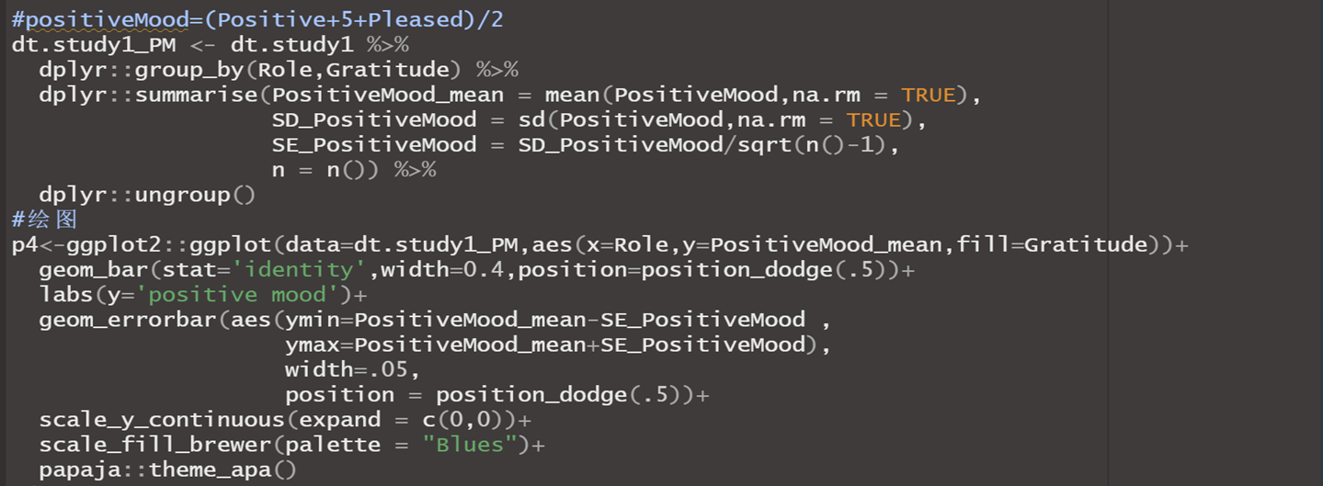
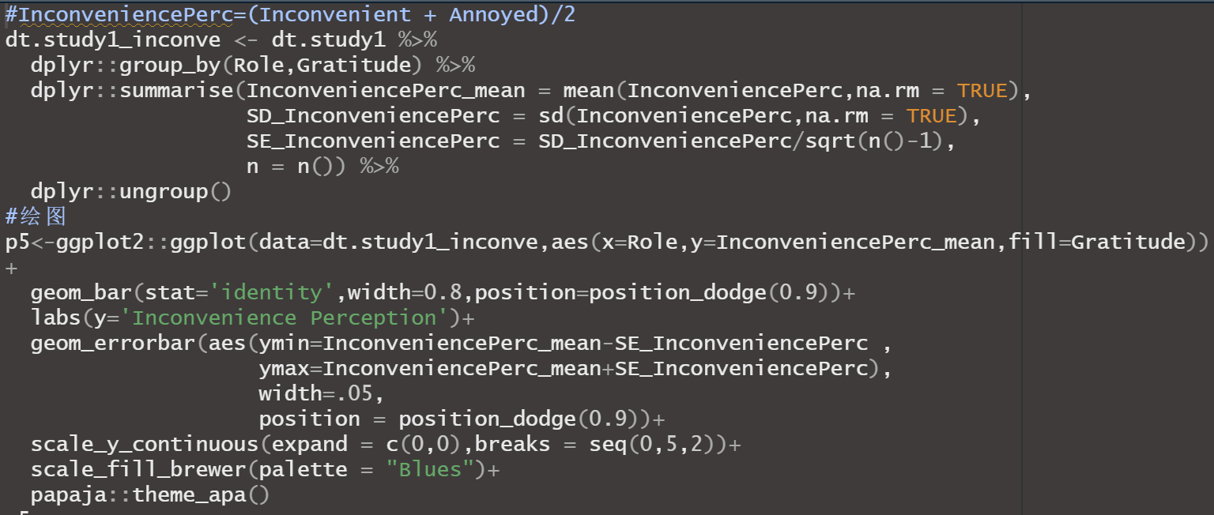

Slide 18
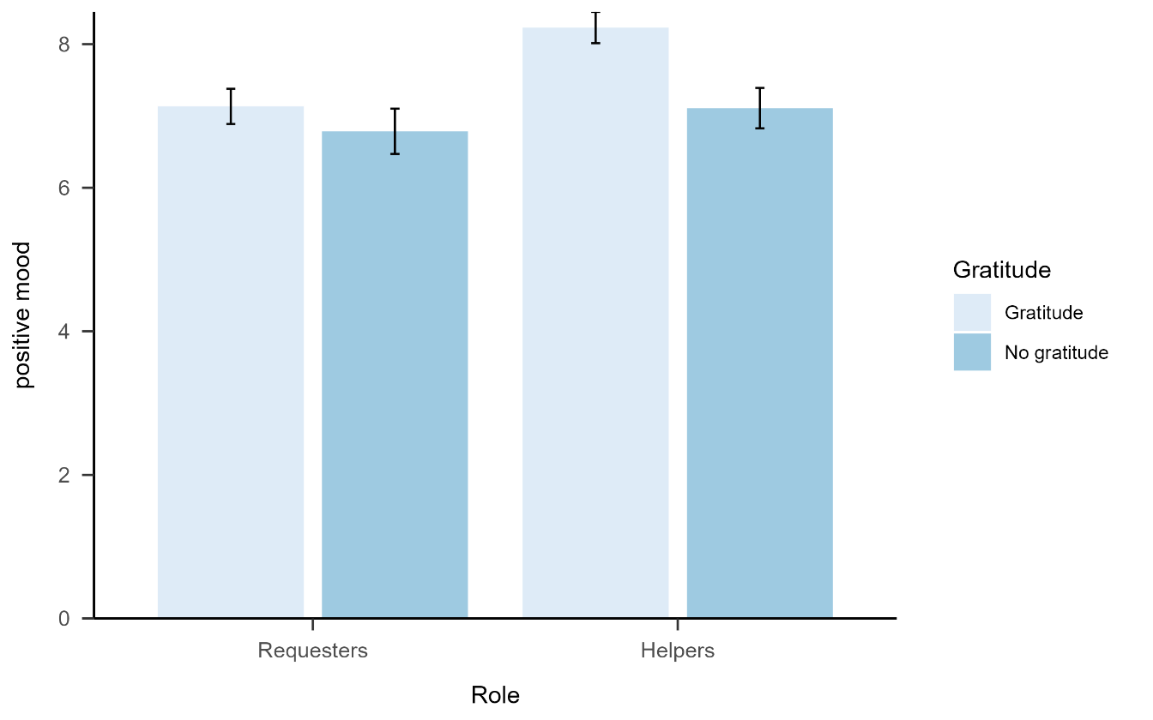
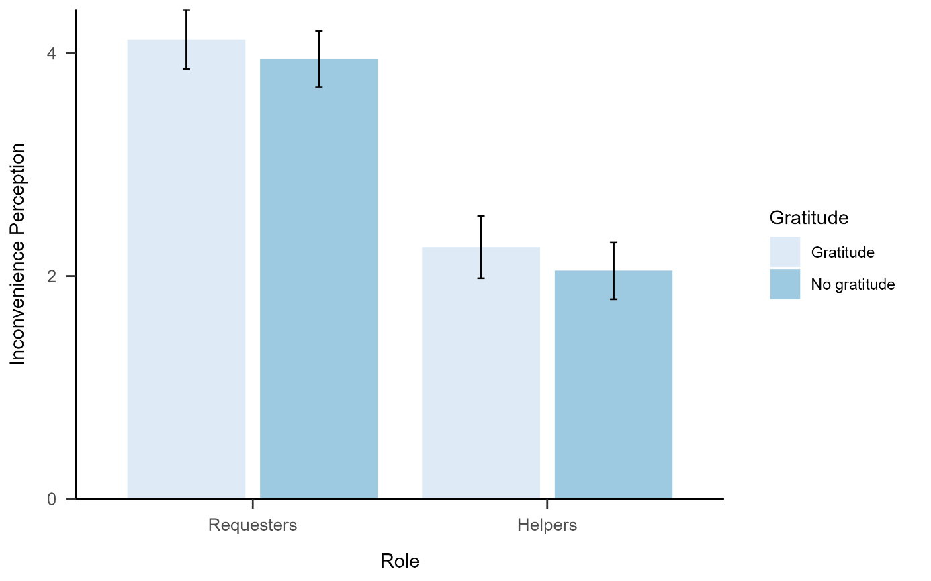
Helping experience
a significant main effect of perspective, F(1, 197) = 7.36, p = .007, η_{p}² = .036, a significant main effect of gratitude expression, F(1, 197) = 7.97, p = .005, η_{p}² = .039.
a significant main effect of perspective, F(1, 196) = 51.29, p < .001, η_{p}² = .21.

Slide 19
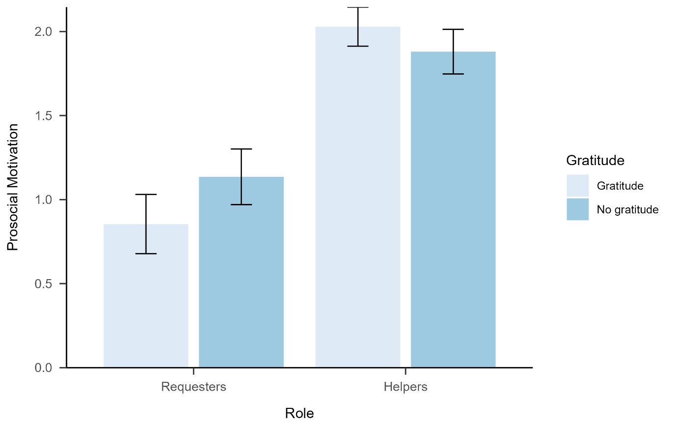
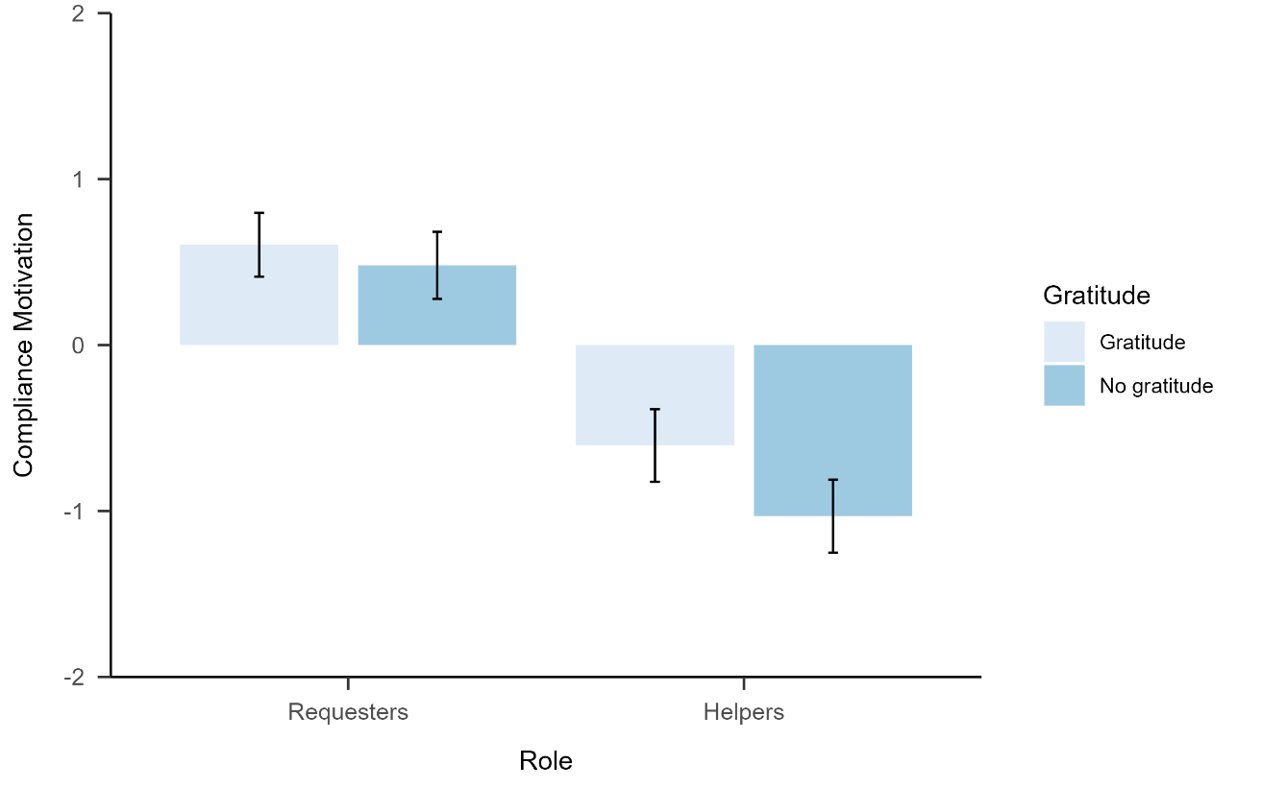
Motivation
A significant main effect of perspective, F(1, 194) =
42.13, p < .001, η_{p}² = .18
A significant main effect of perspective, F(1, 193) = 41.77, p < .001, η_{p}² = .18.

Slide 20
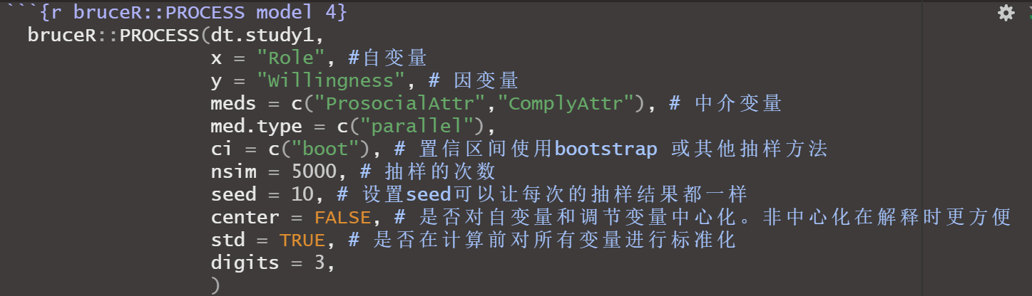
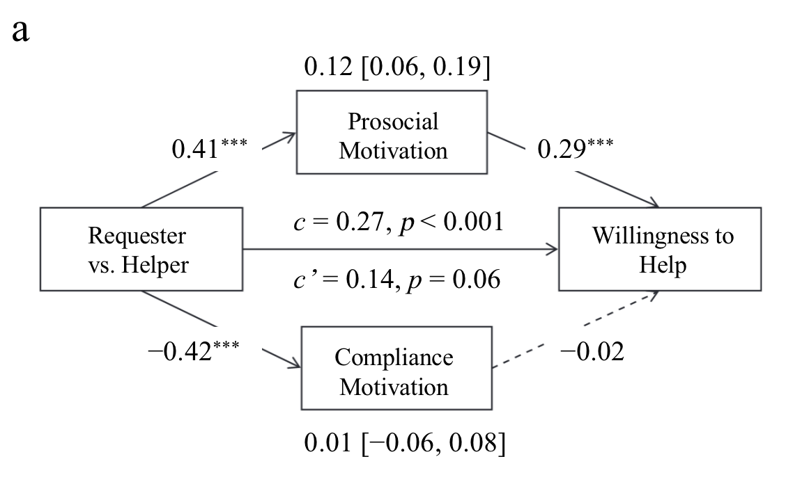
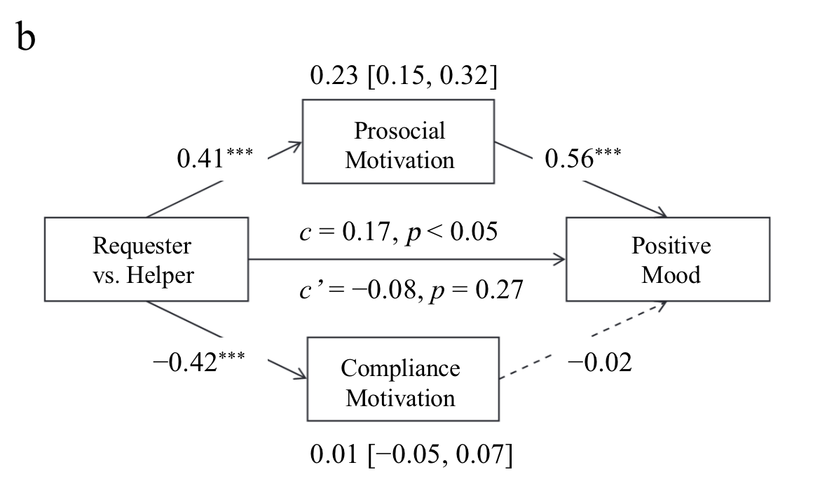
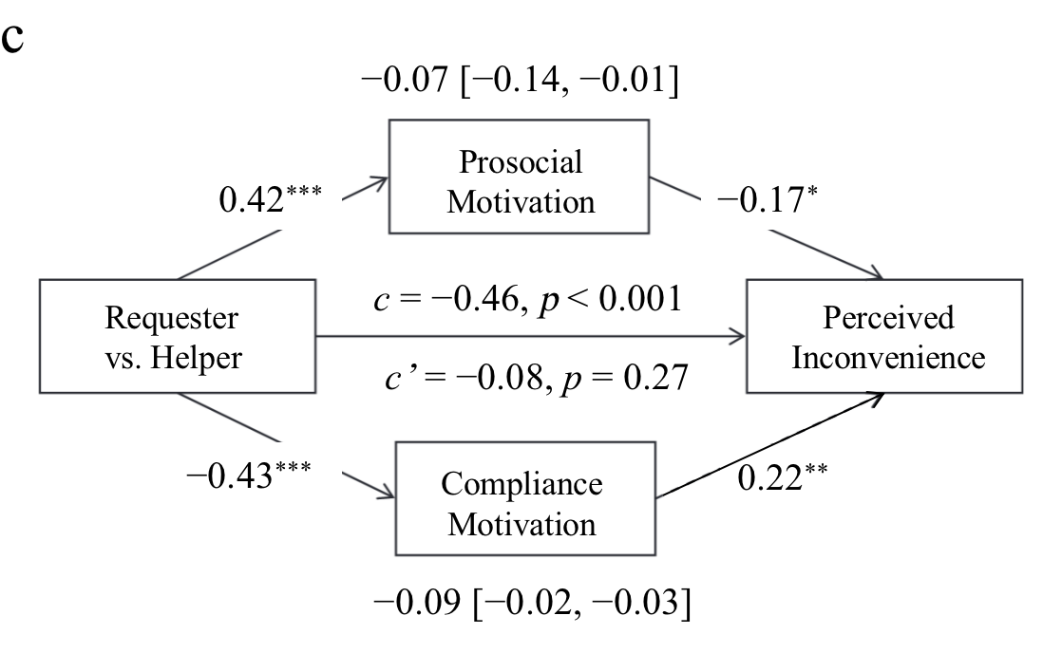
Mediation analysis

Slide 21
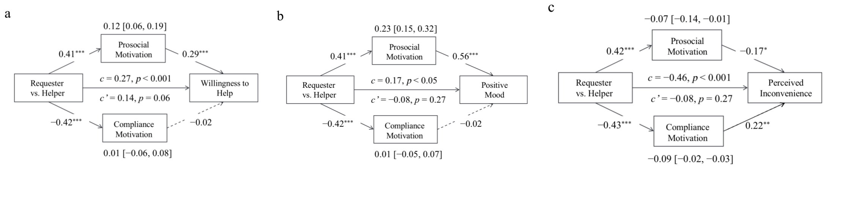
Discussion
Only the Mediation analysis result is not exactly the same as the original article.

Slide 22
Thank you!

