Slide 1
Review of Functional Dependency
Functional Dependency (FD, 函数依赖)
  Def. of FD
  Armstrong’s Axioms (Armstrong公理)
Minimal Cover (最小覆盖)
  Closure of a Set of FDs (函数依赖集的闭包)
  FD Set Cover (函数依赖集的覆盖)
  Equivalence of two sets of FDS (函数依赖集的等价)
  Algorithm 6.6.13：最小覆盖计算算法
Closure of a Set of Attributes (属性集的闭包)
  Algorithm 6.6.12：属性集闭包计算算法

Slide 2
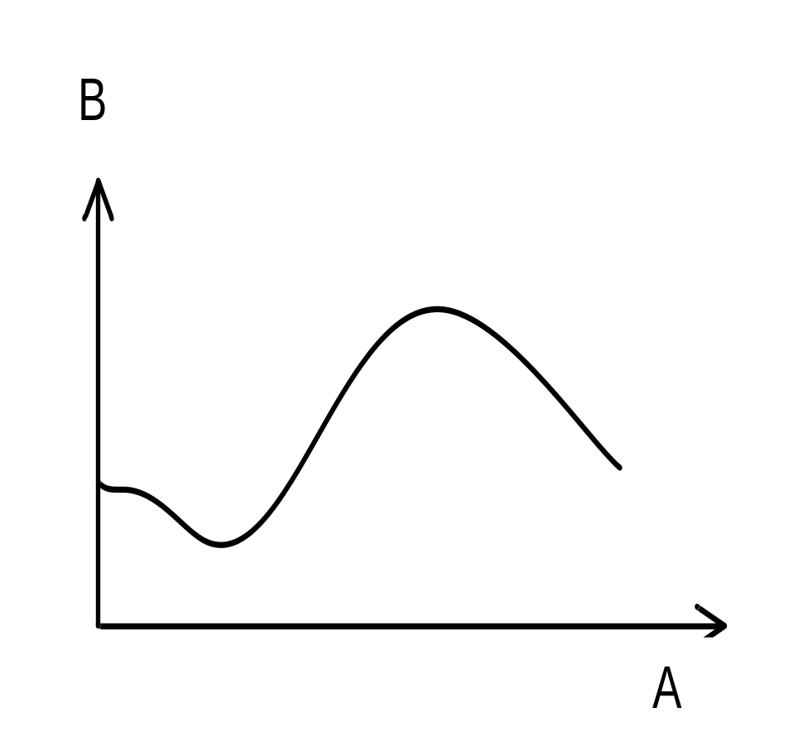
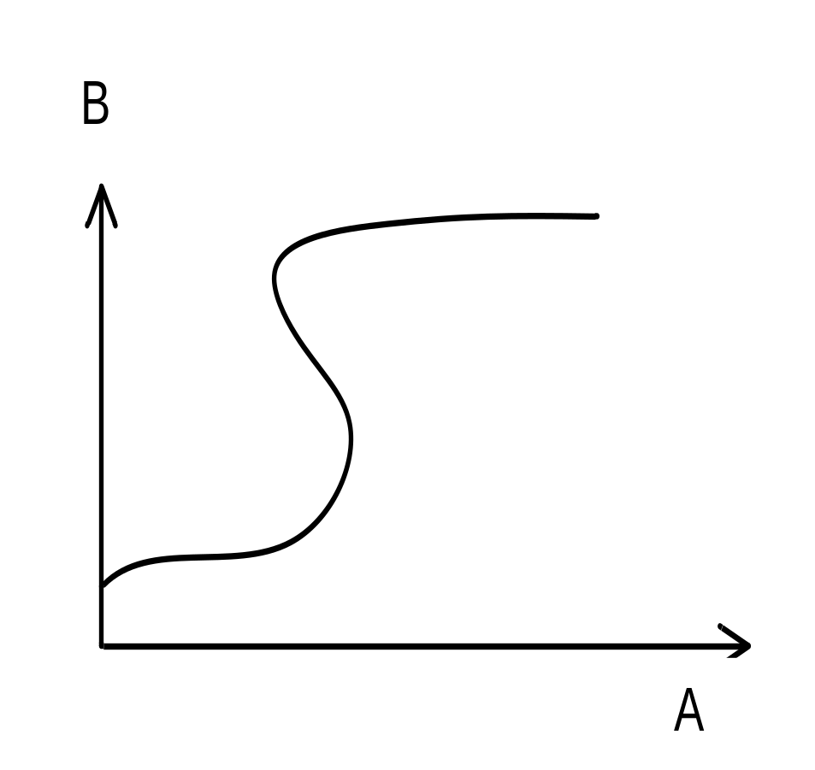
A →B
A →B
A functionally determines B. Each value of A corresponds to only one value of B.
A does not functionally determine B. Some values of A correspond to more than one value of B.
Figure 6.18 Graphical Depiction of Functional Dependency

Slide 3
（一对一）
（一对多）
（多对多）
A
B
A
B
A
B
X1
X2
X3
X4
Y1
Y2
Y3
Y4
X1
X2
X3
Y1
Y2
Y3
Y4
X1
X2
X3
Y1
Y2
Y3
A → B
B → A
B → A
(none)

Slide 4
Review of Armstrong’s Axioms
Armstrong’s Axioms
Rule 1(自反规则): If Y⊆X，then X→Y
Rule 2(传递规则): If X→Y and Y→Z ，then X→Z
Rule 3(增广规则): If X→Y, then XZ→YZ
Some Implications of Armstrong’s
Rule 4(合并规则): If X→Y and X→Z，then X→YZ
Rule 5(分解规则): If X→YZ，then X→Y and X→Z
Rule 6(伪传递规则):If X→Y，and WY→Z，then XW→Z
Rule 7(聚积规则): If X→YZ and Z→W，then X→YZW

Slide 5
Review of Minimal Cover
Closure of a Set of FDs (函数依赖集F的闭包)
  F⁺ = { X→A | F╞ X→A }
FD Set Cover (函数依赖集的覆盖)
  F covers G iff G ⊆ F⁺
Equivalence of two sets of FDS (函数依赖集的等价)
  F covers G and G covers F
Minimal Cover (最小覆盖)
  a minimal set M of FDs that covers a given set F of FDs.
  Algorithm 6.6.13

Slide 6
Review of Closure of a Set of Attributes
Def. 6.6.11: X⁺_{F} = { A | X → A ∈ F⁺ }
algorithm 6.6.12
X⁺ := X;
repeat
  oldX⁺ := X⁺;
  for each functional dependency Y→Z in F do
    if Y⊆ X⁺ then X⁺ := X⁺ ∪ Z;
until ( oldX⁺ = X⁺ )

Slide 7
Review of Normalization
The process of normalization
  Decompositions of table T
  Head(T) = Head(T₁) ∪ Head(T₂) ∪ ...... ∪ Head(T_{k})
Lossless Decomposition (无损分解)
  T ≡ T₁ ∞ T₂ ∞ ... ∞ T_{k}
  Theorem 6.7.3 & 6.7.4：无损分解的判定定理
Lossy Decomposition (有损分解)
  T ⊂ T₁ ∞ T₂ ∞ ... ∞ T_{k}

Slide 8
Exp. of Lossy Decompositions
ABC ≠ AB join BC
ABC
A
B
C
AB join BC
a1
100
c1
A
B
C
a2
200
c2
a1
100
c1
a3
300
c3
a2
200
c2
a4
200
c4
a2
200
c4
a3
300
c3
a4
200
c2
AB
BC
a4
200
c4
A
B
B
C
a1
100
100
c1
a2
200
200
c2
a3
300
300
c3
a4
200
200
c4

Slide 9
Exp. of Lossless Decompositions
ABC
( with FD: B→C )
AB join BC
A
B
C
A
B
C
a1
100
c1
a1
100
c1
a2
200
c2
a3
300
c3
a2
200
c2
a4
200
c2
a3
300
c3
a4
200
c2
AB
BC
A
B
B
C
a1
100
100
c1
a2
200
200
c2
a3
300
300
c3
ABC = AB join BC
a4
200

Slide 10
Content of next
Def. 6.8.3 FD Preserved (依赖保持性)
Superkey & Key
  Algorithm to Find Candidate Key
  PRIME ATTRIBUTE (主属性)
  NON-PRIME ATTRIBUTE (非主属性)
Normal Forms:
  2NF, 3NF, BCNF
Algorithm 6.8.8

