Slide 1
2D Semantic Segmentation in SUSTech Scenes
Proposal for Machine Learning Project
Dec 9，2023
小组成员：王浩羽，陈张杰
张旭东，李宇轩

Slide 2

Outline
Background and Motivation
Related Work
Improvements
Proposed Method
Resources and Experiment Platform
Initial Results
Goals and Objectives
Task Assignment and Project Schedule

Slide 3
Part Ⅰ （李宇轩）
Background
Motivation

Slide 4
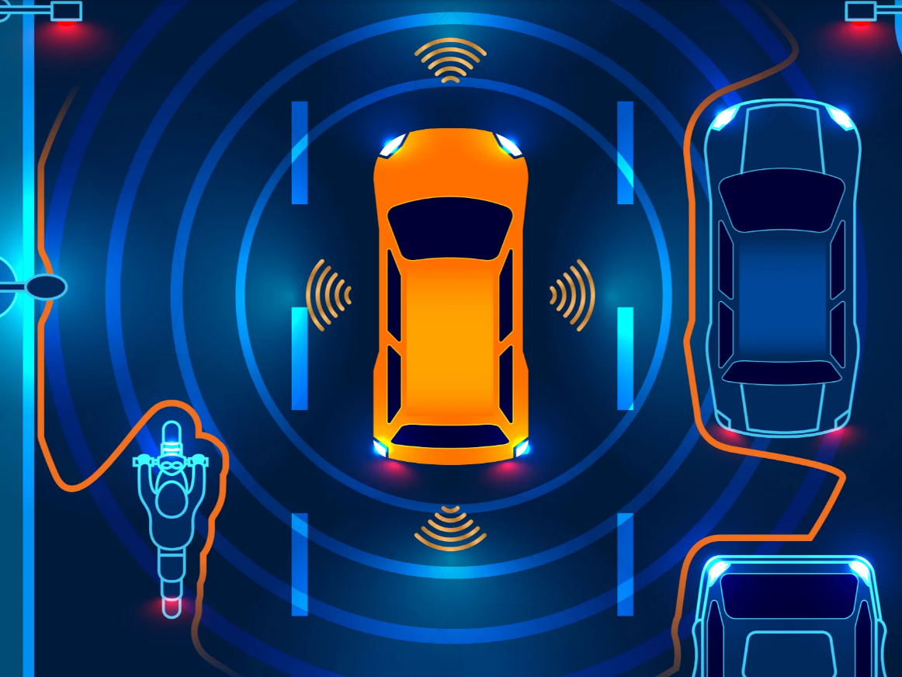
Background and Motivation
Autonomous driving
Image source: https://www.independent.co.uk/travel/news-and-advice/self-driving-cars-buses-autonomous-vehicles-b2413681.html
Notes:
自动驾驶，也被称为自动驾驶或无人驾驶技术，代表了汽车行业的革命性进步。它涉及无需人工干预即可导航和操作的车辆。自动驾驶汽车利用传感器、摄像头、雷达和人工智能的组合来感知周围环境并做出实时决策，使它们能够独立在道路上行驶。自动驾驶汽车的发展基于关键要素，包括环境感知、数据处理、路径规划和控制系统。这些因素共同确保了安全舒适的自动驾驶体验。环境感知是自动驾驶的关键功能，它关注的是车辆解读和理解周围环境的能力。
然而，环境状态的不确定性给自动驾驶系统带来了挑战。不可预测的路况和动态场景等因素需要先进的感知技术来适应并做出准确的决策。为了应对这些挑战，我们将语义分割应用于环境感知。语义分割是一种感知方法，它将图像中的像素划分为不同的语义类，如道路、行人、车辆和障碍物，使车辆能够理解其环境。自动驾驶中语义分割的主要目的是提供对周围环境的详细了解，帮助自动驾驶车辆做出决策。

Slide 5
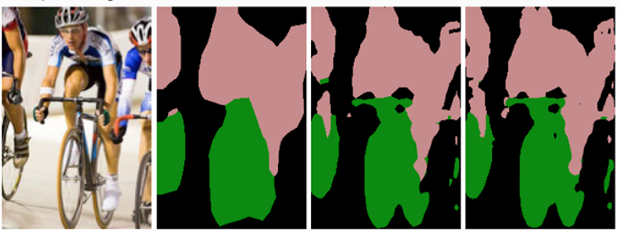
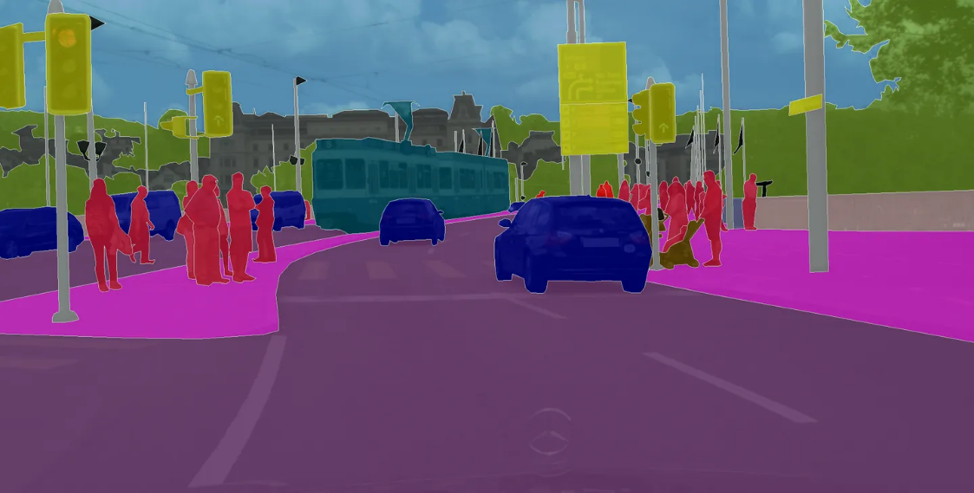
Background and Motivation
Semantic Segmentation
Pixel-level Classification 像素级
Wide applications
autonomous driving
medical imaging
robotic vision
video surveillance
Deep learning Approaches
U-Net, FCN, SegNet, …
Challenges
Image source: https://zhuanlan.zhihu.com/p/31428783
Notes:
语义分割是计算机视觉领域的一个重要分支，它旨在将数字图像分割成若干个语义区域。在语义分割任务中，每个像素都被分配一个类别标签，使得具有相同类别的像素被归为同一区域。这些类别通常是有意义的物体或场景的一部分，如人、车辆、建筑物、树木等。语义分割有助于计算机深入理解图像内容，识别图像中不同的对象及布局。
它的应用非常广泛，包括上文提到的自动驾驶领域以及 医疗影像中对于病变区域的识别、机器人视觉任务中机器人对于周围环境的理解 和 通过监控视频对人群进行识别和分析。
近年来，随着深度学习技术的发展，特别是卷积神经网络（CNN）的广泛应用，语义分割的性能得到了显著提升。常见的深度学习模型包括 U-Net、全卷积网络 - FCN和 SegNet 等。
但语义分割仍面临非常多的挑战，包括类别不平衡（某些类别的样本比其他类别多得多）、小对象识别难度大、以及在复杂背景中的难以精确分割等问题。

Slide 6
Part Ⅱ （王浩羽）
Relative Work
Improvement

Slide 7
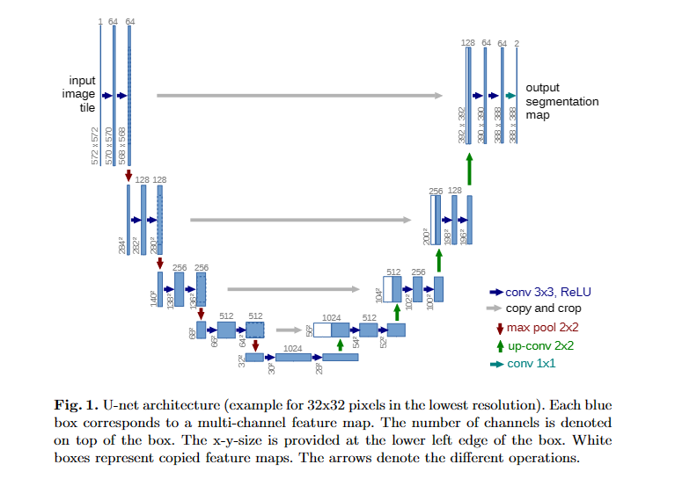
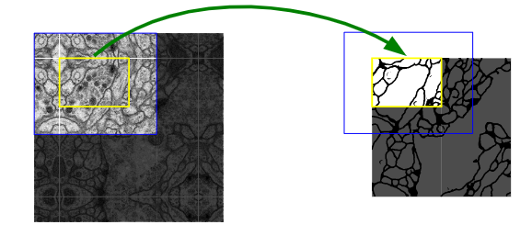
Related Work
U-Net: Architecture
Fully convolutional network
contracting path => expansive path
Image source: U-Net: Convolutional Networks for Biomedical Image Segmentation
Notes:
U-Net是比较早的使用全卷积网络进行语义分割的算法之一，它希望能够识别图片中的细胞边界，论文中使用包含压缩路径和扩展路径的对称U形结构在当时非常具有创新性，且一定程度上影响了后面若干个分割网络的设计，该网络的名字也是取自其U形形状。它包含压缩路径和扩展路径，两个路径分别进行最大池降采样操作和反卷积，最终得到一个2维的segmentation map，因为这是一个二分类问题。

Slide 8
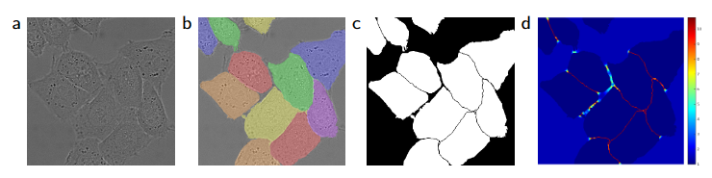
Related Work
U-Net: Optimizer
Stochastic Gradient Descent (SGD)
Small batch size (size=1) ------ Large input tiles
High momentum (0.99)
Image source: U-Net: Convolutional Networks for Biomedical Image Segmentation
Notes:
由于batch size非常大的时候，很多gpu的显存用于存储模型权重，使得gpu显存浪费很多；因此 U-Net 的团队采用更大的单张图片，而batch size设置为1。这会导致梯度估计依赖于单张图片造成噪声比较大，因此采用一个很高的动量，使得早期的训练样本也可以对梯度下降方式产生较大的影响。
(a)是输入数据，(b)是Ground Truth，(c)是基于Ground Truth生成的分割掩码，(d)是U-Net使用的用于分离边界的损失权值。

Slide 9


Related Work
U-Net: Loss Function
Pixel-wise soft-max
Cross entropy loss function ,“l(x)”: true label of pixel x
weight map “w(x)” , w_{c}(x): weight of class
d1(x), d2(x): distance to border of cell
(a) input ; (b) segmentation maps ; (c) generated segmentation mask ; (d) the border pixels
Image source: U-Net: Convolutional Networks for Biomedical Image Segmentation
Notes:
由于batch size非常大的时候，很多gpu的显存用于存储模型权重，使得gpu显存浪费很多；因此 U-Net 的团队采用更大的单张图片，而batch size设置为1。这会导致梯度估计依赖于单张图片造成噪声比较大，因此采用一个很高的动量，使得早期的训练样本也可以对梯度下降方式产生较大的影响。
(a)是输入数据，(b)是Ground Truth，(c)是基于Ground Truth生成的分割掩码，(d)是U-Net使用的用于分离边界的损失权值。

Slide 10
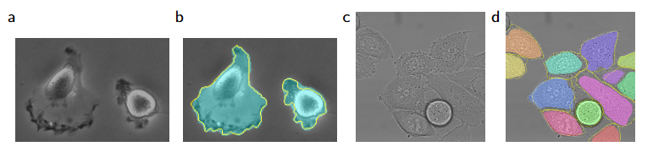
Related Work
U-Net: Dataset - ISBI cell tracking challenge
(2012, 2014, 2015)
Size: 30, 35, 20 (Very Small)
Data Augmentation
Shift, Rotation
random elastic Deformation, Gray value variations
Image source: U-Net: Convolutional Networks for Biomedical Image Segmentation
Notes:
U-Net的实验是一个比较简单的ISBI cell tracking数据集，由于本身的任务比较简单，U-Net 仅通过30张图片并辅以数据扩充策略便达到非常低的错误率

Slide 11
Improvements Enlighten
Some insights from U-Net paper
Architecture: It seems difficult to change?
Optimizer: calculation resource ------ trade off
Loss Function: How to recognize “border”?
Data Preprocessing: How to Augment data to improve the Robustness of model?

Slide 12
Part Ⅲ （陈张杰）
Proposed Method
Resources and Experiment Platform
Initial Results
Goals and Objectives

Slide 13
Proposed Method
Appling to multi-class classification
U-Net was originally designed for binary segmentation tasks (background and foreground).
For multi-class segmentation, the output layer requires more channels, typically one for each class. For instance, if there are 5 classes, the output layer would have 5 channels, each predicting for a specific class.

Slide 14
Proposed Method
Our Model
Down Sampling Layers & Pooling Layers
Input Image
Down1
pool1
Down2
pool2
Down3
pool3
Down4
pool4
Activation function: LeakyReLU
Bridge/Bottleneck
Bottleneck: capturing the most essential features while reducing its spatial dimension
Up4
Up3
Up2
Up1
Input Image
trans4
trans3
trans2
trans1
Up Sampling Layers & Transforming Layers

Slide 15
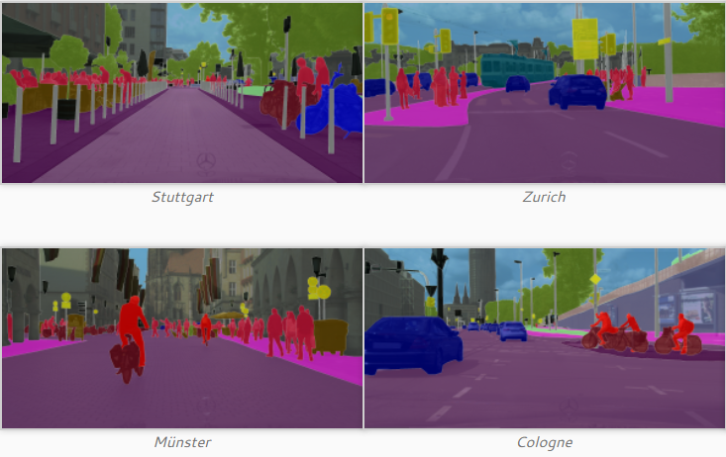
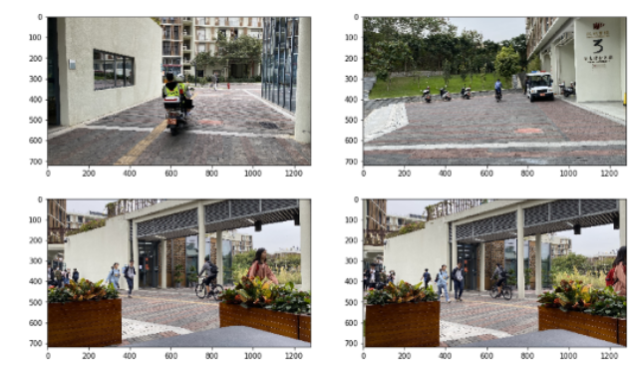
Proposed Method
Dataset
Cityscapes Dataset
https://www.cityscapes-dataset.com/
The Cityscapes Dataset focuses on semantic understanding of urban street scenes
Train/Test set: leftImg8bit_trainvaltest & gtFine_trainvaltest
Self-sampled SUSTech Dataset
We plan to sample and label pictures from SUSTech campus and by ourselves.
The dataset will be used in evaluating segmentation models.

Slide 16
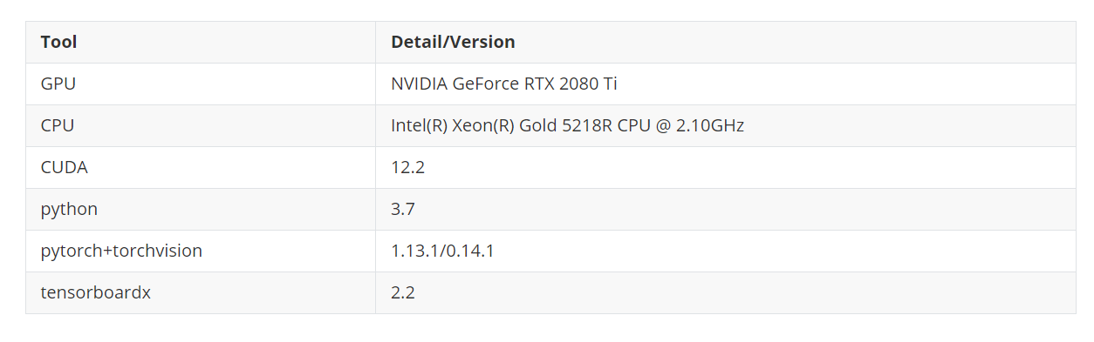
Resources and Experiment Platform
Server provided by ML course

Slide 17
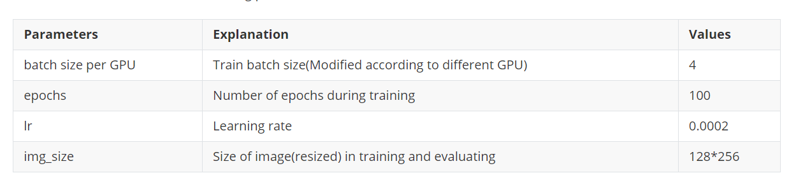
Initial Results
Hyperparameters

Slide 18
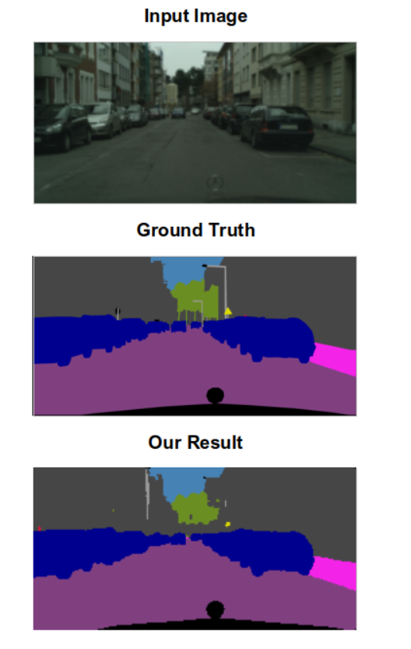
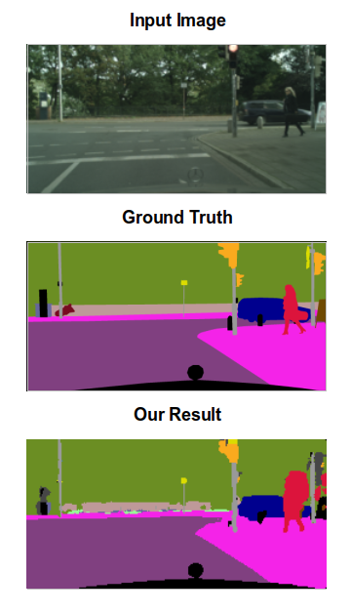
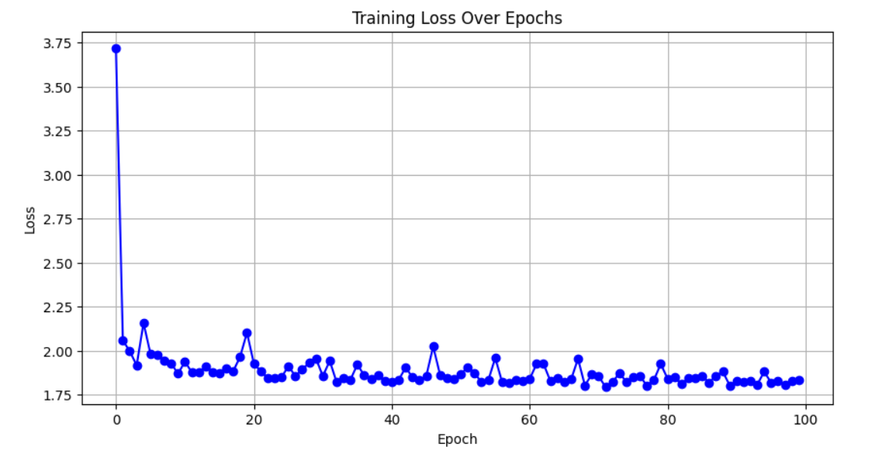
Initial Results
examples of semantic segmentation result
Training Loss

Slide 19
Initial Results
Pixel-Level Accuracy: 0.8443 (benchmark 0.77)
Average Runtime: 0.0186sec
Dominant Class IoU (Intersection over Union):
Label ID | Object Type | IoU
1 | ego vehicle | 0.8170
7 | road | 0.8951
11 | building | 0.7786
20 | traffic sign | 0.3951
21 | vegetation | 0.8210
23 | sky | 0.8090
24 | person | 0.4578
Summary
High efficiency
High IoU over dominant classes
Lower IoU over less dominant classes
The model performs well on segmenting dominant components of the image, however it misses detailed information due to small input size.

Slide 20
Goals and Objects
Learn the basic mathematics behind CNN and self-attention mechanism in transformer.
Deploy models on semantic segmentation tasks.
Explore and try other models including DeepLab v2/v3
Sample SUSTech dataset with fine segmentation results.
Optimize the models based on performance on SUSTech dataset.

Slide 21
Task Assignment
王浩羽：
Survey on 2D semantic segmentation
Construct cityscapes dataset
陈张杰:
Train the model
Conduct evaluations on trained models
Improve model performance
张旭东:
Choose model and estimate memory consumption
Evaluate test performance
Improve model performance
李宇轩:
Construct self-sampled SUSTech dataset
Data preprocessing for SUSTech dataset
Improve model performance

Slide 22
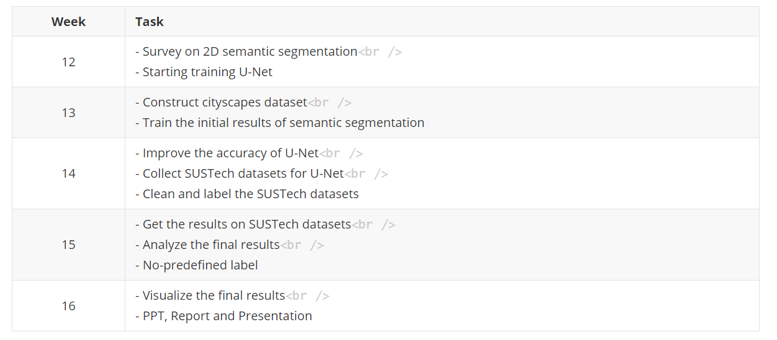
Project Schedule

Slide 23
Reference
[1] Olaf Ronneberger, Philipp Fisher and M. Kozubek. U-Net: Convolutional Networks for Biomedical Image Segmentation[J] .arXiv e-prints arXiv:1505.04597,2015.
[2] Prannay Khosla, Piotr Teterwak and Chen Wang. Supervised Contrastive Learning[J] .arXiv e-prints arXiv:2004.11362,2021.
[3] Xudong Wang, Rohit Girdhar, Stella X. Yu, and Ishan Misra. Cut and Learn for Unsupervised Object Detection and Instance Segmentation[J]. arXiv pre-prints arXiv:2301.11320,2023.

Slide 24
THANK YOU!

Slide 25
Background and Motivation
强调
正文

