Slide 1
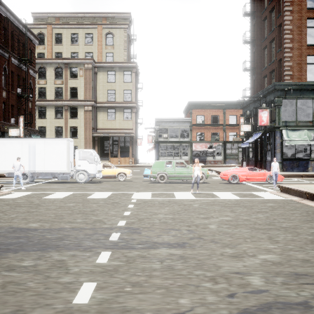
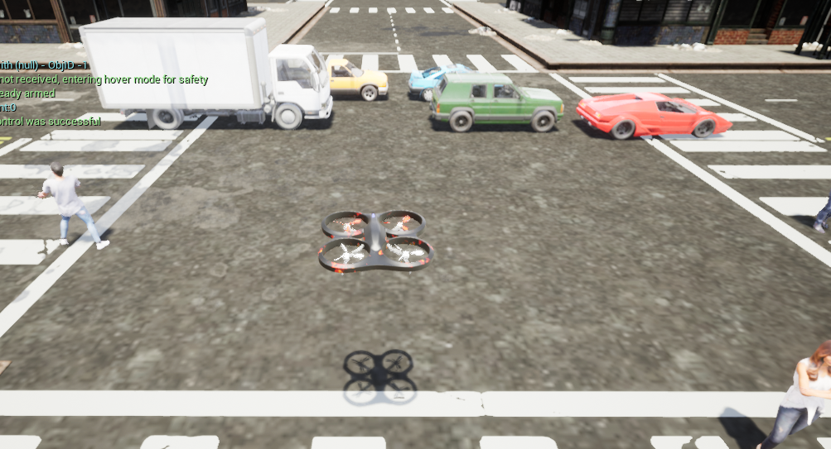
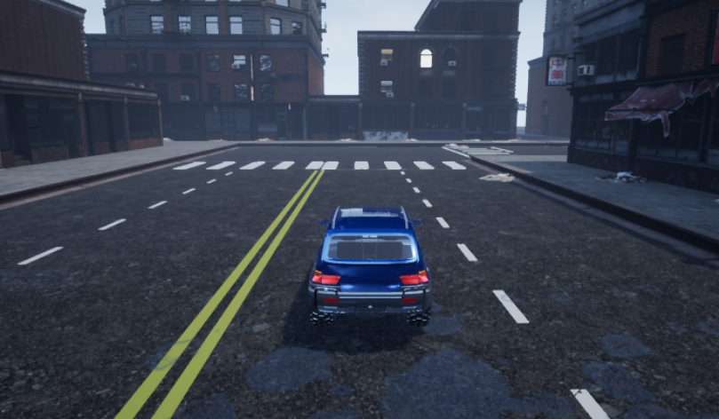
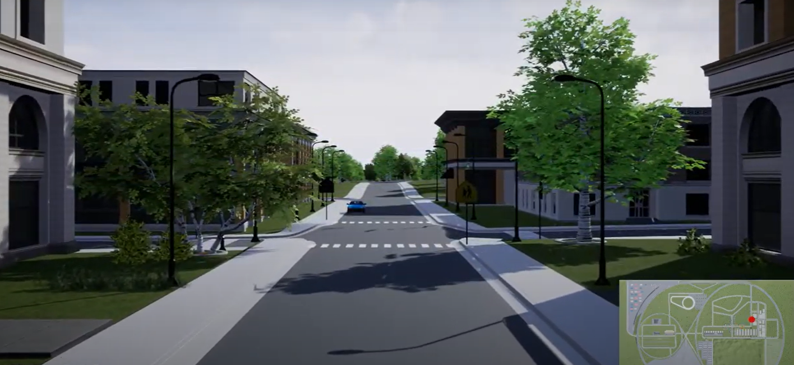

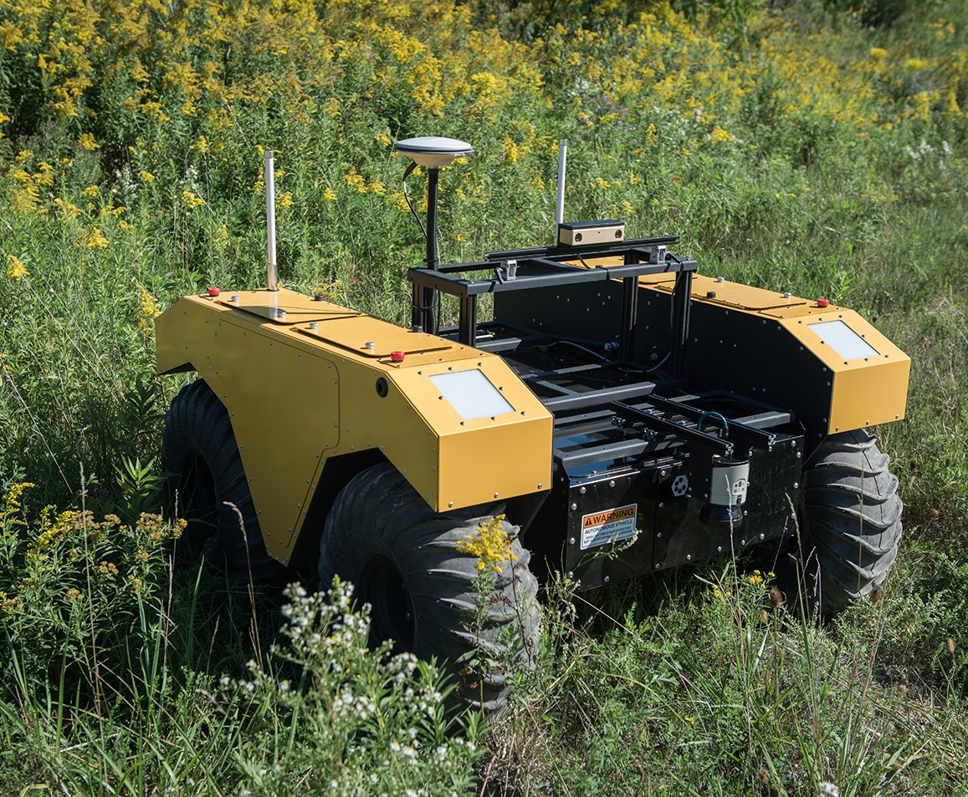
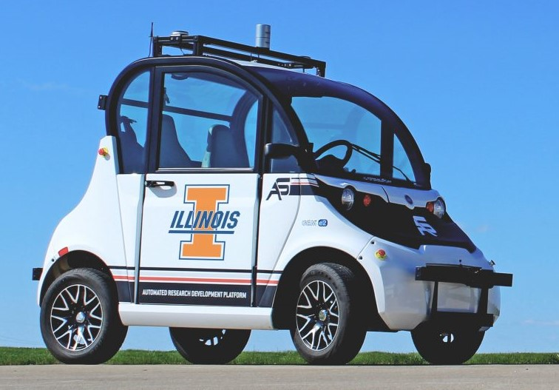

Ambiguity Set, Model Update
Candidate Trajectories with Costs
Environment
Control
Planning
Perception
Simulation
Certificate Learning
Model predictive path integral (MPPI)
Sample Candidate Trajectories
Self-supervised learning and adaptation
Model Learning
Uncertainty-guided fusion
Real Environment
Lower Dimensional Constraint
State estimator (particle filter)
Incremental $ℒ$₁ adaptive control
Cost map
generation
Camera image,
Lidar, IMU
Actuator Cmd.
Target Trajectory, Constraints
Occupancy & Uncertainty Map
Robot Operating System (ROS) Communication Bus

