Slide 1
DAA432C
Assignment-01
Presented By:
IIB2019033-Md Monish Ansari
IIB2019034-Sanket Kokude
IIB2019035-Harshit Kumar

Slide 2
Problem Statement
Given an n x n matrix, where every row and column is sorted in increasing order. Given a key, how to decide whether this key is in the matrix. Solve using divide and conquer algorithm.

Slide 3
Introduction
A divide-and-conquer algorithm recursively breaks down a problem into two or more sub-problems of the same or related type, until these become simple enough to be solved directly. The solutions to the sub-problems are then combined to give a solution to the original problem.

Slide 4
ALGORITHM DESCRIPTION
Following is divide and conquer algorithm:
If the key lesser than the minimum element or greater than the maximum element in the matrix return false
If the matrix contains only one element then check fo key and return true or false accordingly
Find the middle element.
If middle element is same as key return true.
If key is greater than the middle then check if element is present in present in lower submatrix or upper right submatrix, If found return true else return false
If the key is lesser than the middle element then check
If the key is present in vertical submatrix on the left side of the middle element or in upper right submatrix .
If found return true else return false.

Slide 5
Pseudo Code:
bool search(vector<vector<int>> & arr,,sRow,eRow,sColumn,eColumn, key)
If k<arr[sRow][sColumn] or k>arr[eRow][eColumn]
Return false
if sRow == eRow and sColumn == eColumn
if (key == arr[sRow][sColumn])
Print found key
return true
else
return false;
midRow = (sRow + eRow) / 2
midColumn = (sColumn + eColumn) / 2

Slide 6
if (arr[midRow][midColumn] == key)
Print found key
return true
else if (key < arr[midRow][midColumn]) {
bool a = false, b = false
if (midRow - 1 >= sRow)
a = search(arr, sRow, midRow - 1, midColumn, eColumn, key)
if (midColumn - 1 >= sColumn)
b = search(arr, sRow, eRow, sColumn, midColumn - 1, key)
return (a or b)

Slide 7
else
bool a = false, b = false;
if (midColumn + 1 <= eColumn)
a = search(arr, sRow, midRow, midColumn + 1, eColumn, key)
if (midRow + 1 <= eRow)
b = search(arr, midRow + 1, eRow, sColumn, eColumn, key)
return (a or b)
}

Slide 8
Time complexity:
We are given a n*n matrix, the algorithm can be seen as recurring for 3 matrices of size n/2 x n/2. Following is recurrence for time complexity
T(n) = 3T(n/2) + O(1)
The solution of recurrence is O(n^1.58) using master method.
But the actual implementation calls for one submatrix of size n x n/2 or n/2 x n, and other submatrix of size n/2 x n/2.
Space Complexity: O(n)

Slide 9
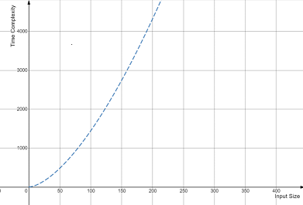
Time Complexity Curve:

Slide 10
Conclusion:
Finding the key with divide and conquer algorithm reduces the time complexity of searching, which would be O(n^2) in case of the linear searching algorithm.
Finally, Divide and Conquer algorithm works more efficiently.

Slide 11
Thank you!

