Slide 1
Very Long Baseline Interferometry (VLBI) – Techniques and Applications
Steven Tingay
ATNF Astronomical Synthesis Imaging Workshop
Narrabri, 24 – 28 September, 2001

Slide 2
Overview
The technique – how is it similar, how is it different to connected element interferometry;
VLBI instrumentation;
VLBI science
Black hole masses - NGC 4258/Circinus;
Low redshift AGN - M87/Centaurus A;
Wide field imaging;
Astrometry/low mass stellar companions;
“superluminal” motion – 3C120;
Microquasars – GRO J1655-40.

Slide 3
The Technique
Elements are not connected
Electronics are locked using station clocks;
Data are recorded on tape for post-observation processing
Elements can therefore be placed, in principle, anywhere, including in space;
Resolution between an Earth-based antenna and a space antenna in a 20,000 km orbit at 5 GHz is approximately 0.25 mas – Earth baseline, 15 GHz;
VLBI is thus very sensitive to errors in the geometric model used by the correlator
Source and station positions (these change with time);
Vastly different weather conditions at each Element

Slide 4
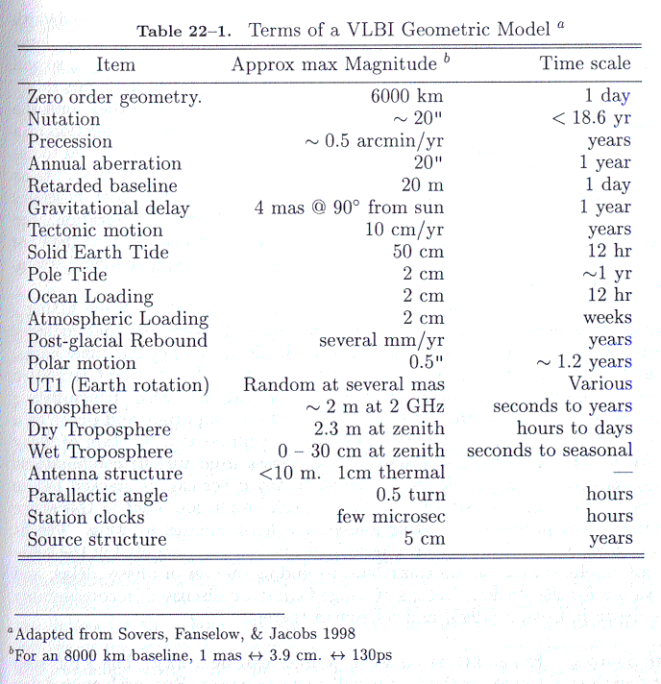

Slide 5
The Technique (cont)
A time-variable delay error in the geometric model used by the correlator causes slopes of phase with frequency and time;
Several schemes (some closely related to self-calibration) have been developed to determine these errors directly from the data;
Modern (last ten years) correlators have access to geometric models that are good to a few cm at worst at all stations and GPS for time-keeping – the atmosphere becomes the limiting factor for determination of the astronomical phase – similar to connected element arrays like the ATCA.

Slide 6
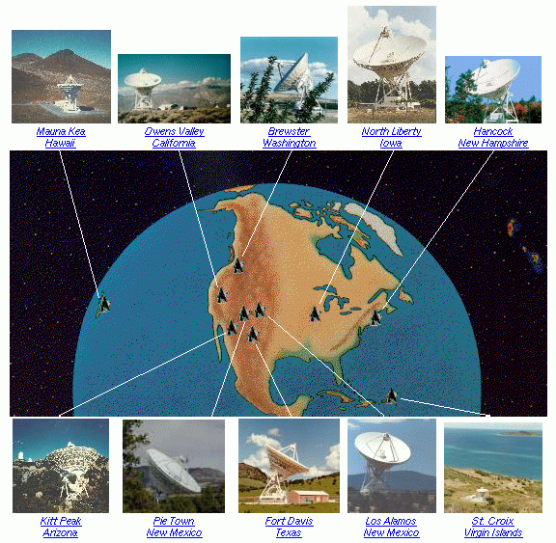
VLBI Instrumentation
Very Long Baseline Array (VLBA), a dedicated 10 station array within US territory, operated by NRAO;
Correlator in Socorro;
Open proposal system;
25 m antennas;
8,600 km baseline;
330 MHz to 43 GHz;

Slide 7
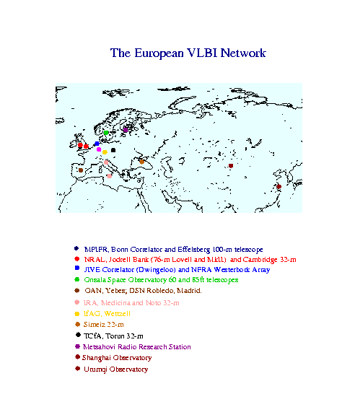
Instrumentation (Cont)
European VLBI Network (EVN), a consortium of observatories and institutes in Eurasia – 18 stations;
JIVE, VLBA, Bonn;
Open proposals;
9,169 km baseline;
Various antennas;
3 week blocks;
3 times per year;
330 MHz – 43 GHz.

Slide 8
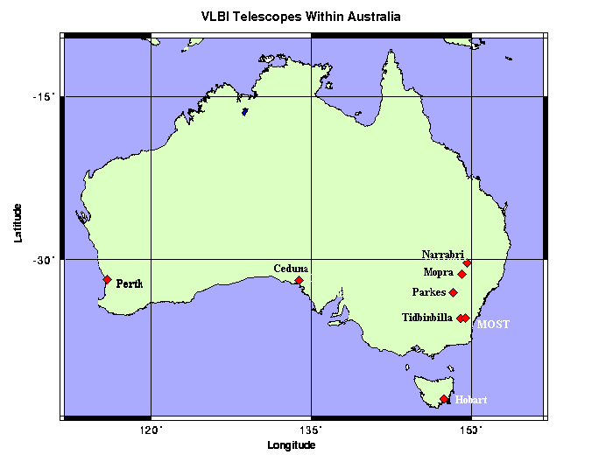
Instrumentation (cont)
Australian VLBI National Facility, 6 - 9 stations in Australia and South Africa;
Marsfield correlator;
Open proposals;
9,853 km baseline;
Various antennas;
843 MHz – 22 GHz;
1 week per AT semester;

Slide 9
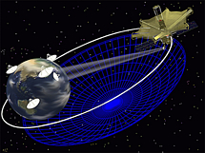
Instrumentation (cont)
VLBI Space Observatory Programme (VSOP) – has been operated since 1997, supported by ground networks;
20,000 km orbit;
30,000 km baseline;
1.6 and 5 GHz;
RadioAstron;
ARISE;
VSOP2.

Slide 10
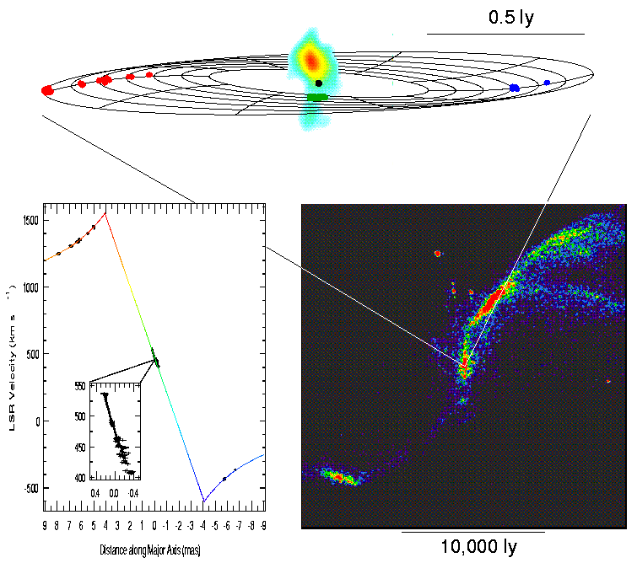
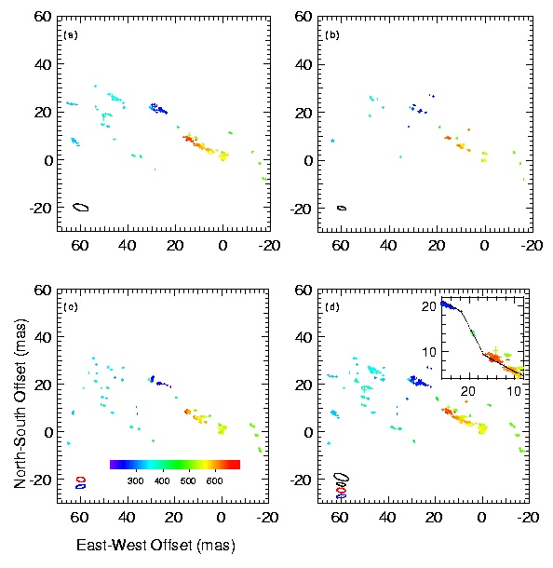
Black Hole Masses – NGC 4258 and Circinus
Greenhill et al. (2001)
Miyoshi et al. (1995)
Herrnstein et al. (1997)

Slide 11
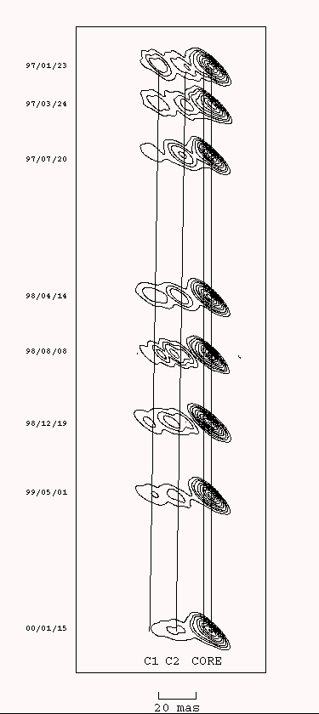
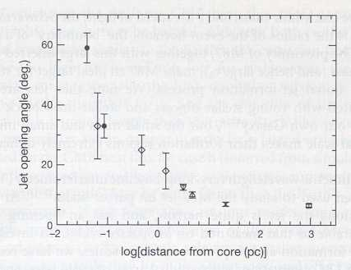
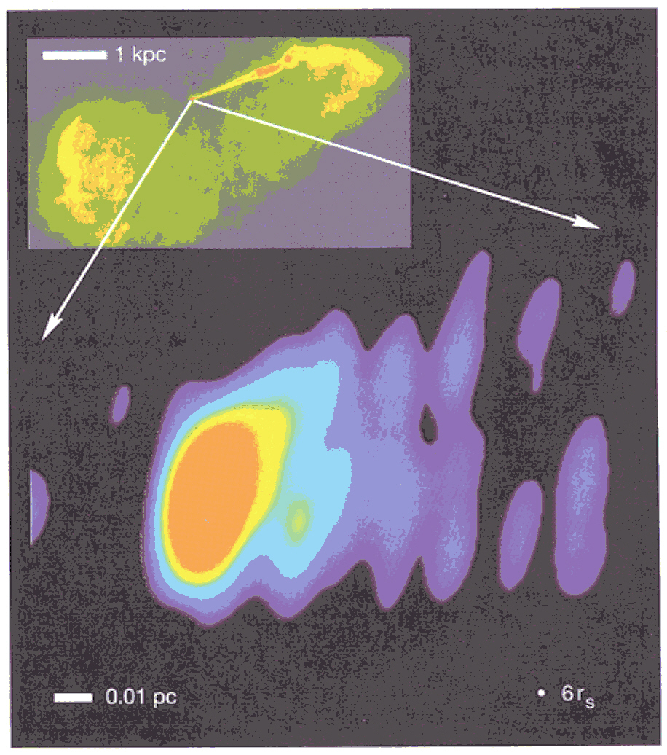
Low redshift AGN – M87 and Centaurus A
Junor, Birreta, & Livio (1999)
Tingay, Preston, and Jauncey (2001)

Slide 12
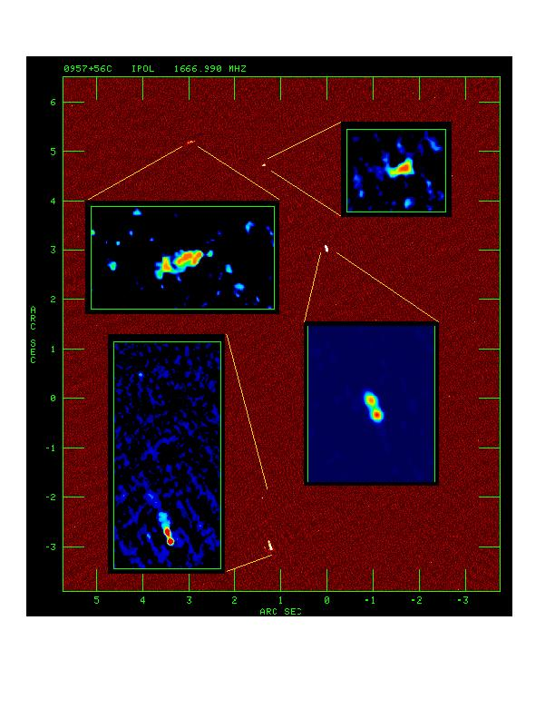
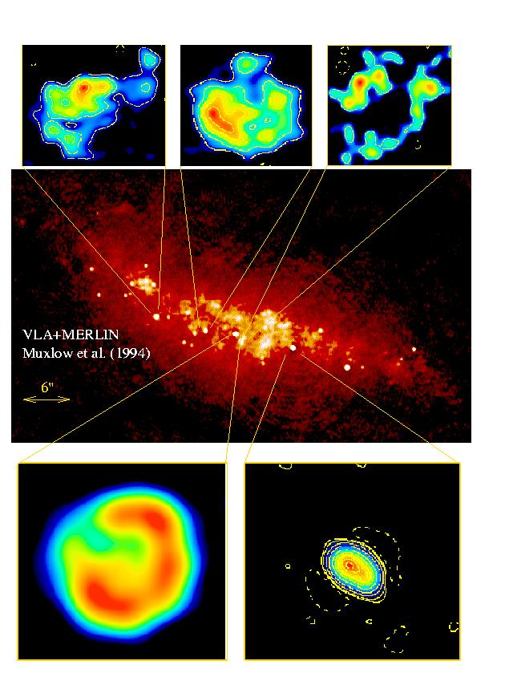
Widefield imaging
Pedlar et al. (1999)
Garrett et al. (1999)

Slide 13
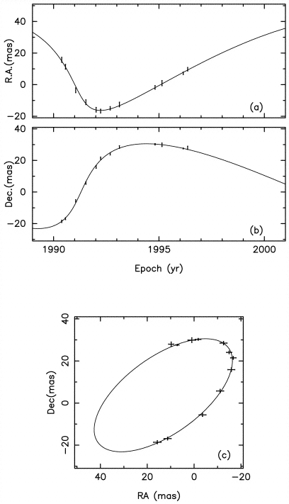
Astrometry/low mass stellar companions
AB Doradus, binary stellar system and weak radio source;
Australian VLBI array at 8.4 GHz;
Phase referenced observations of the radio source;
Measured accurate RA and Dec as a function of time;
After parallax and proper motion are subtracted, left with the orbital signature due to a 0.08 – 0.11 solar mass companion.
Guirado et al. (1999)

Slide 14
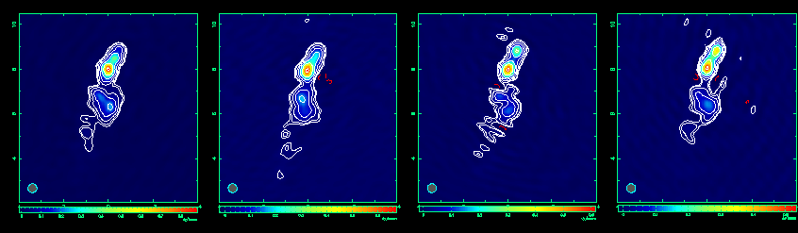
Space VLBI
Murphy et al. (2000)
1928+738, suggested helical jet due to binary black hole;
VLBA+HALCA VSOP observations at 5 GHz give approximately 0.25 mas angular resolution;
Apparent component speeds >10c, variations in the structure of components in the jet;

Slide 15
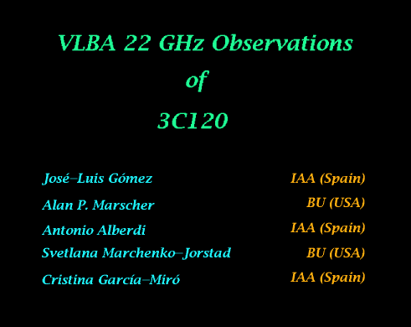
Superluminal motion – 3C120

Slide 16
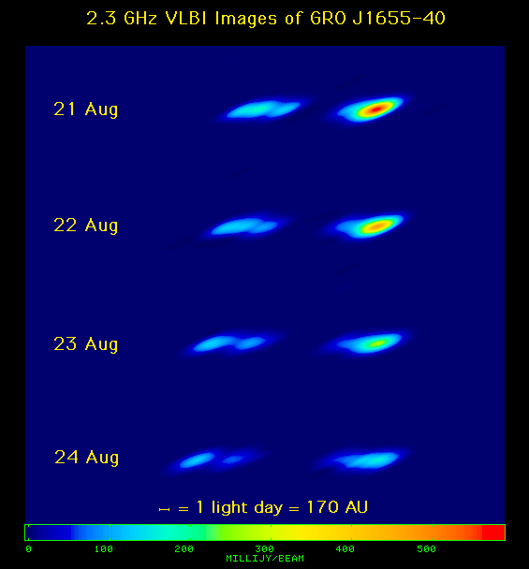
Microquasars
3.2 kpc distant;
Binary system of star (1.7 – 3.3 solar masses) and black hole (4 – 7 solar masses);
VLBI shows 65 mas/day – largest transverse apparent motion for an extra-solar system object, 1.1c - 1.9c;
True speed 0.92c and inclined 85 degrees to our line of sight.
Tingay et al. (1995)

