Slide 1
Oral Presentation Instructions and Template with Example
Dr. Gail P. Taylor
UT San Antonio
02/28/2013
02/28/2013

Slide 2
Presentation Duration
Student Conference Presentation
15 minute presentation
10 Minutes Talk
5 minutes for questions
At most, 15 slides

Slide 3
Outline of Entire Presentation
Title Slide: Strong title, your name, mentor, school.
Introduction/Background (2-3 slides).
Why/How is your topic important (health?)
Give brief literature background (broad to specific)
Goals of project
Hypothesis
Methods and exptl design (1 to 2 slides- flowcharts good)
Results (1 – 2 experiments) 2-3 slides
Summary/Conclusions
Bulleted and refer back to hypothesis
Future Directions
Acknowledgements
Questions?

Slide 4
Slide Characteristics
Uniform Font
Uniform title size and position
Short phrases
~Six lines per page
Story carried by images
Contrast between background and text
All text big (even on figs)

Slide 5

Ergot-Derived Substance-X Reduces Tumor Growth and Size in Nude Mice with MCF-7 Mammary Adenocarcinoma
NOTE! I have
Made up all of the data in this study.
Emily P Frogbottom
Undergraduate Research Trainee
Research Mentor: Dr. Tenure Track
University of Texas at San Antonio

Slide 6
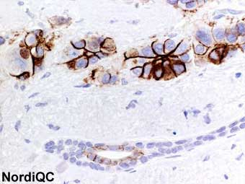
Introduction – Breast Cancer
100,000 diagnoses annually¹
Leading cause of death in women 15-54¹
Vary in metastatic capacity
Vascularization required for growth/metastasis
MCF-7: Human adenocarcinoma cell line
¹ Centers for Disease Control, 2010

Slide 7
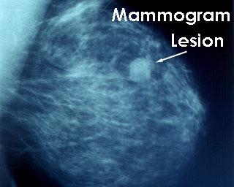
Introduction –Treatment
Generally surgery & chemotherapy
Mortality __% at 5 years¹
More effective chemotherapeutic agents needed
Some work by inhibiting vascularization²
² De Olivera, L, Hamm A, Mazzone M (2011) Mol Aspects Med. 2011 Apr;32(2):71-87. Epub 2011 Apr 22

Slide 8
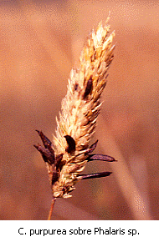
Introduction - Ergot
Claviceps purpurea fungus
“Cocktail” of active substances
CNS - Psychoactive Ergotamine ~LSD
Peripheral Effects –
Tingling- “St. Anthony’s Fire”
Inhibit vascularization and promotes gangrene
Vasoactive Substance-X isolated³
Inhibits growth of cultured endothelial cells³
³Taylor, GP (2011) Terrific thought experiment on using a deadly scourge to humanity to cure cancer. Journal of Positive Data 3(3), 210-212

Slide 9
Hypothesis
MCF-7 tumor growth will be inhibited through treatment with vasoactive Substance-X. Inhibition will be associated with reduced angiogenesis

Slide 10
Experimental Design/Methods
Culture
Induction
Treatment
Analysis
MCF-7 Cells
DMEM
2 weeks
<40% conf.
Athymic mice
N=40 (4 grps)
SubQ Injection
Thigh
10⁶/50ul
1 mo growth
SubQ injections
Control (solv)
1, 10 100 uM SubX
Daily for 8 wk
Weekly caliper measurement
8 weeks sac
Cryosection
ICC anti-BV
Density Test
Stats – T-Test

Slide 11
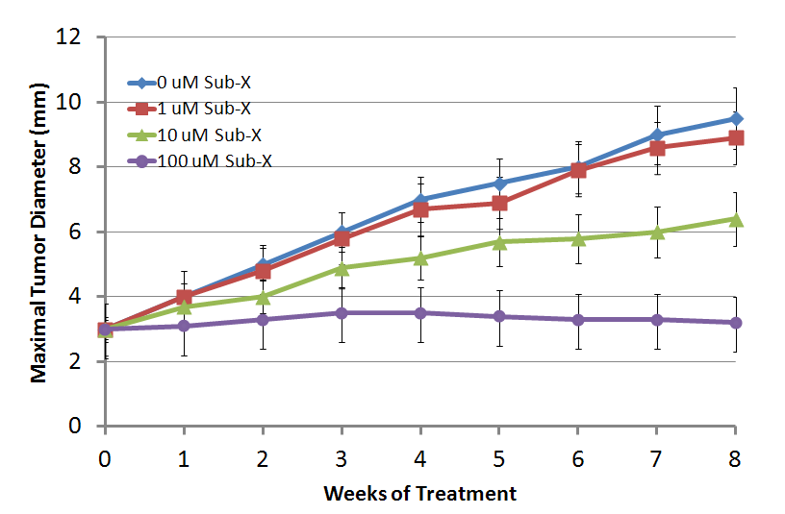
Results
Substance-X Inhibited MCF-7 Tumor Growth
*
*
*
*
*
*
*
*
*
*
P< 0.01

Slide 12
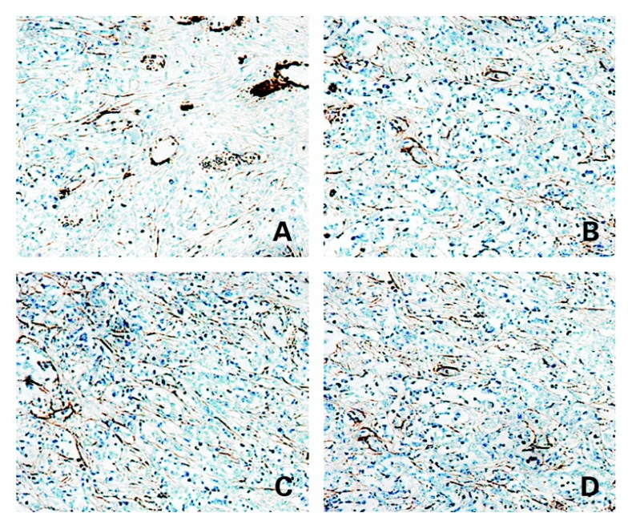
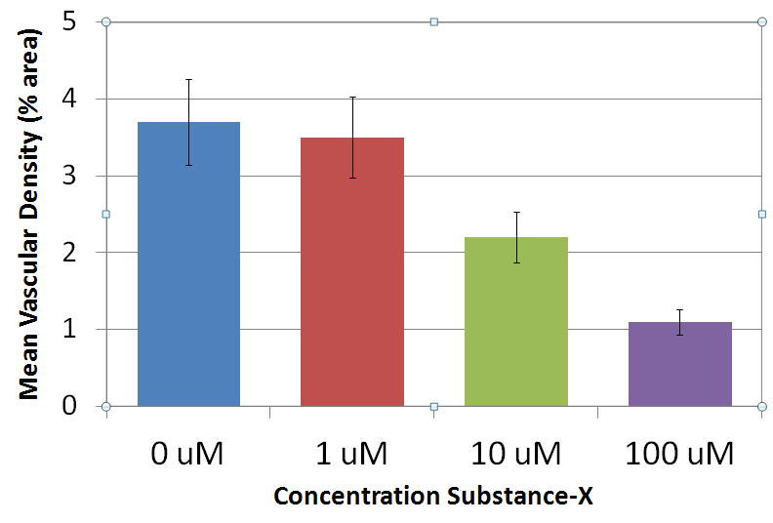
Results
Control
1 uM
Angiogenesis Inhibition
10 uM
100 uM
200X
*
*

Slide 13
Conclusions
Substance-X (10 uM – 100 uM) inhibits growth of MCF-7 tumors in athymic mice
Angiogenesis significantly inhibited at higher dosages
Hypothesis retained
Substance-X may be a powerful treatment against adenocarcinoma breast tumor growth

Slide 14
Future Directions
Establish LD-50 curve
Explore concentrations
Vary treatment schedules
Examine effects on metastasis
Compare with standard chemotherapeutic agents

Slide 15
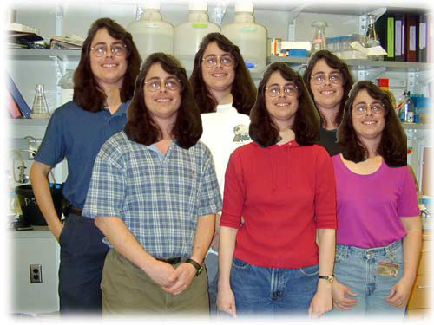
Acknowledgements
Dr. U.R. Fakedata, UTSSSA
Belinda Doolittle
Jason Trimple
MBRS-RISE GM 60655
MARC-U*STAR GM 07717

Slide 16
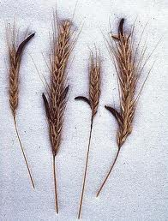
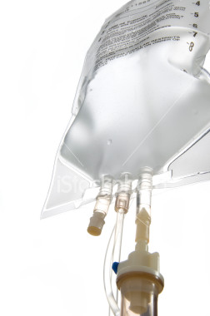
Questions?

