Slide 1
Effective Gaussian mixture learning for video background subtraction
Dar-Shyang Lee, Member, IEEE

Slide 2
Outline
Introduction
Mixture of Gaussian models
Adaptive mixture learning
Background subtraction
Experimental results
Conclusions

Slide 3
Introduction
Adaptive Gaussian mixtures:
  Used for modeling nonstationary temporal distributions of pixels in video surveillance applications for a long time
  Been employed in real-time surveillance systems for background subtraction and object tracking
Balancing problem:
  Convergence speed and stability
The rate of adaptation is controlled by a global parameter that ranges between 0 and 1.
  too small : Slow convergence
  too large : Modeling too sensitive

Slide 4
Introduction
This paper proposes an effective online learning algorithm to improve the convergence rate without compromising model stability
  Replacing the global, static retention factor with an adaptive learning rate calculated for each Gaussian at every frame
  Significant improvements are shown on both synthetic and real video data.

Slide 5
Mixture of Gaussian models
Goal:
  Flexible enough to handle variations in lighting, moving scene clutter, multiple moving objects and other arbitrary changes to the observed scene
Modeling each pixel as a mixture of Gaussians and the adaptive mixture model are then evaluated to determine which are most likely to result from a background process.
Our background method contains two significant parameters – α, the learning constant and T, the proportion of the data that should be accounted for by the background.

Slide 6
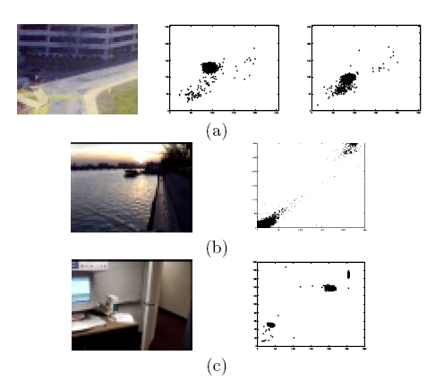
Mixture of Gaussian models
New frame arrives:
  Update parameters of the Gaussians
  The Gaussians are evaluated using a simple heuristic to hypothesize which are most likely to be part of the “background process.”

Slide 7
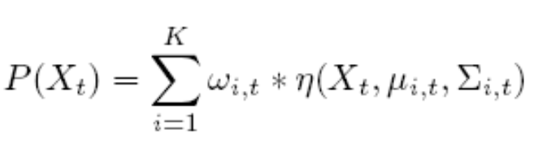

Mixture of Gaussian models
The probability of observing the current pixel value is
Gaussian probability density function
Every new pixel value, Xt, is checked against the existing K Gaussian distributions
  A match is defined as a pixel value within 2.5 standard deviations of a distribution1.

Slide 8
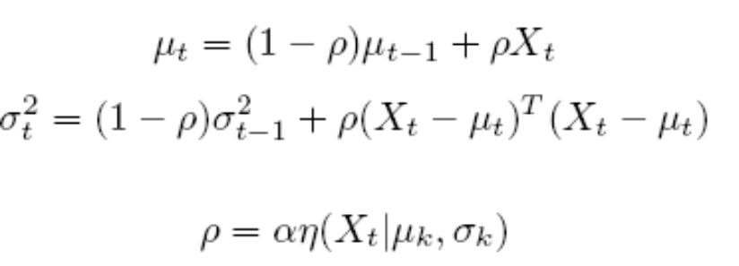

Proposed Algorithm
The parameters of the distribution which matches the new observation are updated as follows
Background Model Estimation
  Consider the accumulation of supporting evidence and the relatively low variance for the “background” distributions
  New object occludes the background object
    ➔ Increase in the variance of an existing distribution.
  First, the Gaussians are ordered by the value of ω/σ.

Slide 9
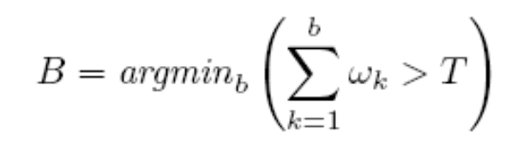
Background Model Estimation
First, the Gaussians are ordered by the value of ω/σ.
Then, the first B distributions are chosen as the background model
T is a measure of the minimum portion of the data that should be accounted for by the background
  Small T: unimodal
  Large T: multi-modal

Slide 10

Adaptive mixture learning
Learning rate schedule:
  : Local estimate
  : Learning rate
A solution that combines fast convergence and temporal adaptability is to use a modified schedule
  is computed for each Gaussian independently from the cumulative expected likelihood estimate.

Slide 11
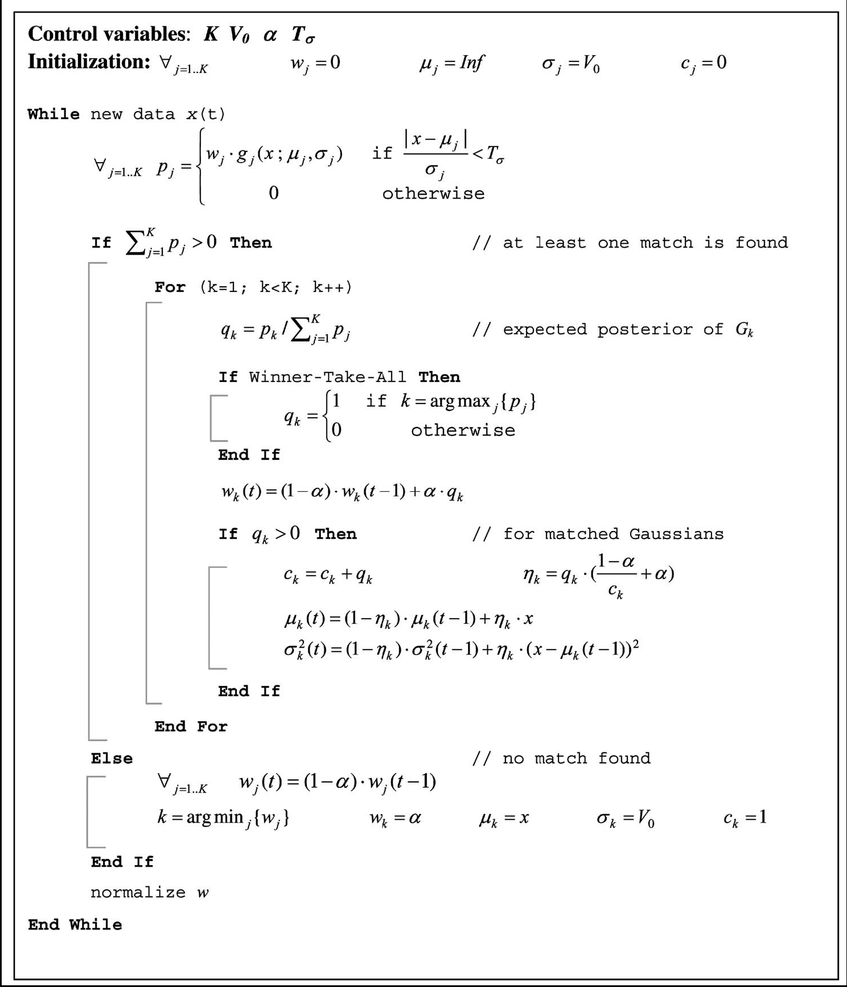
Proposed
Algorithm

Slide 12
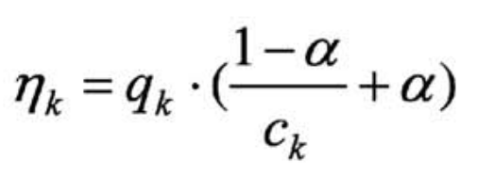

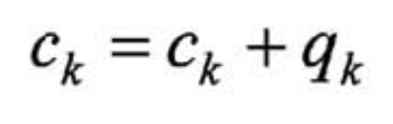

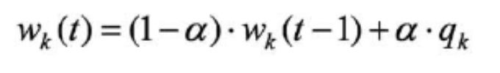

Proposed Algorithm
The basic algorithm follows the formulation by Stauffer and Grimson [9]
Differences:
  ➔
  ➔
  ➔
[9] C. Stauffer and W.E.L. Grimson, “Adaptive Background Mixture Models for Real-Time Tracking,” Proc. Conf. Computer Vision and Pattern Recognition, vol. 2, pp. 246-252, June 1999.

Slide 13

Proposed Algorithm
This modification significantly improved the convergence speed and model accuracy with almost no adverse effects.
Winner-take-all option where only a single best-matching component is selected for parameter update is typically used.
  ➔ Starvation problem
    Soft-partition: All Gaussians that match a data point are updated by an amount proportional to their estimated posterior probability
      Improve robustness in early learning stage for components whose variances are too large and weights too small to be the best match.

Slide 14
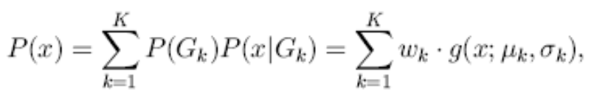


Background subtraction
Temporal distribution P(x) of pixel x
Density estimate
We train a sigmoid function on w/α to approximate P(B|Gk) using logistic regression
  The foreground region is composed of pixels where P(B|x) < 0.5.

Slide 15
Experimental results
The proposed mixture learning is tested and compared to conventional methods[9] using both simulation and real video data.
Mixture Learning Experiment
  Evaluated through quantitative analysis on a set of synthetic data.
  Converged faster and achieved better accuracy.
Background Segmentation Experiment
  Successful segmentation in early stage
  Quick convergence
[9] C. Stauffer and W.E.L. Grimson, “Adaptive Background Mixture Models for Real-Time Tracking,” Proc. Conf. Computer Vision and Pattern Recognition, vol. 2, pp. 246-252, June 1999.

Slide 16
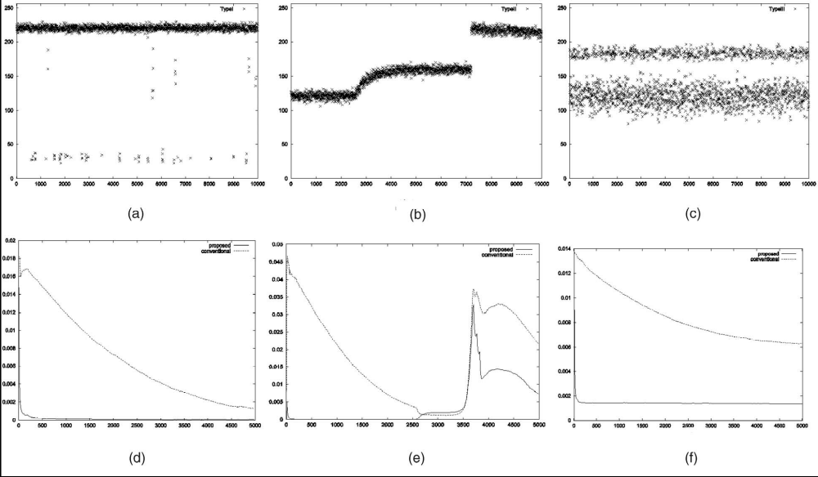
Mixture Learning Experiment

Slide 17
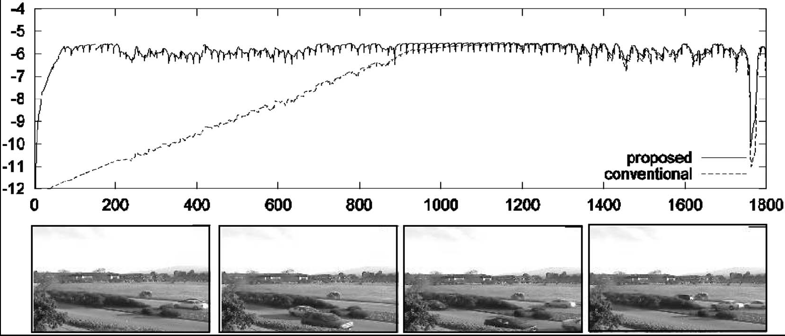
Experimental results

Slide 18
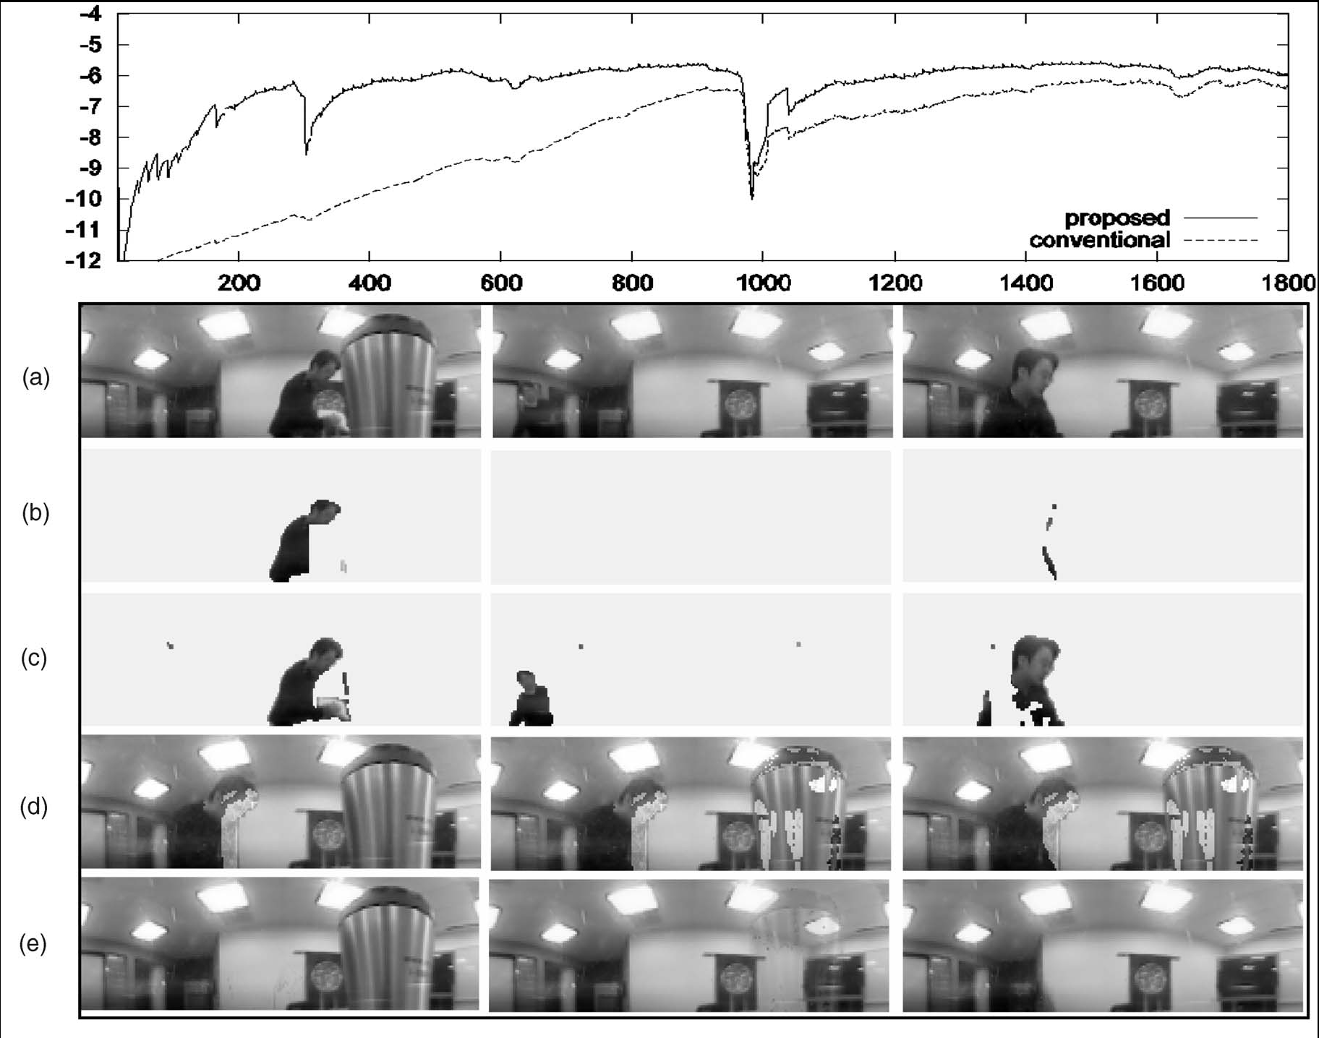
Experimental results

Slide 19
Conclusions
We presented an effective learning algorithm that improved convergence rate and estimation accuracy over the standard method used today
The results were verified by a large number of simulations over a range of
parameter settings and distributions.

