Slide 1
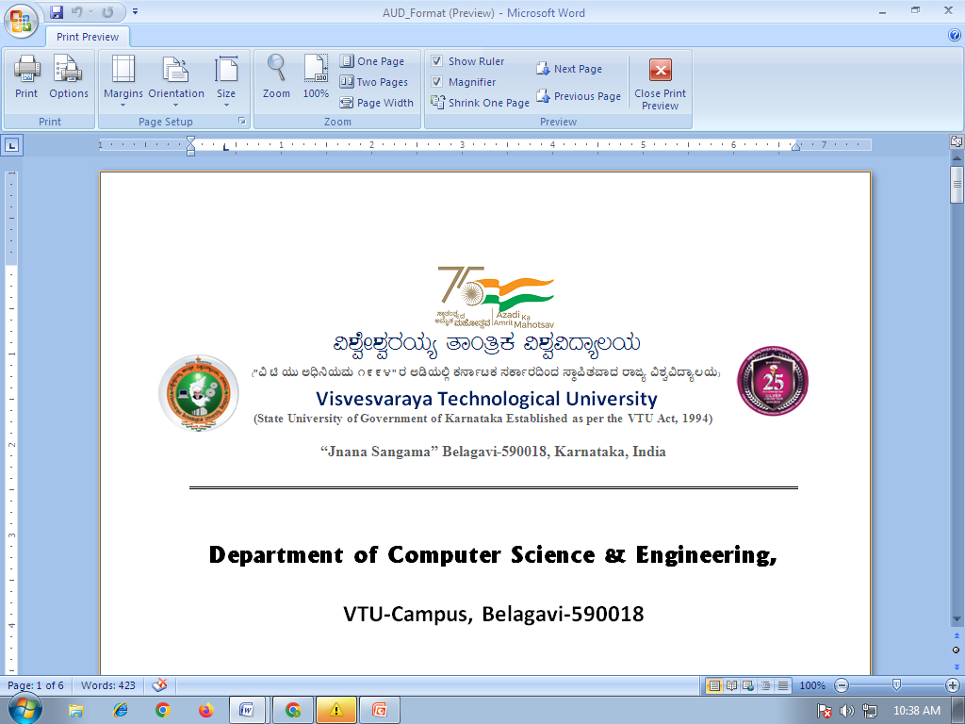
Department of Computer Science & Engineering
Presentation on
AI RENTAL SCAM DETECTOR
Submitted By
Preeti Hosurkar
2VX25MC103
Internal Guide
Prof. Irrana Tonni

Slide 2
Software Requirements
• Operating System: Windows 10/11
• Frontend: HTML5, CSS3, JavaScript
• Backend: Python
• AI/Image Processing: OpenCV
• OCR: Tesseract OCR
• Database:MySQL, SQLite
• Browser: Chrome, Firefox

Slide 3
Hardware Requirements
• Processor: Intel Core i5
• RAM: 8 GB recommended
• Storage: Minimum 10 GB free space
• Display: Standard HD monitor
• Mobile Camera: For capturing clear document images
• Internet: Required for accessing the web-based system

Slide 4
Tools & Technologies used
• Python – main programming language for backend logic and AI/ML
• Flask – web framework that connects the web interface with the backend
• HTML, CSS, JavaScript – web interface for upload, preview and result dashboard
• Tesseract OCR – extracts text from the uploaded document image
• OpenCV – image processing for alignment, blur and photograph checks
• Pandas, NumPy – data handling and numerical processing
• AI/ML Model – classifies the document as genuine or suspicious
• MySQL / SQLite – stores owner, document, verification and findings data
• Visual Studio Code – development environment

Slide 5
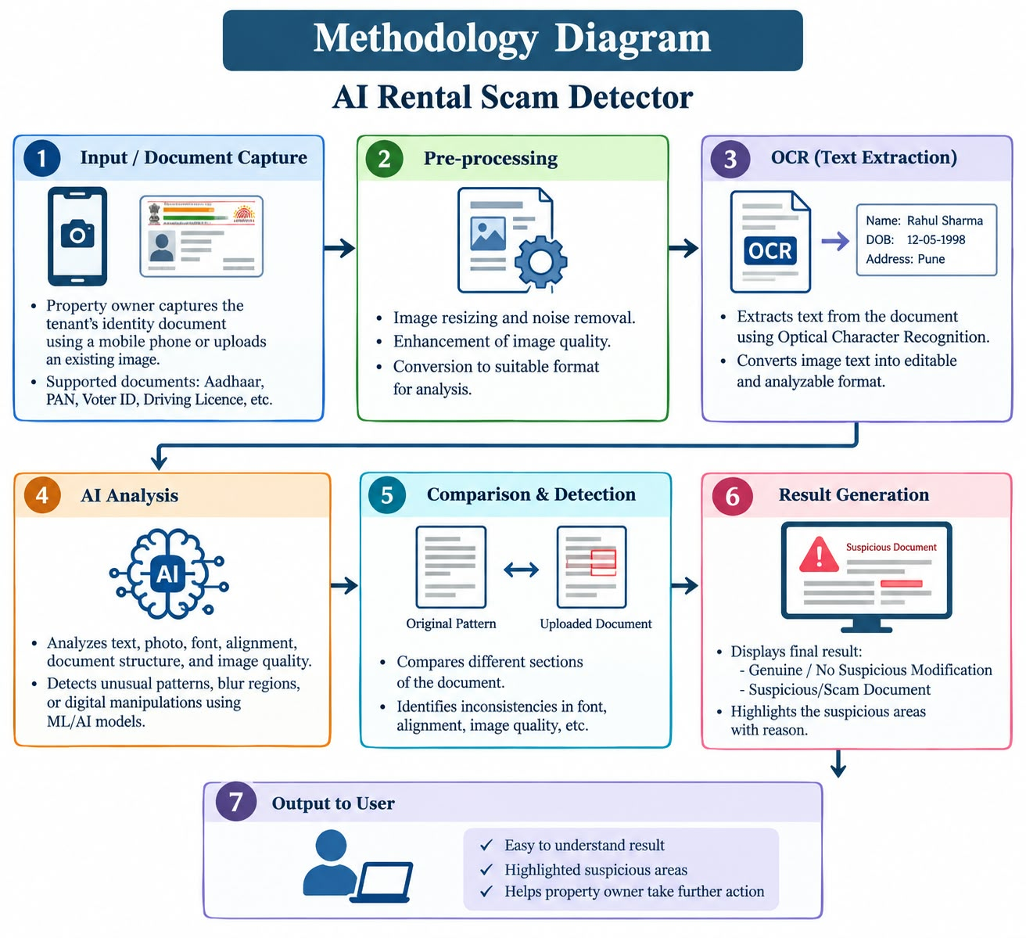

Slide 6
Use Case Diagram
AI Rental Scam Detector
Upload Document
Extract Text (OCR)
Preview Document
<<include>>
Start Verification
<<include>>
Analyze Document
Owner
<<include>>
View Result
AI/ML Verification

Slide 7
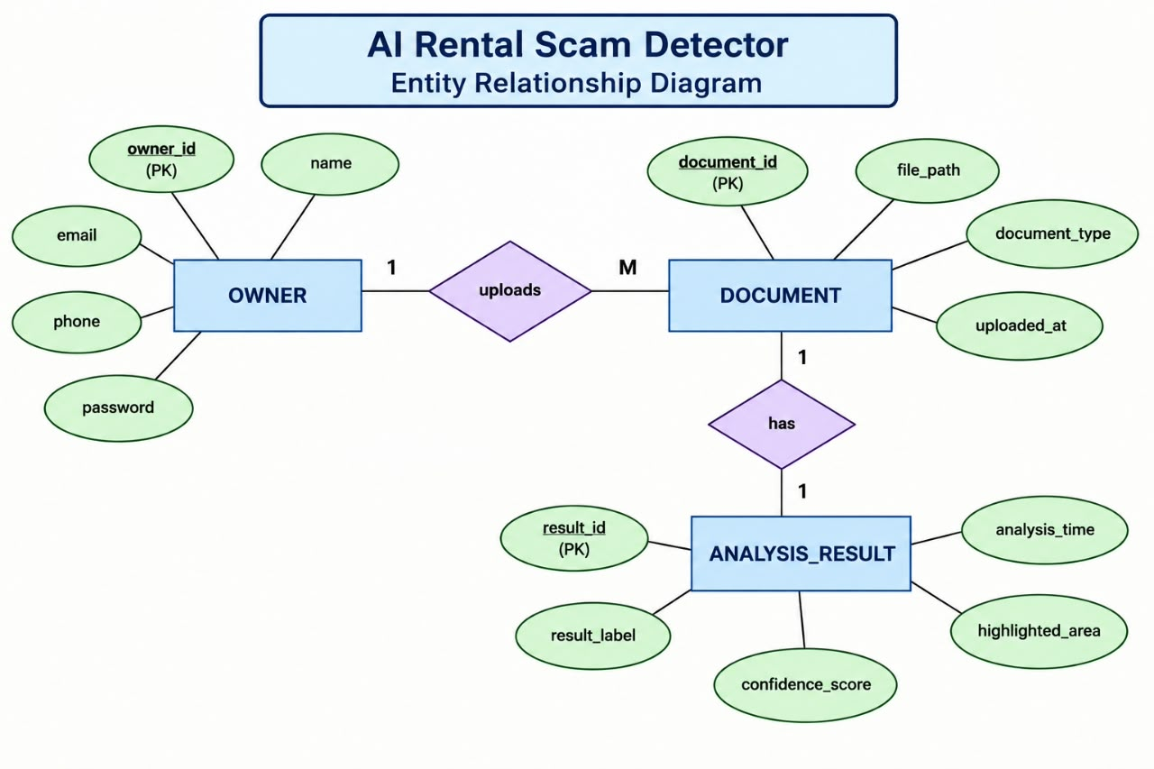
Entity Relationship

Slide 8
7. Proposed System
Owner
Web Interface
Upload & Preview
Flask Backend
Python
OCR & Image Analysis
Tesseract, OpenCV
AI/ML Verification
Model
Result
Genuine / Suspicious
Database
MySQL / SQLite
• The owner uploads an identity/rental document and the system verifies it automatically
• The system checks text alignment, blurred regions, photograph quality and possible alterations
• The result is shown on a simple dashboard as genuine or suspicious
• Verification records and findings are stored in the database
9

Slide 9
User Requirements
The owner is able to:
• Access the document verification system through a web interface
• Upload or select a clear identity document image
• Preview the uploaded document
• Start document verification
• View detected text and document analysis
• View the final genuine/suspicious result
• Understand the result through a simple dashboard

Slide 10
Functional Requirements
• Accept an identity/rental document image as input
• Validate and preview the uploaded document
• Extract document text using OCR
• Analyze text alignment and document structure
• Check blurred, unclear or inconsistent regions
• Analyze photograph quality and possible alterations
• Apply AI/ML-based document analysis
• Display the verification result and relevant findings

Slide 11
Non–Functional Requirements
• Accuracy – Provide consistent document-level analysis
• Performance – Process a valid document within a reasonable time
• Usability – Provide a simple and user-friendly interface
• Security – Protect uploaded document information
• Privacy – Avoid unnecessary exposure of identity documents
• Maintainability – Allow easy updates to verification logic
• Scalability – Support additional document types in future

Slide 12
External Interface Requirements
• User Interface
• Web-based document verification dashboard
• Document upload and image preview
• Verify button and analysis-result display
• Text and document-quality findings
• Software Interface
• Flask backend, Python OCR/image-processing modules and AI/ML model
• Hardware Interface
• Camera or mobile device may be used to capture the document image

Slide 13
Thank You

