Slide 1

DENSITY BASED TRAFFIC CONTROL USING MICROCONTROLLER
DHINESH.R
RA1711004020198

Slide 2
Contents
The Project Highlights
Working Principle
Significance of Parts used
Circuit Diagram & IR Sensor
Functions of Micro Controller
The Features & Advantages
Scope & Conclusion

Slide 3
1.The Project Highlights
Use of Standard Electronic Components Like IR Receiver, Transmitter, Microprocessor, Arduino.
No Special Custom Built Items Used
Installation of IR Sensors in all Four sides or as required with a standardized Road width approach
Only an additional input in existing Traffic Signal System
The Complexity in Positioning of sensors practically at road sides is not addressed in this project.
This project is aimed at “Density Based signaling” instead of “Standard preprogrammed Signaling”
To Start with this can be experimented in a well laid out, Disciplined road layout system present in Metro Cities

Slide 4
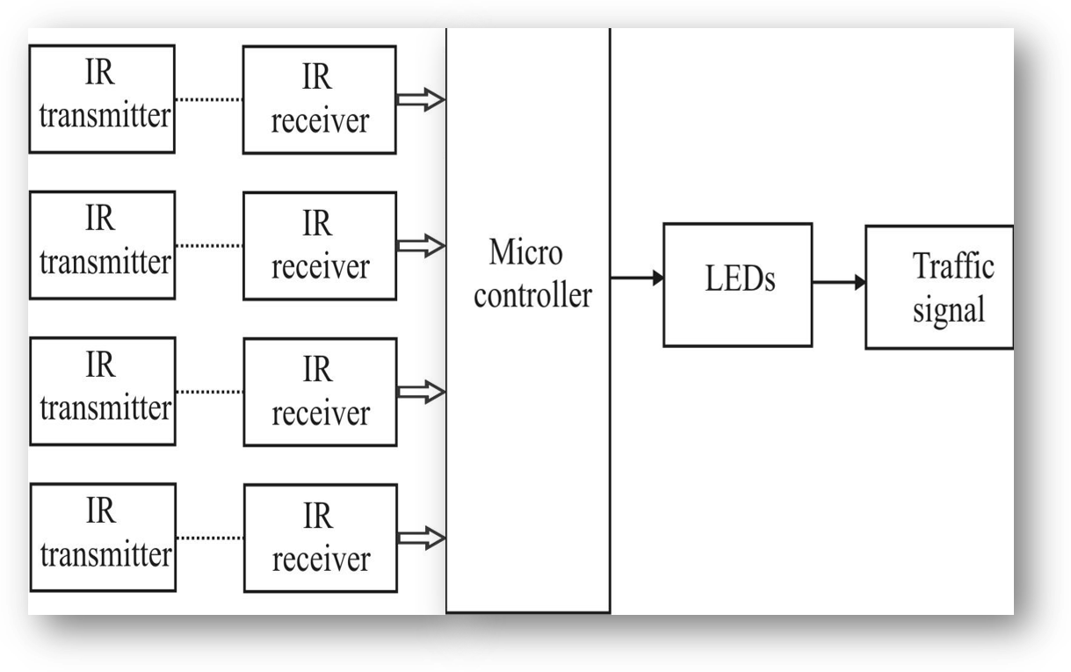
2. Working Principle
IR sensor is an electronic device which senses the objects in the surroundings
The principle is it transmits an infrared signal , this signal strikes the body of an object and the signal is bounced which is received at the infrared receiver. All the sensors send the corresponding output signal to microcontroller.
The microcontroller compares which road side is the highest density (i e, more vehicles) and it delivers the corresponding signal to LED driver circuits. The LED driver circuit enables the LED to display for particular time depends on traffic density.
The Block Diagram ( working Method)

Slide 5
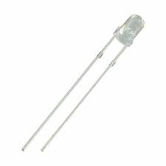
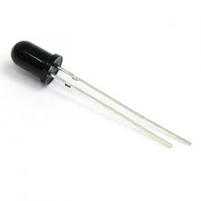
3.1 Significance of Parts Used 1/2
Symbol and operation : similar to ordinary LED
Generates infrared & made of Gallium arsenide
If we pass the current to gallium arsenide it produces IR rays
Current applied to the sensor is directly proportional to the rays emitted
Though IR transmitter can withstand up to 35mA, used 5mA only due to shortest distance
If the distance is more we have to increase the current flow to the transmitter.
IR
Transmitter
IR
Receiver
This circuit is mainly used for counting application
Since IR can be used only during proper alignment position
IR receiver is having reverse characteristics of the IR transmitter
IR Receiver will conduct as long as the rays falls on it.

Slide 6
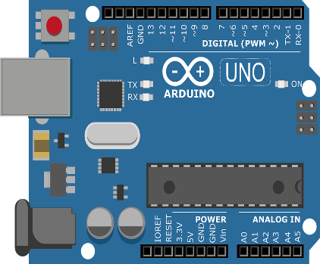

3.1 Significance of Parts Used 2/2
The Arduino UNO is a microcontroller board based on the ATmega328. It is made of 14 digital input output pins in which 6 can be used as PWM outputs. And also it has 6 analog inputs ,a 16 MHz ceramic resonator, a USB connection, a power pack ,and a reset button. It has everything needed to support the microcontroller. It is so simple that it is to be connected to computer with a USB cable or power it with a AC- to DC adaptor or battery to get started
ARDUINO UNO
LED Light
A light-emitting diode (LED) is a semiconductor light source. The color of the light is determined by the energy gap of the semiconductor.

Slide 7
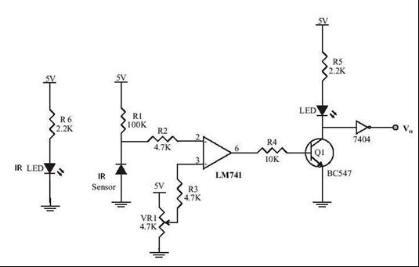
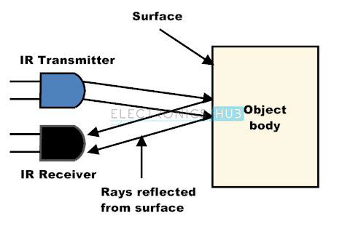
4. Circuit Diagram & IR Sensor
Circuit Diagram
IR Sensor (Working)

Slide 8
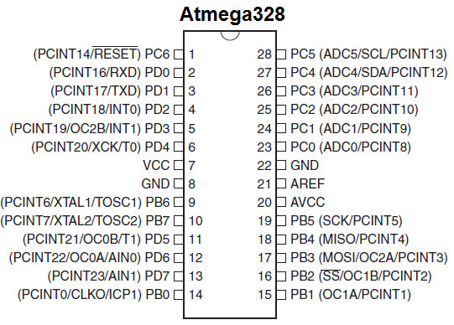
5. Micro Controller : ATMEGA 328
The Atmega328 is a very popular microcontroller chip produced by Atmel. It is an 8-bit microcontroller that has 32K of flash memory, 1K of EEPROM, and 2K of internal SRAM.
The Atmega328 is one of the microcontroller chips that are used with the popular Arduino Duemilanove boards. The Arduino Duemilanove board comes with either 1 of 2 microcontroller chips, the Atmega168 or the Atmega328. Of these 2, the Atmega328 is the upgraded, more advanced chip. Unlike the Atmega168 which has 16K of flash program memory and 512 bytes of internal SRAM, the Atmega328 has 32K of flash program memory and 2K of Internal SRAM.
The Atmega328 has 28 pins.
It has 14 digital I/O pins, of which 6 can be used as PWM outputs and 6 analog input pins. These I/O pins account for 20 of the pins.

Slide 9
6.The Features & advantages
Smooth flow of Vehicular Traffic at Signals
Reduction of waiting time at Traffic signals
Fuel saving to the extent of 5 ~ 10% ( Estimation)
Reduction of People’s Commuting time ( Time Saving)
Improves efficiency of Volume of Traffic
Equal Importance to all sides of Traffic ( Justified Approach)
100% risk free signaling discipline & Reduces accidents
Reduces Pollution at Traffic Junctions
Applicable to all countries irrespective their economic status

Slide 10
7.The Scope & Conclusion
The Scope
IR modules can be replaced with ultrasonic sensors for more accuracy in density estimation
The system can be replaced by image processing techniques using machine learning algorithm implemented in traffic signal CCTV cameras.
Concl-usions
The project can be implemented in places where the traffic congestion is heavy and in many other places where we need automation.
Signal related accidents can be avoided using this system
Traffic congestion account for 80% of the pollution worldwide which can be reduced by decreasing the wait time in signals.

Slide 11
CONCLUSION
The project can be implemented in places where the traffic congestion is heavy and in many other places where we need automation.
Signal related accidents can be avoided using this system
Traffic congestion account for 80% of the pollution worldwide which can be reduced by decreasing the wait time in signals.

Slide 12


