Slide 1
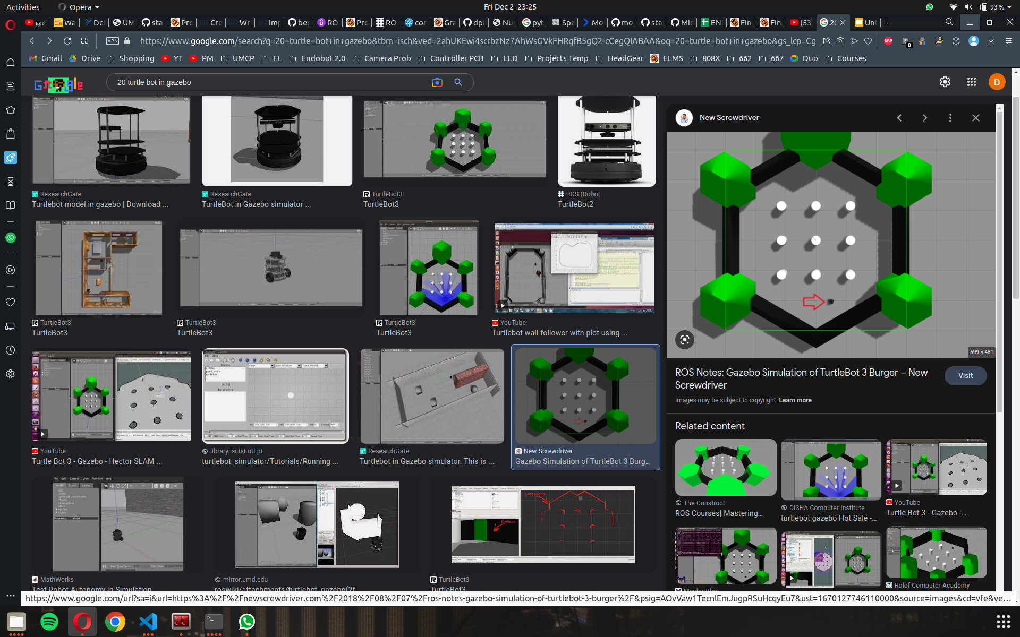
Leader TurtleBot
Leader TurtleBot

