Slide 1
游 宗 穎 國立台北大學
Resume
Work Experience
Research of Master

Slide 2
Resume
01

Slide 3
Resume
Birthday | 1997/08/10
Bachelor | Tatung University
Master | National Taipei University
Specialty | Software Development( Java, Python, C, Asm)and Hardware design

Slide 4
Work Experience
02

Slide 5
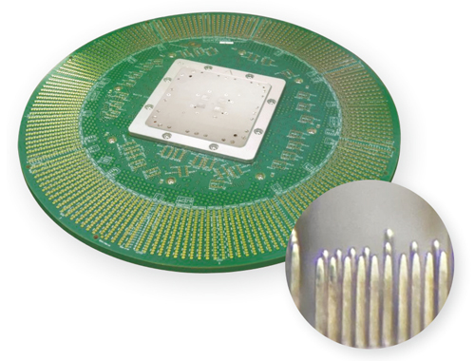
Probe Card : Burn Pin Project
Mainly responsible for the project
Programing automated measurement software .(Use Python)
Data analysis.

Slide 6

Probe Card : Burn Pin Prject
Achievement
Make stepping motor, power supply, and force sensor cooperate with each other for automatic measurement and generate data.
500 times more data than manual measurement in the past.

Slide 7


Distributed system development
Make the software tools originally developed in the compony can be distributed to multiple computers for calculation.
Achievement
Can handle more operations depends on the amount of clinet.
Greatly increased stability.

Slide 8

Design background website system
The webpage and database have been developed, allowing users to put data into the database in a unified format, and then the webpage has functions such as statistics, report generation, drawing charts, etc., making the records more intuitive and clear.

Slide 9
Research of Master
03

Slide 10

On the Problems of Drone Formation and Light Shows
In my research, I expanded the original two dimensional path planning algorithm into three to solve the problem of drone path planning, and then I developed an algorithm to solve the task assignment problem, and finally combined the two applications in the drone light show

Slide 11
Task assignment problem
A
B

Slide 12
Task assignment problem
A
B

Slide 13
Task assignment problem
A
B

Slide 14
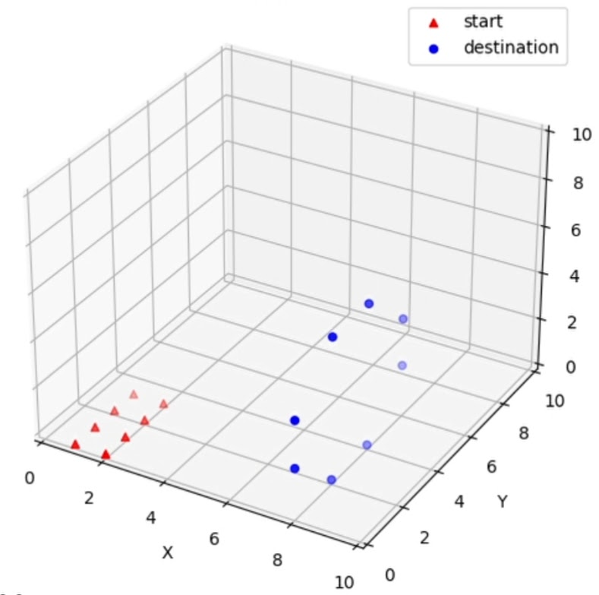
On the Problems of Drone Formation and Light Shows

Slide 15
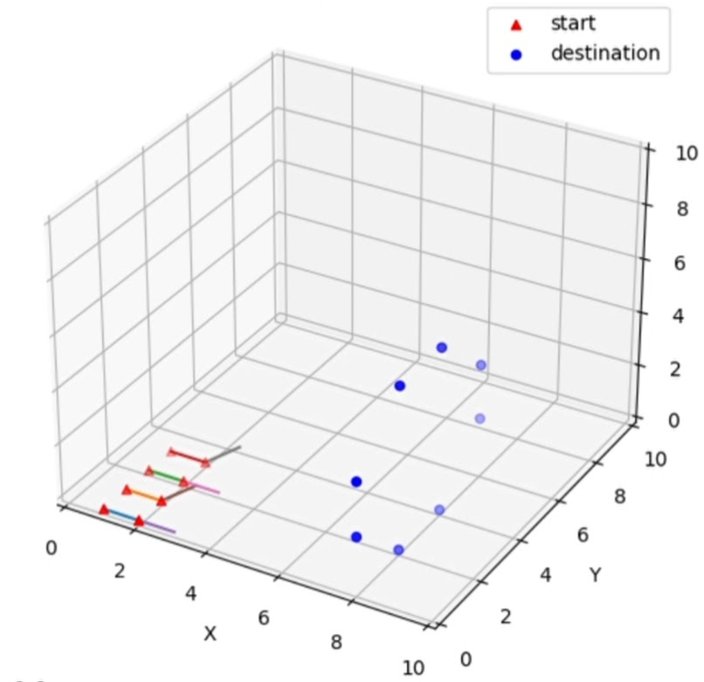
On the Problems of Drone Formation and Light Shows

Slide 16
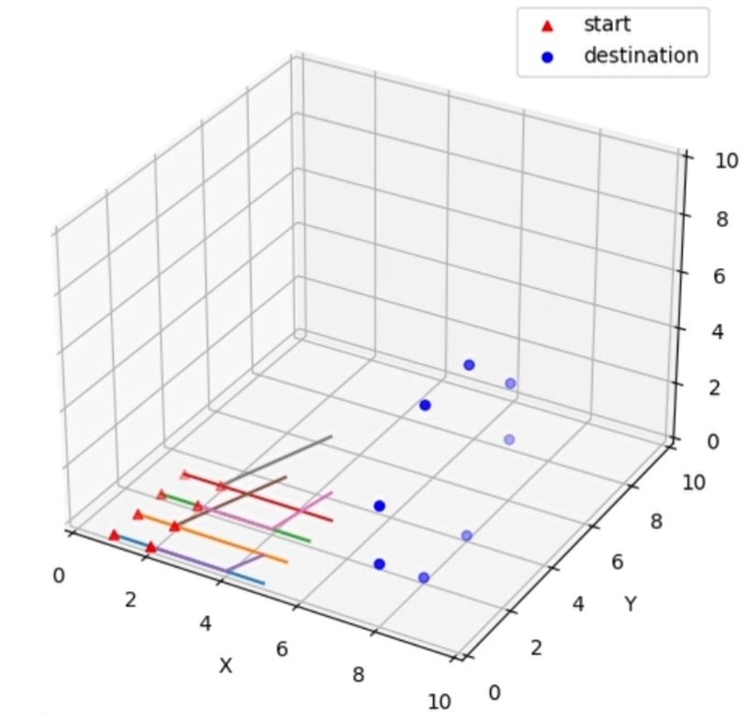
On the Problems of Drone Formation and Light Shows

Slide 17
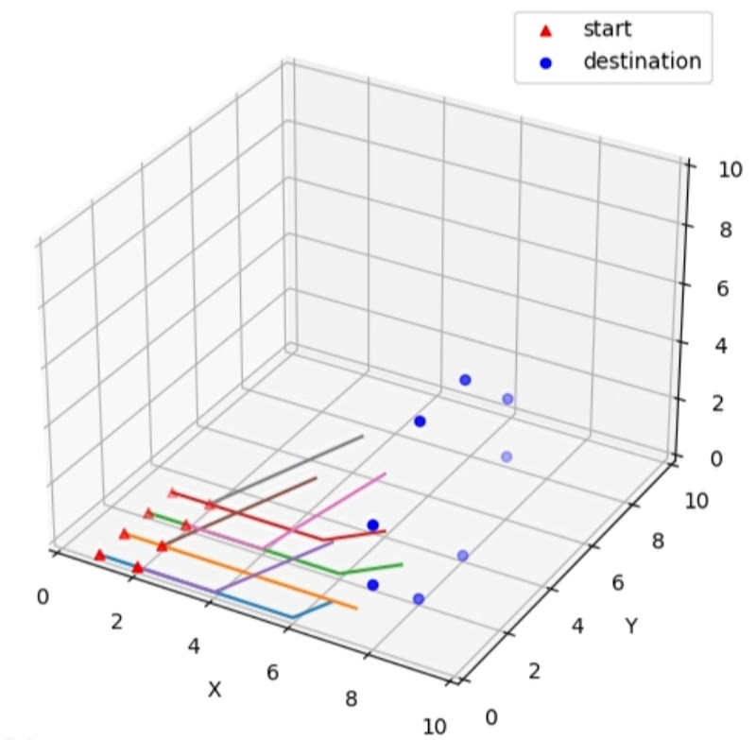
On the Problems of Drone Formation and Light Shows

Slide 18
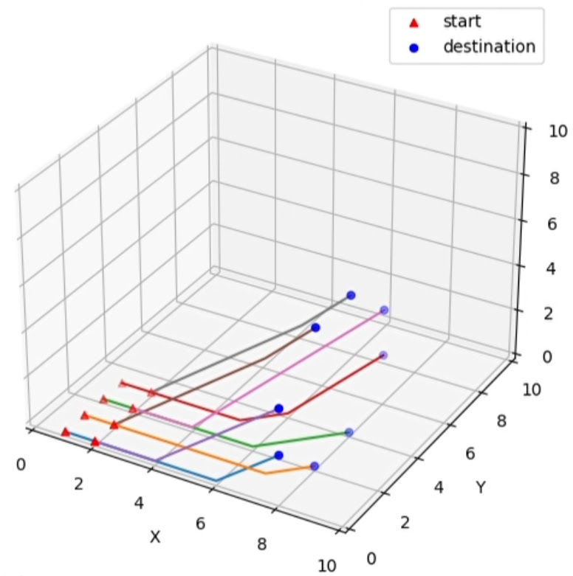
On the Problems of Drone Formation and Light Shows

Slide 19
Thanks for listening

