Slide 1
TWA 800
BY: Cameron Stark

Slide 2
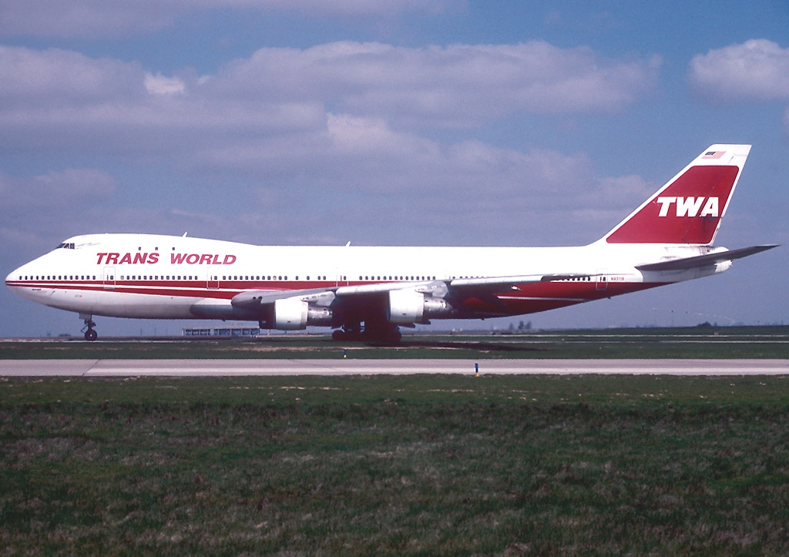
Flight Background
Airline: Trans World Airlines
Aircraft: Boeing 747-100 N93119
Route: JFK International to CDG International to FCO International
Occupants: 212 Passengers & 18 Crew
Notes:
Flight was traveling from John F Kennedy Airport to Leonardo Da Vinci Airport with a stopover in at Charles De Gaulle Airport

Slide 3
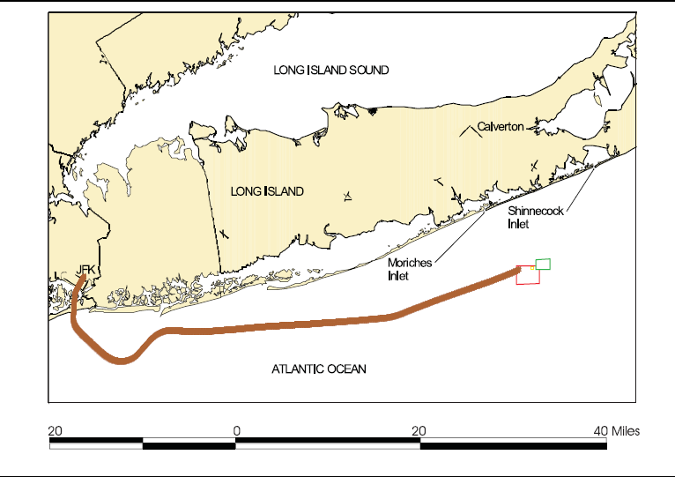
What Happened?
On July 17th , 1996 the flight departed from JFK flying CDG
Prior to the flight, the Engine Trust reverser was shutdown and fuel lines were replaced before flight 800
Upon climbing the belly of the aircraft exploded disconnecting the nose from the aircraft.
Notes:
The Flight prior to flight 800 had numerous issues
The thrust reverser had a fault and was disconnected, accord to the MEL (Minimum Equipment List)
The volumetric shutoff for the fuel tank was malfunctioning and was replaced (multiple instances of this occurred the prior weeks)

Slide 4

Crash Animation
https://youtu.be/DQSrVFRg7k8?t=21

Slide 5

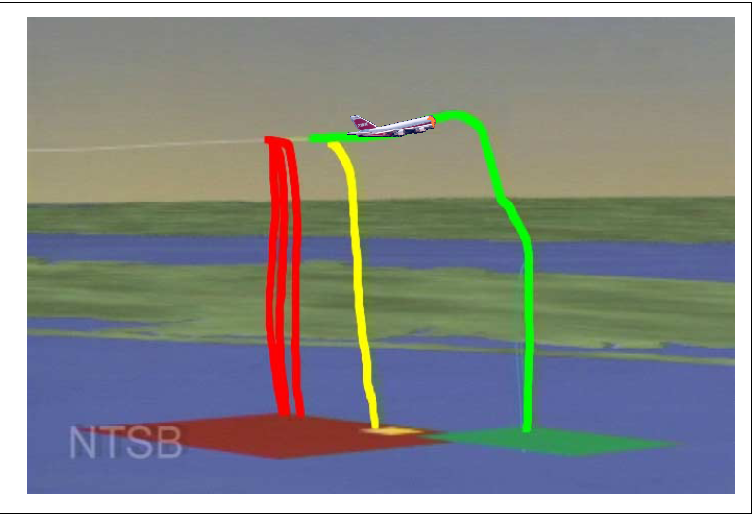

Investigations
Following the accident the NTSB was tasked with determining what had happened
The initial witness interviews reported it as an act of aggression with both possibilities of a missile or explosive device on board
The FBI was tasked with taking over the investigation from the NTSB
NTSB vs FBI
Notes:
The NTSB conducted preliminary interviews following the accident, where the majority all stated that a “streak of light” was seen heading towards the aircraft before the explosion
These testimonies and FBI believing the NTSB to be too indecisive prompted the FBI takeover of the investigation, where more interviews were done with the same stories.
The Image shows the trajectory of the debris for each of the three sections
Red is the initial explosion and the main fuel tank/Belly of the plane
Yellow is the Nose of the aircraft and cockpit, after separation
Green is the rest of the body of the aircraft and wings after separation

Slide 6
Possible Causes of the Crash
Structural Failure and Decompression
Live Missile Strike or Bomb Detonation
Fuel-Air Explosion in the Center Wing Fuel Tank
Other Weather Related causes
Notes:
Structural Failure and Decompression
Initial thoughts were it was a similar case to Turkish Flight 981 & United Flight 811, where the forward cargo door separated from the aircraft during the flight
But no evidence of structural fatigue and the door was locked and closed
Missile or Bomb
Reviews of radar data show multiple objects within the area of the aircraft, but none show any indication of a connection in trajectories, which concluded no missiles made contact
Military surface records indicated no surface vehicles in the area of the explosion
Upon examination of the wreckage trace amounts of explosive residue were discovered but the NTSB concluded that source
Could have been the 747’s prior life as a military transport in the Gulf war
Or the military vessels it was transported back to DC on
Fuel-Air explosion (Most probable even)
Heavy examination of the structure of the bottom of the aircraft found
Evidence of fire burn on many pieces
Fractures in the wing and bottom, consistent with an overpressure event
The fuel tank in prior flights had issues with its sensors to prevent overfilling
During the flight the pressure in the tank rose, and was triggered by what could possibly be a simple short in a wire to trigger the detonation
Other Weather Related Causes
The ideas of lightning strikes and storms were quickly ruled out because of the existing weather data on the day and time of the crash

Slide 7
Conclusion of the Investigation
NTSB reported the cause was a fuel air explosion of the center wing fuel tank that caused a cascading effect leading to the in-flight breakup of the aircraft
Future implications
The design and certification of fuel tanks
The certification of the 747 in regards of the heat control near fuel tanks

Slide 8
Aftermath
A new Federal Regulation 831.5
Notes:
Stated that after an accident the NTSB will have full control of the investigation until the time that evidence of criminal activity is uncovered.

Slide 9
Questions?

