Slide 1
TWA 800
BY: Cameron Stark

Slide 2
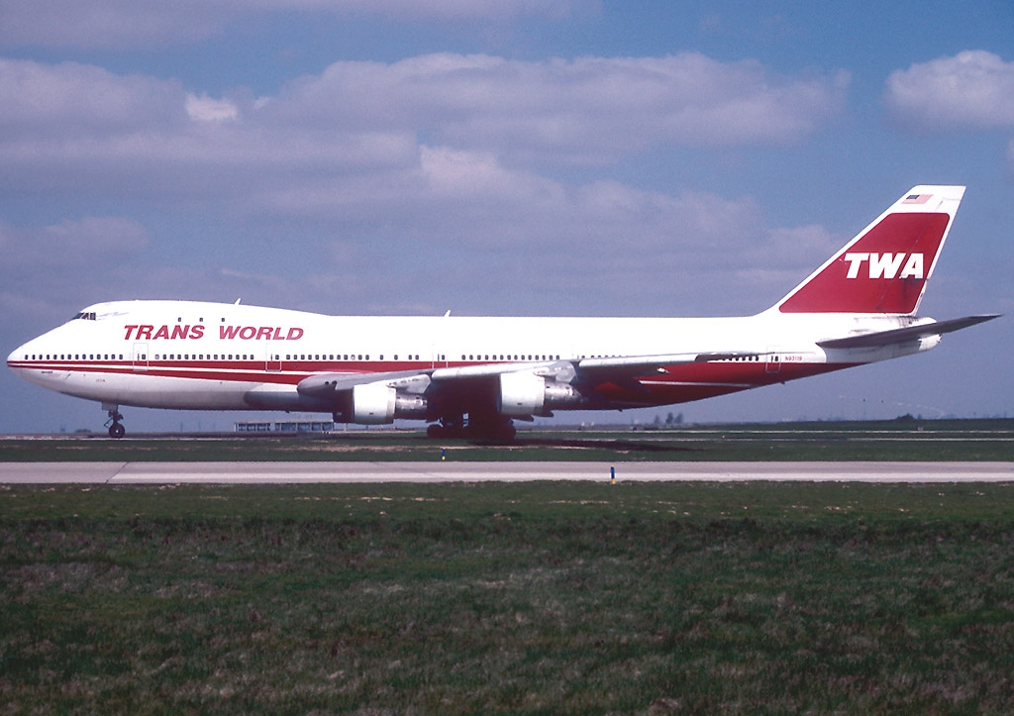
Flight Background
Airline: Trans World Airlines
Aircraft: Boeing 747-100 N93119
Route: JFK International to CDG International to FCO International
Occupants: 212 Passengers & 18 Crew
Notes:
Flight was traveling from John F Kennedy Airport to Leonardo Da Vinci Airport with a stopover in at Charles De Gaulle Airport

Slide 3
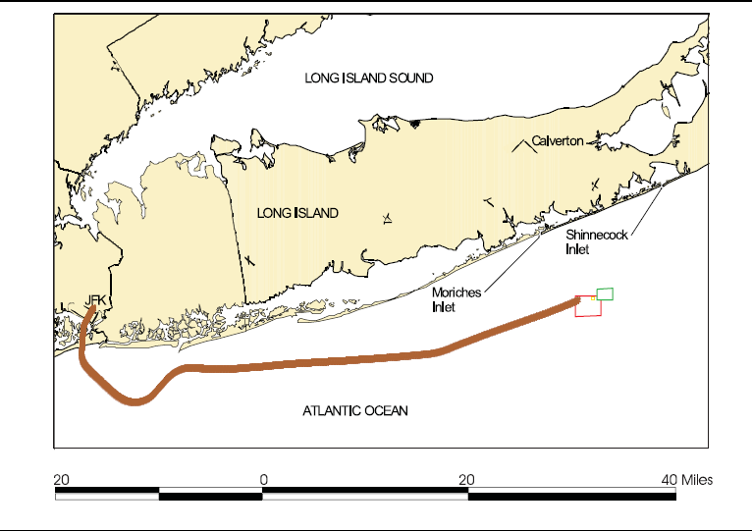
What Happened?
On July 17th , 1996 the flight departed from JFK flying CDG
Prior to the flight, the Engine Trust reverser was shutdown and fuel lines were replaced before flight 800
Upon climbing the belly of the aircraft exploded disconnecting the nose from the aircraft.
Notes:
The Flight prior to flight 800 had numerous issues
The thrust reverser had a fault and was disconnected, accord to the MEL (Minimum Equipment List)
The volumetric shutoff for the fuel tank was malfunctioning and was replaced (multiple instances of this occurred the prior weeks)

Slide 4
Investigations

