Slide 1
Using Lightweight Formal Methods for JavaScript Security
By: Cameron Stark

Slide 2
Author of the Paper
Mark C. Reynolds
Professor of Computer Science at Boston University

Slide 3
Purpose of the Paper
Demonstrate that it is possible to construct a model for JavaScript security
Demonstrate that an event translator can be written to monitor site traversal
Present results from real-world websites

Slide 4
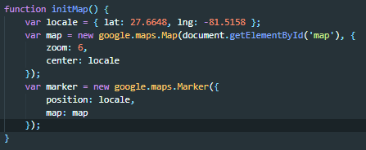
Background What is JavaScript
A high-level, interpreted programming language that uses “Just In Time” Compilation
Characterized as dynamic, weakly typed, and multi-paradigm
Unlike Java, with which it only shares name, is not run in a virtual machine, which allows for malware to be carried through JavaScript
Notes:
“Just in Time” compilation is where the script is loaded and compiled as it is needed and removed when not being used
The versatility of the language has made it widely used among web developers to provide functionality to a website
Java and JavaScript vary in that Java has a strict set of rules and constraints that must be met for the compiler and finally the JVM to accept and run the program, where as JavaScript can be loaded into a website, and therefore onto a users computer with very little constraints and restrictions, which leads to various security concerns

Slide 5
Background JavaScript security concerns
JavaScript on a website is generally placed in between <script></script> tags
JavaScript loaded in the script tags must share the same origin.
The Same Origin Policy, with which formal methods mainly deal with controls the loading of scripts that their origin should match the origin of the host site loading them.
Most malware is attempted via the violation of Same Origin Policy
Notes:
The script tags, signify the scripts that are Top Level Scripts associated with the site either written by the developer or brought in from an outside source
Most violation of the SOP, is done with Cross Site Scripting and Cross Site Request Forgery

