Slide 1
Using Lightweight Formal Methods for JavaScript Security
By: Cameron Stark

Slide 2
Author of the Paper
Mark C. Reynolds
Professor of Computer Science at Boston University

Slide 3
Purpose of the Paper
Demonstrate that it is possible to construct a model for JavaScript security
Demonstrate that an event translator can be written to monitor site traversal
Present results from real-world websites

Slide 4
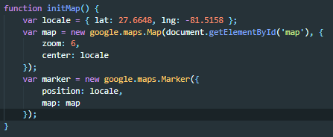
Background What is JavaScript
A high-level, interpreted programming language that uses “Just In Time” Compilation
Characterized as dynamic, weakly typed, and multi-paradigm
Unlike Java, with which it only shares name, is not run in a virtual machine, which allows for malware to be carried through JavaScript
Notes:
“Just in Time” compilation is where the script is loaded and compiled as it is needed and removed when not being used
The versatility of the language has made it widely used among web developers to provide functionality to a website
Java and JavaScript vary in that Java has a strict set of rules and constraints that must be met for the compiler and finally the JVM to accept and run the program, where as JavaScript can be loaded into a website, and therefore onto a users computer with very little constraints and restrictions, which leads to various security concerns

Slide 5
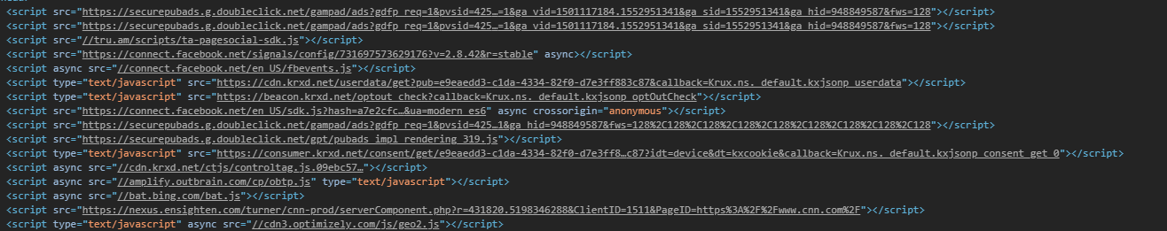
Background JavaScript security concerns
JavaScript on a website is generally placed in between <script></script> tags
JavaScript loaded in the script tags must share the same origin.
The Same Origin Policy, with which formal methods mainly deal with controls the loading of scripts that their origin should match the origin of the host site loading them.
Most malware is attempted via the violation of Same Origin Policy
Notes:
The script tags, signify the scripts that are Top Level Scripts associated with the site either written by the developer or brought in from an outside source
Most violation of the SOP, is done with Cross Site Scripting and Cross Site Request Forgery
The screenshot below shows the many outside javascript files that are accessed when a site loads, but because these are all called from the same origin they are allowed

Slide 6
Modeling The Structure of a Website Domain
Because of the complexity of organizational units, websites and domains are structured as a forest which contains tress and each tree has nodes which
Forest
A Collection of Trees
Tree
A Collection of Nodes
Node
Address Node and Host Node
Contains the ipv4
Address Node
Never a leaf in the tree
Host Node
Always the leaf, similar to a file directory

Slide 7
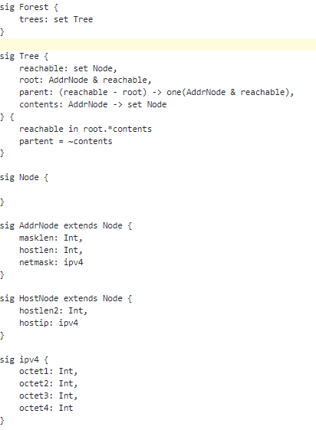
Modeling Alloy Signatures
Notes:
The tree signature contains four relations
Reachability Relation - which is the of nodes that can be reached by starting from this root
Root Relation - which must always be a reachable address node, since it is always a collection
Parent Relation - which is a map from one root to one reachable address node
Contents Relation – which is a map from the address node to the set of reachable nodes

Slide 8
Modeling JavaScript on Page Load
When JavaScript is loaded as part of a web page, its functions become available to the scope of the site
This is one method of loading, but there are three other methods.
Using the script src tag can allow a script to call in additional scritpts
A script can use elements of the DOM to write HTML which can have its own scripts to call
A script can be loaded thorugh JSON that can make functional changes to exisiting scripts
Notes:
When implanting these in the Alloy model, it proves to be more complicated because any combination and form of each method can be used
This is useful however because it conforms best to the AJAX and other async methods for web development
However, these attempt to bypass or weaken the CORS policy which can lead to security risks when loading JavaScript scripts

Slide 9
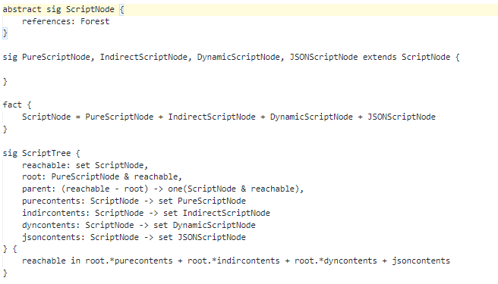
Modeling Alloy Signatures
Notes:
When implementing these in the Alloy model, it proves to be more complicated because any combination and form of each method can be used
This is useful however because it conforms best to the AJAX and other async methods for web development
However, these asynchronous operations attempt to bypass or weaken the CORS policy which can lead to security risks when loading JavaScript scripts

Slide 10
Modeling Issues with Alloy
The Author attempted to make Alloy model the intrinsic nature of the webpage loading several different types of JavaScript files from various different sources
Base Alloy doesn’t have the capabilities to perform such complex relationships and actions, to get around this the author modified the Alloy program to allow for custom operations
fun bitand [n1, n2 : Int] : Int { n1 fun/bitand n2 }
fun bitor [n1, n2 : Int] : Int { n1 fun/bitor n2 }
fun bitnot [n1 : Int] : Int { fun/bitnot n1 }
Notes:
The fun keyword is the namespace of the custom operations
The operations perform various bitwise tasks with the inputs being integer values

Slide 11
Analysis Call Stack of JavaScript
The purpose of the alloy model is to determine where a function/JavaScript call originates from
For Example: alert(“this is an alert);
_callHook():
function: alert
nargs: 1
arg0type: JSString
arg0: “This is an alert”
event: onClick
eventType: Button <class>
eventText: OK
coords: 235, 644
function: <anonymous>
nargs: 1
arg0type: integer
arg0: 0
Notes:
Consider the JavaScript Function alert, with the arguments of the string “this is an alert”
Upon being called the following call stack is performed to display the alert with the proper functionality of an OK button to dismiss the alert

Slide 12
Analysis Website Testing
The author uses abcnews.com as the website to test for the JavaScript security using the Alloy models
Upon page load of the abcnews.com site, the following “safe” scripts are loaded from the same origin “domain”
abcnews.com 199.181.132.250
abcnews.go.com 198.105.195.49
a.abcnews.com 96.6.46.50; 96.6.46.35
unified to 96.6.46.0/24
ll.static.abc.go.com 208.111.128.6; 208.111.128.7
unified to 208.111.128.0/24
And these ones are not from the same origin showing that website used some method to get around the origin policy
edge.quantserve.com 64.94.107.0/24
www.google-analytics.com 74.125.113.0/24
Notes:
The Alloy Model is testing for two outcomes
the first being a website conforming to safe methods should yield at least one instance and no counter examples
whereas a website not conforming will yield at least one counter example and no instances

Slide 13
Analysis Future Work
The author hopes to in the future improve on and finish completely a security model for JavaScript and have implemented into website development and browsers
Firefox browser has an instrumentation framework that converts the logged event output from websites and creates Alloy initializers

Slide 14
Opinions
The Author
The Topic
Notes:
The Author
The author clearly understands every aspect of not just web development but also how organization/company websites are structured and how the web browser/website works on a process level
with this he does his best to explain but it is assumed that passed web development work is done and specifically development with making your own JavaScript and calling external JavaScript
The Topic
The Topic is very complex and requires indepth knowledge of website functionality and browser running of a website

Slide 15
Questions
Any Questions?
Notes:
The Author
The author clearly understands every aspect of not just web development but also how organization/company websites are structured and how the web browser/website works on a process level
with this he does his best to explain but it is assumed that passed web development work is done and specifically development with making your own JavaScript and calling external JavaScript
The Topic
The Topic is very complex and requires indepth knowledge of website functionality and browser running of a website

Slide 16
Sources
Reynolds, Mark. Using Lightweight Formal Methods for JavaScript Security . www.cs.bu.edu/techreports/pdf/2010-021-lightweight-formal-javascript-security.pdf.
Notes:
The Author
The author clearly understands every aspect of not just web development but also how organization/company websites are structured and how the web browser/website works on a process level
with this he does his best to explain but it is assumed that passed web development work is done and specifically development with making your own JavaScript and calling external JavaScript
The Topic
The Topic is very complex and requires indepth knowledge of website functionality and browser running of a website

