Slide 1
Blowfish
Cameron Stark and Jacob Gattuso

Slide 2
Background
Developed by Bruce Schneier, as a faster alternative of already existing encryption algorithms such as DES
Created in 1993
Blowfish is a symmetric block cipher

Slide 3
Outside Knowledge Related To Blowfish
Block Size - The length of the bit string for the block cipher used in encryption
Key Size - The length of the bit string key used in encryption
Feistel Cipher - A symmetric structure used in the construction of Block Ciphers
Block Cipher - A deterministic algorithm that makes use of fixed length bit strings called blocks, and keys
DES (Data Encryption Standard) - Symmetric Key Algorithm (SKA) for the encryption of digital data
S-box - A component of SKA that performs the substitution action
Key Schedule - An algorithm that calculates the round keys from the key, that have occured during the rounds

Slide 4
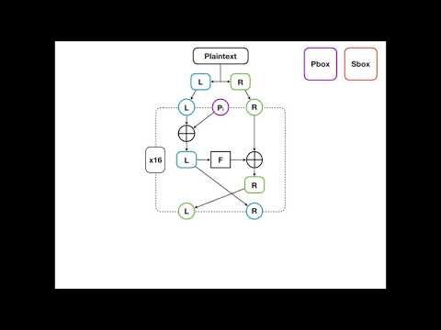
Algorithm

Slide 5
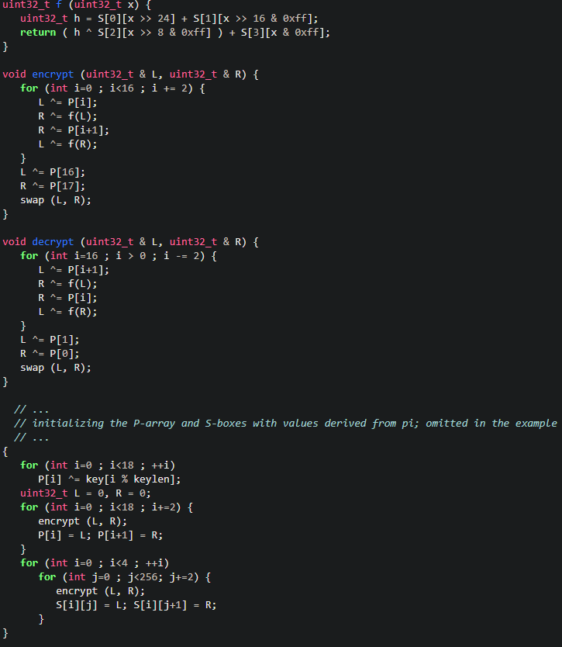
Pseudocode
Initialization

Slide 6
Pseudocode
XOR Function

Slide 7
Pseudocode
Encryption

Slide 8
Pseudocode
Decryption

Slide 9
In Practice
Blowfish in action is a fast block cipher, however when changing keys the process can take a long time
The size of blowfish is approximately 4 kb
An application of blowfish is password-hashing

Slide 10
Benefits?
Blowfish is a fast symmetric block cipher
Resilient against crypto analysis
Free to use

Slide 11
Drawbacks?
Small Block size of 64 bits
Runs generally slowly in the key changing aspect

Slide 12
Alternatives
Twofish
Threefish
bcrypt

Slide 13
1 Alternative in Specific
Twofish
The algorithm is similar to Blowfish algorithm applying 16 rounds of encryption to the plaintext input
Increased block size to 128 bits

Slide 14
Works Cited
“Schneier on Security,” Blog. [Online]. Available: https://www.schneier.com/academic/blowfish/. [Accessed: 29-Mar-2020].
“Blowfish”, Video [Online]. Available: https://www.youtube.com/watch?v=gz8AV0bPaOU. [Accessed: 29-Mar-2020].

