Slide 1
Utility of Imagination

Slide 2
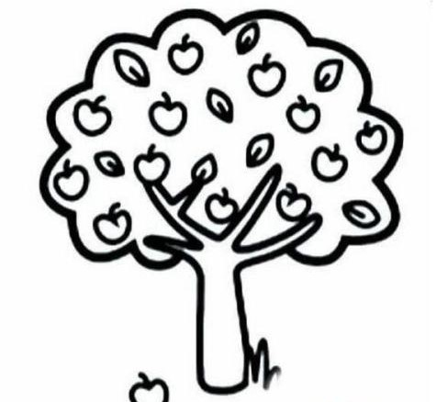

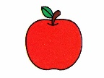
There must be some inner interaction!

Slide 3


Triple integration
domain
$$\iiint_{V}^{ }{ }$$
$$\left\{\begin{aligned}0≤x≤1 \\ 0≤y≤1−x \\ 0≤z≤1−x−y\end{aligned}\right.$$
What is it?

Slide 4
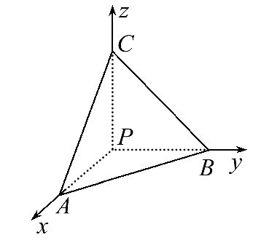
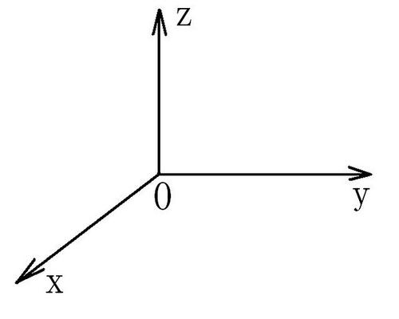
coordinate system

Slide 5
IMAGINATION!

