Slide 1
Aladdin Simulator
Bohan Yang
2022.11.6

Slide 2
References
[1] Y. S. Shao, B. Reagen, G.-Y. Wei, and D. Brooks, “Aladdin: A Pre-RTL, Power-Performance Accelerator Simulator Enabling Large Design Space Exploration of Customized Architectures” in ISCA, 2014
[2] Yakun Sophia Shao, Sam Likun Xi, Vijayalakshmi Srinivasan, Gu-Yeon Wei, and David Brooks. 2016. Co-designing accelerators and Soc interfaces using gem5-Aladdin , MICRO’16.
[3] Sam (Likun) Xi, Yuan Yao, Kshitij Bhardwaj, Paul Whatmough, Gu-Yeon Wei, and David Brooks. SMAUG: End-to-End Full-Stack Simulation Infrastructure for Deep Learning Workloads. ACM Trans. Archit.Code.Optim.2020.

Slide 3
Intro
A pre-RTL, power-performance accelerator modeling framework and demonstrate its application to system-on-chip (SoC) simulation
RTL implementations is a tedious and time-consuming process
-> cannot support architecture-level design space exploration (sweeping parameters)
We need a high-level design flow that abstracts RTL implementations of accelerators.
(Q1: high-level -> abstract -> behavior simulation -> HLS-like ??? -> how to efficiently map) .

Slide 4
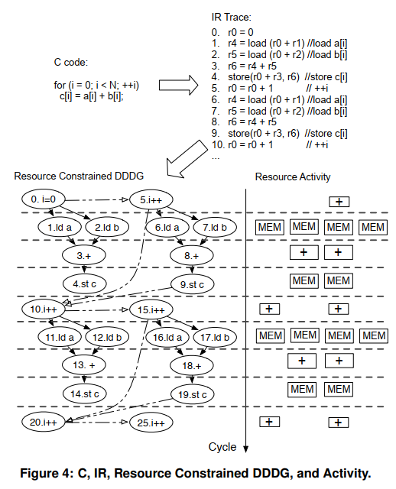
Simulation Method
Taking high-level language descriptions of algorithms (C/C++) as inputs
Using dynamic data dependence graphs (DDDG) as a representation of an accelerator without having to generate RTL. (Q2: mapping method?
totally automatic? ) .

Slide 5
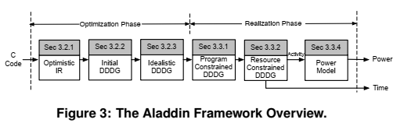
Inner Framework
DDDG: a directed, acyclic graph (DAG) where nodes represent computation and edges represent dynamic data dependences between nodes.
Dataflow nature of accelerators --> make DDDG a good candidate to model their behavior .
Have 2 phases: Optimization Phase --> Realization Phase

Slide 6
Optimization Phase
Step 1 : Optimistic IR
IR: a high-level, machine independent intermediate representation provided by the ILDJIT compiler.
ILDJIT IR is optimistic because it allows an unlimited number of registers, eliminating additional instructions generated due to stack overheads and register spilling.
Step 2 : Idealized DDDG
Customize datapaths for application-specific features to optimize initial DDDG.
ex. bitwidth reduction, mem2reg
Including node-level, loop-level, memory-level transformations and Extensibility.

Slide 7
Realization Phase
Aladdin uses program and resource parameters, defined by users, to constrain the idealized DDDG generated.
The idealized DDDG optimistically assumes elimination of all control and false data dependences at design time.
Aladdin’s realization phase models actual control and memory dependences to create the program-constrained DDDG
(Sorry I didn’t get it while reading) (RAW and input dependent memory accesses)
Resource-Constrained DDDG specify the type and size of hardware resources in an input configuration file. loop rolling, loop pipelining, and memory ports

Slide 8
Example
an accelerator with a factor-of-2 loop-iteration parallelism and without loop pipelining
The solid arrows in the DDDG are true data dependences.
The dashed arrows represent resource constraints, such as loop rolling and turning off loop pipelining.
(Q3: I admit the dataflow is enough optimized, but how about architecture mapping? --> power and area)

Slide 9
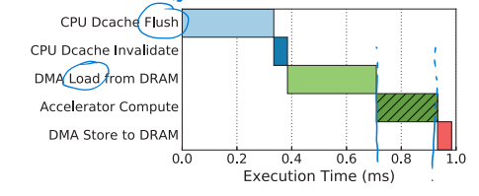
Gem5-Aladdin
From systematic view, data movement and coherence management for accelerators takes up ~ 40% execution time --> misleading performance predictions and inefficient accelerator designs
Aladdin only focuses on the standalone datapath and local memories. It assumes that all data has been preloaded into the local scratchpads. This skips the modeling of any interactions between accelerators and the rest of the system in which they belong.

Slide 10
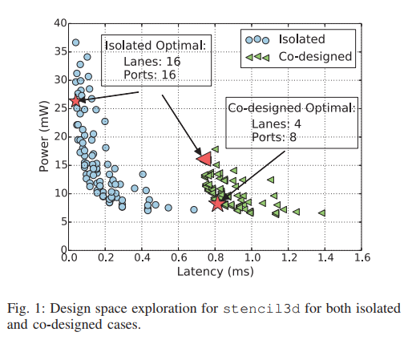
Motivation
Datapaths should be less aggressively parallel, which results in more balanced designs and improved energy efficiency compared to accelerators designed in isolation.
The choice of local memory interfaces is highly dependent on the dynamic memory characteristics
DMA VS Cache (less rigid)

Slide 11
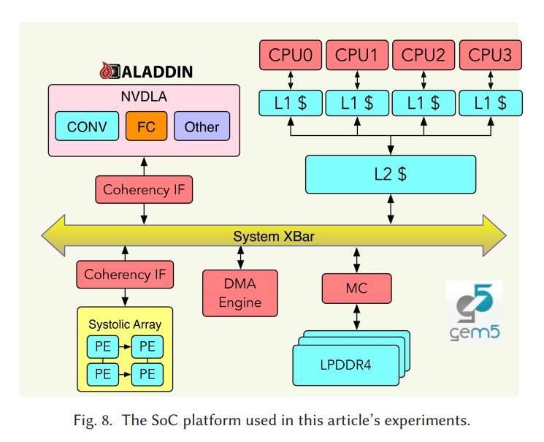
Components
Gem5-Aladdin includes general purpose cores, memory controllers, a DMA engine, and fixed-function accelerators, and the system bus.
CPU and accelerator use shared cache or ioctl to communicate (offload)
Maybe we don’t need the whole system?

Slide 12
Aladdin Summary
Aladdin is a trace-based (program) accelerator simulator
Profiles the dynamic execution of a program
Constructs a dynamic data dependence graph (DDDG) as a dataflow representation of an accelerator.
Applies common accelerator design optimizations （common?）
Schedules the graph for execution through a breadth-first traversal

Slide 13
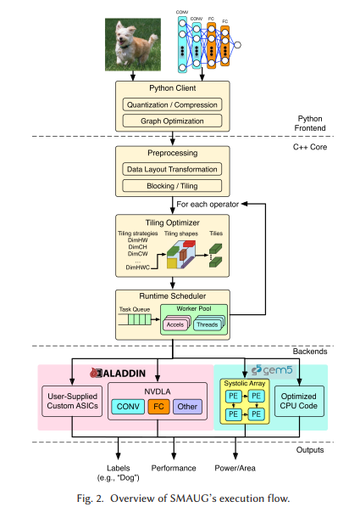
SMAUG
SMAUG: End-to-End Full-Stack Simulation
（quite meet our need）
Motivated by >60% time spent on data movement and the deep learning software framework
What matters: data layout transformations， the choice of accelerator interfacing, management of multiple independently programmed accelerators, and contention for shared system resources

Slide 14
Framework
Step 1: Python API
Converted into a dataflow graph
Step 2: C++ runtime to manage the execution flow
Preprocess
Tiling optimizer
Scheduler
Step 3: hardware-accelerated kernels

Slide 15
Comment
Since the internal representation of the network is a graph, arbitrarily complex networks can be defined and scheduled （complex DAG, including dynamic NN）
Deriving some ideas from SMAUG is fine
Take a look at the source codes and implement details
I still don’t understand the mapping method (match our design? Area & power? Library?)
Maybe we have to design it ourselves，，，

Slide 16
Thanks for listening!

