Slide 1





DISTILLING THE MICROSOFT CYBERSECURITY REFERENCE ARCHITECTURE
Pete Zerger, CISSP
MVP (Azure, Cloud &DC)
United States
@pzerger linkedin.com/in/petezerger
July 23rd, 2020
8AM-10:30 PM CDT
DONATIONS SUPPORTING

Slide 2
Deploying a Practical YAML Build Pipeline for AKS
Presentation Content:
https://github.com/starkfell/iam-conf-2020-aks-practical-yaml
Additional Link(s):
https://github.com/starkfell/100DaysOfIaC/blob/master/articles/day.59.one.service.principal.to.rule.them.all.md

Slide 3
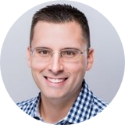
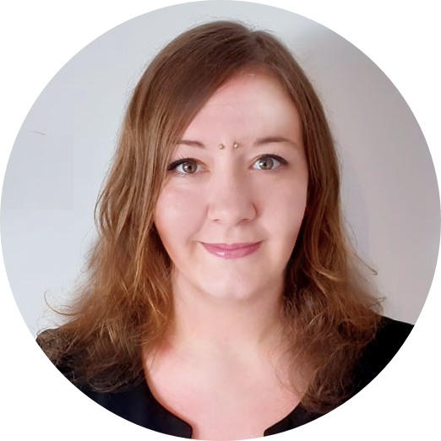
Ryan Irujo
Principal consultant at Innofactor Norge
Specializes in Architecting and deploying customized solutions in the Azure Cloud, with particular focus on Automation and Kubernetes
Marie Yerna
Junior Consultant at Innofactor Norge
Focus on technical documentation, automation and Kubernetes in Azure

Slide 4
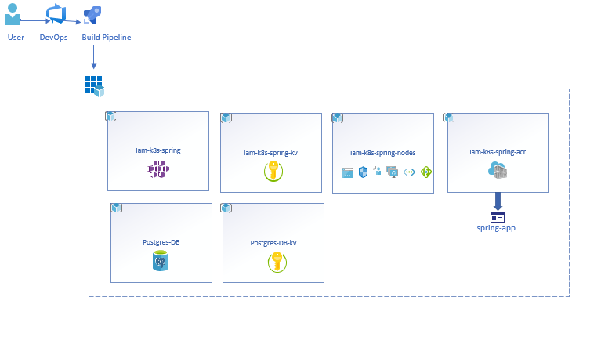
.
Overview

Slide 5
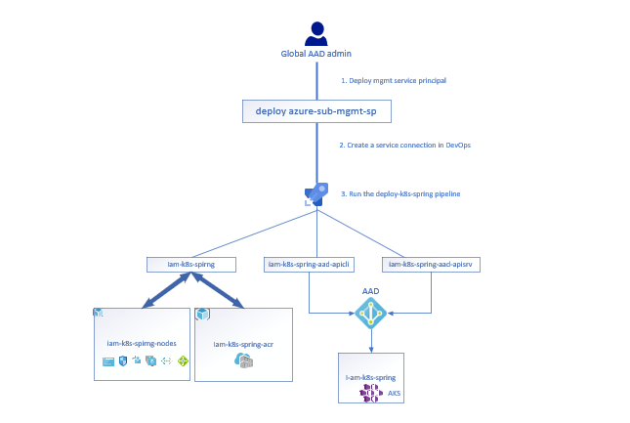
Service principals overview

Slide 6
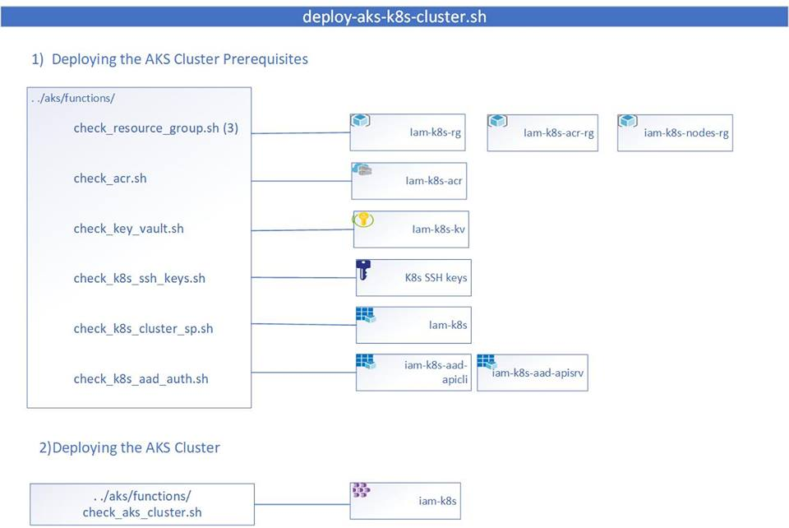
deploy-aks-k8s-cluster.sh script overview

Slide 7

QUESTIONS?
To ask a question, select Q&A on the right side of the screen

