Slide 1





DISTILLING THE MICROSOFT CYBERSECURITY REFERENCE ARCHITECTURE
Pete Zerger, CISSP
MVP (Azure, Cloud &DC)
United States
@pzerger linkedin.com/in/petezerger
July 23rd, 2020
8AM-10:30 PM CDT
DONATIONS SUPPORTING

Slide 2
Deploying a Practical YAML Build Pipeline for AKS
- Add stuff here

Slide 3


Ryan Irujo
Principal consultant at Innofactor Norge
Specialize in Deploying and Configuring Solutions in the
Microsoft Azure Cloud using ARM and Azure Automation
Focus on automation and Kubernetes in Azure
Marie Yerna
Junior IT Administrator at Innofactor Norge
Focus on documentation, automation and Kubernetes in Azure

Slide 4
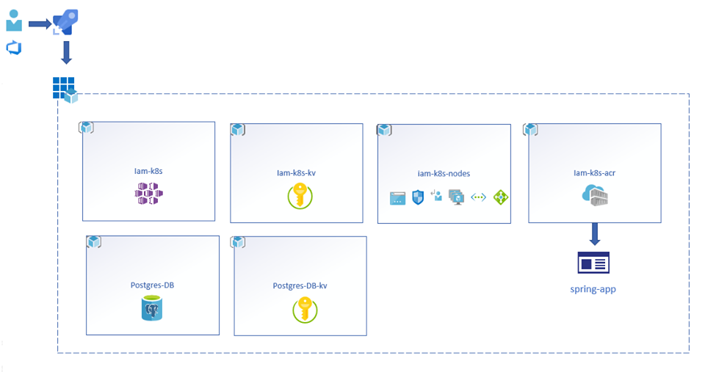
.
Overview of the resources being deployed

Slide 5
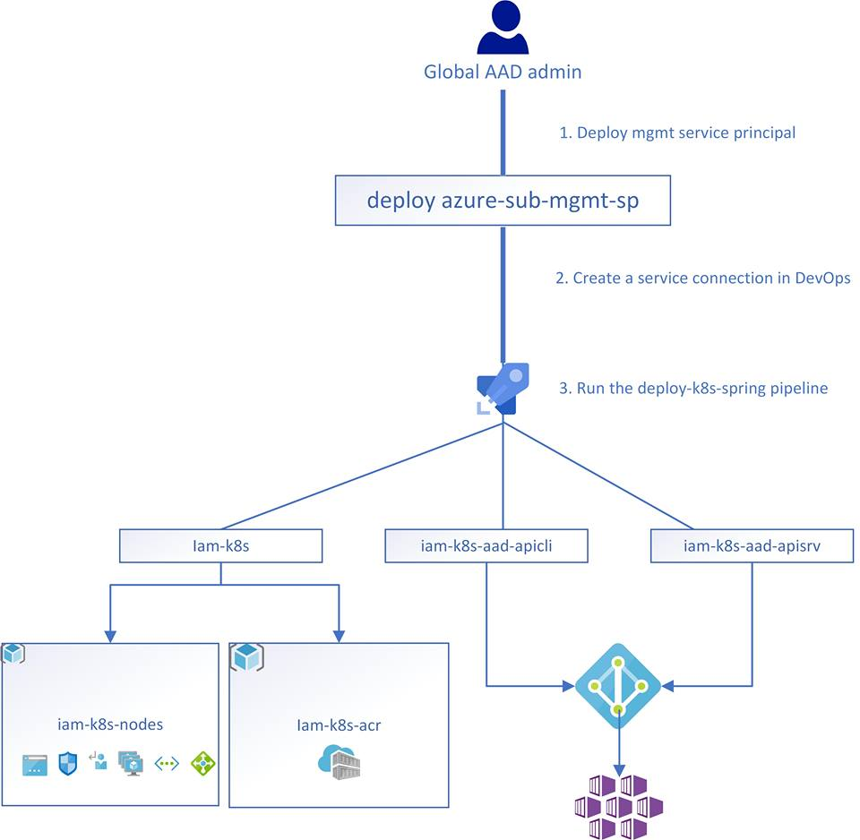
Overview of the ????

Slide 6
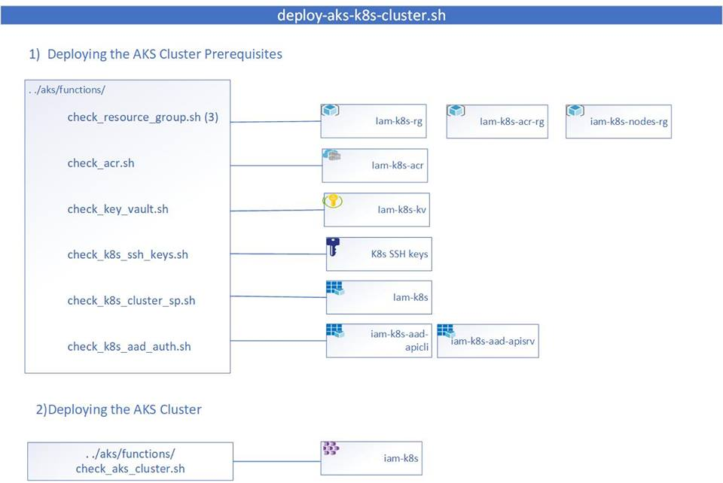
Overview of the deloy-aks-k8s-cluster.sh script deployment

Slide 7

QUESTIONS?
To ask a question, select Q&A on the right side of the screen

