Slide 1





DISTILLING THE MICROSOFT CYBERSECURITY REFERENCE ARCHITECTURE
Pete Zerger, CISSP
MVP (Azure, Cloud &DC)
United States
@pzerger linkedin.com/in/petezerger
July 23rd, 2020
8AM-10:30 PM CDT
DONATIONS SUPPORTING

Slide 2
Deploying a Practical YAML Build Pipeline for AKS

Slide 3


Ryan Irujo
Principal consultant at Innofactor Norge
Specializes in Architecting and deploying customized solutions in the Azure Cloud, with particular focus on Automation and Kubernetes
Marie Yerna
Junior Consultant at Innofactor Norge
Focus on technical documentation, automation and Kubernetes in Azure

Slide 4
Supplemental Content
Presentation Content:
https://github.com/starkfell/iam-conf-2020-aks-practical-yaml
Additional Link(s):
https://github.com/starkfell/100DaysOfIaC/
YAML Build Pipeline Related Day(s): 33-42, 49-51, 55, 58, 60, 63, 70, and 98.

Slide 5
Why YAML Pipelines
Control Azure Resources as Infrastructure-As-Code
Control Infrastructure Management from a single location
Changes to Infrastructure are tracked in Repositories

Slide 6
Pro’s and Con’s of YAML Build Pipelines
Pro’s:
Complete Management of Azure Resources
Ability to Track all environment changes
Tooling to use is up to you and your Team
Azure CLI, ARM, Terraform, bash, python, etc.
Con’s:
Requires time and code related skillsets
Requires code maintenance

Slide 7
What we will cover in the Deployment
Deploying a Management Service Principal
Create a YAML Build Pipeline
Deploy Infrastructure using our Build Pipeline
AKS Cluster
PostgreSQL Server and Database
Key Vaults
Springboot App
Verifying access and connectivity to resources

Slide 8
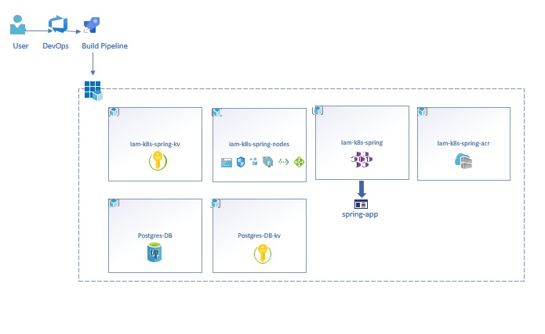
.
Deployment Overview

Slide 9
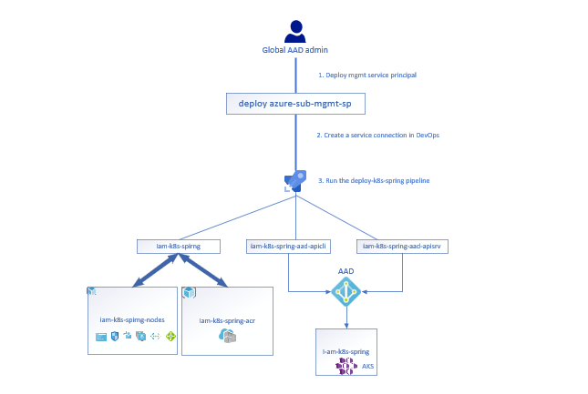
Service Principals Overview

Slide 10
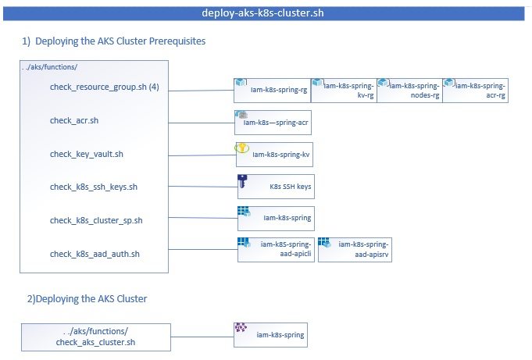
Deploy-k8s-cluster.sh Overview

Slide 11

QUESTIONS?
To ask a question, select Q&A on the right side of the screen

