Slide 1

Project Title: Improving Multi-Label Deep Learning models for classes with Long Tail Distribution Supervisor & Mentor : Dr. K. S. Phani Krishna Presented by: K Abhishek Raj (521143) Prashant Mishra (521218) Rakesh Yamjala (521260) Sandeep K Aazad (521230)
राष्ट्रीय प्रौद्योगिकी संस्थान - आंध्र प्रदेश
NATIONAL INSTITUTE OF TECHNOLOGY ANDHRA PRADESH
TADEPALLIGUDEM – 534102, WEST GODAVARI DIST., ANDHRA PRADESH, INDIA.

Slide 2
Abstract
The objective of this project is to design and improve a robust multi-label classification framework for the Ocular Disease Intelligent Recognition (ODIR) dataset using self-supervised learning techniques. The project focuses on detecting the presence of multiple ocular diseases from a single retinal image, aiming to assist in early diagnosis and treatment. Four CNN backbones (VGG16, InceptionV3, ResNet50, ResNet101) were adapted with sigmoid outputs and optimized using advanced loss functions like Weighted BCE, Dice Loss, and hybrid losses. ResNet101 achieved the best results with 66% accuracy and a 0.62 macro F1-score. The study highlights the importance of backbone depth, tailored loss strategies, and robust training for handling long-tail medical datasets.

Slide 3
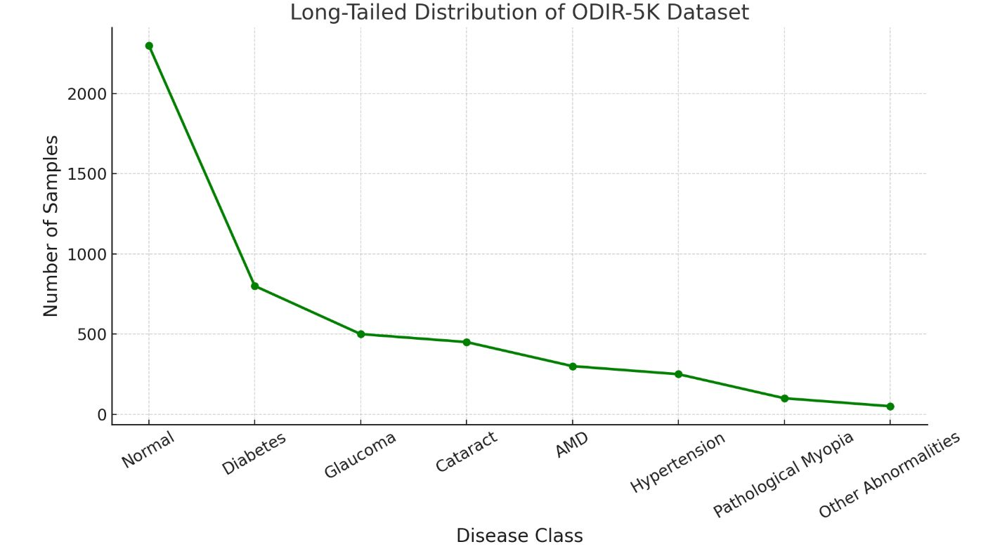
Problem Statement
Fundus images often contain multiple diseases, making multi-label classification a critical task.
Long-tail distribution presents a challenge as some diseases appear frequently, while others are rare.
Deep learning models face challenges in multi-label medical image classification due to class imbalance and limited data.
How can we enhance classification accuracy and generalization using deep architectures and hybrid loss functions?
Long-Tail Distribution

Slide 4
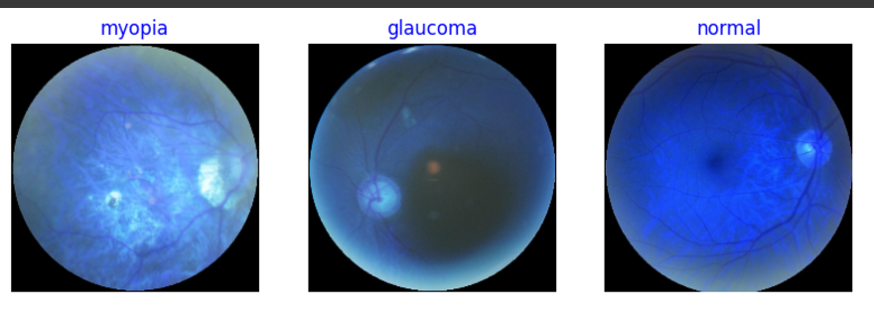
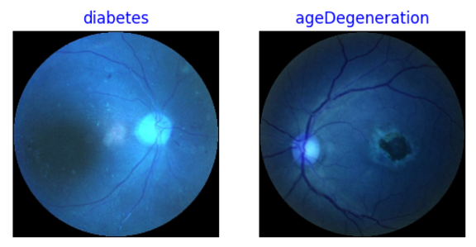
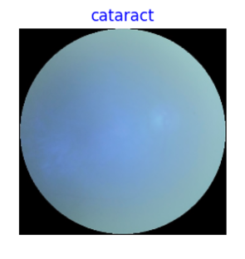
Dataset
Ocular Disease Intelligent Recognition (ODIR) is a structured ophthalmic database of 5,000 patients with age, color fundus photographs from left and right eyes, and doctors' diagnostic keywords from doctors.
8 Classes of ODIR Classification :
Normal (N),
Diabetes (D),
Glaucoma (G),
Cataract (C),
Age related Macular Degeneration (A),
Hypertension (H),
Pathological Myopia (M),
Other diseases/abnormalities (O)

Slide 5
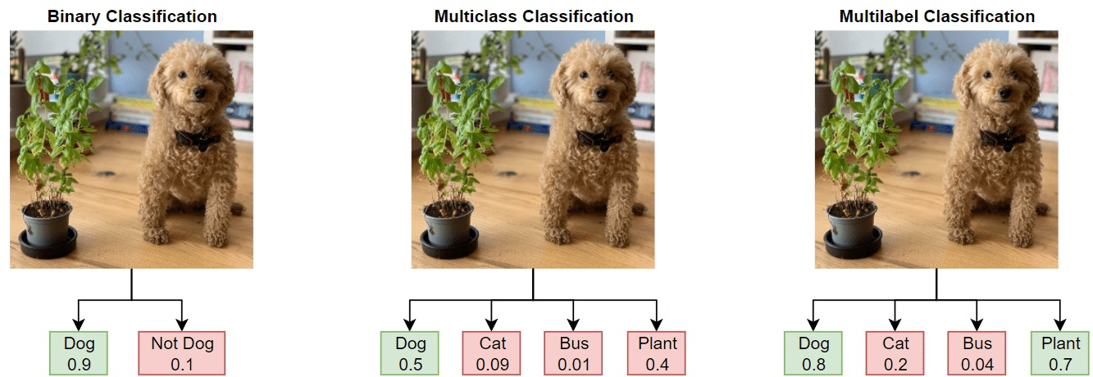
Objectives
Primary Objective: Develop robust multi-label classification models for fundus images that address the challenges of long-tail distribution.
Specific Goals:
1) Develop a robust pipeline for multi-label classification of ocular diseases using the ODIR dataset.
2) Incorporate Multi model architecture with hybrid losses to improve model’s accuracy.
3) Compare and evaluate the performance of various loss functions, including:
BCE-Hill Hybridization
Dice-BCE Hybridization
4) Demonstrate the model’s efficiency using ResNet101 as the backbone for feature extraction and classification.

Slide 6
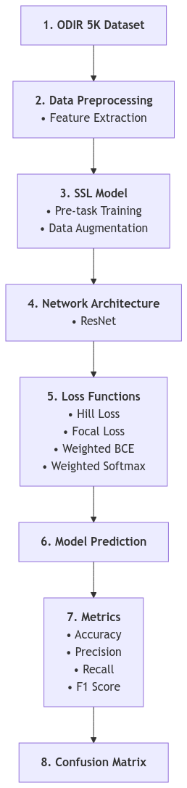
Methodology
Dataset Preparation:
Fundus images from the ODIR-5K dataset were resized, normalized, label-encoded for eight diseases, and augmented (rotation, flipping, jittering) to boost generalization.
Model Architecture:
CNN models (VGG16, InceptionV3, ResNet50, ResNet101) were evaluated; ResNet101, fine-tuned from ImageNet with sigmoid outputs, was selected for its superior performance.
Loss Function Implementation:
Implemented BCE, Weighted BCE, Dice, Hill, and hybrid losses to tackle class imbalance and enhance rare disease detection.
Training Strategy:
Models were optimized using Adam with early stopping, learning rate scheduling, and stratified sampling for balanced training.
Evaluation Metrics:
Performance was measured using accuracy, macro/micro precision, recall, F1-score, and confusion matrices, emphasizing sensitivity to rare classes.

Slide 7
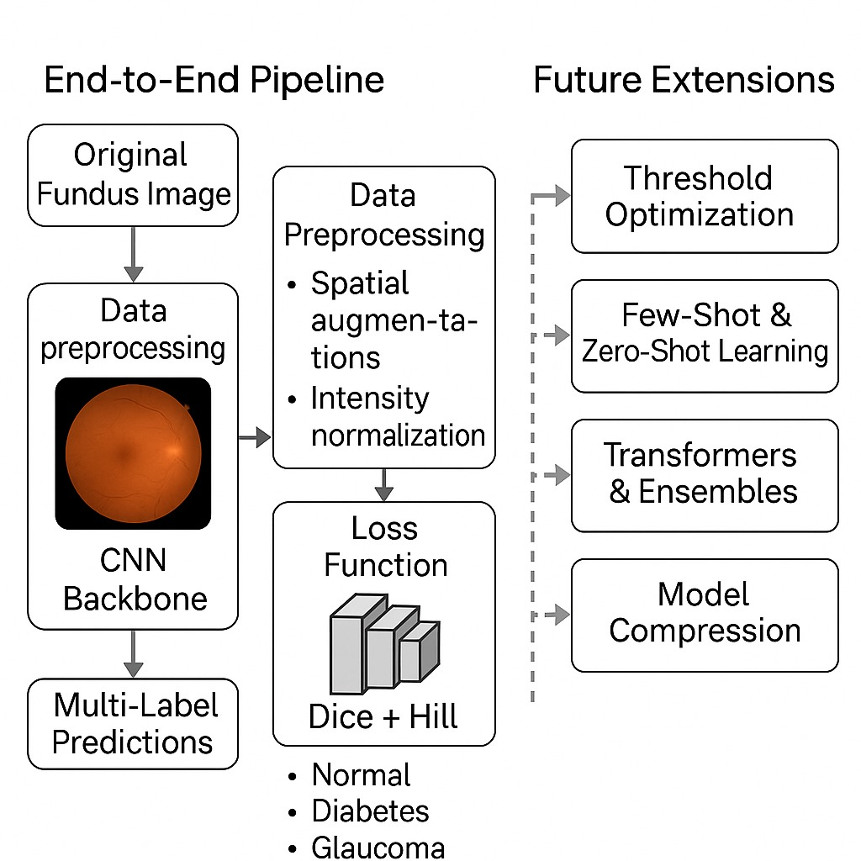
Methodology

Slide 8
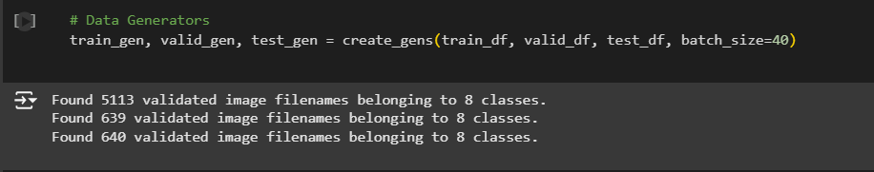
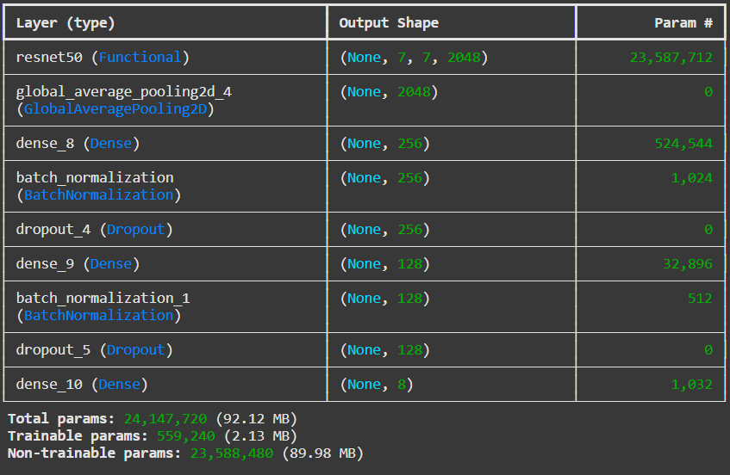
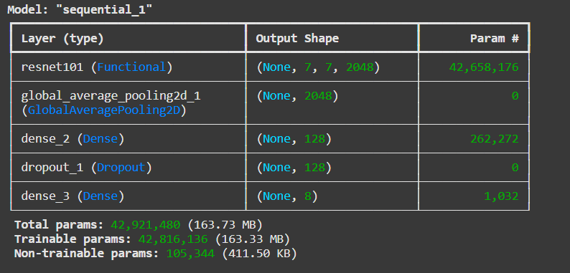
Model Implementation
Stage I : Data Preprocessing
Hyper-Parameters : Epochs : 30 Learning Rate : 0.001 Batch size : 40 test size : 0.2 Input Image size : [224,224,3]
Stage II : Building Backbone of Model using ResNet101

Slide 9
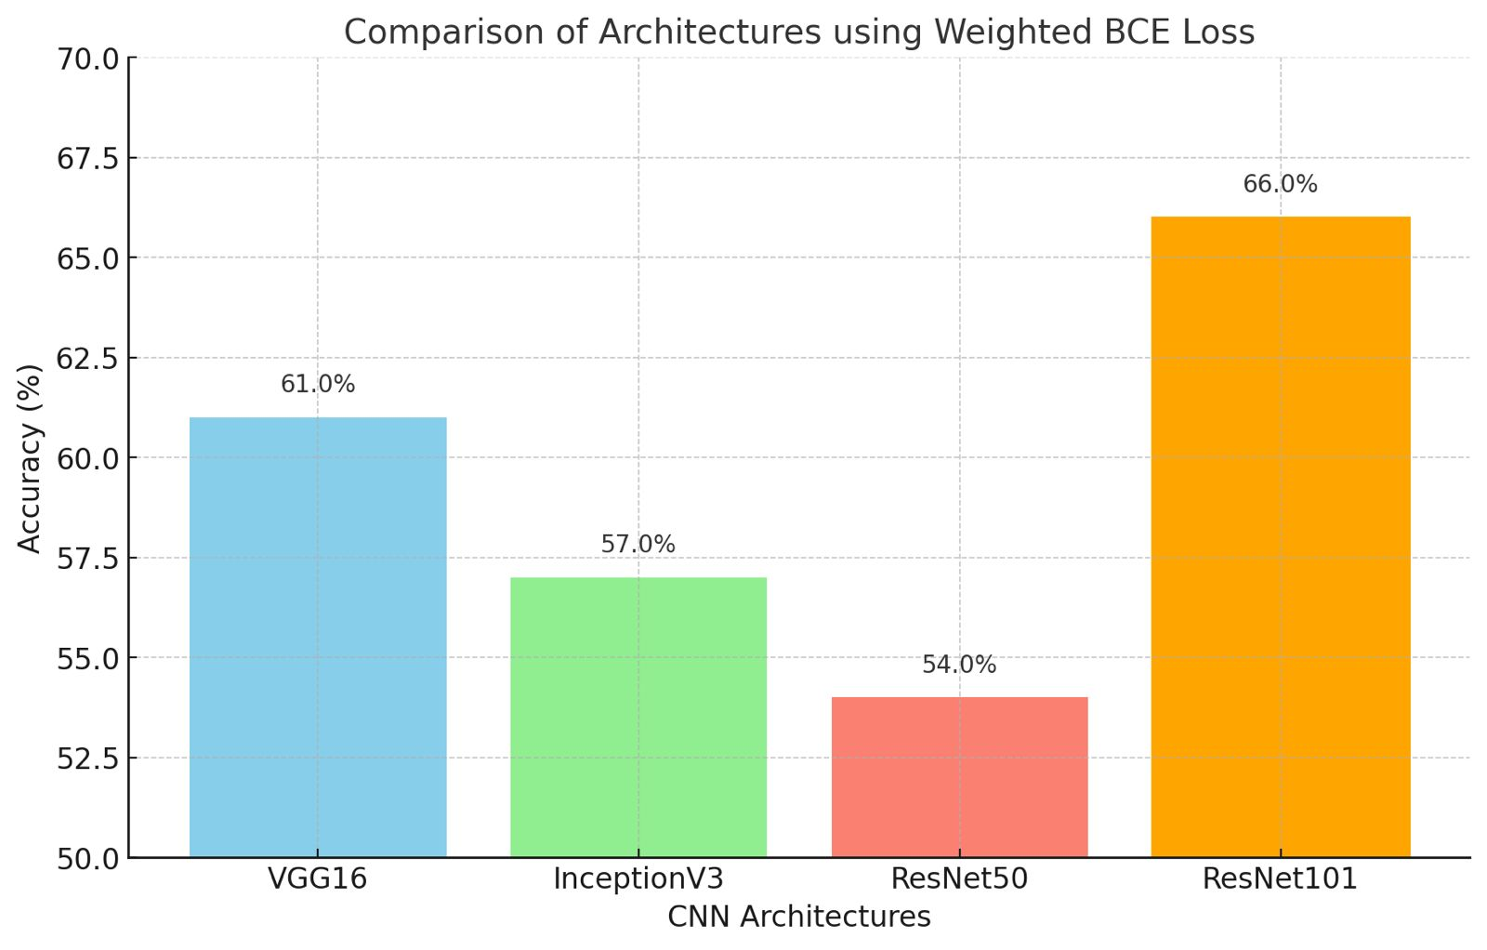
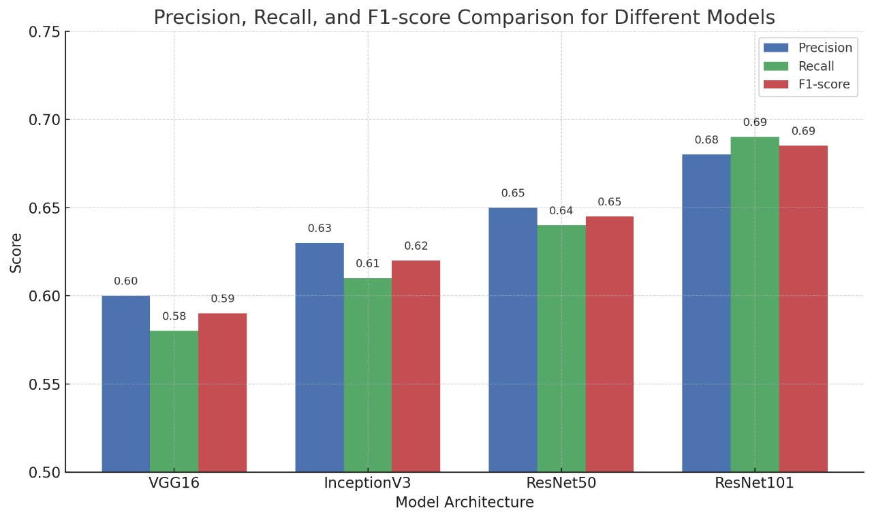
Stage III : Different Network Comparison

Slide 10
Stage IV : Hybridization of loss functions
Architecture | BCE Accuracy | Weighted BCE Accuracy | Hill Loss Accuracy | Dice Loss Accuracy | BCE + Hill Accuracy | Dice + Hill Accuracy | Trainable Params | Dropout Rate
VGG16 | 55% | 61% | 52% | 54% | 58% | 56% | ~15 Million | 0.3
InceptionV3 | 54% | 56% | 52% | 53% | 57% | 58% | ~23 Million | 0.4
ResNet50 | 59% | 61% | 57% | 58% | 62% | 63% | ~25 Million | 0.3
ResNet101 | 66% | 67% | 64% | 64% | 62% | 63% | ~44 Million | 0.25

Slide 11
Challenges in Accuracy and Solutions
Challenge | Description | Approach
Noisy or Low-Quality Data | The ODIR-5K dataset contains blurry, poorly labeled, or inconsistent images, making it hard for models to generalize. | Data cleaning and enhanced preprocessing techniques (e.g., normalization, augmentation).
Suboptimal Learning Rate | A too-high learning rate causes the model to oscillate or get stuck in local minima, leading to slow or poor convergence. | Hyperparameter tuning, especially careful learning rate scheduling.
Stratified K-Fold Cross Validation | Ensures that each fold of the dataset maintains the same proportion of each class, improving generalization and robustness. | Stratified K-Fold CV was used to get reliable and unbiased performance estimates.
Trying Different Models | Different CNN architectures have different capabilities in feature extraction and generalization. | Experimented with multiple models: VGG16, ResNet101, and InceptionV3 to find the best fit for the data.
Class Imbalance (Long-Tail Problem) | Rare diseases have very few examples, leading to model bias towards frequent classes. | Applied weighted loss functions and oversampling of minority classes to balance learning.

Slide 12


Hybridization of Loss Function
BCE-Hill Hybrid Loss :
Why BCE ?
Computationally efficient and standard loss for multi-label classification
Optimized for independent labels
Why Hill Loss ?
Robust to class-Imbalance
Reduces overconfidence on frequent labels.
2. Dice-BCE Hybrid Loss :
Improves Recall, ensures rare labels gets detected (works well for Medical Data).
Optimal choice for Imbalanced datasets.

Slide 13
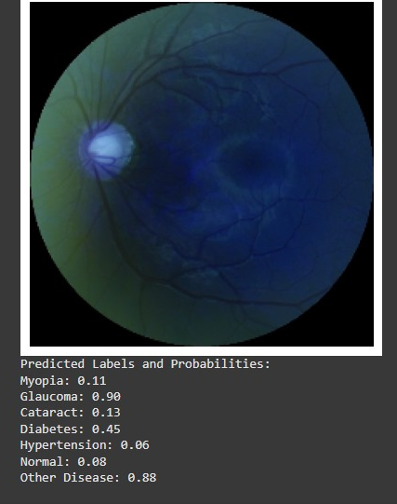
Outcome
Random Selected Image
True Label : Glaucoma

Slide 14
Further Extentions
Improving Model Accuracy:✅
Explore advanced architectures and hyperparameter tuning to enhance classification performance.
Hybridization of Loss Functions: ✅
Develop and test hybrid loss functions combining the strengths of Weighted BCE, Focal Loss, and Hill Loss.
Trying Multiple Models: ✅
Utilized different CNN models for Accuracy improvement along with hybrid losses.
ResNet101
VGG Net16
Inception V3
Research & Publication:
If hybrid loss functions prove effective, demonstrate results for publication in relevant medical AI journals.
Generalization to Other Medical Fields:
Adapt the model for multi-label classification tasks in other domains, such as detecting abnormalities in blood samples or other diagnostic imaging datasets.

Slide 15
References
[1] Deep Learning-Based Pipeline for the Detection of Multiple Ocular Diseases, Machine Learning and Computational Intelligence Techniques for Data Engineering (MISP 2022), May 16, 2023, DOI: 10.1007/978-981-99-0047-3_69.
[2] Pre-Trained Deep Learning-Based Approaches for Eye Disease Detection, Pankaj Kumar, Sudhir Bhandari, Vishal Dutt, 2023 International Conference on Circuit Power and Computing Technologies (ICCPCT), August 2023, DOI: 10.1109/ICCPCT58313.2023.10245175.
[3] An Efficient Deep Learning Model for Eye Disease Classification, Archana Saini, Kalpna Guleria, Shagun Sharma, 2023 International Research Conference on Smart Computing and Systems Engineering (SCSE), June 29, 2023, DOI: 10.1109/SCSE59836.2023.10215000.
[4] Explainable Classification of Macular Degeneration Using Deep Learning, Sahil Khose, Ankita Ghosh, Yogish S. Kamath, Neetha I.R. Kuzhuppilly, J. R. Harish Kumar, Manipal Academy of Higher Education, published online at researcher.manipal.edu.
[5] A Structure-Fusion Network for Medical Image Classification, Fuli Wu, Wei Yuan, Pengyi Hao, Shuyuan Tian, IEEE International Conference on Image Processing (ICIP) 2023, October 9, 2023, available at resourcecenter.ieee.org.

