Slide 1

Student Details
Name : - Kunal Kumar
SkillBuild Email ID : - kunal73014@gmail.com
College Name : - Dronacharya College of Engineering
College State : - Uttar Pradesh
Internship Domain : - Cyber Security
Internship Start and End Date : - 12-06-2023 to 24-07-2023
Internship ID: - INTERNSHIP_168198413964410a8b547b1
Student ID: - STU60e42af9b39ca1625565945

Slide 2
A Journey into the World of Keyloggers
By Kunal Kumar

Slide 3
Table of Contents
1.Introduction
2.What is a Keylogger?
3.Why Use a Keylogger?
4.How to Create a Keylogger
5.Risks and Ethical Considerations
6.Conclusion

Slide 4

01
Introduction

Slide 5

Introduction
Welcome to our presentation on keyloggers, a tool that has become increasingly popular in today's digital age. Keyloggers are software programs that record every keystroke made on a computer or mobile device, allowing someone to track everything that is typed, from passwords to personal messages.
While keyloggers have many legitimate uses, such as monitoring employee productivity or keeping an eye on your child's online activity, they can also be used for malicious purposes, such as stealing sensitive information or spying on someone without their knowledge. In this presentation, we will explore the different types of keyloggers, how they work, and the ethical considerations associated with using them.

Slide 6
02
What is a Keylogger?

Slide 7
What is a Keylogger?
A keylogger is a type of surveillance software that records every keystroke made on a computer or mobile device. This includes everything from passwords and credit card numbers to emails and instant messages. Keyloggers can be installed remotely or physically, and can operate in stealth mode without the user's knowledge.
A keylogger is an invisible tool for surveillance that allows you to monitor the activities carried out by the users of your computer without them knowing. A keylogger is great for both companies who want to keep track of their employee’s internet and computer usage or for private persons where the family shares one or many computers. This great product is not always used for surveillance, it can also be a great tool for the person with many passwords and user names to easier remember them.

Slide 8

03
Why Use a Keylogger?

Slide 9

Why Use a Keylogger?
Keyloggers can be a valuable tool for parents who want to keep an eye on their children's online activities. By monitoring keystrokes and capturing screenshots, parents can identify potential dangers and protect their kids from cyberbullying, online predators, and other threats.
Employers can also benefit from using keyloggers to monitor employee activity. This can help prevent data breaches, ensure compliance with company policies, and increase productivity by identifying areas where employees may need additional training or support.

Slide 10
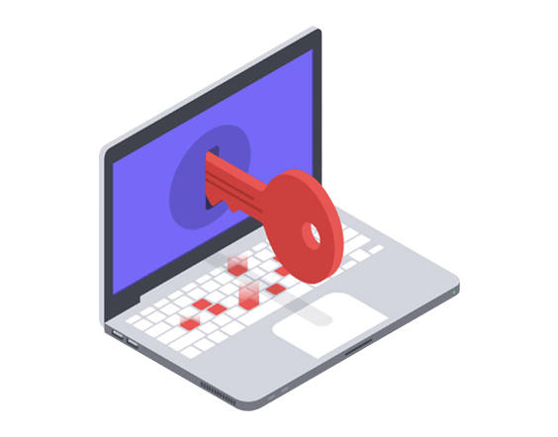
04
How to Create a Keylogger?

Slide 11
How to Create a Keylogger?
To create a keylogger, you will need to have a good understanding of programming languages such as C++ or Python. You will also need to choose a tool that fits your needs, such as PyKeylogger or Ardamax Keylogger.
Once you have chosen your programming language and tool, the next step is to write the code for your keylogger. This involves capturing keystrokes and saving them to a log file, as well as implementing any additional features you may want, such as screenshot capture or email forwarding.

Slide 12
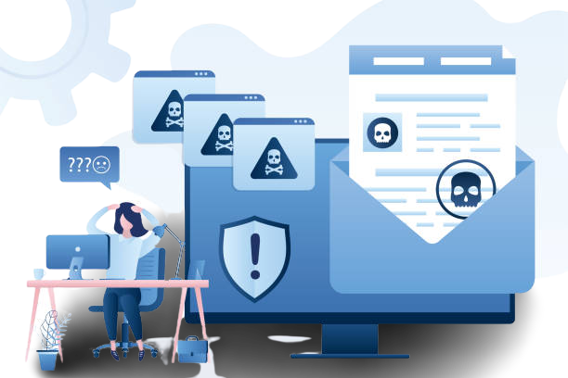
05
Risks and Ethical Considerations

Slide 13
Risks and Ethical Considerations
Using a keylogger can be a powerful tool for monitoring activity on a computer, but it also comes with significant risks. One major concern is the invasion of privacy that can occur when someone uses a keylogger without the knowledge or consent of the person being monitored. This can lead to serious legal and ethical issues, especially if sensitive information is obtained through the use of the keylogger.
On the other hand, there are situations where using a keylogger may be necessary, such as in cases of suspected criminal activity or to protect children from online predators. In these instances, the benefits of using a keylogger may outweigh the risks, but it's important to carefully consider all of the potential consequences before deciding to use one.

Slide 14
06
Conclusion

Slide 15
Conclusion
In conclusion, keyloggers can be a powerful tool for monitoring activity and tracking behavior online. They can be used in a variety of settings, from businesses to households, to keep track of what is happening on computers and devices.
However, it is important to consider the potential risks and ethical considerations associated with using a keylogger. Invasion of privacy and legal issues are just some of the concerns that must be taken into account before deciding whether or not to use this technology.
Ultimately, the decision to use a keylogger should be made carefully and with full knowledge of the benefits and risks involved. It is up to each individual to weigh the pros and cons and make an informed choice.

Slide 16
Thank you

