Slide 1



AI and Emerging Technology Executive Fireside Chat
Sunny Song
September 7, 2018

Slide 2

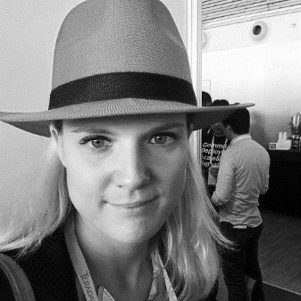
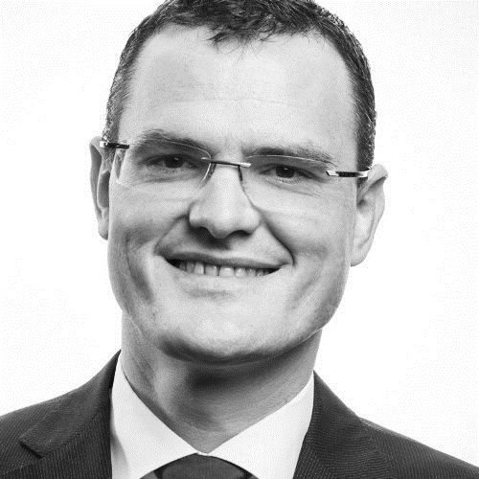
Introduction
Moderator:
Sunny Song
Apps Svcs
North America
Speaker:
Anne Laure
Thieullent
Global Head of AI, I&D
Speaker:
Frank
Wammes
Chief Innovation Officer,
Apps Svcs
Europe

Slide 3
Agenda
Topic approx. time
Introduction
Fireside Chat Discussion 30-45 min.
Live Q&A 15-30 min.
A panel led by thought leaders in AI within our organization on the current and future state of AI, focusing on their experiences and thoughts on emerging technologies. Have questions you’re interested in having answered? Be sure to type it into the Skype Webcast chat box during the live Fireside chat.

Slide 4
Questions
SKYPE SURVEY
Do you think that society will become better or worse from increased automation and AI?
A. Won't change
B. Worse/Much Worse
C. Better/Much Better
SKYPE SURVEY

Slide 5
Questions
When many people think of artificial intelligence, they think of the Terminator. So let’s start off by having you define artificial intelligence and machine learning in the context of our current business applications. How is “good” AI defined?

Slide 6
Questions
Tell us a little bit about what Capgemini has been doing in AI. Is there anything in particular that stands out to you?

Slide 7
Questions
What are the most creative uses of AI that you have seen so far or have been a part of?

Slide 8
Questions
Have all the low-hanging “AI fruits” been picked? Will AI advancement become increasingly difficult?

Slide 9
Questions
We have heard a lot about data’s crucial involvement in AI; how much of a challenge is there in utilizing data to enable AI? How much data do you need to enable these machines to improve?

Slide 10
Questions
SKYPE SURVEY
Do the following scenarios concern you?
AI machines being hacked and loss of personal data
AI machines being more intelligent than humans
AI machines being unreliable
None
SKYPE SURVEY

Slide 11
Questions
What are the privacy implications of AI? For example, when we use Google Home or Amazon Echo, are we entering into a “social contract” where we give up privacy for the sake of convenience?

Slide 12
Questions
Where do you think AI will be in 5-10 years?

Slide 13
Questions
SKYPE SURVEY
Would you trust an autonomous car?
Yes, I would trust it now
Yes, I would trust it 10 years time
Never
SKYPE SURVEY

Slide 14
Questions
SKYPE SURVEY
Would you trust an AI doctor?
Yes, I would trust it now
Yes, I would trust it 10 years time
Never
SKYPE SURVEY

Slide 15
Questions
What particular areas are most critical to success in AI? What are the biggest challenges and obstacles we will have to overcome with AI?

Slide 16
Questions
What skills should people learn now to be part of the AI development problem?

Slide 17
- End of Presentation -
Thank you

