Slide 1
Survey
SKYPE SURVEY
Were you able to install jupyter notebook on your machine? Yes/No
How much experience do you have in python? (None, 0-1 year, 2-4years, expert)
What is your past experience with data science (none/little/main job)
SKYPE SURVEY

Slide 2

Linear Regression
Brian, Halperin, Julie Buard
September 7, 2018

Slide 3


Introduction
Moderator:
Brian Halperin
Netsuite
North America
Speaker:
Julie Buard
Insights and Data
North America

Slide 4
Agenda
Topic approx. time
Linear Regression 20 min.
Code Review and Answers 50 min.
Questions 20 min.
As your first introduction to Data Science, you will start with one of the most famous and classic techniques: Linear Regression. You will be able to put your new skills to the test as you build a supervised learning prediction module in python with a Boston Housing data set!
Acknowledgements:
This material was first created for the 2017 German Connect and Learn Initiative
The presentation has been repurposed for Global Innovators Month by Brian Halperin and Julie Buard

Slide 5
Chapter 1: Introduction to Linear Regression

Slide 6
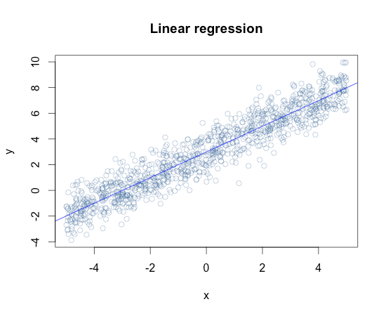
Linear Regression
We often encounter data sets in which there is a relationship between two variables. In many cases, we have observations for one of the variables (the independent variable) and need to come to a conclusion about what this means for the other variables (the dependent variable).
If our data appears to have a linear relationship*, then we may consider Linear Regression as a means of explaining the relationship between these variables.

Slide 7
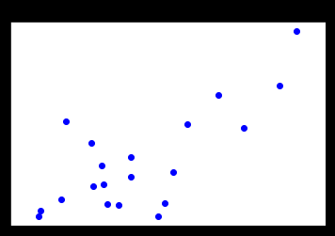
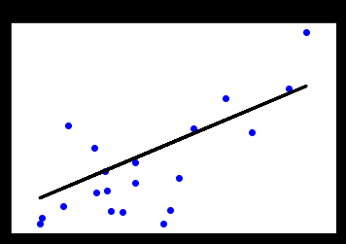
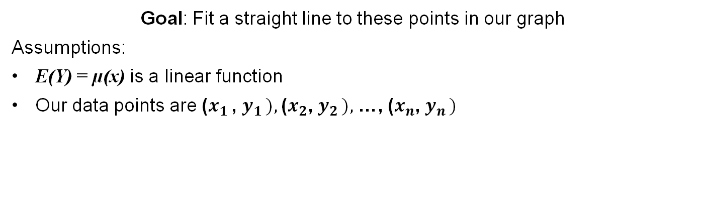
Linear Regression
Goal: Fit a straight line to these points in our graph
Assumptions:
E(Y) = µ(x) is a linear function
Our data points are ($x_{1 }$, $y_{1 }),$($x_{2}$, $y_{2 }),$ …, ($x_{n}$, $y_{n })$
Data Points on Scatter Plot
Regression Fitted
We see here that we were able to fit a straight line through these data points. As we will see in the coming slides, our goal is to minimize the sum of the distance between each of the points and this line.

Slide 8
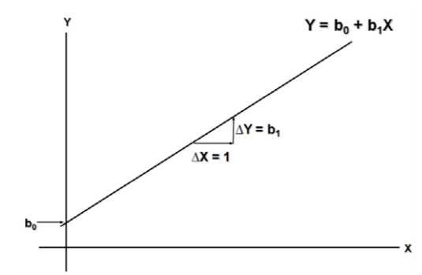
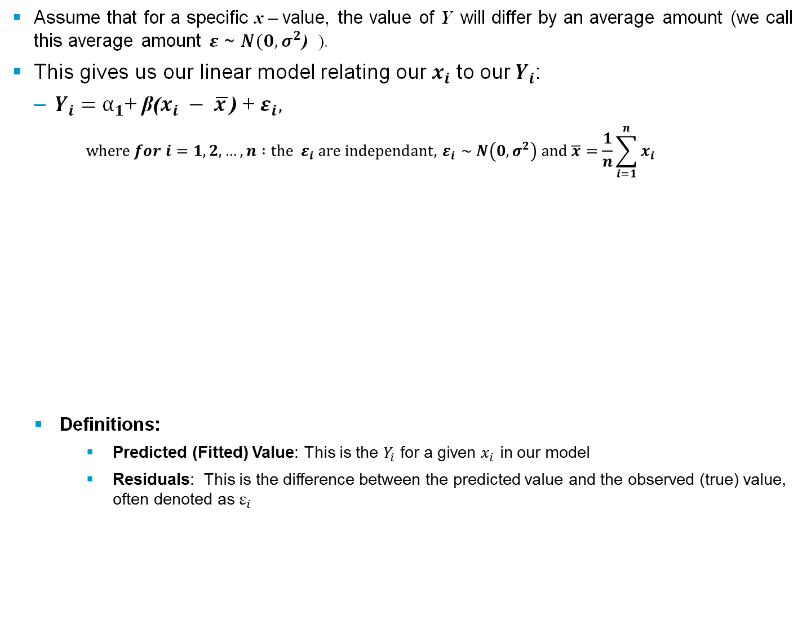
Linear Regression
Assume that for a specific x – value, the value of Y will differ by an average amount (we call this average amount $ε$ ~ $N(0, σ^{2}$) ).
This gives us our linear model relating our $x_{i}$ to our${ Y}_{i}$:
$Y_{i}=α_{1}$+ β($x_{i} − \overline{x }$) + $ε_{i},$
$$where for i=1, 2, …, n :{the ε}_{i} are independant, { ε}_{i} \sim N\left(0, σ^{2}\right) and \overline{x}=\frac{1}{n}\sum_{i=1}^{n}{x_{i}}$$
Definitions:
Predicted (Fitted) Value: This is the $Y_{i}$ for a given $x_{i}$ in our model
Residuals: This is the difference between the predicted value and the observed (true) value, often denoted as $ε_{i}$
Voice of Customer

Slide 9
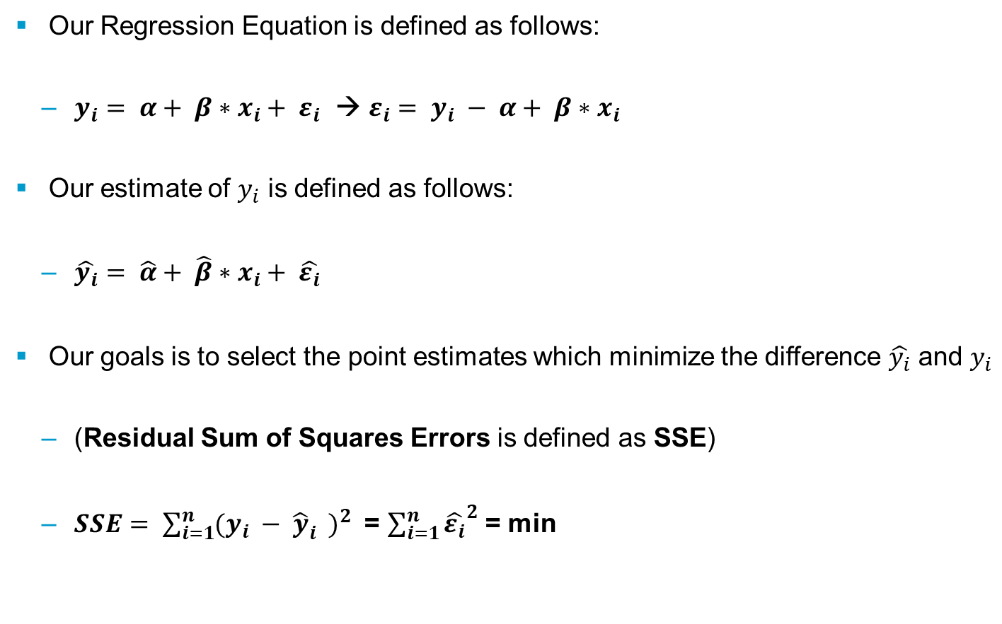
Linear Regression – Fitting our Model
Our Regression Equation is defined as follows:
$y_{i}= α+ β∗x_{i}+ ε_{i}$ → $ε_{i}= y_{i} − α+ β∗x_{i}$
Our estimate of $y_{i}$ is defined as follows:
$\hat{y_{i}}= \hat{α}+ \hat{β}∗x_{i}+ {\hat{ε_{i}}}_{}$
Our goals is to select the point estimates which minimize the difference $\hat{y_{i}}$ and $y_{i}$
(Residual Sum of Squares Errors is defined as SSE)
$SSE= \sum_{i=1}^{n}{{(y_{i} − {\hat{y}}_{i}^{})}^{2}}$ = $\sum_{i=1}^{n}{{\hat{ε_{i}}}^{2}}$ = min

Slide 10
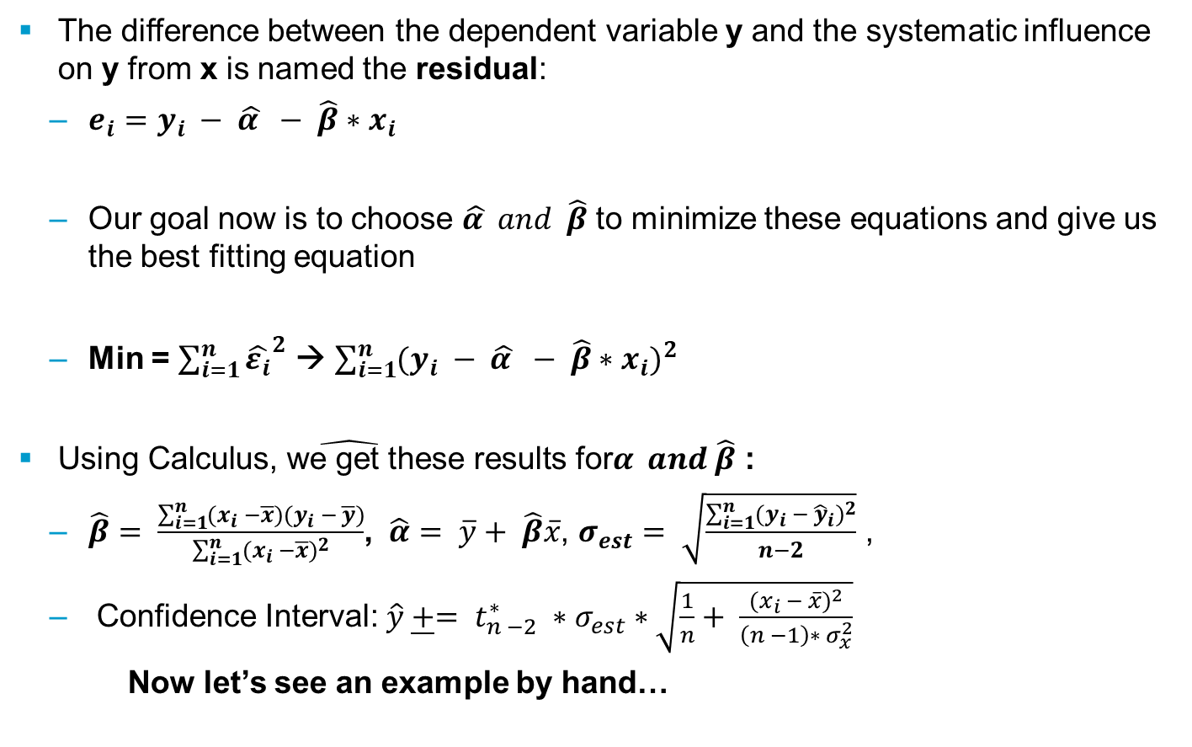
Linear Regression – Fitting our Model
The difference between the dependent variable y and the systematic influence on y from x is named the residual:
$e_{i}=y_{i} − \hat{α } − \hat{β}∗x_{i}$
Our goal now is to choose $\hat{α } and \hat{β}$ to minimize these equations and give us the best fitting equation
Min = $\sum_{i=1}^{n}{{\hat{ε_{i}}}^{2}}$ → $\sum_{i=1}^{n}{{(y_{i} − \hat{α } − \hat{β}∗x_{i})}^{2}}$
$\hat{\text{Using} \text{Calculus}\text{, }\text{we} \text{get} \text{these} \text{results} \text{for}α } and \hat{β}$ :
$\hat{β}= \frac{\sum_{i=1}^{n}{(x_{i} −\overline{x})(y_{i} − \overline{y})}}{\sum_{i=1}^{n}{{(x_{i} −\overline{x})}^{2}}}$, $\hat{α}= \overline{y}+ \hat{β}\overline{x}$, $σ_{est}= \sqrt{\frac{\sum_{i=1}^{n}{{(y_{i} − {\hat{y}}_{i})}^{2}}}{n−2}}$ ,
Confidence Interval: $\hat{y} \underline{+}= t_{n −2}^{∗} ∗σ_{est}∗\sqrt{\frac{1}{n}+ \frac{{{(x}_{i} − \overline{x})}^{2}}{\left(n −1\right)∗ σ_{x}^{2}}}$
Now let’s see an example by hand…

Slide 11
Linear Regression – Example
Example: 10 pairs of test scores of 10 students in a psychology class, x being the score on the preliminary test and y the score on the final examination.

Slide 12
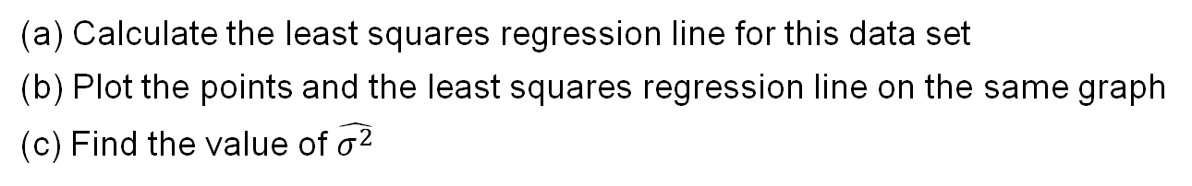
Linear Regression - Exercise
Calculate the least squares regression line for this data set
Plot the points and the least squares regression line on the same graph
Find the value of $\hat{σ^{2}}$

Slide 13
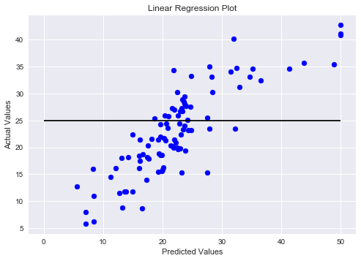
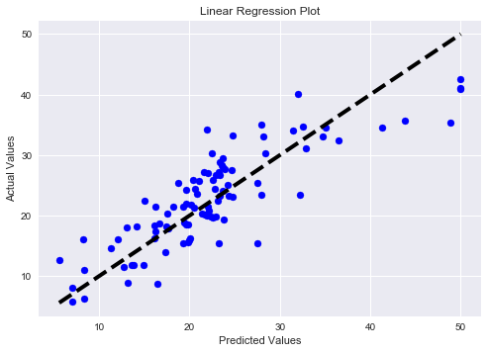
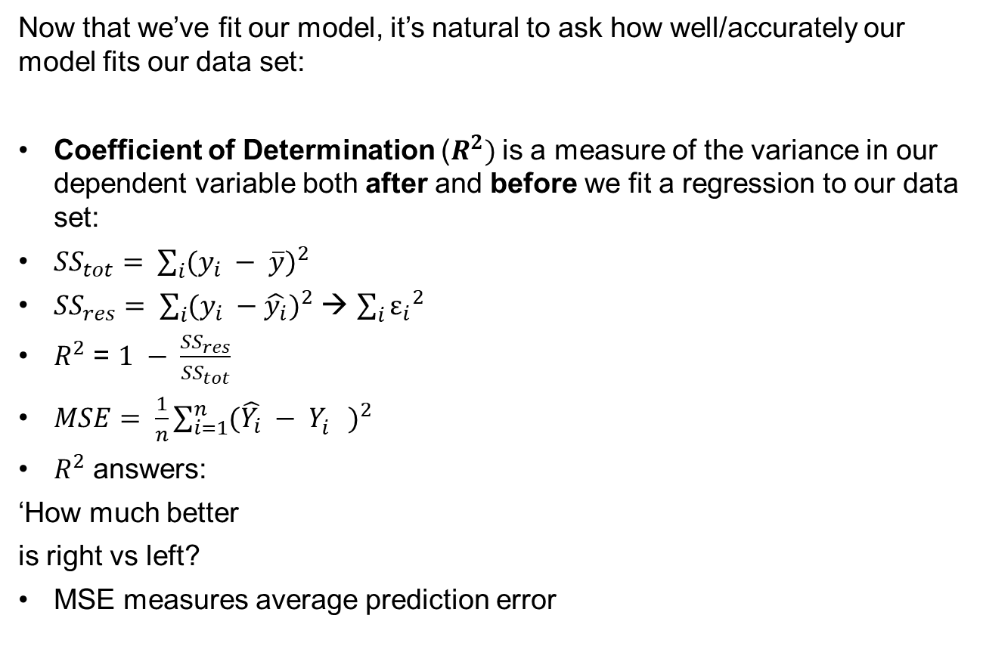
Linear Regression – Analyzing our Model
Now that we’ve fit our model, it’s natural to ask how well/accurately our model fits our data set:
Coefficient of Determination ($R^{2})$is a measure of the variance in our dependent variable both after and before we fit a regression to our data set:
${SS}_{tot}= \sum_{i}{{(y_{i} − \overline{y})}^{2}}$
${SS}_{res}= \sum_{i}{{(y_{i} −\hat{y_{i}})}^{2}}$ → $\sum_{i}{{ε_{i}}^{2}}$
$R^{2}$ = $1 − \frac{{SS}_{res}}{{SS}_{tot}}$
$MSE= \frac{1}{n}\sum_{i=1}^{n}{{(\hat{Y_{i}} − Y_{i}^{})}^{2}}$
$R^{2}$ answers:
‘How much better
is right vs left?
MSE measures average prediction error

Slide 14
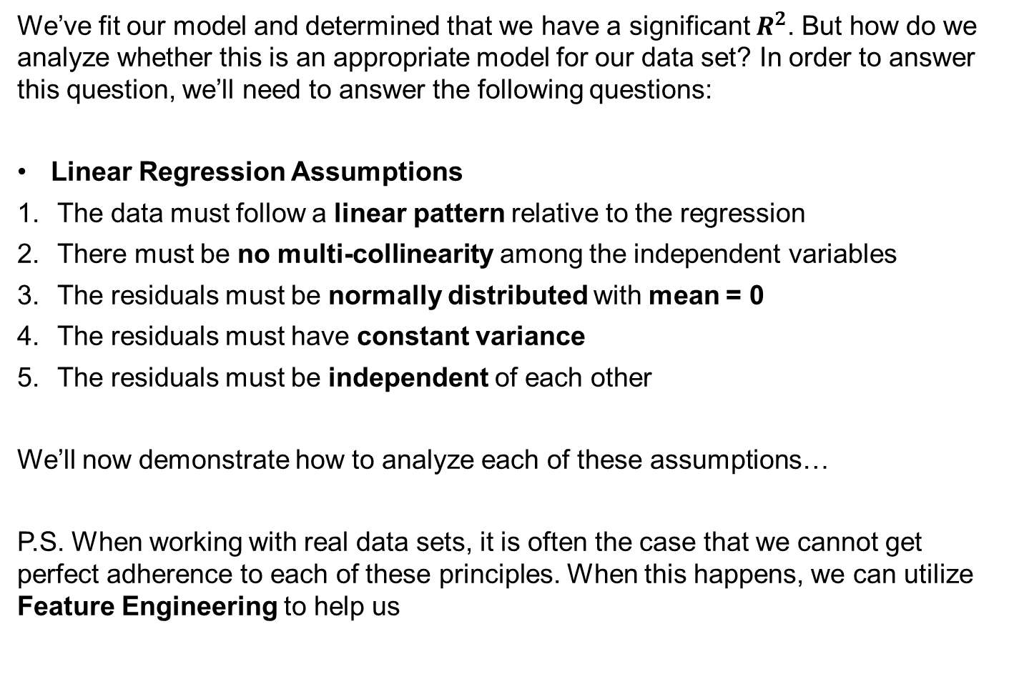
Linear Regression – Assumptions
We’ve fit our model and determined that we have a significant $R^{2}$. But how do we analyze whether this is an appropriate model for our data set? In order to answer this question, we’ll need to answer the following questions:
Linear Regression Assumptions
The data must follow a linear pattern relative to the regression
There must be no multi-collinearity among the independent variables
The residuals must be normally distributed with mean = 0
The residuals must have constant variance
The residuals must be independent of each other
We’ll now demonstrate how to analyze each of these assumptions…
P.S. When working with real data sets, it is often the case that we cannot get perfect adherence to each of these principles. When this happens, we can utilize Feature Engineering to help us

Slide 15
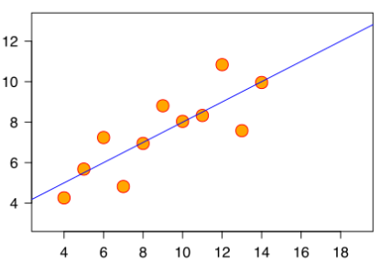
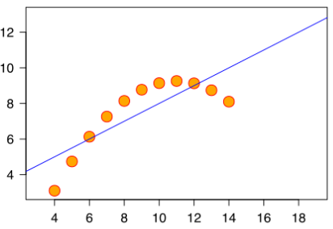
Linear Regression – Assumptions
Linear Pattern: we want to see a linear relationship when we plot a scatter plot of our fitted values against the realized values in our data set
We see that with the chart on the left, our orange regression line will not predict accurate values due to the concave nature of the data set, whereas our data exhibits strong linearity in our graph to the right.

Slide 16
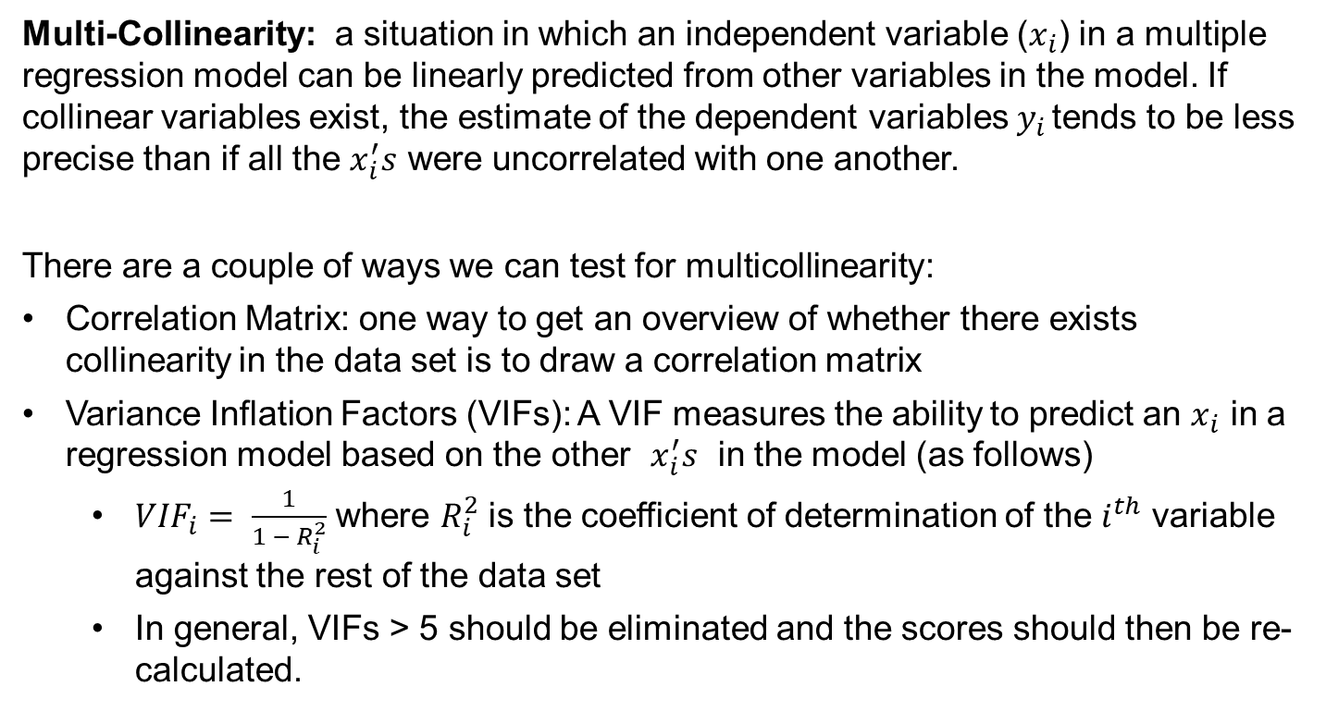
Linear Regression – Multicollinearity
Multi-Collinearity: a situation in which an independent variable ($x_{i}$) in a multiple regression model can be linearly predicted from other variables in the model. If collinear variables exist, the estimate of the dependent variables $y_{i }$tends to be less precise than if all the $x_{i}^{′}s$ were uncorrelated with one another.
There are a couple of ways we can test for multicollinearity:
Correlation Matrix: one way to get an overview of whether there exists collinearity in the data set is to draw a correlation matrix
Variance Inflation Factors (VIFs): A VIF measures the ability to predict an $x_{i}$ in a regression model based on the other $x_{i}^{′}s$ in the model (as follows)
${VIF}_{i}= \frac{1}{1 − R_{i}^{2}}$ where $R_{i}^{2}$ is the coefficient of determination of the $i^{th}$ variable against the rest of the data set
In general, VIFs > 5 should be eliminated and the scores should then be re-calculated.

Slide 17
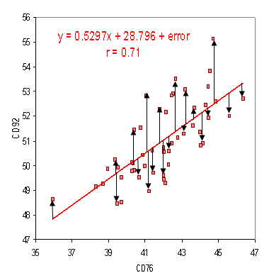
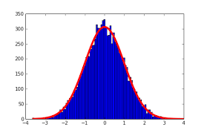
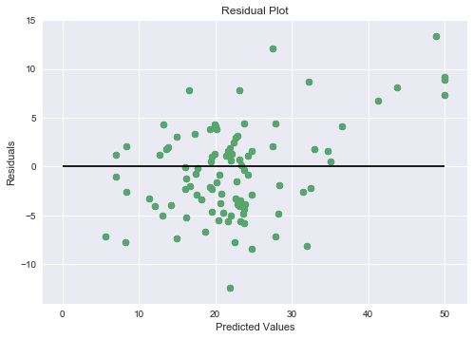
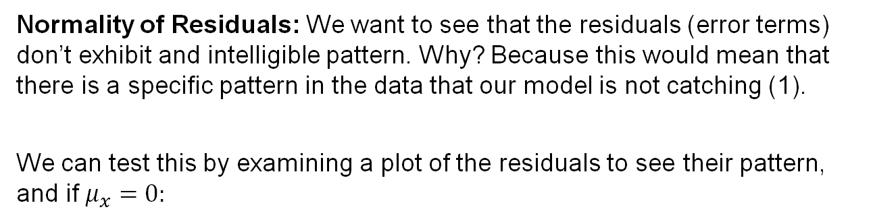
Linear Regression – Normality of Residuals
Normality of Residuals: We want to see that the residuals (error terms) don’t exhibit and intelligible pattern. Why? Because this would mean that there is a specific pattern in the data that our model is not catching (1).
We can test this by examining a plot of the residuals to see their pattern, and if $μ_{x}=0:$
Residuals are the distance between the fitted values and the regression line
Residuals with normal distribution around 0
There should be no noticeable pattern when we examine a scatter plot of the residuals
(1) http://www.statisticshowto.com/rmse/

Slide 18
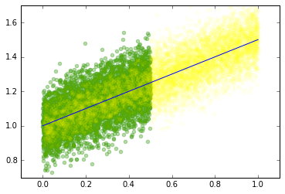
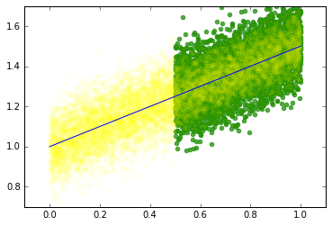
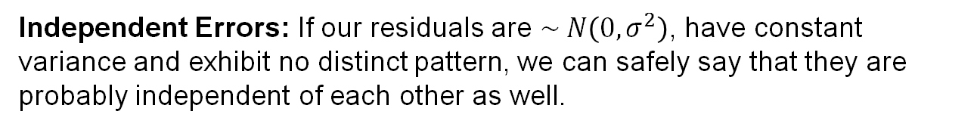
Linear Regression – Constant Variance & Ind. Errors
Constant Variance: A sign of a well-fit regression is that the variance of the residuals is the same no matter where on the regression line the fitted value falls
Graph A
Graph B
We see that the variance in Graph A and Graph B are identical, even though they are highlighting residuals in different parts of the graph.
Independent Errors: If our residuals are $\sim N\left(0, σ^{2}\right)$, have constant variance and exhibit no distinct pattern, we can safely say that they are probably independent of each other as well.

Slide 19
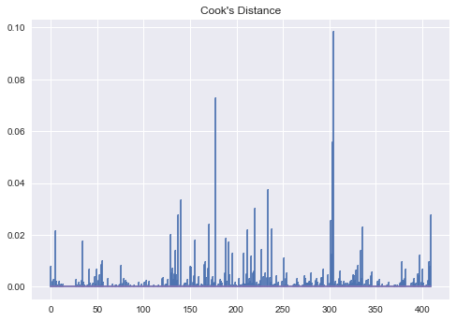
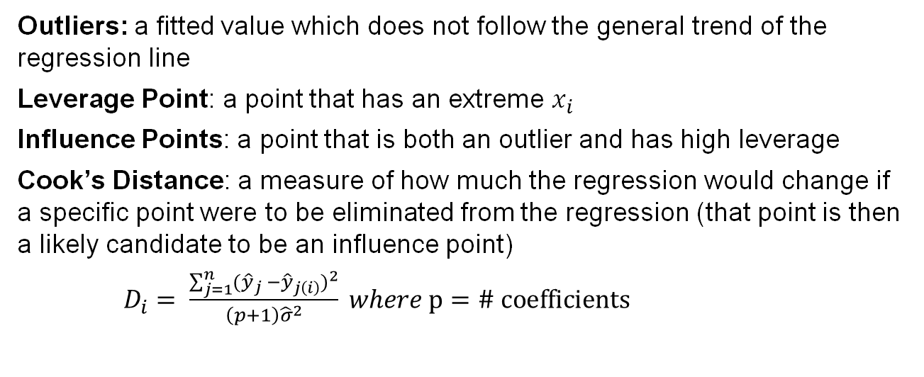
Linear Regression – Influence Points
Outliers: a fitted value which does not follow the general trend of the regression line
Leverage Point: a point that has an extreme $x_{i}$
Influence Points: a point that is both an outlier and has high leverage
Cook’s Distance: a measure of how much the regression would change if a specific point were to be eliminated from the regression (that point is then a likely candidate to be an influence point)
$D_{i}= \frac{\sum_{j=1}^{n}{{({\hat{y}}_{j} −{\hat{y}}_{j\left(i\right)})}^{2}}}{\left(p+1\right){\hat{σ}}^{2}} where p=\# coefficients$

Slide 20
Linear Regression – Conclusion
Conclusion: Thus far we have discovered how to fit our model estimates, calculated our confidence interval for our predictions, and checked the necessary assumptions to ensure this model is appropriate for our data set.
Now the only thing left to do is go to the code and run this model in Python!

Slide 21
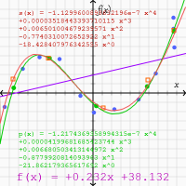
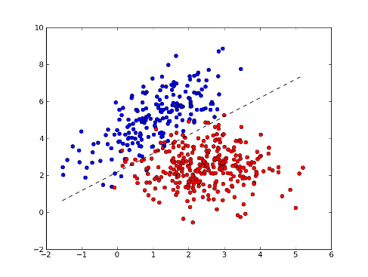
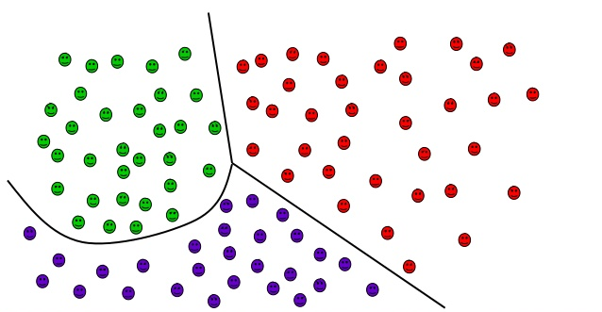
Classifier (Algorithm) v.s Regression (Data Model)
Binary
Classifier
Multi-class
Classifier
Regression Assumptions

Slide 22
Chapter 2: Code Overview
Jupyter Notebook

Slide 23

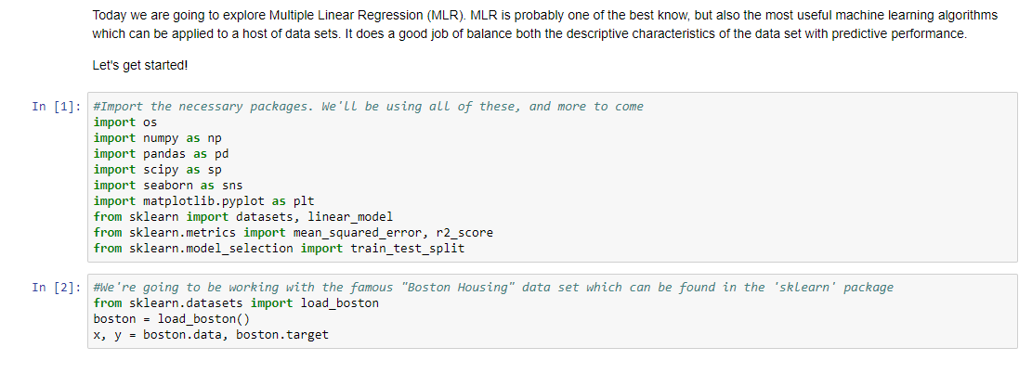
Linear Regression

Slide 24
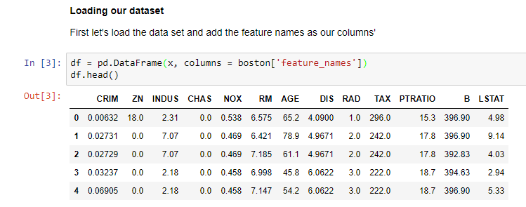
Linear Regression: Loading Dataset

Slide 25
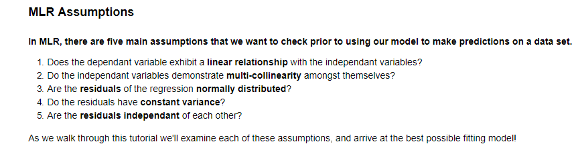
Multiple Linear Regression: Assumptions

Slide 26
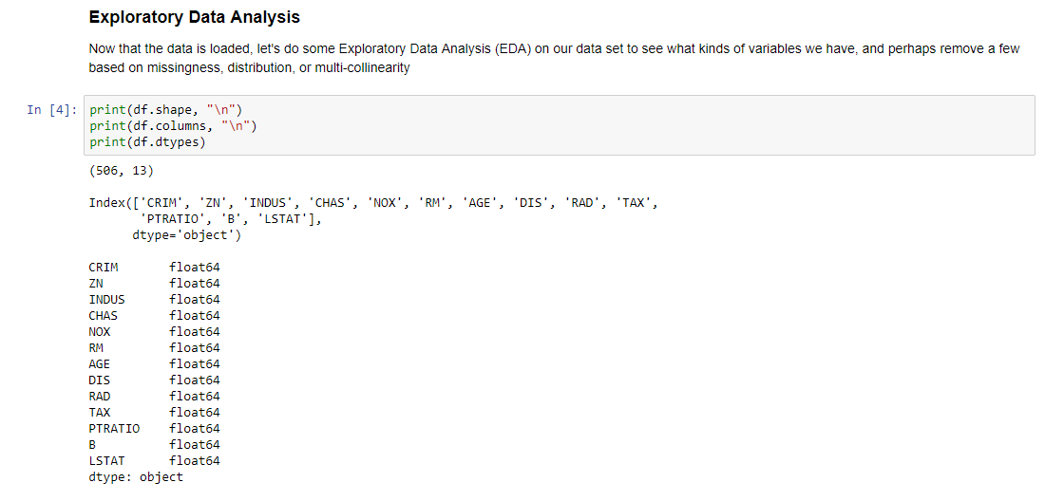
Multiple Linear Regression: Exploratory Data Analysis

Slide 27
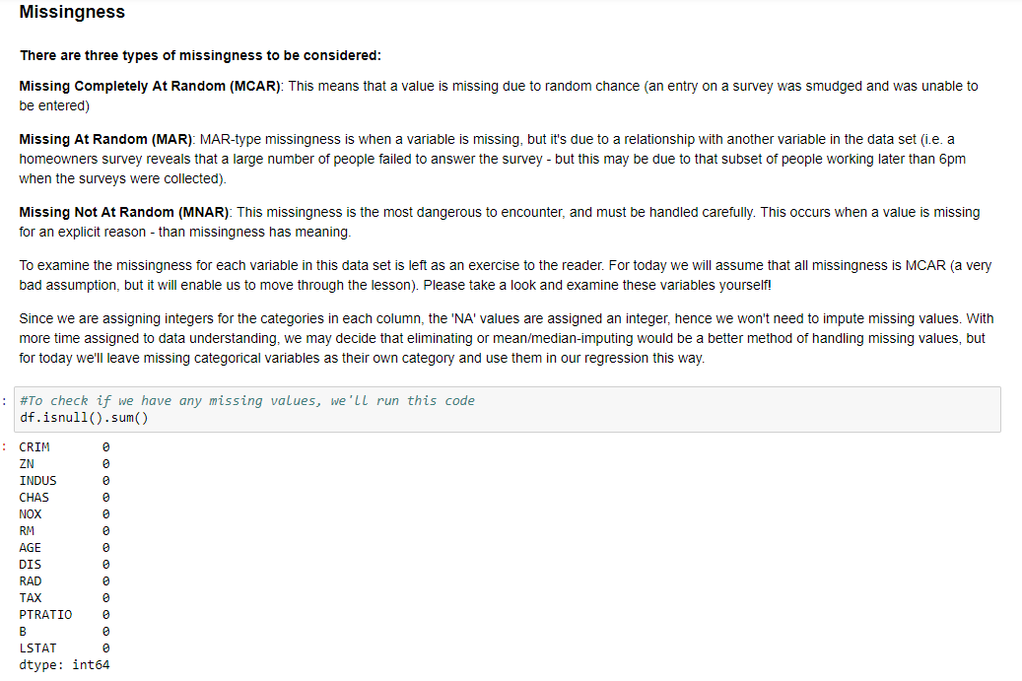
Multiple Linear Regression: Missingness

Slide 28
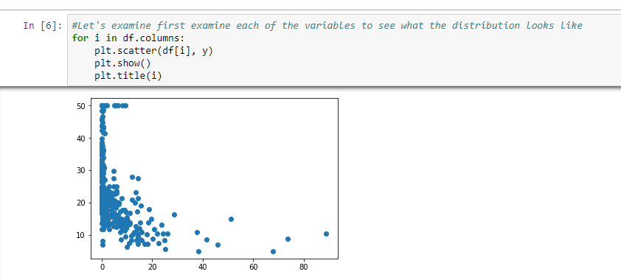
Understanding Variables Distribution

Slide 29
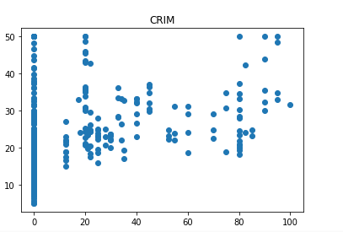
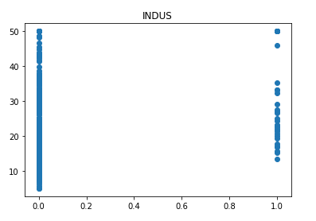
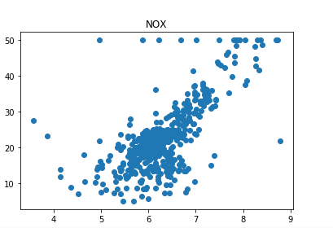
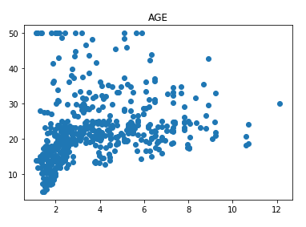
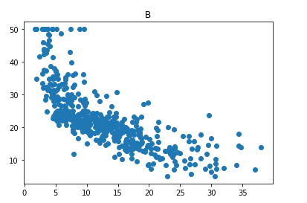
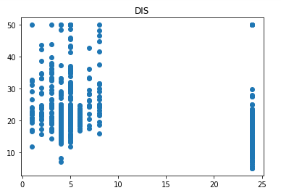
Examples

Slide 30
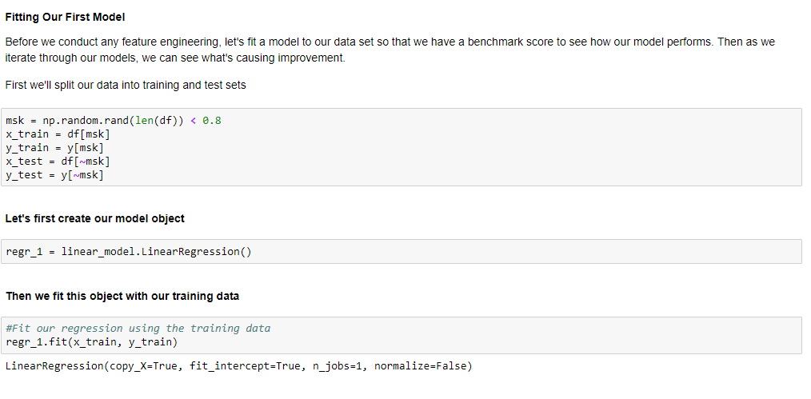
Fitting Our First Model

Slide 31
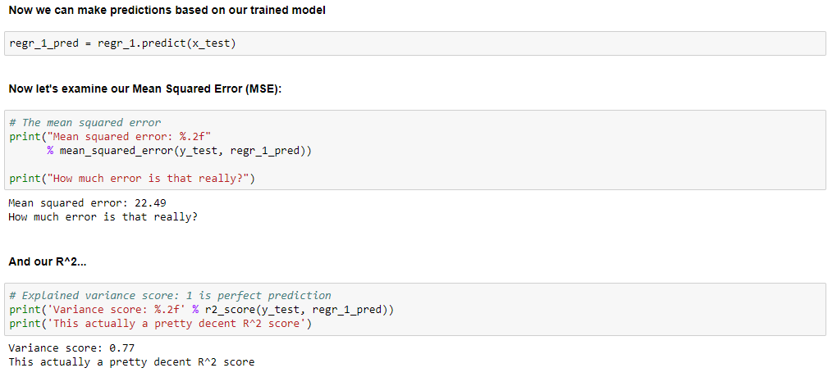
Predict Leveraging Our Fitted Model

Slide 32
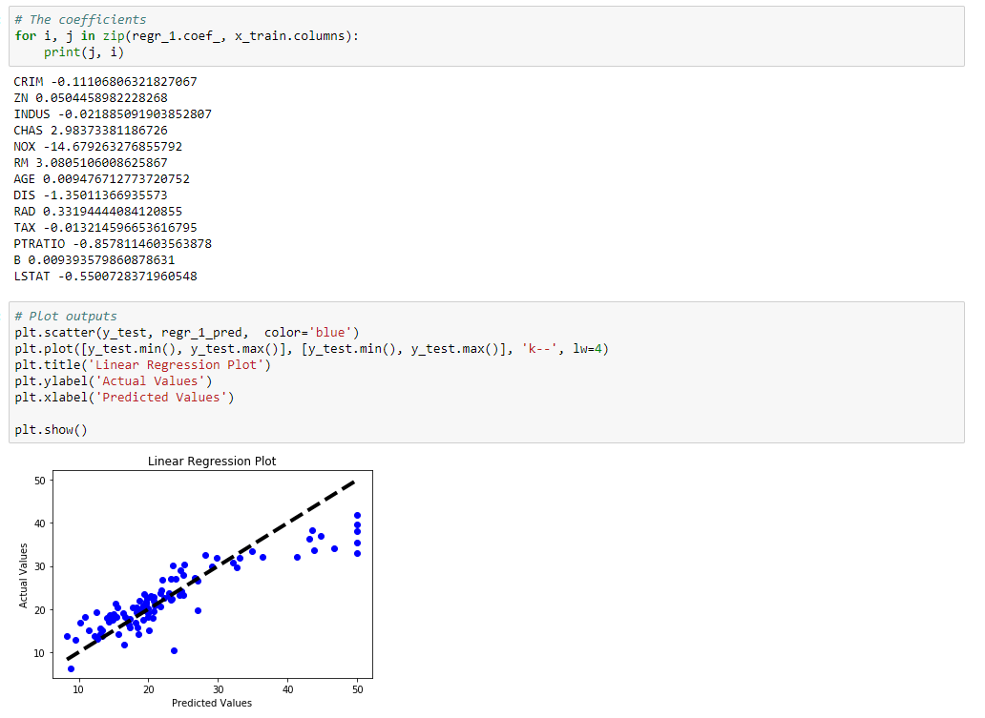
Model Coefficients and Results Understanding

Slide 33
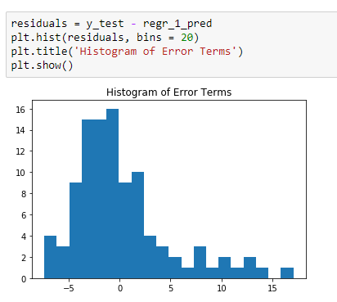
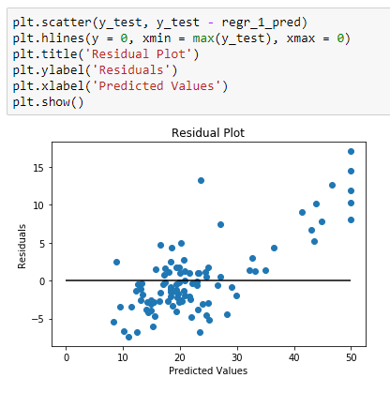
Model Error Analysis

Slide 34
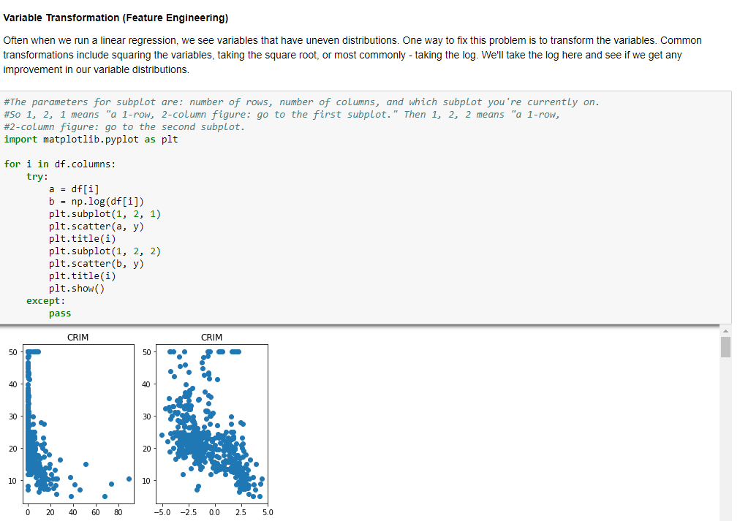
Variable Transformation

Slide 35
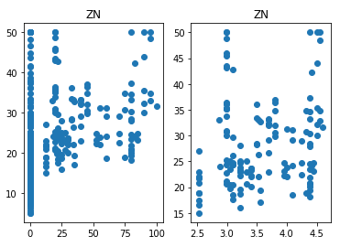
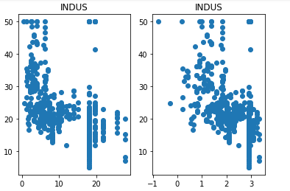
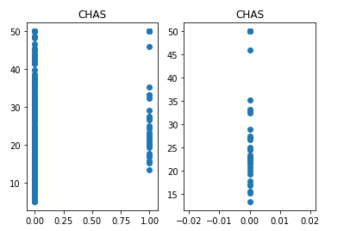
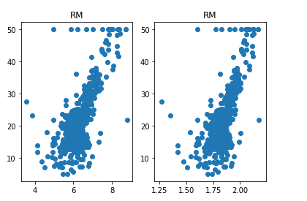


Examples

Slide 36

Multi-Collinearity

Slide 37

Multi-Collinearity and Variance Inflation Factor (VIF)

Slide 38

Fitting Our Second Model

Slide 39

Mean Square Error Rate

Slide 40

Model Performances

Slide 41

Fitting our Third Model

Slide 42

Predictor Importance

Slide 43

Model Performance

Slide 44
Questions?

Slide 45
Next Week’s
Session
Logistic Regression, Decision Tree’s and Random Forest
In this workshop you will learn:
Other supervised learning techniques
Classification Algorithms:
Logistic classification
Tree based algorithm with decision tree’s and random forest.
Walk through an interactive notebook using the classic Iris petal data set

Slide 46



- End of Presentation -
Thank you

