Slide 1
Survey
SKYPE SURVEY
What is your background in NLP and Machine Learning?
No previous background
Beginner
Intermediate
Advanced
Expert
SKYPE SURVEY

Slide 2




NLP Technical Workshop
Brian Halperin, Kirtyanand Mishra
September 12, 2018

Slide 3


Introductions
Moderator:
Brian Halperin
Netsuite
North America
Speaker:
Kirtyanand Mishra
Data Science and Analytics
India

Slide 4
Agenda
Topic approx. time
Introduction 5 min.
NLP Methods 25 min.
Machine Learning 15 min.
Questions & Answers 15 min
Learner is introduced to the technical basics of NLP through Python and Jupyter Notebook
Acknowledgements:
This material was first created by Brian Halperin and Kirtyanand Mishra specifically for Global Innovators Month
Jupyter notebook was inspired by Ipython notebook “text mining (nlp) with python” by Ties De Kok

Slide 5
Chapter 1: Introduction

Slide 6
Introduction
We will be walking through the “NLP Notebook” available for download from the Global Innovators Month website. You can follow along in the notebook, or just follow along with the deck.

Slide 7
Introduction
The Ipython notebook contains code examples to get you started with Natural Language Processing (NLP) / Text Mining for Research and Data Science purposes.
In the large scheme of things there are roughly 4 steps:
Identify a data source
Gather the data
Process the data
Analyze the data

Slide 8
Chapter 2: NLP Methods

Slide 9
NLP Tools
Standard NLP Packages
NLTK
Spacy
textacy
Other NLP Libraries
PyLDAvis – LDA visualization
FuzzyWuzzy – Text similarity
TextStat – Text statistics
Machine Learning Packages
SciKit-Learn

Slide 10
Installing Packages
Prior to running the Ipython Notebook on your own, you will need to install the proper packages.
In the Anaconda Prompt, run the following commands to install packages:
-m pip install --upgrade pip
pip install textstat
pip install fuzzywuzzy
pip install pyLDAvis
pip install textacy
pip install spacy

Slide 11
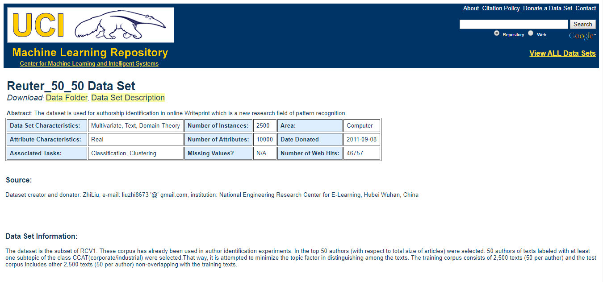
Downloading Example Data
The data that we will use for most of the examples is the "Reuter_50_50 Data Set" that is used for author identification experiments.
See the details here: https://archive.ics.uci.edu/ml/datasets/Reuter_50_50

Slide 12
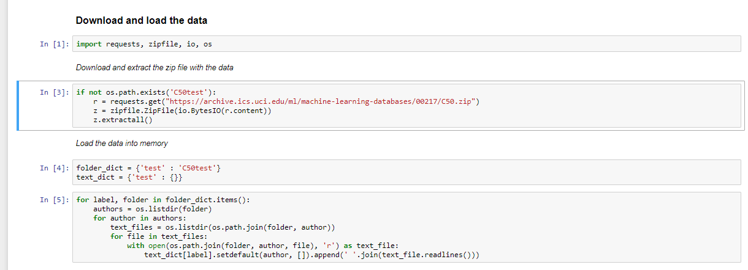
Downloading Example Data

Slide 13
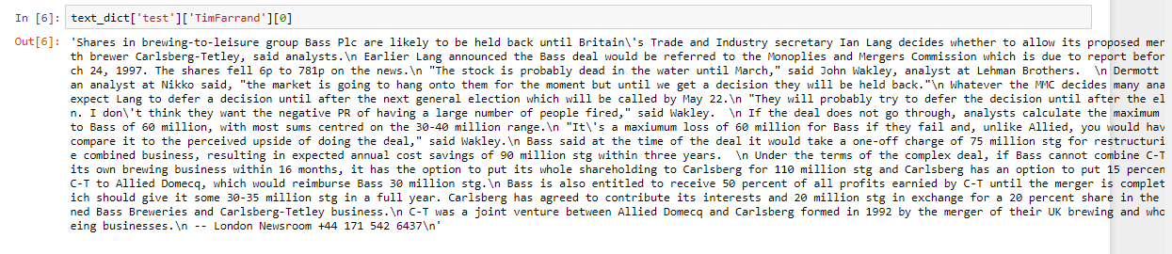
Downloading Example Data

Slide 14
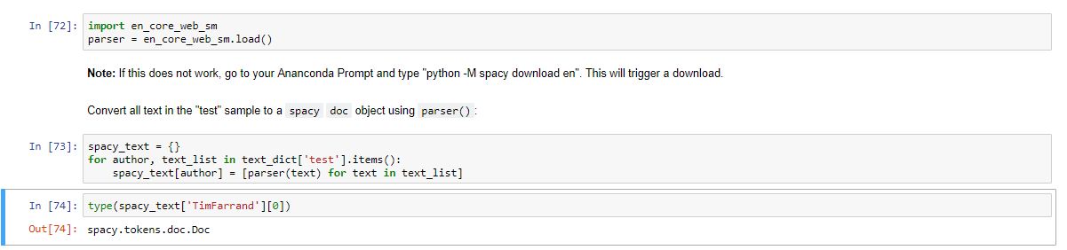
Process + Clean Data
We can use the text directly, but if want to use packages like `spacy` and `textblob` we first have to convert the text into a corresponding object.

Slide 15
Text Normalization
Text normalization describes the task of transforming the text into a different (more comparable) form.
For example – “play”, “player”, “played”, “plays” and “playing” are the different variations of the word – “play”
Though they mean different but contextually all are similar. The step converts all the disparities of a word into their normalized form (also known as lemma). Normalization is a pivotal step for feature engineering with text as it converts the high dimensional features (N different features) to the low dimensional space (1 feature), which is an ideal ask for any ML model.

Slide 16
Deal with unwanted characters
You will often notice that there are characters that you don't want in your text.
"Shares in brewing-to-leisure group Bass Plc are likely to be held back until Britain\'s Trade and Industry secretary Ian Lang decides whether to allow its proposed merge with brewer Carlsberg-Tetley, said analysts.\n Earlier Lang announced the Bass deal would be referred to the Monoplies and Mergers"
You notice that there are some `\` and `\n` in there. These are used to define how a string should be displayed, if we print this text we get:

Slide 17

Deal with unwanted characters
So how do we remove them?
In many cases it is sufficient to simply use the `.replace()` function:
Sometimes, however, the problem is because of encoding / decoding problems.
In those cases you can usually do something like:

Slide 18
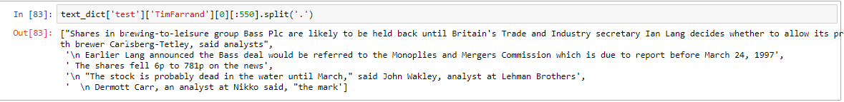
Sentence Segmentation
Sentence segmentation means the task of splitting up the piece of text by sentence.
You could do this by splitting on the `.` symbol, but dots are used in many other cases as well so it is not very robust:

Slide 19
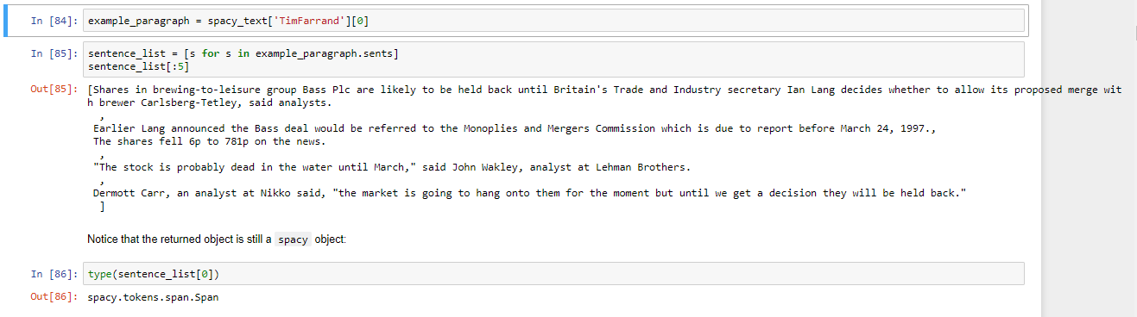
Sentence Segmentation
It is better to use a more sophisticated implementation such as the one by `Spacy`:

Slide 20
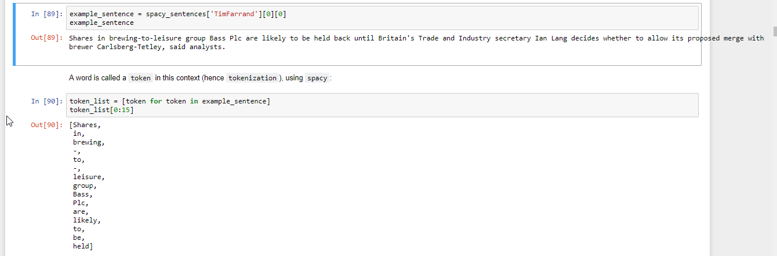
Word Tokenization
Word tokenization means to split the sentence (or text) up into words.

Slide 21
Lemmatization & Stemming
In some cases you want to convert a word (i.e. token) into a more general representation.
For example: convert "car", "cars", "car's", "cars'" all into the word `car`.
This is generally done through lemmatization / stemming (different approaches trying to achieve a similar goal).
Spacy offers build-in functionality for lemmatization:
Lemmatization | Stemming
Lemmatization usually considers words and the context of the word in the sentence | Stemming usually operates on single word without knowledge of the context
In lemmatization, we consider POS tags | In stemming, we do not consider POS tags
Lemmatization concept is used to make dictionary or WordNet kind of dictionary. | Stemming is used to group words with a similar basic meaning together

Slide 22
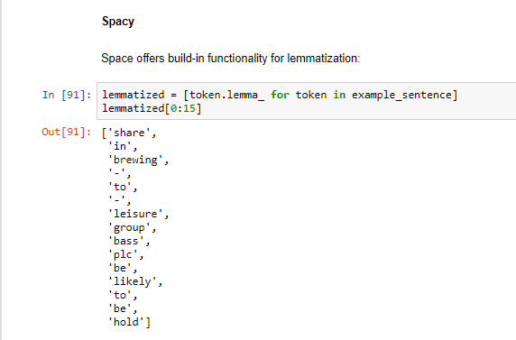
Lemmatization & Stemming
Shares in brewing-to-leisure group Bass Plc are likely to be held back until Britain's Trade and Industry secretary Ian Lang decides whether to allow its proposed merge with brewer Carlsberg-Tetley, said analysts.

Slide 23
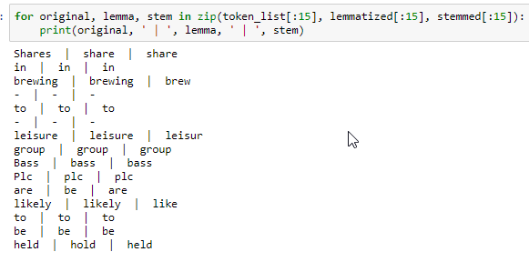
Lemmatization & Stemming
We can also use the NLTK Library
Shares in brewing-to-leisure group Bass Plc are likely to be held back until Britain's Trade and Industry secretary Ian Lang decides whether to allow its proposed merge with brewer Carlsberg-Tetley, said analysts.

Slide 24

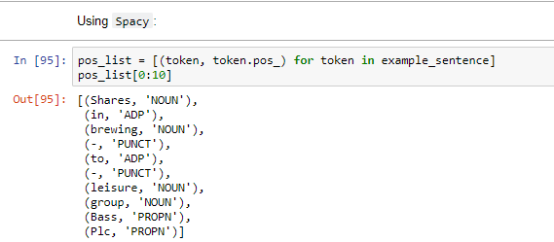
Part-of-Speech tagging
Part of speech tagging refers to the identification of words as nouns, verbs, adjectives, etc.

Slide 25
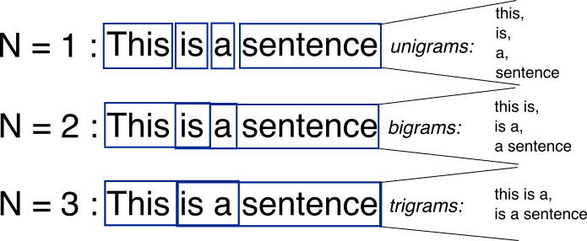
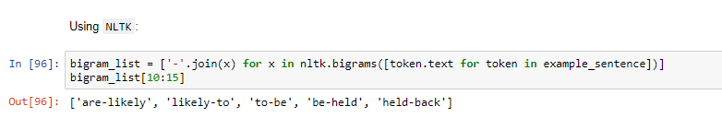
Uni-Gram & N-Grams
A sentence is not a random collection of words, the sequence of words has information value.
A simple way to incorporate some of this sequence is by using what is called `n-grams`.
An `n-gram` is nothing more than a combination of `N` words into one token (a uni-gram token is just one word).
So we can convert `"Sentence about flying cars"` into a list of bigrams: Sentence-about, about-flying, flying-cars

Slide 26
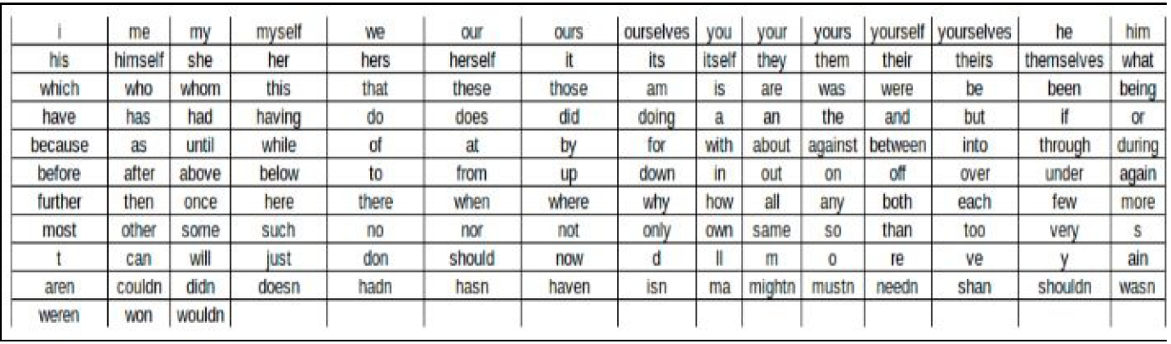
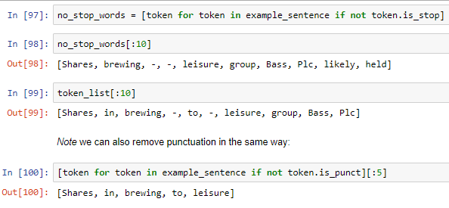
Stop Words
Depending on what you are trying to do it is possible that there are many words that don't add any information value to the sentence
Sometimes you can improve the accuracy of your model by removing stop words

Slide 27
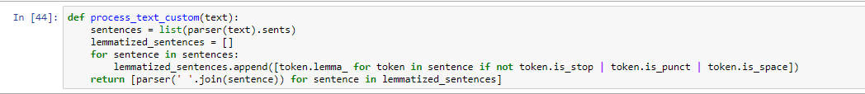
SPACY Text Processing Function
1. Split into sentences
2. Apply lemmatizer and remove top words
3. Clean up the sentence using `textacy`

Slide 28
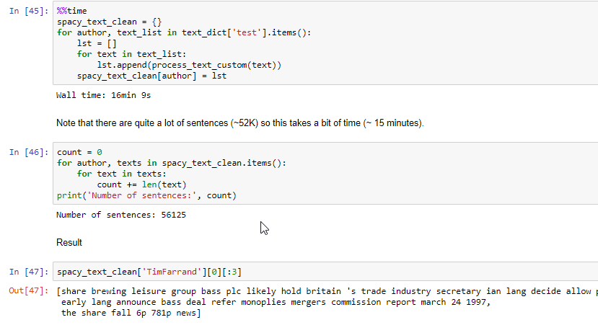
SPACY text processing function
Running this function takes about 15 minutes because of the amount of data

Slide 29
Direct Feature Extraction
We now have pre-processed our text into something that we can use for direct feature extraction or to convert it to a numerical representation.
Entity Recognition
It is often useful/relevant to extract entities that are mentioned in a piece of text.
SpaCy is quite powerful in extracting entities, however, it doesn't work very well on lowercase text.
Given that "token.lemma\_" removes capitalization we will use `spacy_sentences` for this example.

Slide 30
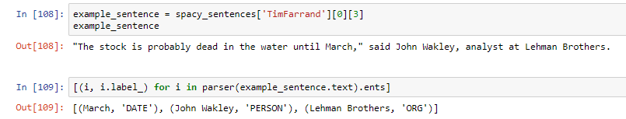
Direct Feature Extraction
Let’s take an example
“The stock is probably dead in the water until March," said John Wakley, analyst at Lehman Brothers.

Slide 31
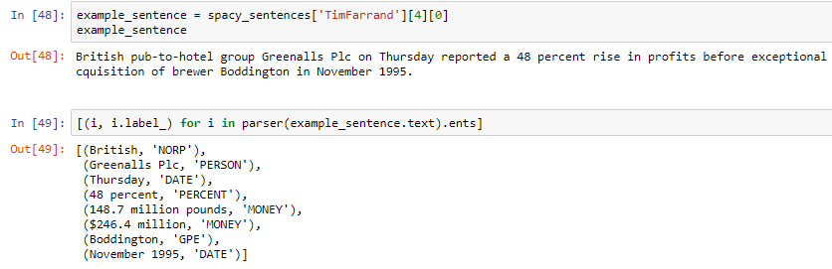
Direct Feature Extraction
Another example:
“British pub-to-hotel group Greenalls Plc on Thursday reported a 48 percent rise in profits before exceptional items to 148.7 million pounds ($246.4 million), driven by its acquisition of brewer Boddington in November 1995.”

Slide 32
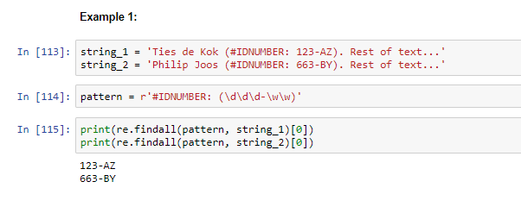
Pattern Search
Using the build-in `re` (regular expression) library you can pattern match nearly anything you want.

Slide 33
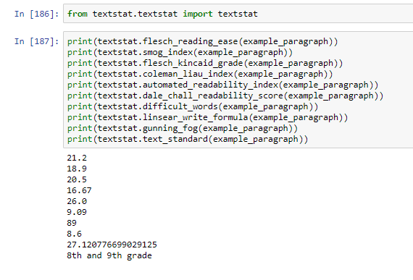
Text Evaluation
Using the `textstat` package we can compute various readability metrics

Slide 34


Text Similarity
Using FuzzyWuzzy, we can find out text similarity

Slide 35
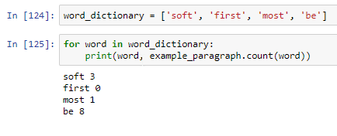
Term Counting
One of the most common techniques that researchers currently use (at least in Accounting research) are simple metrics based on counting words in a dictionary.

Slide 36
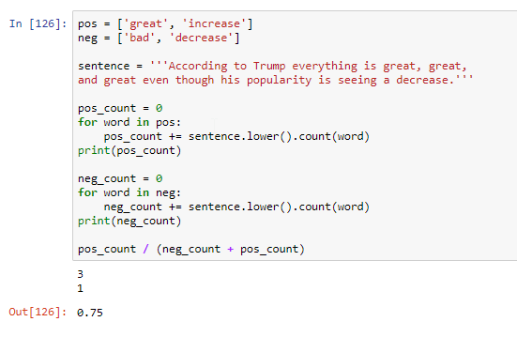
Sentiment Analysis
Analyzing the positivity or negativity of text

Slide 37
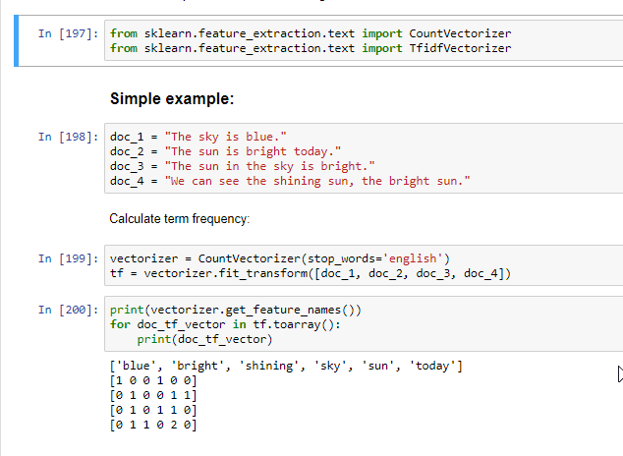
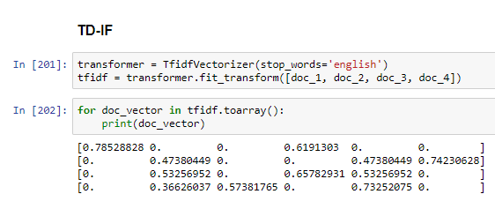
Representing Text Numerically
Sklearn includes the `CountVectorizer` and `TfidfVectorizer` function.

Slide 38
Chapter 3: Machine Learning

Slide 39
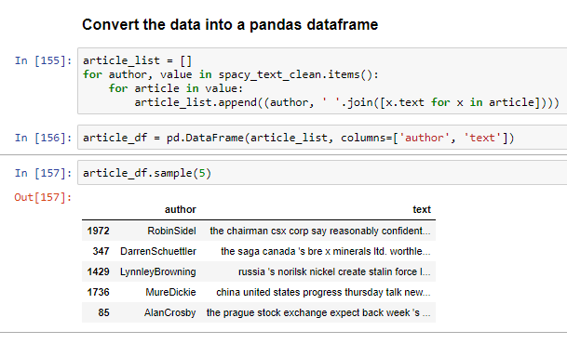
Machine Learning
The library to use for machine learning is scikit-learn

Slide 40
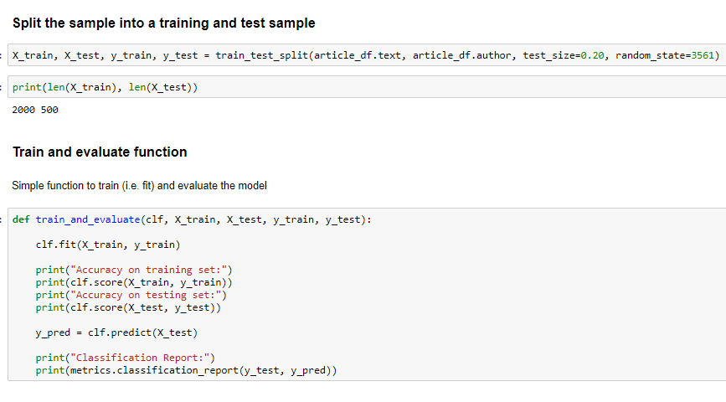
Machine Learning

Slide 41
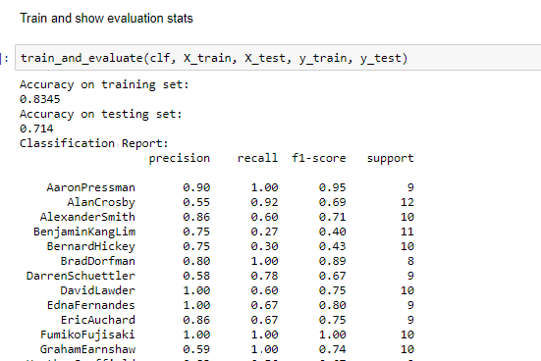
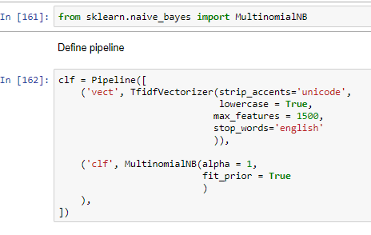
Machine Learning
Naïve Bayes Estimator

Slide 42
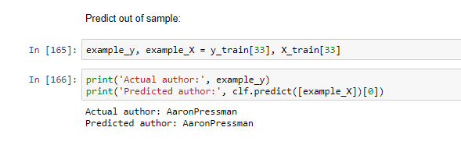
Machine Learning

Slide 43
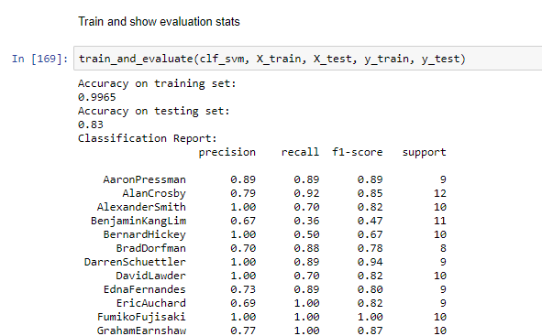
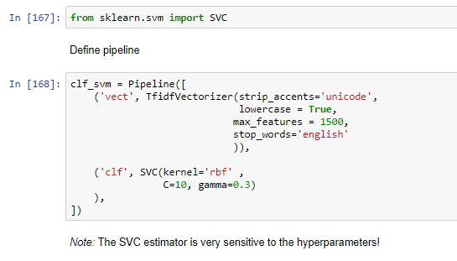
Machine Learning
Support Vector Machines

Slide 44
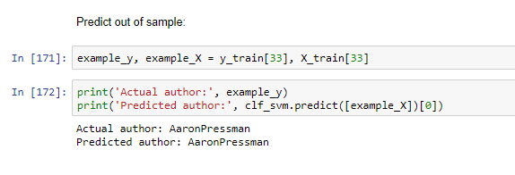
Machine Learning
Support Vector Machines

Slide 45
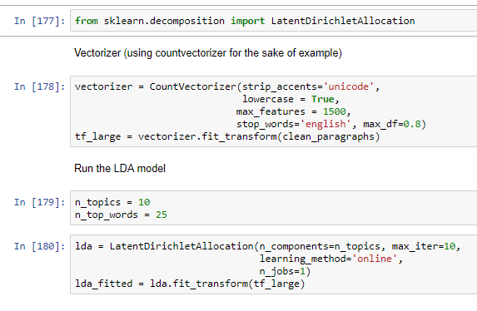
Machine Learning
Unsupervised Learning - Latent Dirich Allocation

Slide 46
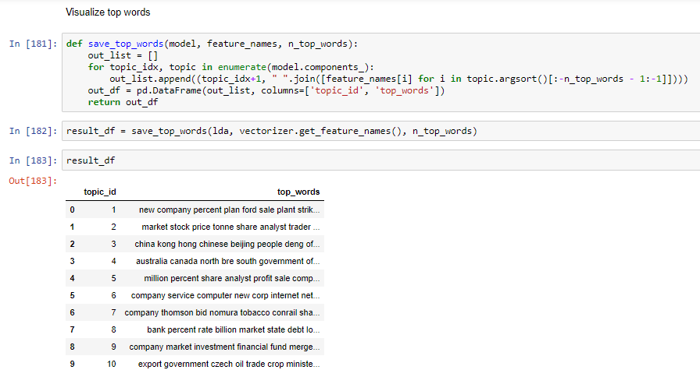
Machine Learning
Unsupervised Learning - Latent Dirich Allocation

Slide 47
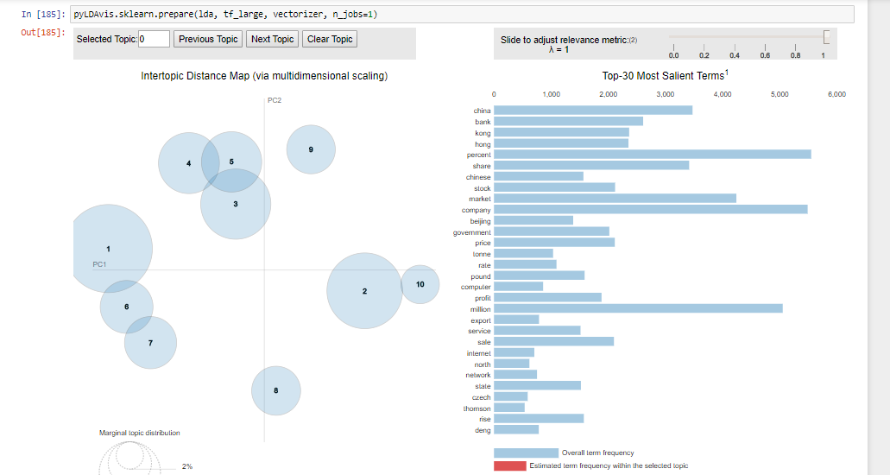
PyLDAvis

Slide 48
Chapter 4: Questions

Slide 49
Next Week’s
Session
During this workshop you’ll learn:
The basics of how to build skills for Amazon Alexa to run on Alexa devices like the Amazon Tap or Echo
Alexa Skills Kit
Developing your first skill
Deploying your skill to AWS Lambda
Submitting your skill for publication
Notes:
Fixar a posicao do titulo – sempre do lado esquerdo.
Sempre que tiver muito texto o coluna deve sempre ser “ narrowed” , se nao fica dificil de ler. Colocar paragrafos no texto.
Linha vertical deve ser mais fina e as pontas NUNCA devem ser arredondadas.

Slide 50
- End of Presentation -
Thank you

