Slide 1

Voice-Activated Control System
Presented by:
Xena Gabrielle Lavarias
Allen Edward Lindron
Julia Mae Ronquillo
Dennis Idan Lopez
Crispin Remon Jr.
Star Life Macabio
Shan Quimado
Jude Oiga
CPE 114 DATA STRUCTURES AND ALGORITHMS
Instructor: Engr. Jay-Ar M. Pentecostes
SY 2022-2023, First Semester Section: CpE 2B

Slide 2
WHY CAME UP WITH SUCH TOPIC/TITLE
Initially, we came up with our title in response to provide a solution to the problem that has something to do with stopping the flow of current from a certain power source in case of electrical circuit malfunctions. In an event where circuit-related incidents such as short circuits, occur in a building, we want to be able to immediately turn power connections off right from where we are in the building to lessen the potential damages it will further create if left unattended for several minutes. With our project, this will help people to control which circuit to cut off electricity from to turning off the power supply completely with one voice command away. If such incident happens, it will save not only the time taken to reach the affected circuit but also the whole building itself from fire break outs or loss of power supply in the worst-case scenario.
CPE 114 DATA STRUCTURES AND ALGORITHMS
Instructor: Engr. Jay-Ar M. Pentecostes
AY 2022-2023, First Semester Section: CpE 2B

Slide 3
OBJECTIVE
To create a functioning program that can use audio input as commands that will influence a circuit's operation,
To design and develop a prototype that will execute said commands through the application of integrated circuits,
To provide a voice-controlled solution to prevent related electric circuit incidents and,
To provide people with disabilities a convenient way to access home appliances much easier.
To be able to be an effective basis for future researchers.
CPE 114 DATA STRUCTURES AND ALGORITHMS
Instructor: Engr. Jay-Ar M. Pentecostes
AY 2022-2023, First Semester Section: CpE 2B

Slide 4
USERS OR BENEFICIARIES
Entrepreneurs
Homeowners
Future researchers
CPE 114 DATA STRUCTURES AND ALGORITHMS
Instructor: Engr. Jay-Ar M. Pentecostes
SY 2022-2023, First Semester Section: CpE 2B

Slide 5
SCOPE AND DELIMITATION
Scope
The focus of this project is to build both a program that will convert Voice into Commands and a prototype that will execute those commands. The project will use python as the main language, an audio recorder/recognizer, a speech-to-text package, algorithm and api. Hardware components include the raspberry pi Pico, a Bluetooth module, led lights, a micro motor and jumper wires.
CPE 114 DATA STRUCTURES AND ALGORITHMS
Instructor: Engr. Jay-Ar M. Pentecostes
SY 2022-2023, First Semester Section: CpE 2B

Slide 6
SCOPE AND DELIMITATION
Delimitation
The project doesn’t cover;
Significant changes to a hardware component. Each component has a role to play in the build and each component is expected to do their job properly so there will be no disassembling of a unit.
Voice Recognition Ai training. The program will use a speech recognition package that includes a recognizer class, this class is responsible for the process's audio recording and speech-to-text conversion.
Offline Voice Recognition. Recognizers differ on each package and currently, the offline recognizers from the packages pocketsphinx (livespeech) and vosk (Kaldirecognizer) are inaccurate, use large space consuming models, and/or slow.
The system will not use GUI and Mobile system to run the system. The miniature and source code of the system will be provided for the demonstration of the system.
CPE 114 DATA STRUCTURES AND ALGORITHMS
Instructor: Engr. Jay-Ar M. Pentecostes
SY 2022-2023, First Semester Section: CpE 2B

Slide 7
CONCEPTUAL FRAMEWORK
INPUT
PROCESS
OUTPUT
The program will convert the input as a valid command that the raspberry pi Pico can execute in which will either relay or stop a current flow to a specific appliance around the house miniature.
Automatic control of home appliances, such as automatic turning on and off of light bulbs and ceiling fans.
User’s voice input
CPE 114 DATA STRUCTURES AND ALGORITHMS
Instructor: Engr. Jay-Ar M. Pentecostes
SY 2022-2023, First Semester Section: CpE 2B

Slide 8

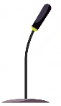
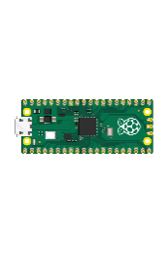



THEORETICAL FRAMWORK
Raspberry Pi Pico
Laptop (Package, speech recognizer & code)
House Model
Mic
CPE 114 DATA STRUCTURES AND ALGORITHMS
Instructor: Engr. Jay-Ar M. Pentecostes
SY 2022-2023, First Semester Section: CpE 2B

Slide 9
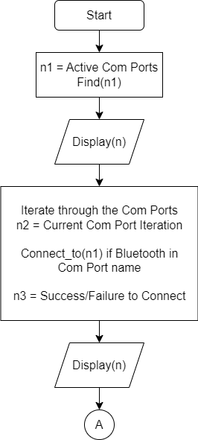
METHODOLOGY
CPE 114 DATA STRUCTURES AND ALGORITHMS
Instructor: Engr. Jay-Ar M. Pentecostes
SY 2022-2023, First Semester Section: CpE 2B

Slide 10
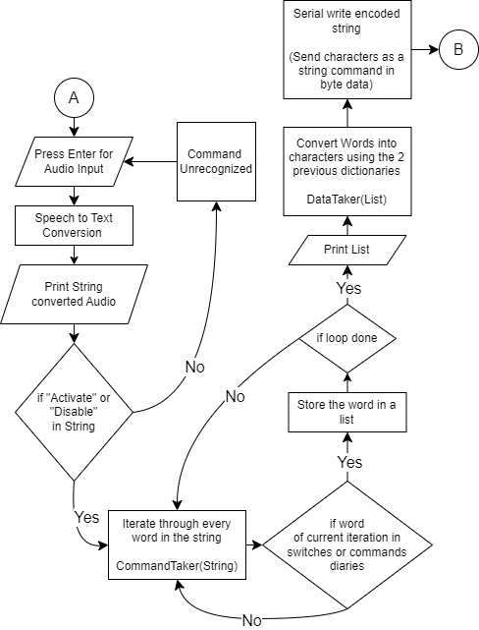
METHODOLOGY
CPE 114 DATA STRUCTURES AND ALGORITHMS
Instructor: Engr. Jay-Ar M. Pentecostes
SY 2022-2023, First Semester Section: CpE 2B

Slide 11
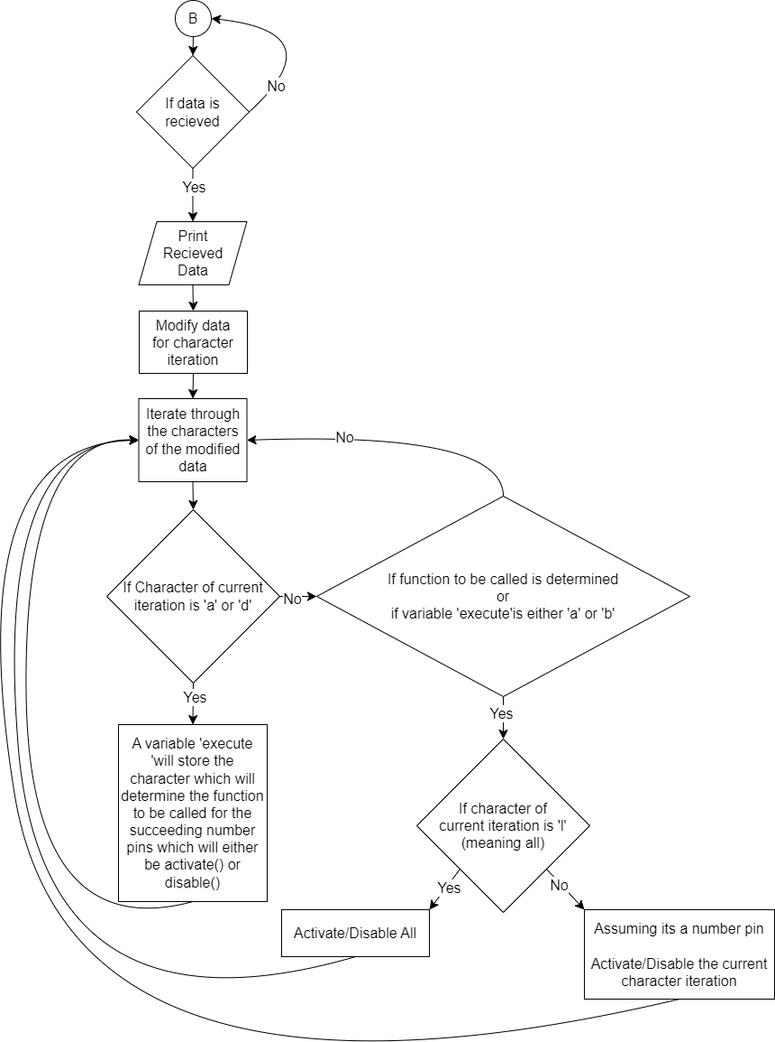
METHODOLOGY
CPE 114 DATA STRUCTURES AND ALGORITHMS
Instructor: Engr. Jay-Ar M. Pentecostes
SY 2022-2023, First Semester Section: CpE 2B

Slide 12
RESULTS AND DISCUSSION
The Project’s final output includes a program from a phone connected wirelessly thru Bluetooth to an assembly of hardware(device) built by the project members. The program can record audio input from the microphone and translate it into a readable string, the program then checks the string and correlates with the possible executable commands. The commands are then sent via Bluetooth to the Bluetooth module within the device, this device is connected to several activatable components such as led lights and dc motors. Commands include the activation and deactivation of each or all components and will be executed immediately. After execution the program will then be waiting for another audio input a miniature model of a house was made mostly with cardboards and acrylic sheets bonded with glue stick.
CPE 114 DATA STRUCTURES AND ALGORITHMS
Instructor: Engr. Jay-Ar M. Pentecostes
SY 2022-2023, First Semester Section: CpE 2B

Slide 13
RESULTS AND DISCUSSION
The Led lights served as light bulbs and dc motors served as fans, through voice commands, the fans and lights can be switched on/off at will by voice command. If this project could be developed and installed on households especially with those of disabilities, this could be a great help for them as they wouldn't bother to exert efforts in simply switching lights and fans. The developers plans on adding more features on the system by adding more appliances/switches that can be controlled. With the continuous ascend of technology, humans are keeping up by making this advance technology that helps people in living a convenient life.
CPE 114 DATA STRUCTURES AND ALGORITHMS
Instructor: Engr. Jay-Ar M. Pentecostes
SY 2022-2023, First Semester Section: CpE 2B

Slide 14
DETAILED BUDGET
Amount | Description
300 | Raspberry Pi Pico - is the microcontroller used in the prototype for this project.
300 | Hc-05 Bluetooth Module - used as the receiver, it receives data/program to the phone and transfers the data/program to Raspberry Pi Pico.
50 | Breadboard is used to connect the jumper wire to the led light, micro motor and USB led lights.
40 | Usb led lights is to represent the light bulb to this prototyping project.
30 | Led lights constitute the light bulb for this prototyping endeavor.
CPE 114 DATA STRUCTURES AND ALGORITHMS
Instructor: Engr. Jay-Ar M. Pentecostes
SY 2022-2023, First Semester Section: CpE 2B

Slide 15
DETAILED BUDGET
50 | Micro motor is the material used to depict the fan's motor in this prototype.
30 | Pin male header 2.54mm pitch is used to put in Raspberry Pi Pico and it is used to connect the Raspberry Pi Pico to jumping wire.
50 | Jumper wires (Female - Female) this material is utilized to link and transport data from the Hc-05 Bluetooth module.
90 | Jumper wires (Male - Female) this material is used to connect between the Raspberry Pi Pico with Pin male header 2.54mm pitch to the breadboard
CPE 114 DATA STRUCTURES AND ALGORITHMS
Instructor: Engr. Jay-Ar M. Pentecostes
SY 2022-2023, First Semester Section: CpE 2B

Slide 16
DETAILED BUDGET
50 | Propeller is the material used to simulate the fan in the micro motor.
190 | Others include the cost of delivering the materials and other items that must be purchased in the future.
200 | Color paint is the material that used to give appropriate design to the miniature
600 | Card case, sticker paper and glue stick are the materials that need to assemble the miniature
CPE 114 DATA STRUCTURES AND ALGORITHMS
Instructor: Engr. Jay-Ar M. Pentecostes
SY 2022-2023, First Semester Section: CpE 2B

