Slide 1
STARLING OFFICE / OPEN SOURCE
Big ideas.
Start here.
W
An open source office suite.
Starting with Writer.
WRITER IS LIVE

Slide 2
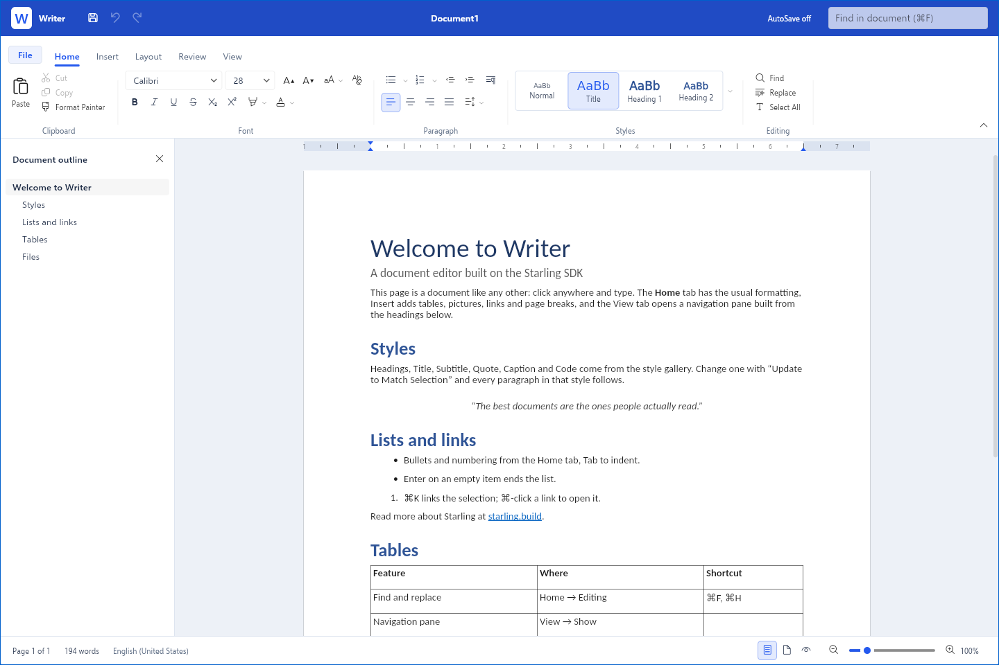
01 / MEET WRITER
Write something
great.
A familiar ribbon. A clean page.
Room for your next big idea.
Fonts, styles, tables, pictures.
The tools to make it yours.
DOCX · RTF · MARKDOWN · TEXT

Slide 3
02 / SIX PLATFORMS. ONE AMBITION.
Your office.
Everywhere.
macOS
Windows
Planned
Planned
Linux
iOS
Planned
Planned
At a desk. On the move.
In a browser.
Android
Web
Planned
Writer is live
Writer is available on the web today.
More apps and platforms are on the way.

Slide 4
03 / OPEN SOURCE. FROM THE START.
Open code.
Shared ambition.
Read the code. Follow the progress.
Help shape what comes next.
Built on the Starling SDK.
Apache 2.0 licensed.
ONLY WRITER IS AVAILABLE SO FAR.

